Slide 1
Employee Management System
Project By
Soumya S G

Slide 2
Introduction :
The Employee Management System is a desktop application designed to efficiently manage employee data for small to medium-sized businesses.
Expanded into a user-friendly GUI application with advanced features like user authentication, department management, and attendance tracking.
Streamlines HR tasks such as employee onboarding, data updates, reporting, and compliance, reducing manual effort and errors.
Leverages MySQL for reliable data persistence, Swing for intuitive user interfaces, and modular design for scalability and maintenance.

Slide 3
Objective :
To develop a secure, efficient, and user-friendly desktop application for managing employee data in organizations.
Implement full employee records with comprehensive data fields.
Integrate user authentication and role-based access control to protect sensitive information.
Design an intuitive graphical user interface (GUI) using Swing to enhance usability over console-based systems.
Add features for department management and attendance tracking to support broader HR functionalities.
Ensure data validation, error handling, and integrity through layered architecture (DAO, Service, UI).

Slide 4
Technology Stack:
Programming Language: Java for core development, offering portability and object-oriented features.
IDE: Eclipse for coding, debugging, and project management.
Database: MySQL for relational data storage, queries, and integrity.
Libraries and Frameworks : JDBC (Java Database Connectivity) for secure database interactions.
Swing for building the graphical user interface (GUI) components like buttons and forms.
MySQL Connector/J for seamless Java-MySQL integration.
Additional Tools: MySQL Workbench for database design, querying, and management.

Slide 5
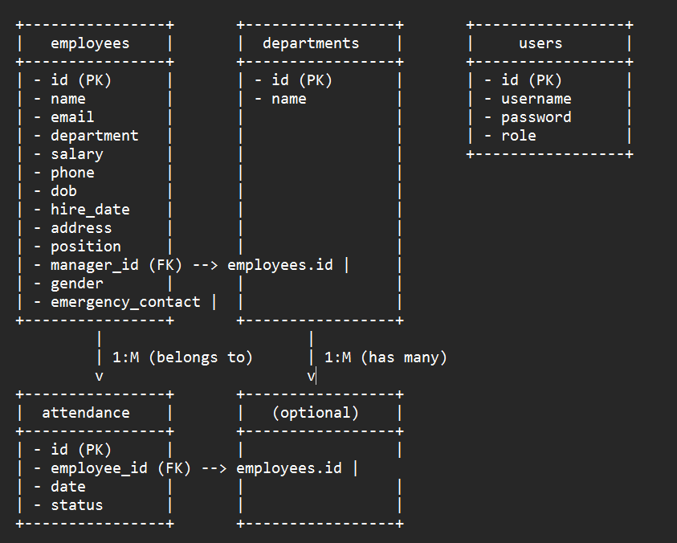
ER Diagram :

Slide 6
Features and Functionality :
Core Features:
Employee Management: Full operations Add, View, Update, Delete with expanded fields like phone, DOB, address, and position for detailed profiles.
User Authentication: Secure login system with role-based access (e.g., admin vs. employee) using the users table.
Department Management: View and organize employees by departments (e.g., IT, HR) for better structure.
Attendance Tracking: Record and monitor employee attendance with date and status (Present/Absent).
User Interface Components: Login page for authentication, dashboard with action buttons, and forms for data input (e.g., EmployeeForm for adding records).
Additional Capabilities: Data validation (e.g., required fields, format checks), error handling with user-friendly messages, and real-time database updates.

Slide 7
Implementation Details :
Architecture: Layered design separating concerns—Model (data classes), DAO (database access), Service (business logic), and UI (user interface).
Key Classes and Components:
Models: Employee, Department, User, Attendance for data representation.
DAOs: EmployeeDAO, DepartmentDAO, UserDAO, AttendanceDAO with DBConnection for centralized database handling.
Services: EmployeeService, UserService, AttendanceService for validation and logic (e.g., checking required fields).
UI: LoginPage, Dashboard, EmployeeForm built with Swing for interactive elements.
Workflow: User logs in via UI → Services validate requests → DAOs execute SQL queries on MySQL → Data displayed or updated.
Code Highlights: Prepared statements for security, try-with-resources for connection management, and exception handling for robustness.

Slide 8
Conclusion :
Successfully built a robust employee management system with GUI, database, and advanced features.
Achievements: Full CRUD, authentication, attendance, and scalable architecture.
Future Enhancements: Add reports, multi-user support, or web version.
Lessons Learned: Importance of layered design, validation, and iterative development.

