Slide 1
NLTK Overview

Slide 2
Contents
Different text processing libraries and corpora in NLTK
The corpora with NLTK
Wordnet with NLTK
Text classification with NLTK
N-gram Language model with NLTK

Slide 3
Different text processing libraries and corpora in NLTK
NLTK provides interfaces to over 50 corpora and lexical resources. Some of the examples are brown corpus, gutenberg corpus.
http://www.nltk.org/nltk_data/
https://www.nltk.org/book/ch02.html
Also provides a suite of text processing libraries for classification, tokenization, stemming, tagging, parsing, and semantic reasoning and much more.
https://www.nltk.org/py-modindex.html

Slide 4
The corpora with NLTK
NLTK corpus is a massive dump of many kinds of natural language data sets.
These come with functions to read and analyze the corpora.
Available corpora, includes things like books, chat logs, movie reviews, and a lot more.
As an examples we explored gutenberg, webtext, npschat, brown corpora etc.

Slide 5
Wordnet with NLTK
WordNet is a lexical database of semantic relations between words in more than 200 languages.
One can use WordNet alongside the NLTK module to find the meanings of words, synonyms, antonyms, and more.
The synonyms are grouped into synsets with short definitions and usage examples.
Some usages have been explored in the notebook.

Slide 6
Text classification with NLTK
A simple classifier has been built in the notebook using the movie review corpus.
NLTK comes with various functions to help find out features to help in classification.
NLTK also provides access to various classifier functions.e.g. Naïve Bayes, Decision tree etc.

Slide 7
N-gram Language Model with NLTK
N-grams are a set of co-occuring words within a given window. Example for n = 2 :- 'the cow', 'cow jumps', 'jumps over', 'over the', 'the moon'.
In the notebook, n-grams where used to generate language model to predict which word comes next given a history of words.
'lm' module in nltk to helps in non-neural language modelling.
'nltk.util' module helps in creating ngrams.

Slide 8
Stanford overview

Slide 9
Contents
What is Stanford CoreNLP?
What tools are intigrated with Stanford CoreNLP?
Part-of-speech tagging
Annotation and Annotator
What is Annotation Pipeline in Stanford CoreNLP?

Slide 10
What is Stanford CoreNLP?
It provides a set of human language technology tools.
NLP library for 53 Languages.
An integrated NLP toolkit with a broad range of grammatical analysis tools.
Contains pretrained neural models supporting 53 (human) languages featured in 73 treebanks.

Slide 11
Part-of-speech tagging
In corpus linguistics, part-of-speech tagging (POS tagging), also called grammatical tagging or word-category disambiguation, is the process of marking up a word in a text (corpus) as corresponding to a particular part of speech, based on both its definition and its context, i.e., its relationship with adjacent and related words in a phrase, sentence, or paragraph.

Slide 12
What tools are integrated with Stanford CoreNLP?
The part-of-speech (POS) tagger.
The named entity recognizer (NER).
The parser.
Sentiment analysis.
An annotator pipeline can include additional custom or third-party annotators.

Slide 13
Annotation and Annotator
CoreNLP’s core package includes two classes: Annotation and Annotator.
Annotations are data structures that hold the results of the annotators. Annotations are generally maps.
Annotators are more like functions, but they operate on Annotations rather than Objects.
Annotators can perform tokenize, parse, NER, POS. Annotators and Annotations are integrated in AnnotationPipelines. Stanford CoreNLP inherits the AnnotationPipeline class and customizes NLP Annotators .

Slide 14
Annotation and Annotator
Stanford CoreNLP ANNOTATORS:
tokenize,
cleanxml,
ssplit,
pos,
lemma,
ner,
regexner,
sentiment,
truecase,
parse, depparse,
dcoref,
relation,
natlog,
quote.

Slide 15
What is Annotation Pipeline in Stanford CoreNLP?
CoreNLP implements an annotation pipeline. An Annotation Pipeline is run on the Annotation. An Annotation Pipeline is essentially a List of Annotators, each of which is run in turn. (And an Annotation Pipeline is itself an Annotator, so you can actually nest Annotation Pipelines inside each other.)
Each Annotator reads the value of one or more keys from the Annotation, does some natural language analysis, and then writes the results back to the Annotation.

Slide 16
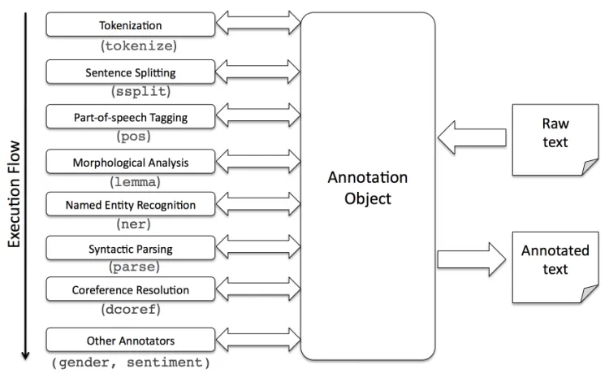
What is Annotation Pipeline in Stanford CoreNLP?
Typically, each Annotator stores its analyses under different keys, so that the information stored in an Annotation is cumulative rather than things being overwritten. The overall picture is given in this picture.

