Slide 1
Transaction Sales Analysis
Exploratory Data Analysis
Presented By-
Soumyajeet Mohapatra

Slide 2
The Situation
This is a transnational data set which contains all the transactions occurring between 01/12/2010 and 09/12/2011 for a UK-based and registered non-store online retail. The company mainly sells unique all-occasion gifts. Many customers of the company are wholesalers.
Goals:
Data Cleaning
Analysis (EDA)
Feature Engineering
Model Selection and Evaluation

Slide 3
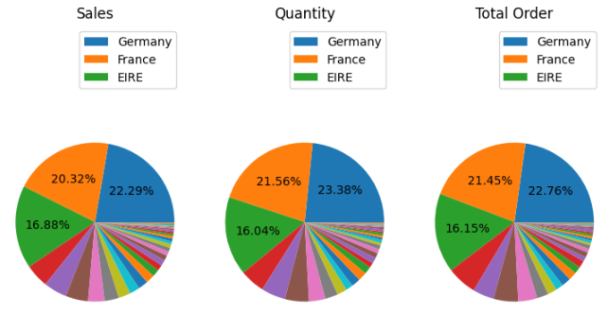
Standard Insights
From Dataset
Total Net Sales-
$ 9769872.134
Cancelled-
$ 98206
Average Total Spend per Customer: 939.62
Average Stock Turn Rate: 842.97
Average Price of All Products: 2.30
Average Purchase Frequency: 3.99
Average Spend per Visit: 229.93
Majority of Sales belong to UK. But for the purpose of analysis, nearly 60% of Sales and order belong to countries like Germany, France, Ireland.
Most of transactions with the percentage 0f 80% more (Total Order, Sales, and Quantity) are coming from the United Kingdom (UK) or domestic transaction.

Slide 4
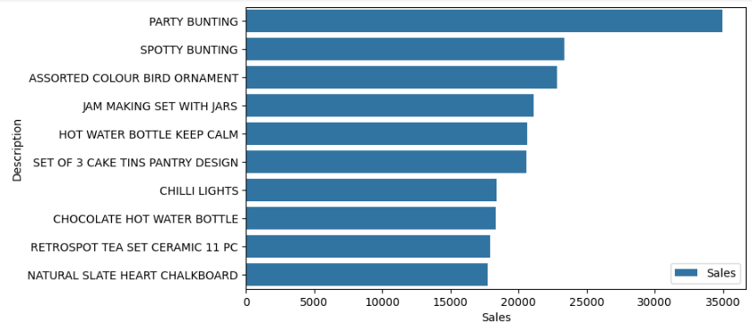
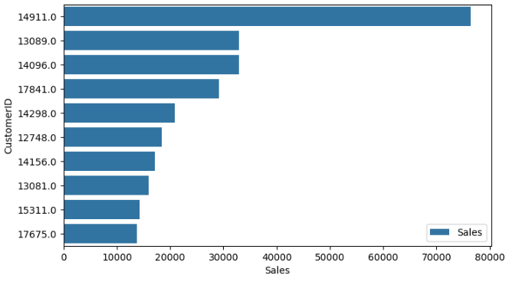
Standard Insights
Customer Analysis
Customer Retention: 98.37% of customers who have customer ID have been retained.
There is some difference in Top 10 Sales and Top 10 Quantity of products transactions. It means the higher quantity of sales does not guarantee the higher sales earned. We can draw what is the Top 10 quantity that also generated the highest income sales.
Next, Who is the customer that generated BOTH the highest quantity and sales?
There is only one product that have the highest quantity and sales that is ASSORTED COLOUR BIRD ORNAMENT.
Quantity | Sales | CustomerID
14911 | 45072 | 76424.67
13089 | 18858 | 32957.08
17841 | 17602 | 29176.25
14298 | 14482 | 20823.48
12748 | 13372 | 18388.33
14096 | 11819 | 32949.41
13081 | 11129 | 16012.81
14156 | 7422 | 17179.68
Now, it's time to answer, Who are the customers that generated the highest Sales and Quantity?
There are 8 customers that have the highest quantity and generated the highest sales revenue.

Slide 5
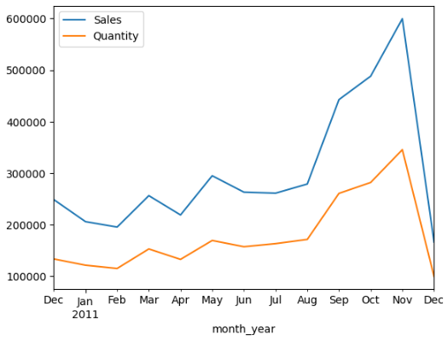
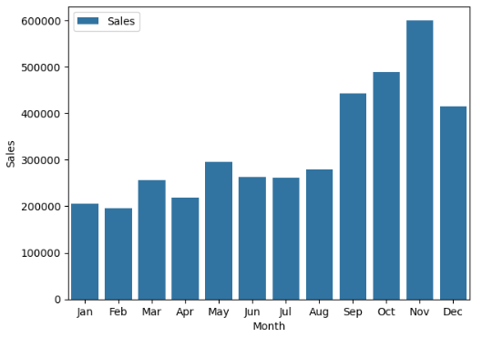
Sales Trend Analysis
Monthly sales
Common observation:
From this chart, we can conclude, the growth seems to have occurred since August and reached its highest point in November 2011.
We already know, if November is the highest peak of transactions. But let's make it clear by exploring what is the month that generated the highest and the lowest sales and quantity. – November and February

Slide 6
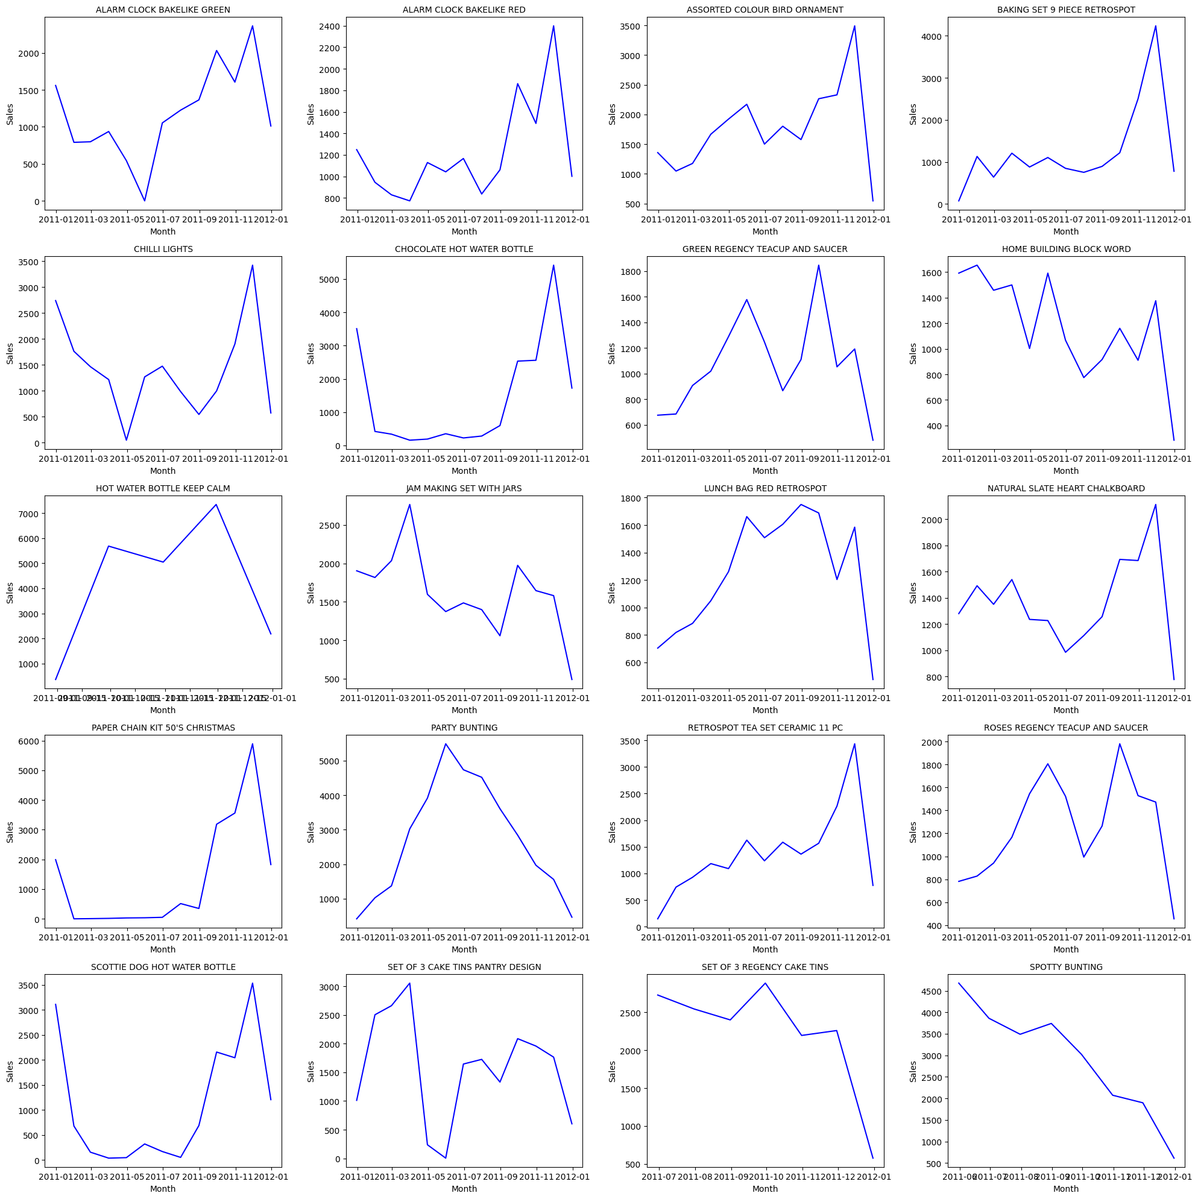
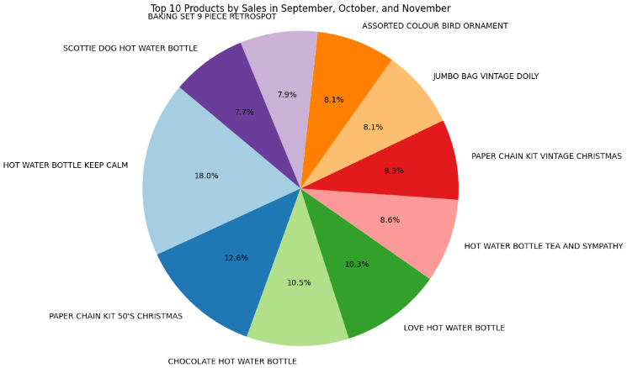
Most Selling Products
Monthly Trend Analysis
Down Trend:
‘SPOTTY BUNTING’
‘SET OF 3 REGENCY CAKE TINS’
Strategy: Product Review/Removal
Good Trend: (especially in sales season)
‘HOT WATER BOTTLE KEEP CALM’
‘RETROSPOT TEA SET’
Strategy: Promotion
These are the top 10 products which had the highest sales in September, October, November.

Slide 7

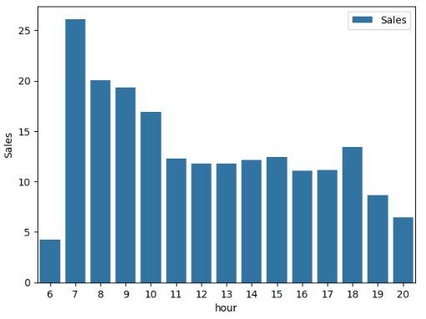
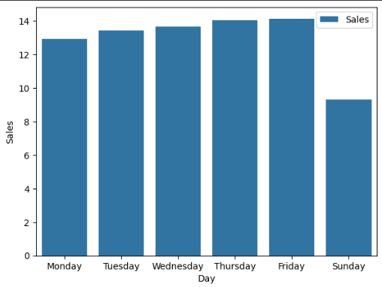
Analysis
Weekly and Daily
Weekly Analysis
How about the day? Instead using of sum(), we will explore the highest average of sales and quantity by day of the weekend. For note, There is no transactions during Saturday.
But we know, Friday is the best day for shopping and Sunday is the 'worst' day for shopping.
The answer is morning. Most of transactions happen during morning Especially at 7 a.m, and 8- 10 a.m respectively.
Also, some customers like to do it in the evening at 6 pm.

Slide 8
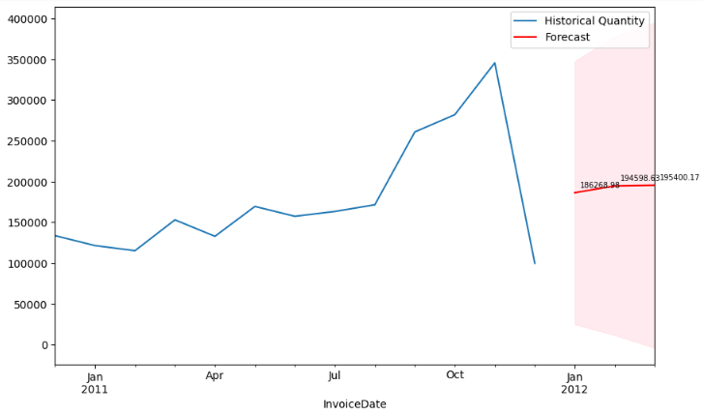
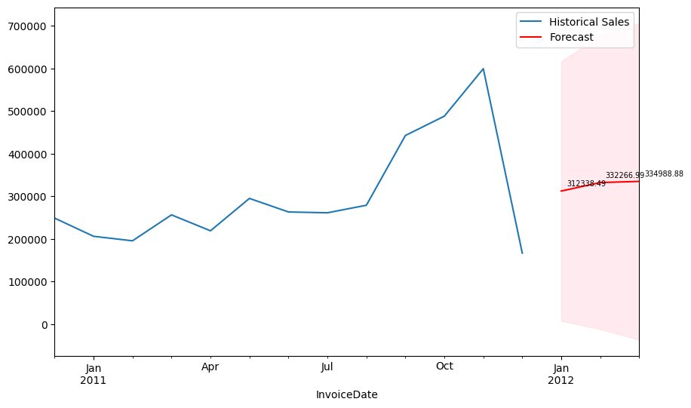
Additional Recommendations
Sales Prediction, Demand Forecasting and Cross-Selling.
Prediction(ARIMA)
Sales Prediction for next 3 Months
January - 312339
February - 332267
March – 334989
Similarly, top selling products in month of January, February and March is shown-to maintain stock keeping levels.
Bucket Products
Bucket 2 products and discounts
This list is only for correlation of 2 products, similarly, buckets of 2/3/4 products can also increase sales.
StockCode | January | February | March | Total
21212 | 926 | 1144 | 1511 | 3581
22961 | 727 | 718 | 1075 | 2520
84879 | 619 | 695 | 986 | 2300
21977 | 491 | 598 | 1104 | 2193
84991 | 614 | 551 | 892 | 2057
22969 | 651 | 612 | 672 | 1935
21985 | 1044 | 341 | 371 | 1756
22720 | 526 | 563 | 634 | 1723
84992 | 884 | 359 | 443 | 1686
22469 | 736 | 792 | 156 | 1684
Cross Selling
Here is a list of products that could used for the purpose od cross selling.
Correlation>0.9 is set parameter for this.
Offer free products as other product as cross-selling to gain loyalty.
Product1 | Product2 | Correlation
22916 | 22917 | 0.931578
22917 | 22918 | 0.920983
22916 | 22918 | 0.911611
22917 | 22920 | 0.91008
22918 | 22920 | 0.906577
22917 | 22919 | 0.905607
22918 | 22919 | 0.902186
22916 | 22920 | 0.90056
Seasonal Discounts
Seasonal discounts can be applied from August to November to attract new customers.

Slide 9

Thank you!
Please feel free to share your questions, suggestions or feedback.

