Slide 1


(Traveler from 2050 comes to 2024)

Slide 2
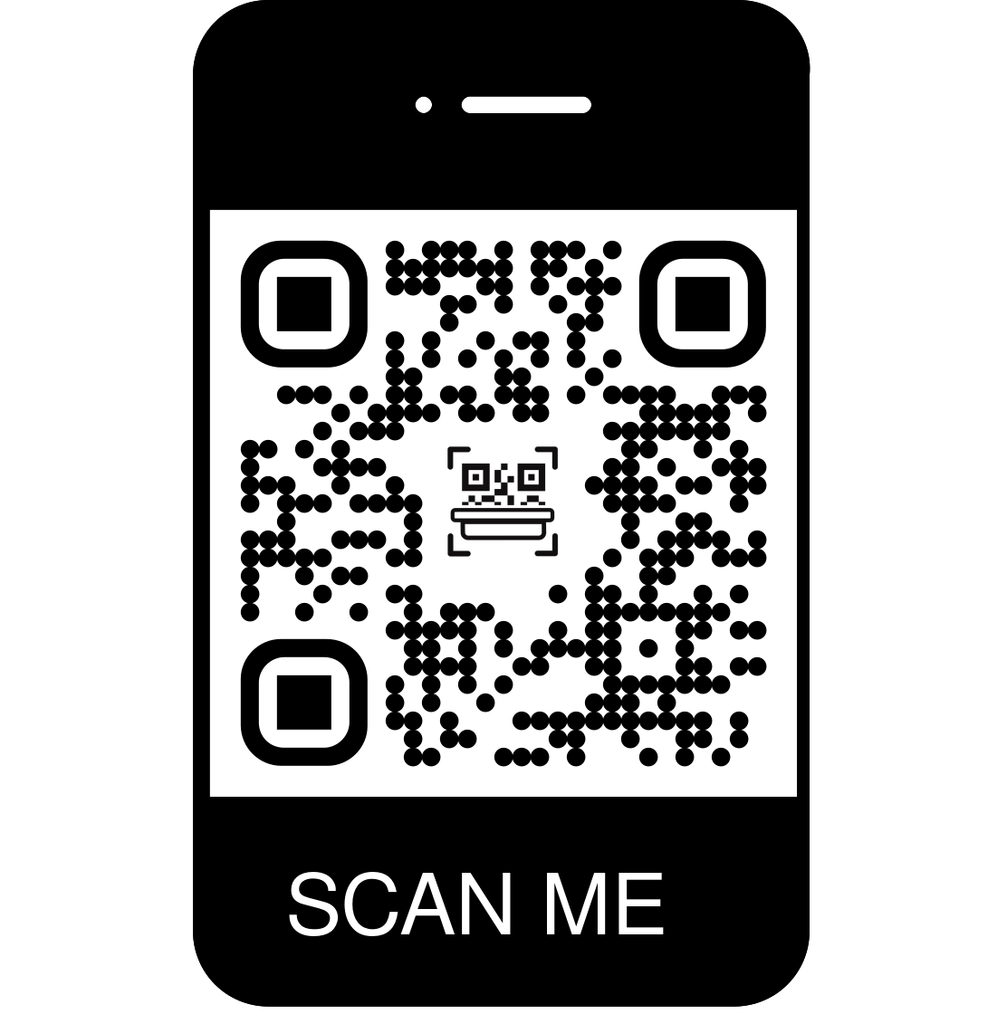
Order Now!

