Slide 1
A Study on Directed Feedback Vertex Set (DFVS)
By Soumyajit Karmakar
1901200
CS300
Supervisor: Dr. Srinibas Swain

Slide 2
Contents
Brief Introduction
Definitions and Notations
Graph Theoretic Definitions
Algorithmic Definitions
Classifications of Algorithms
Previous Works and Literature Survey
Working of the Algorithm
Overview
Skew Separator problem
Directed Acyclic Graph Bipartition FVS problem
DFVS Reduction problem
DFVS problem
Conclusion and Future Work
References

Slide 3
Brief Introduction
A Feedback Vertex Set (FVS) for an graph G, is a set of vertices S, whose removal ensures that the remaining graph does not have any cycles.
We will discuss the exact and parametrized Directed FVS (DFVS).
“Given a directed graph G and a parameter k, our task is to either return a feedback vertex set whose size is bounded by k, or report that no such set exists.”
This problem falls in the NP-Complete class of problems.
This problem is found is many areas, such as,
Deadlocks
Testing circuits
Notes:
Line 1 : Explain for undirected vs directed case.

Slide 4

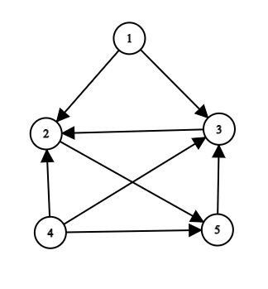
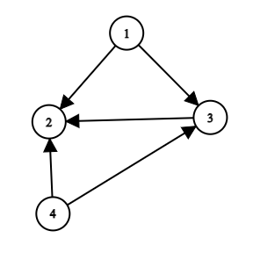
Definitions and Notations
Graph Theoretic Definitions
A directed graph represented as, G = (V, E).
An edge represented as, e = [u, v].
For a vertex set V′ ⊆ V in the directed graph G = (V, E),
the graph induced by the vertices of V′ is denoted by G[V′].
A set F ⊆ V(G) in the directed graph G is a DFVS if the graph G[V \ F] is a directed acyclic graph (DAG).
Induced graph example :
e
Original Graph
Graph induced by 1,2,3 and 4
Notes:
…where V is the set of vertices and E is the set of edges.
The edge e is called an outgoing edge of the vertex u, and an incoming edge of the vertex v.
Define induced graph.
Define cycles.

Slide 5
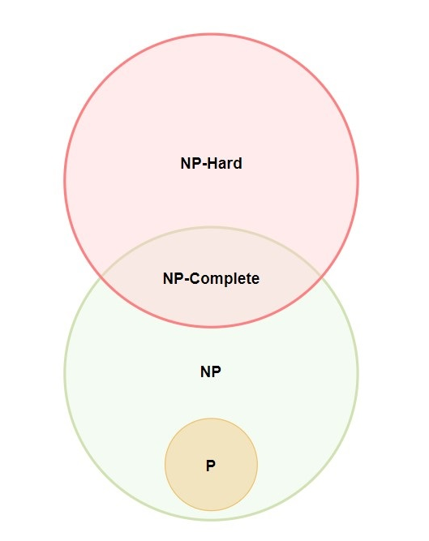
Definitions and Notations
Algorithmic Definitions
P problems are quick to verify and solve.
NP problems are quick to verify but slow to solve.
NP-Complete problems are also quick to verify, slow to solve and can be reduced to any other NP problem.
NP-Hard problems are slow to verify, slow to solve and can be reduced to any other NP problem.
Notes:
Define quick (solvable in polynomial time using deterministic turing machine) and slow (solvable in polynomial time using non deterministic turing machine).

Slide 6
Classifications of Algorithms
Once a problem is proved to be NP-Complete, what next ?
There are broadly two approaches to deal with such problems.
When the exact problem is not solvable in polynomial time, we try to find the solution to a easier and restricted version of the problem, ie. Parameterized algorithms, or try to approximate the solution within reasonable bounds, ie. Approximation algorithms.
For parameterized algorithms we take a fixed parameter k and try to come up with an algorithm for the restricted version of the problem such that the time complexity becomes a polynomial function of the input size, it may contain any function of the parameter k.
For approximation algorithms we come up with an algorithm that gives some result in polynomial time and we prove a bound on the ratio between the optimal solution and the solution produced by the algorithm.
One last method is Randomized algorithms, here we pick a solution to the problem based on some probability in polynomial time. This method is non deterministic in nature.
In this project we tackle the “exact and parameterized” version of the original DFVS problem.

Slide 7

Previous Works and Literature Survey
Karp [2] in the year 1972 showed that DFVS can be reduced from the well-known problem of Vertex Cover, thus proving it was in the NP-Hard class and the decision problem was in NP-Complete class.
Even et al. [4] in the year 1998 showed the relationship between multi-cults and feedback sets and came up with an approximate algorithm for the DFVS problem.
Chen et al. [1] in the year 2008 proved that the problem of fixed parameterized DFVS is fixed-parameter tractable by coming up with an algorithm for the problem with the time complexity of O($n^{4}4^{k}k^{3}$k!).
Notes:
Define multi-cuts.

Slide 8
Working of the Algorithm
Overview:
The algorithm for the DFVS problem is obtained through careful development of algorithms for a series of problems. The problems are:
Skew Separator problem
Directed Acyclic Graph Bipartition FVS problem
DFVS Reduction problem
And then finally the DFVS problem.

Slide 9
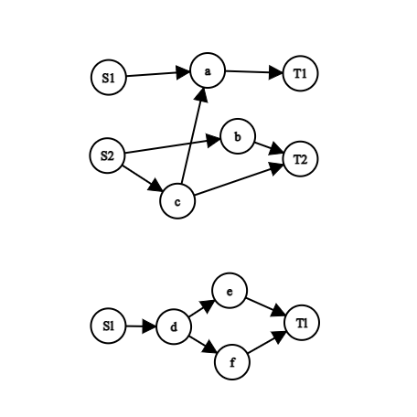

Working of the Algorithm
Skew Separator problem
Given a directed graph G, a parameter k and collection of “Source Sets” [$S_{1},S_{2},…,S_{l}$] and “Sink Sets” $[T_{1},$ $T_{2},…,T_{l}$], such that
all the sets $S_{1}$,...,$S_{l}$, $T_{1}$,...,$T_{l}$ are pairwise disjoint,
for each i, 1 ≤ i ≤ l−1, there is not edge coming into the set $S_{i}$, for each j, 1 ≤ j ≤ l, there is no edge going out from the set $T_{j}$.
We need to either find a set of vertices, called a Skew Separator X, of at most k vertices such that for any pair of indices i and j satisfying l ≥ i ≥ j ≥ 1, there is no path from $S_{i}$ to $T_{j}$in the graph G[V \ X] or report that no such set exists. The authors discussed an algorithm which solves the problem in time O ($4^{k}$k $n^{3}$).
.
.
.
.
.
.
Notes:
Lines are taken from my report.

Slide 10
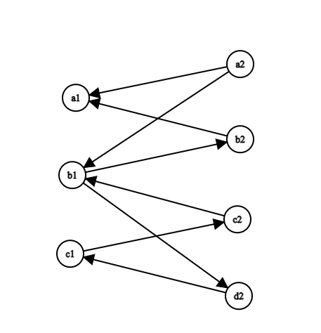



Working of the Algorithm
Directed Acyclic Graph Bipartition FVS problem
Given a directed graph G and a DAG-bipartition (D1,D2) for G and a parameter k, we need to either find a $D_{1}$-FVS with size bounded by k for the graph G, or report that no such set exists. A vertex subset F in the graph G is a $D_{1}$-FVS if F is an FVS for G and F ⊆ D1. The algorithm for this problem has a running time of O ($4^{k}$k $n^{3}$h!), where h is the number of vertices in the set D2.
$$D_{1}$$
$$D_{2}$$
Notes:
Cycles check !

Slide 11

Working of the Algorithm
DFVS Reduction problem
Given a directed graph G, a parameter k and a FVS set of size k + 1, our task is to construct an FVS of size bounded by k for the graph G or report that no such FVS exists. The algorithm for this problem has a run time of O ($n^{3}4^{k}k^{3}k$!).
DFVS problem
Now this can be solved using the above algorithm by applying the Iterative Compression Method, as proposed by Reed et al. [3]. Here we start with a trivial FVS solution on a subset of the graph and slowly add other vertices to it, at each step trying to find a new FVS bounded by k or reporting that no such set exists, until we have covered the entire graph. The time complexity for this algorithm is O ($n^{4}4^{k}k^{3}k$!).
The source code for the implementation and the report for this project can be found here

Slide 12

Conclusion and Future Works
In this project we have analyzed and implemented the foundation of the algorithm to find the exact solution of the parameterized DFVS problem, with the runtime of O ($n^{4}4^{k}k^{3}k$!).
This algorithm can be further improved by using the approximation algorithm as discussed in [4].
In future we plan on participating in the Parameterized Algorithms and Computational Experiments Challenge (PACE) 2022 challenge after further improving the algorithm and implementation.
Notes:
Explain the approximation algo usage.

Slide 13
References
[1] J. Chen, Y. Liu, S. Lu, B. O’sullivan, and I. Razgon, “A fixed-parameter algorithm for the directed feedback vertex set problem,” in Proceedings of the fortieth annual ACM symposium on Theory of computing, pp. 177–186, 2008.
[2] R. M. Karp, “Reducibility among combinatorial problems,” in Complexity of computer computations, pp. 85–103, Springer, 1972.
[3] B. Reed, K. Smith, and A. Vetta, “Finding odd cycle transversals,” Operations Research Letters, vol. 32, no. 4, pp. 299–301, 2004.
[4] G. Even, B. Schieber, M. Sudan, et al., “Approximating minimum feedback sets and multicuts in directed graphs,” Algorithmica, vol. 20, no. 2, pp. 151–174, 1998.

Slide 14
Thank You

