Slide 1
Lab 5
CS232 OS LAB

Slide 2
TCP
Transmission Control Protocol (TCP)
One-to-one and connection-oriented reliable protocol
Used in the accurate transmission of large amounts of data
Slower compared to UDP because of additional error checking being performed

Slide 3
TCP/IP Application Interface
Applications require an Application Programming Interface (API) to use the services of TCP/IP
API is a standardized interface between the applications and the TCP/IP services
Sockets interface is the standard interface

Slide 4
Sockets Overview
Client
Server
socket
socket
bind
open_listenfd
open_clientfd
listen
Connection
request
connect
accept
Client / Server
Session
write
read
read
write
close
EOF
read
close

Slide 5
Linux Sockets Example
Server Code (without error processing, and address init)
sockfd = socket(AF_INET, SOCK_STREAM, 0)
bind(sockfd, (struct sockaddr *)&my_addr, sizeof(struct sockaddr))
listen(sockfd, BACKLOG)
while(1) { /* main accept() loop */
sin_size = sizeof(struct sockaddr_in);
new_fd = accept(sockfd, (struct sockaddr *)&their_addr, &sin_size) ;
if (!fork()) { /* this is the child process */
send(new_fd, "Hello, world!\n", 14, 0);
close(new_fd); exit(0);
}
close(new_fd); /* parent doesn't need this */
while(waitpid(-1,NULL,WNOHANG) > 0); /* clean up child processes */
}

Slide 6
Linux Socket Client Example
sockfd = socket(AF_INET, SOCK_STREAM, 0);
connect(sockfd, (struct sockaddr *)&their_addr, sizeof(struct sockaddr);
numbytes=recv(sockfd, buf, MAXDATASIZE, 0);
close(sockfd);

Slide 7
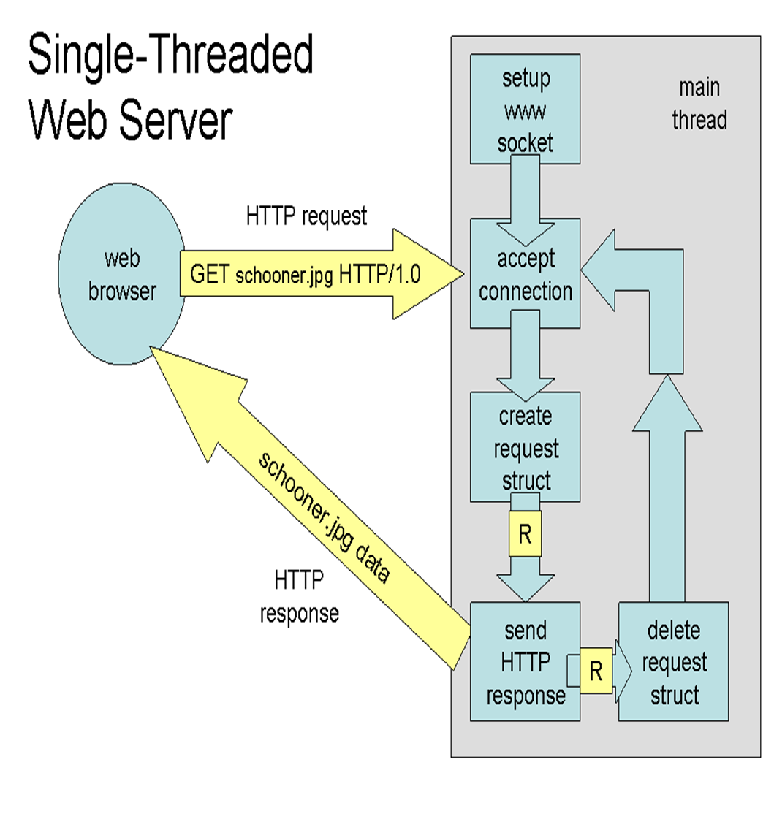

Slide 8
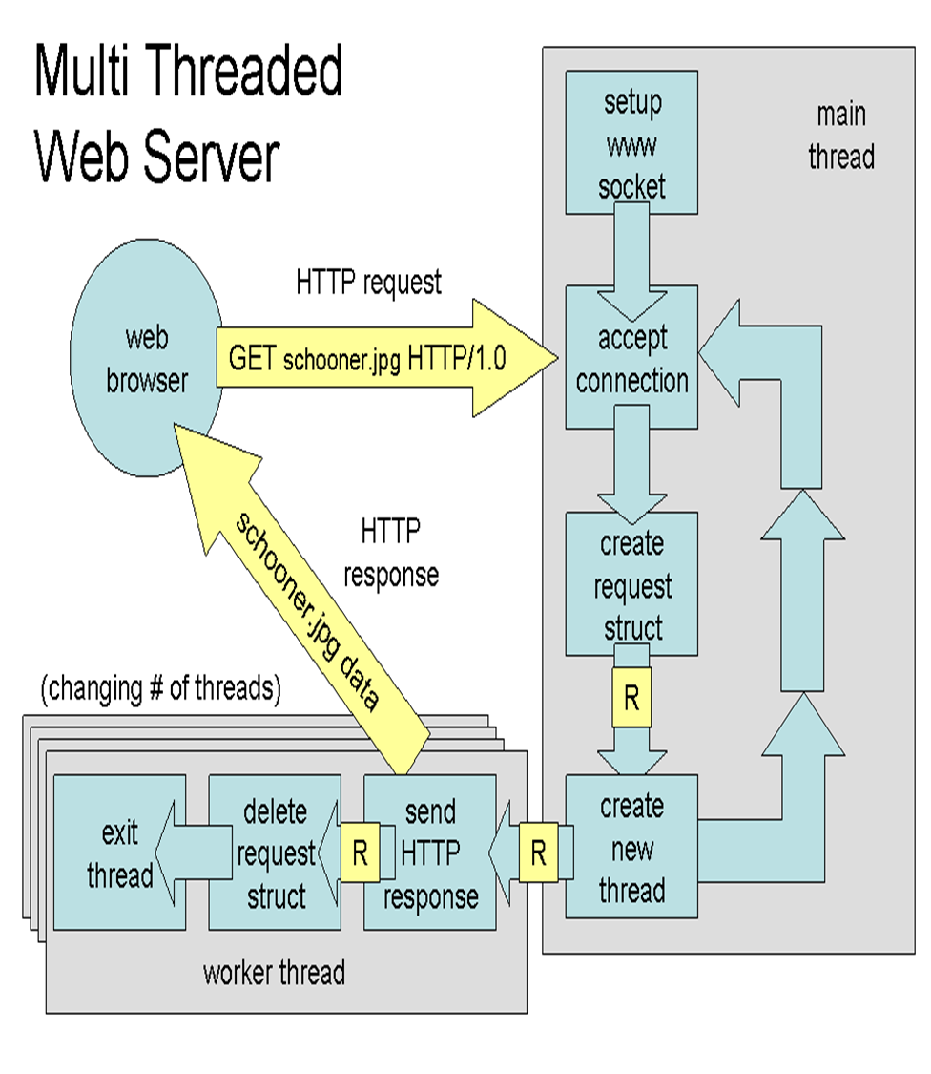

Slide 9
