Slide 1

ABC Bank
Superuser

Slide 2
The Ask- Where we Started

Slide 3
Framework for 8 Weeks
1
Database Concepts and SQL
Introduction to Applications
2
Object Oriented Programming
Data Structures
Core Java Programming
3
Project- Banking Application
JDBC and Web Design fundamentals
4
5
Java Script, ES5, ES6, Angular7
UML Daigrams
6
Architecture, framework of angular.
JEE Architecture
Html, CSS,
Bootstrap, AJAX
7
JSP Servlet
Spring REST( Core & MVC)
myBatis
8
Agile Methodology, Tomcat,
GitHub, Jenkins, Maven,
Project Presentation

Slide 4

Objective of the Training
To become a Full Stack web developer by gaining knowledge which builds confident and makes us a successful Product Engineer.​

Slide 5

Overview
Database(SQL)
Introduction and basics of SQL. All the operations related to tables. Query writing.
HTML, CSS
Introduction of HTML and CSS. Simple examples of both HTML and CSS and the CSS rules. Differences between HTML and CSS.
Java script
History, Introduction, Types of Java Script, Components of JS, Introduction of Typescript, ES5 and ES6
Angular7
History, Introduction, Environmental setup, Architecture of Angular, Installation using Angular CLI, Components, Modules, Data Binding, Event Binding, Directives, Pipes, Routing, Services, Testing and building Angular Project.

Slide 6
Overview
Jsp and Servlet
Introduction, Environmental Setup, Architecture, Lifecycle, Container(Apache TomCat), Inbuilt services, API​
Spring Rest
Introduction, Spring framework, Environmental setup in eclipse Mars, Architecture, Containers, Configurations, Annotations, Components of Spring Application
Agile Methodology
Introduction to Scrum and Scrum Artifacts.
TomCat
History and introduction to tomcat. Versions of Tomcat.

Slide 7
Overview
GitHub
Introduction to GitHub. Account creation and the push and pull of the code in the GitHub.​
Maven
Introduction to Maven. Life cycle and phases of Maven. Maven commands. Maven Plugins and Goals
Jenkins
Introduction to Jenkins. Life cycles and phases of Devops.

Slide 8

AGENDA
Our Journey
Our Team
Project Goals
Tech Stack
Development
Challenges and Learnings
Demo
Q & A

Slide 9
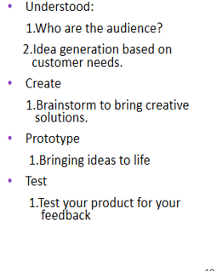
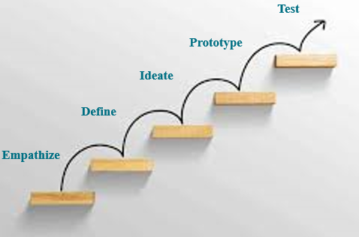
Our Journey

Slide 10
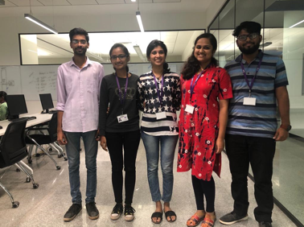
Our Team

Slide 11

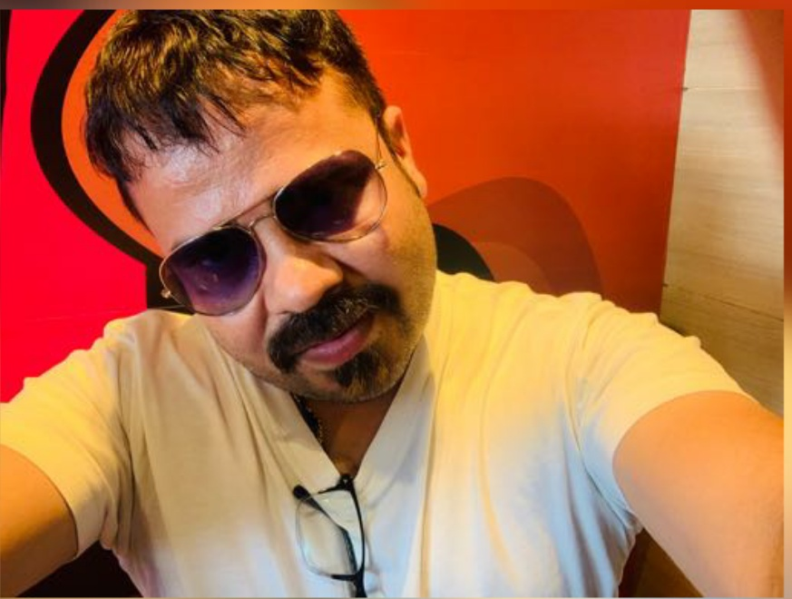
Trainers
Upasana
Amit Kr Balayan
Kavita

Slide 12



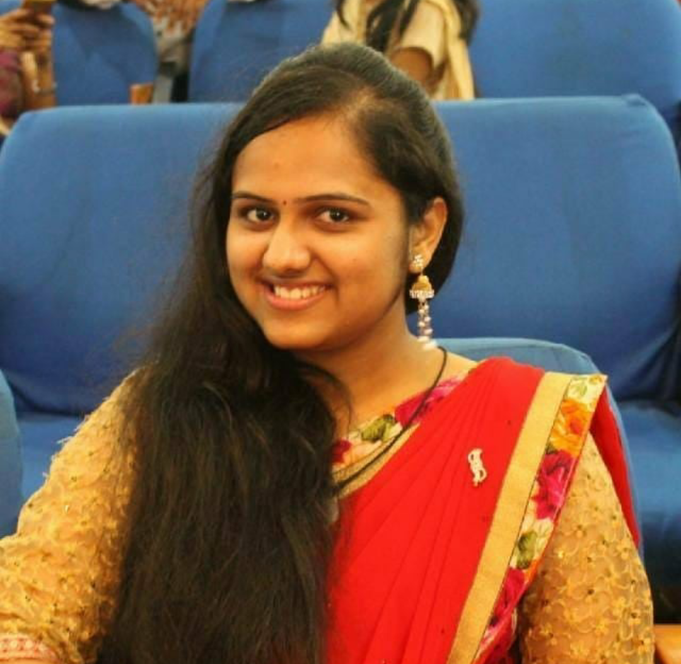
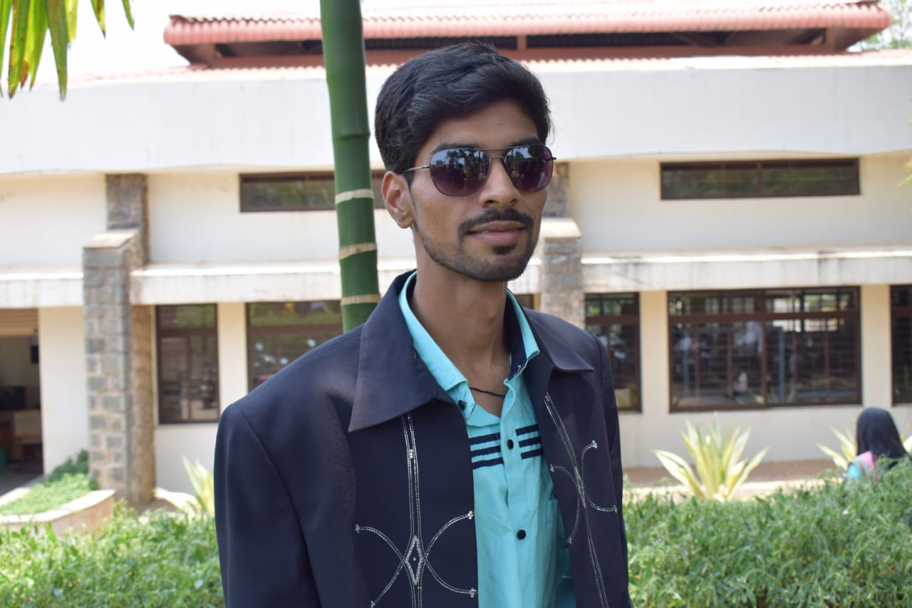
Team Simba
Manjunath
Kirthana
Scrum master
Emp ID:109272
Emp ID:109285
Nishmitha
Soumya
Prajwal
Emp ID:109262
Emp ID:109278
Emp ID:109274

Slide 13

ABC Bank Management Application
This online banking application provides the basic services to manage bank accounts of a bank. Bank has many branches, each of which has an address and branch number. A customer/client opens accounts at a branch. Each account is uniquely identified by an account number; it has a balance and a credit or overdraft limit. There are three types of accounts, including: Savings, Current and Loan account (loan account is treated as separate entity).

Slide 14
Objective
The main objective of Online Bank Management Application is to register the admins,manage the details of admins, handle the profile of Superuser, and to reduce the manual work for managing the profile of Admins.

Slide 15
Problem Definition
Although the basic type of services offered by a bank depends upon the type of bank and the country, services provided usually include:
Registration of Admins.
Providing Login credentials to Admins.

Slide 16
Overview of Bank Management Application
There are various job positions within bank institutions. The positions are as
follows:
Super User
Admin
Agent
Customer
Super User - Super user can Create/Update/Delete/ view all Admin operations.
• Can View / Edit his own profile
• Approve Admins(unable/Disable)

Slide 17
Scope and Conclusion
Scope of the Project:
This project can be implemented in any bank by fulfilling basic requirements.
Conclusion of the Project:
This Bank Management Application will allow the customers to create the
account and manage all his transactions and it also allows the admin and
agent to examine the transactions going inside the bank without manual
processing. All information will be updated automatically by using the
information stored in the database system.

Slide 18

To become a Full Stack web developer by gaining knowledge which builds confident and makes us a successful Product Engineer.
Tech Stack

Slide 19













FRONTEND
BACKEND
DevOps
DATA

Slide 20

Full Stack Development
Development

Slide 21
Full Stack Architecture
Angular 7
HTML/CSS/JS
Java/Spring
iBatis/Hibernate
UI/UX
ORM/
Database
Spring
Boot
XML HTTP
Request
Browser
DB
XML HTTP
Response
Node JS
REST API
Front End Development
TOMCAT/Jettey

Slide 22

CHALLENGES AND LEARNINGS

Slide 23


Slide 24

Q & A

Slide 25
THANK YOU!

