Slide 1

CVR COLLEGE OF ENGINEERING
Department of Emerging Technologies
Project Title : PRODUCTIFY
DONTHOJU ANANYA(22B81A6605)
KOTHA SHRAVYA(22B81A6641)
BODIGAM SOUMYA(22B81A6645)
GUIDE NAME:
Dr.M.SURYA BHUPAL RAO

Slide 2

Introduction to Productify
Welcome to Productify, the premier online clothing store that offers a curated selection of high-quality, fashionable apparel for every occasion. Established with a commitment to providing our customers with an exceptional shopping experience, Productify is more than just a website - it's a destination where style, quality, and convenience converge.
sa

Slide 3
Abstract
"Productify" is a comprehensive project aimed at revolutionizing the way products and services are presented, marketed, and enhanced in the digital landscape.
At its core, Productify is a product landing page builder, equipped with an intuitive user interface and robust backend infrastructure.

Slide 4
Project Overview
Productify is an innovative e-commerce platform designed to revolutionize the online clothing retail industry. As an industry-leading provider of trendy, high-quality apparel, Productify offers a seamless and enjoyable shopping experience for fashion-conscious consumers. With a focus on curating a diverse product catalog, user-friendly navigation, and secure payment processing, Productify aims to become the go-to destination for discerning shoppers seeking the latest fashion trends and exceptional value.
At the core of Productify's mission is a commitment to providing customers with an unparalleled shopping experience. Through intuitive design, and a robust shopping cart system, Productify empowers users to effortlessly discover, and purchase the clothing and accessories that best suit their unique style and preferences. By leveraging cutting-edge technologies and data-driven insights, the platform constantly evolves to anticipate and exceed the expectations of its ever-growing customer base.

Slide 5

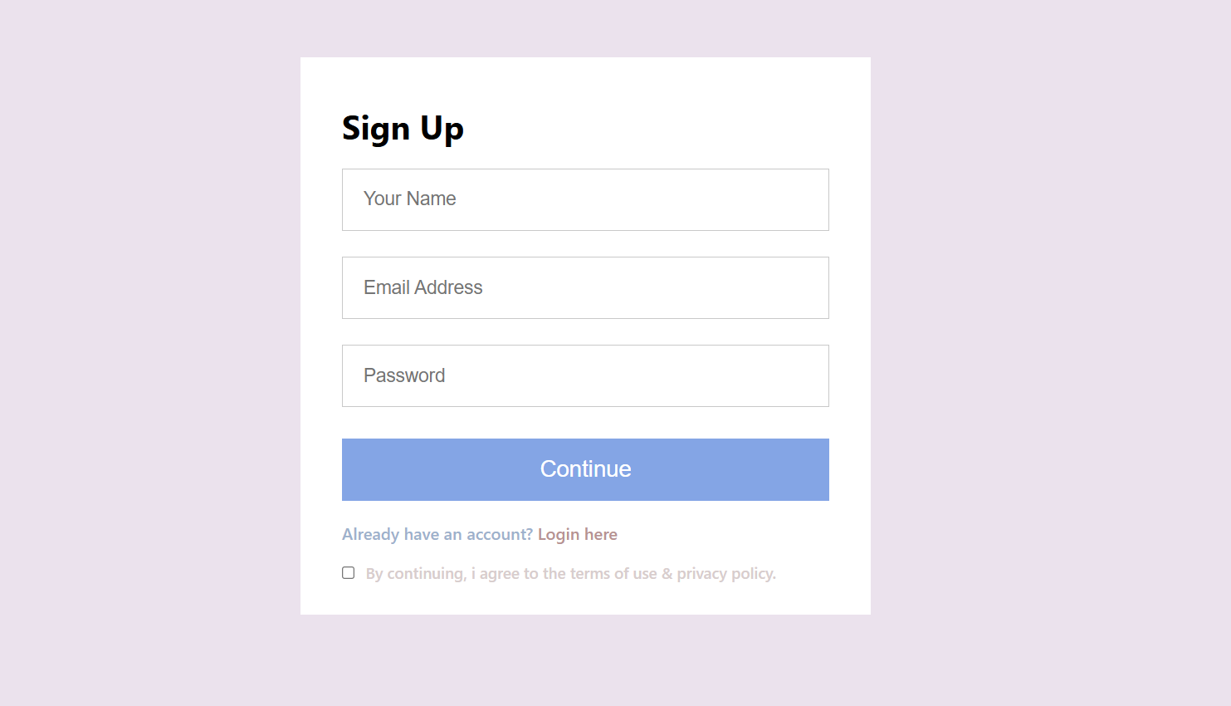
User Registration and Accounts
Productify offers a robust user registration and account management system to provide customers with a personalized and secure shopping experience. When new visitors arrive at the Productify website, they can easily create an account by providing basic information such as their name, email address, and a secure password. The registration process is streamlined and intuitive, ensuring a smooth onboarding for first-time users.

Slide 6
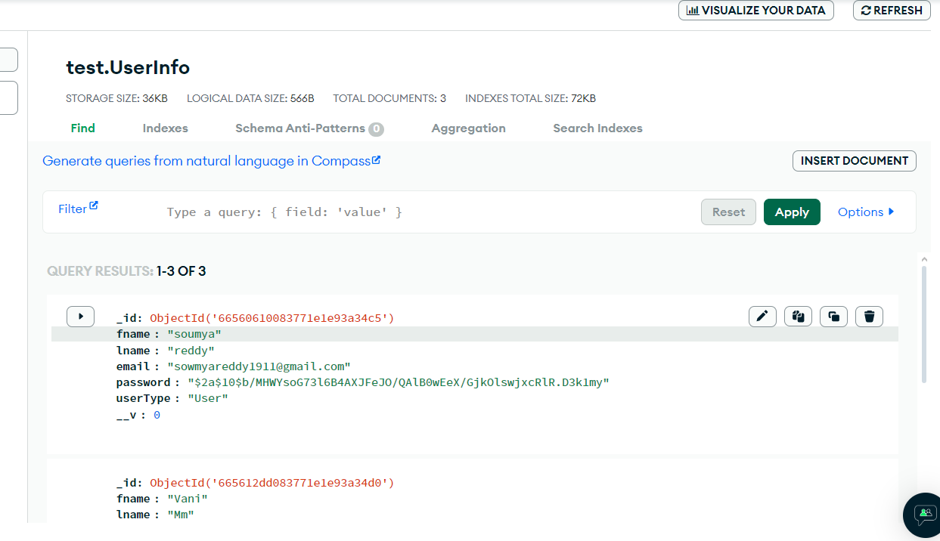
Once registered, customers can log in to their Productify account to access a wide range of features and functionalities. They can view their order history, track the status of their deliveries, manage their shipping and billing information, and even set personal preferences for their shopping experience. The user-friendly account dashboard allows customers to effortlessly navigate and customize their account settings to suit their individual needs.

Slide 7


Logo:
Navbar:
Footer:

Slide 8
Key features
High quality product visuals: include images,videos,or interactive elements that showcase the product from different angles and in use.
Responsive design: Ensure the landing page is optimized for various devices and screen sizes,providing a seamless user experience.
Performance optimization: Continuously optimize the landing page for overall performance to provide a smooth user experience.

Slide 9
The Product Development Journey: From Prototype to Yield
P - Prototype
R - Research
O - Optimize
D - Develop
U - Unveil
C - Create
T - Test
I - Iterate
F - Finalize
Y - Yield

Slide 10
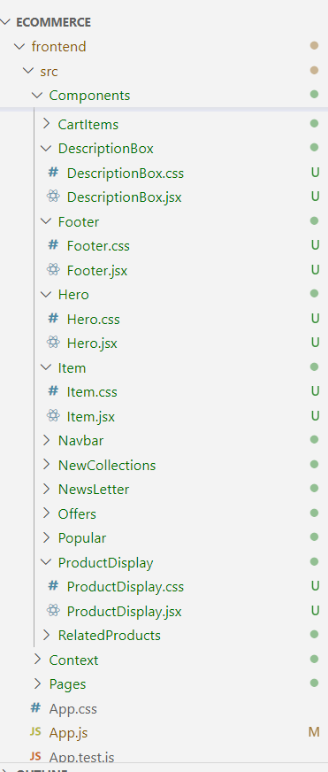
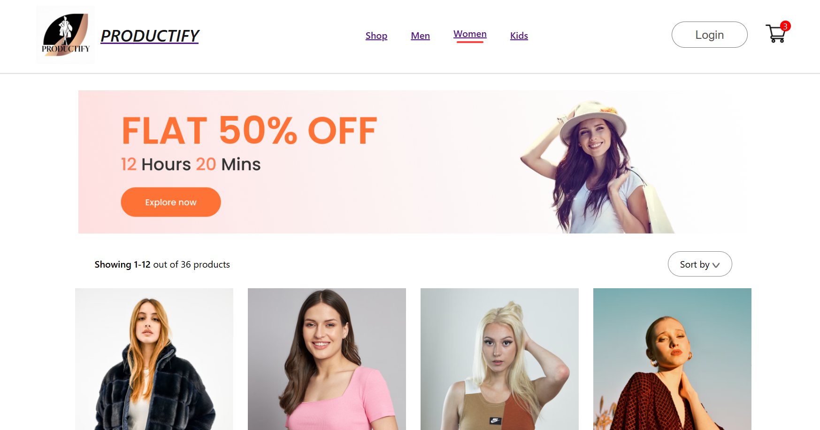
Home page

Slide 11
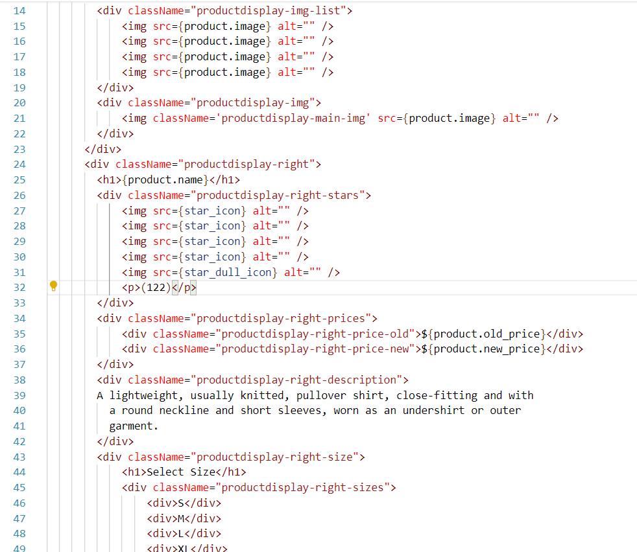
ProductDisplay.jsx

Slide 12
Product Catalog Management
At the heart of the Productify e-commerce platform is a robust and flexible product catalog management system. This system allows merchants to effortlessly add, update, and organize their product offerings, ensuring customers have access to a comprehensive and up-to-date selection of apparel, accessories, and other fashion items.
The product catalog features detailed product pages showcasing high-quality images, thorough descriptions, pricing information, and size/color availability. Merchants can easily upload new product images, write compelling descriptions, and specify crucial details like SKUs, inventory levels, and shipping options. Advanced categorization and tagging tools make it simple to group products into intuitive collections, enabling customers to quickly navigate.

Slide 13
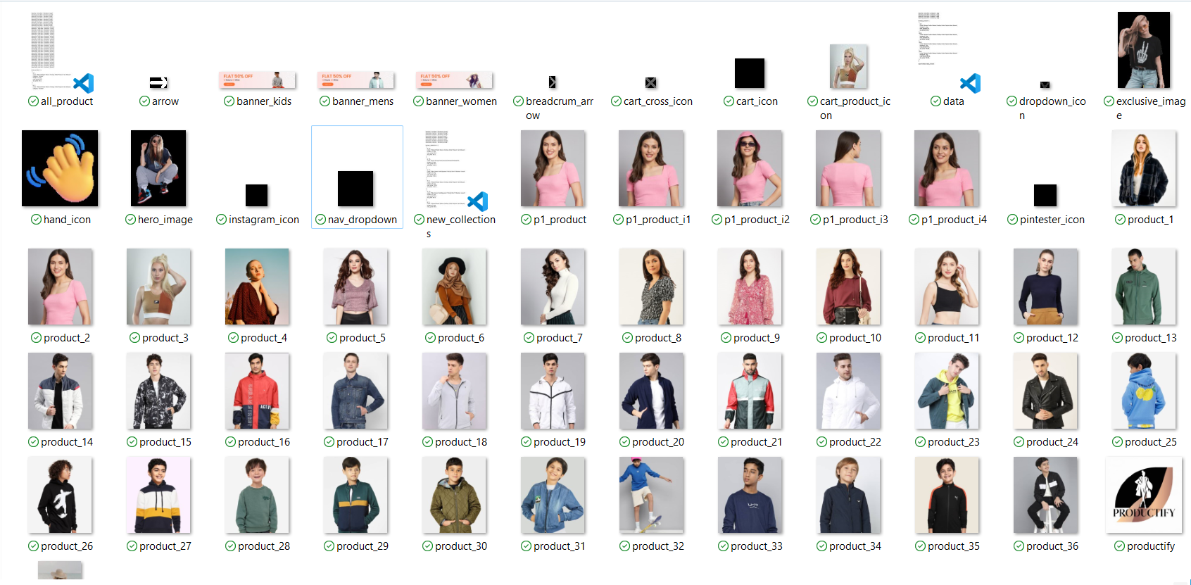

Slide 14
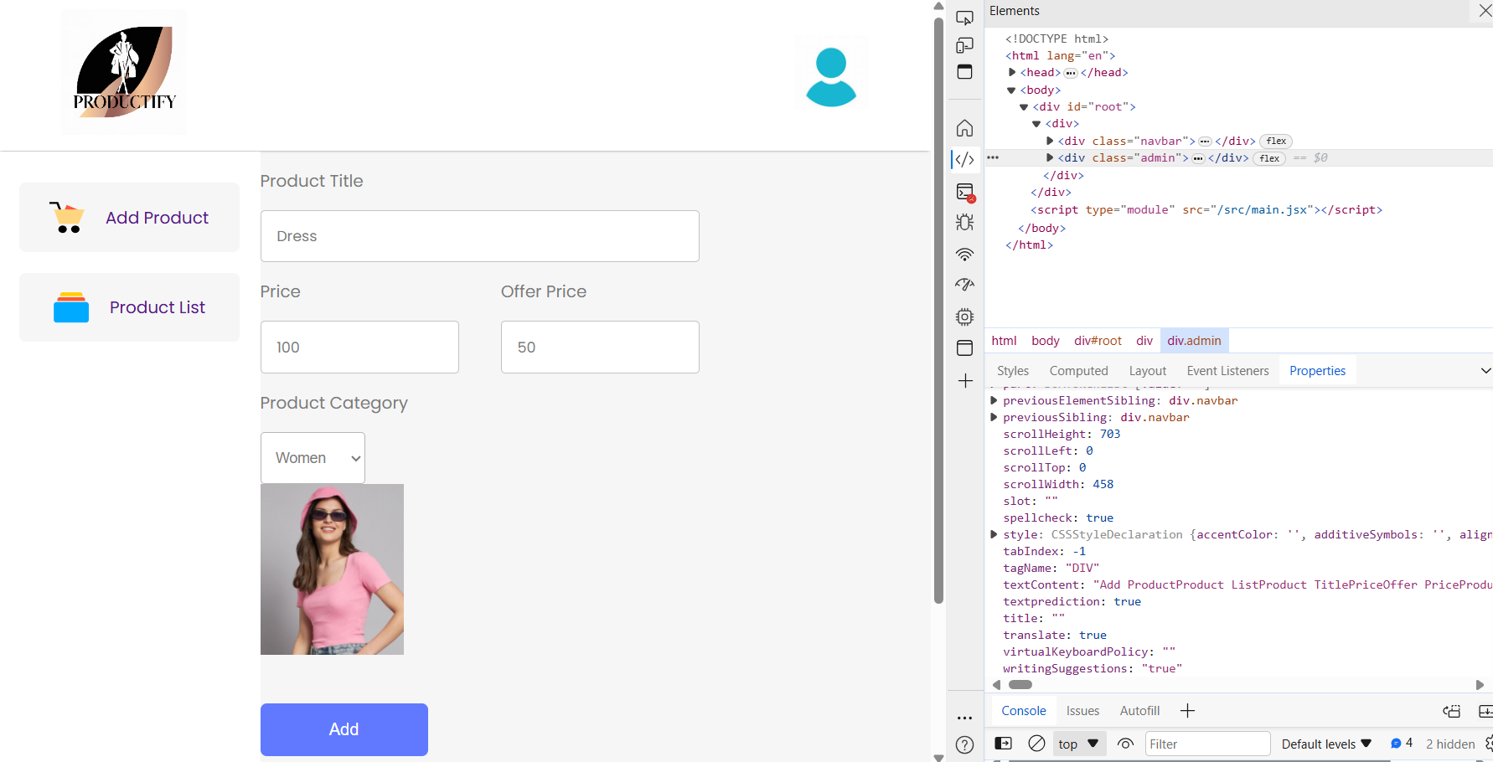
Add/Edit Products: Add new products, update details of existing products, and manage product descriptions, pricing, and images.
Admin Panel

Slide 15
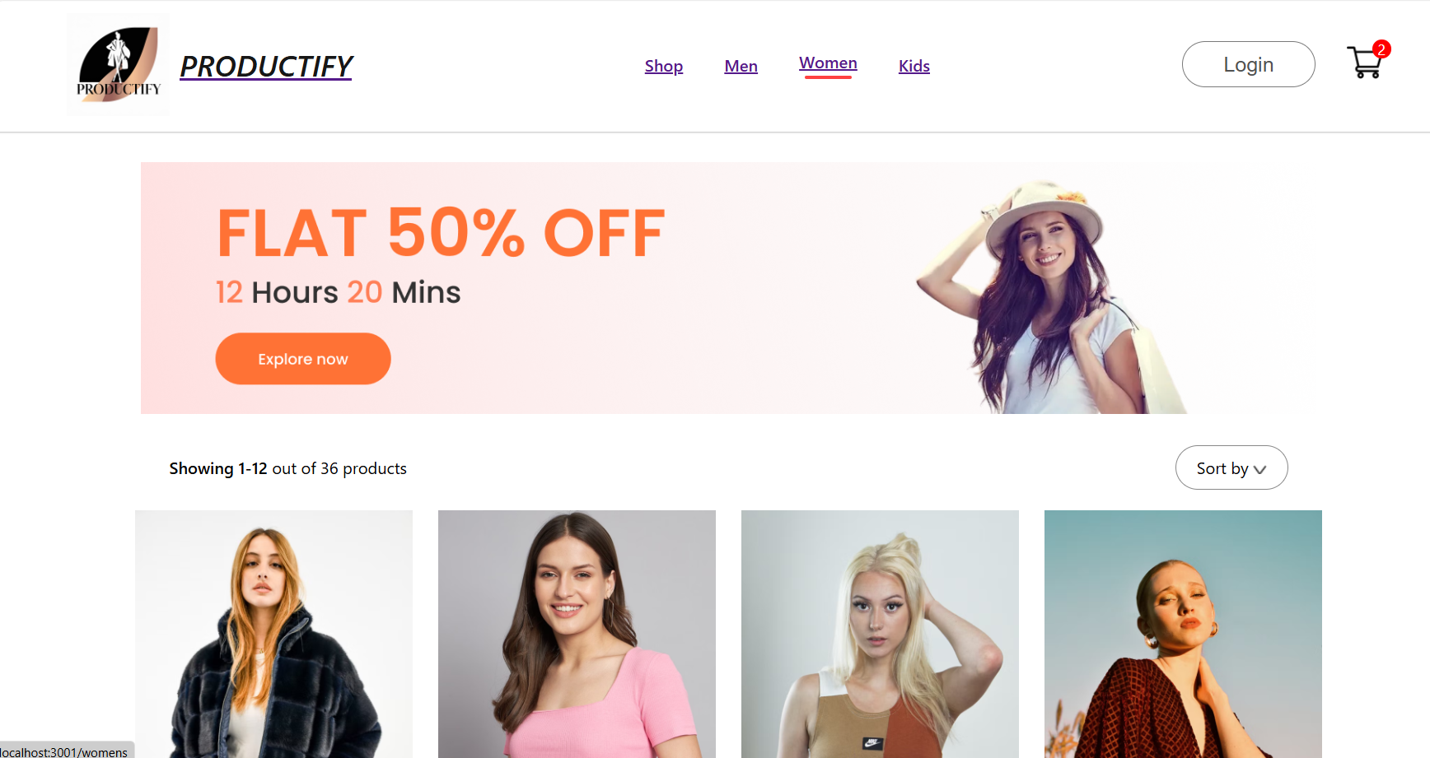
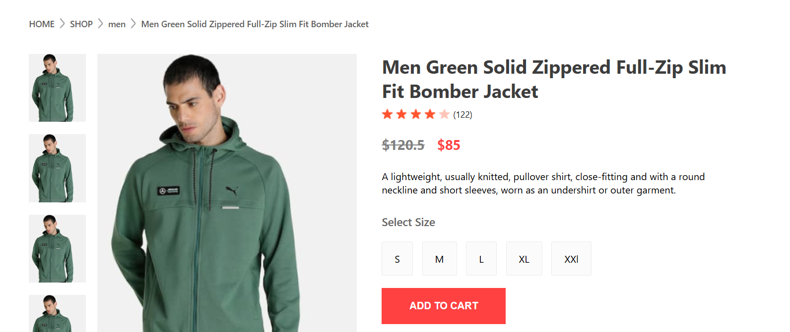
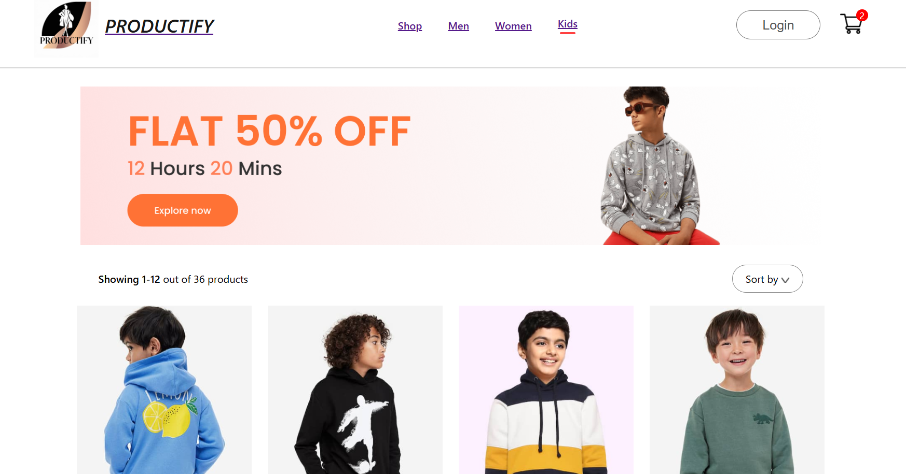
Website Features
Intuitive Homepage
Detailed Product Pages
Streamlined Navigation
Productify's homepage is designed to be clean, visually appealing, and highly intuitive. It features prominent product showcases, easy-to-navigate menus, and captivating imagery that draws customers in and encourages exploration of the website.
Each product on Productify has a dedicated page that provides comprehensive information, including high-quality images, detailed descriptions, size guides, and customer reviews. This empowers customers to make informed purchasing decisions and helps them find the perfect items to meet their needs.
Productify's website features a well-organized and intuitive navigation system, making it easy for customers to browse and discover products. The categories and subcategories are clearly labeled, and the search functionality allows users to quickly find what they're looking for.

Slide 16
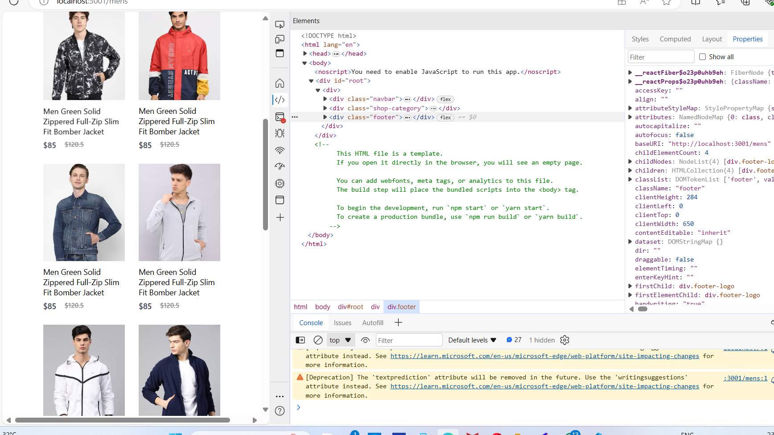
Responsive design
Mobile-Friendly UI
Productify's user interface is designed with mobile users in mind, with touch-friendly links and buttons Fonts are dynamically resized to maintain readability at different resolutions.
Mobile-First Approach
We followed a mobile-first design philosophy, prioritizing content and functionality for smaller screens first This allowed us to focus on the essentials and deliver a streamlined experience that scales up to larger devices Productify's responsive design is built on a solid foundation that adapts to the user's environment.

Slide 17
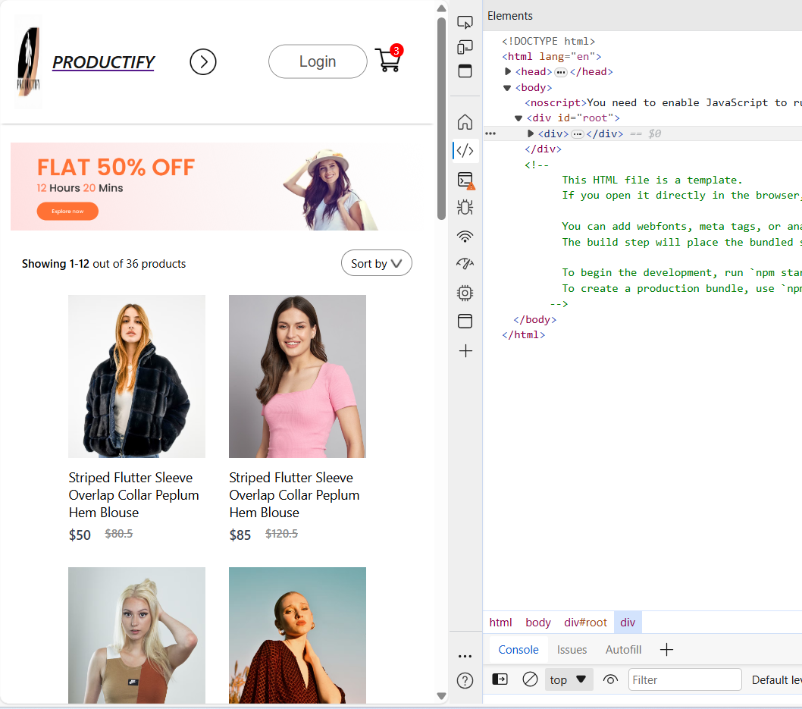
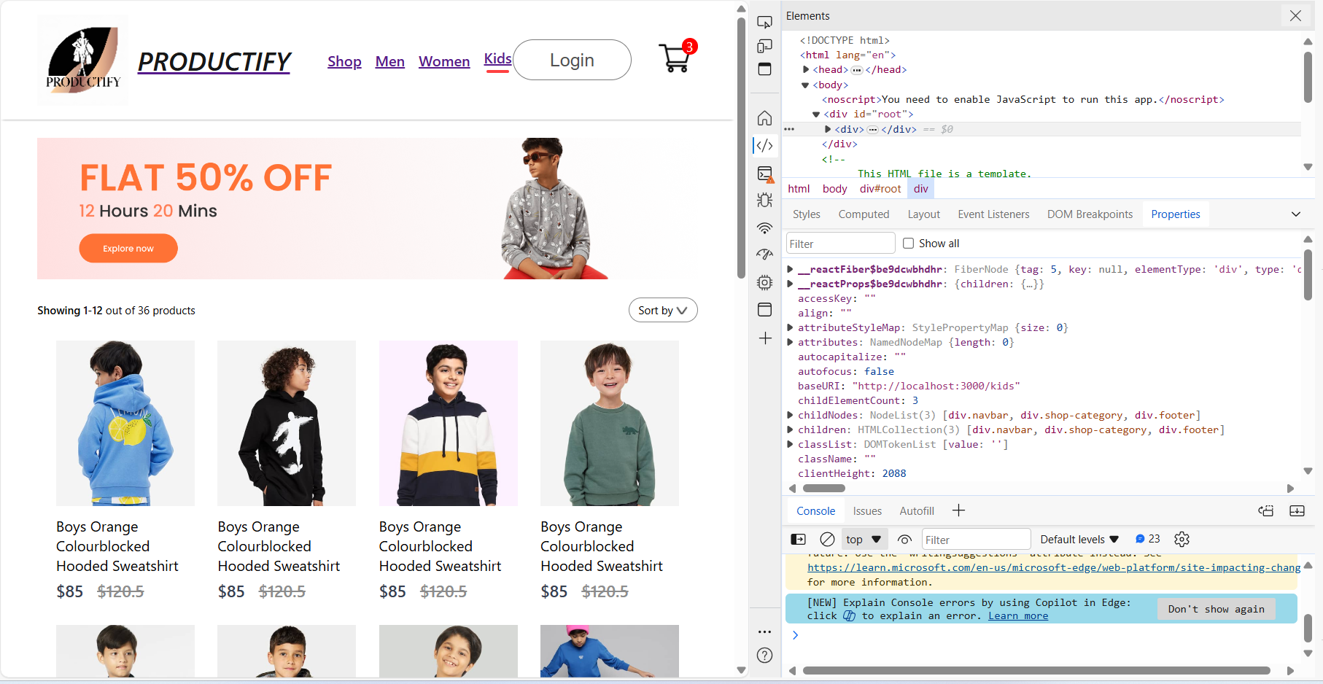
By implementing these responsive design best practices, Productify ensures that users enjoy a seamless and optimized experience regardless of the device they're using. Our mobile-friendly UI, fluid layouts, and optimized images work together to deliver the same high-quality presentation of products and services across desktops, tablets, and smartphones.

Slide 18

Shopping Cart
The shopping cart and checkout experience are critical components of the Productify e-commerce website. Customers should be able to easily add items to their cart.The shopping cart should display a summary of the items selected, including the product name, image, quantity, size, color, and total price. Customers should be able to update the quantity or remove items directly from the cart.

Slide 19
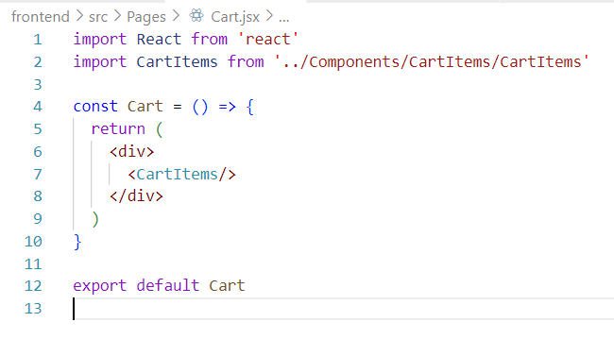
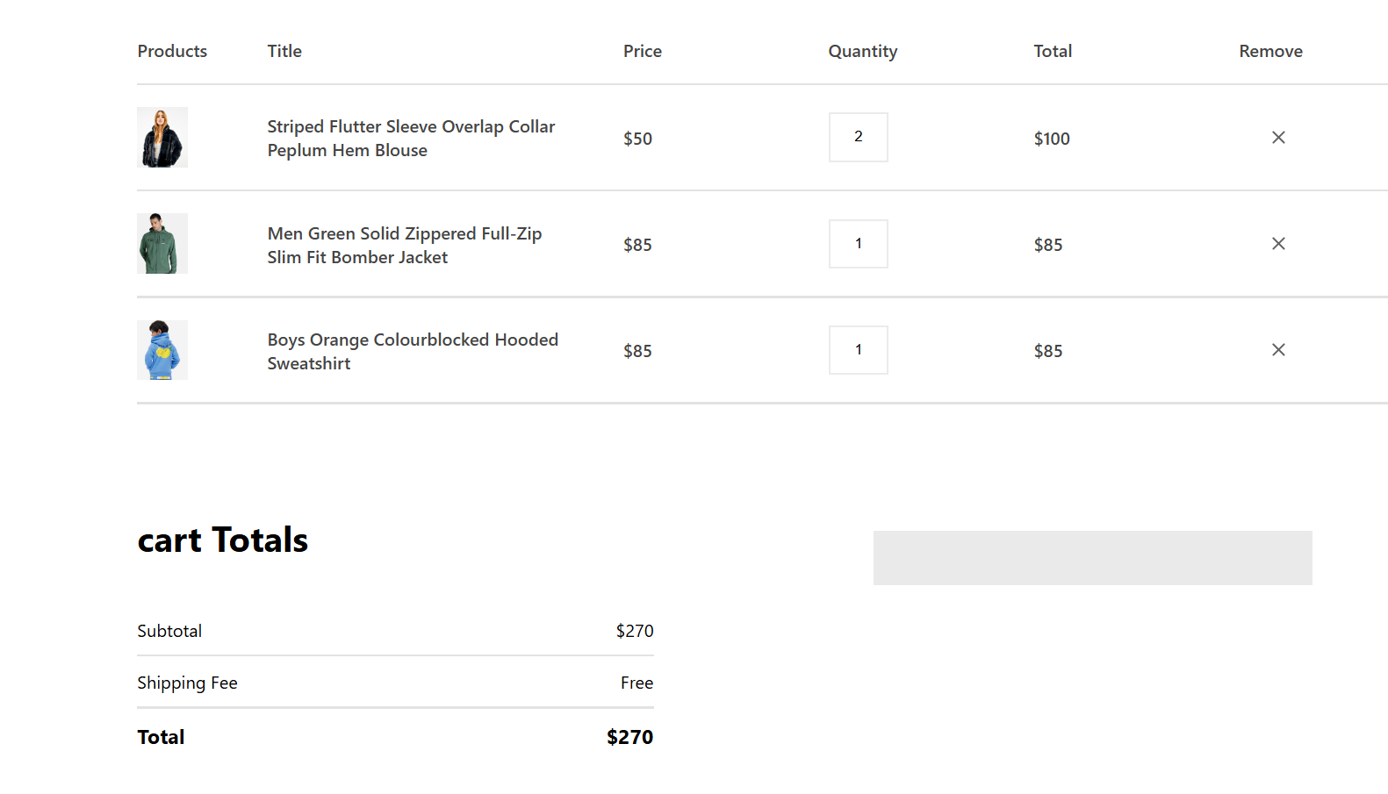
Productify’s shopping cart

Slide 20
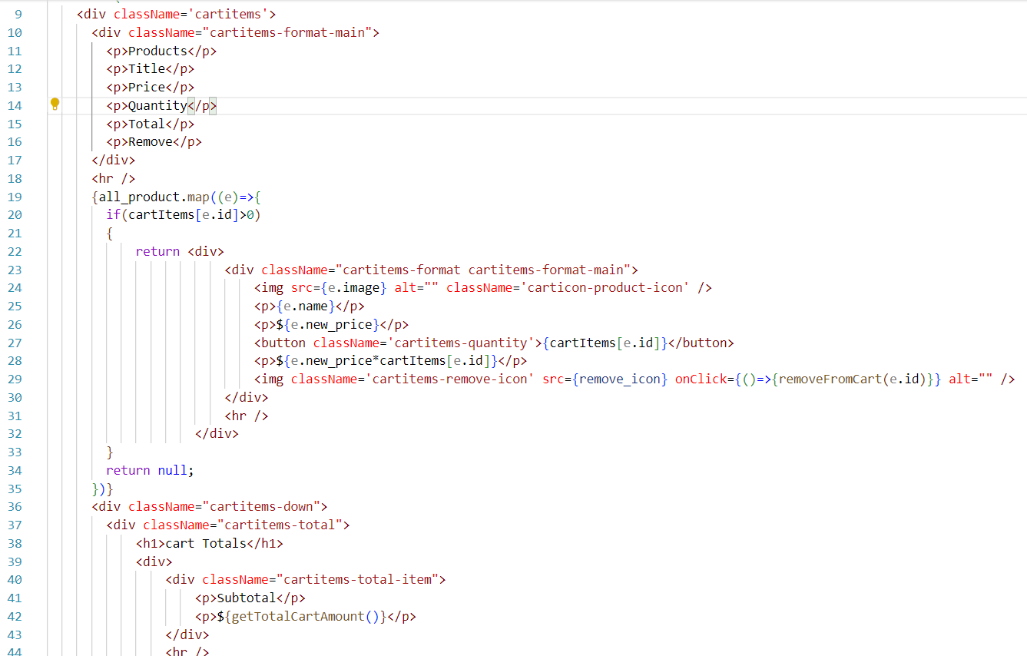
CartItems.jsx

Slide 21
Software Requirements
Languages:React JS.
Database :Mongodb
Tools/IDE: VS Code
Hardware Requirements
System Specifications: (RAM & Hard disk):8GB,128GB SSD.
Operating System: Windows.
Processor: Intel Core i3/i5.
Conclusion and Next Steps
In conclusion, the Productify e-commerce website has been designed and developed to provide a seamless and enjoyable shopping experience for customers. By incorporating a comprehensive set of features, such as user registration and accounts, a robust product catalog, a user-friendly shopping cart.
As we look to the future, the Productify team is committed to continually improving and expanding the website's offerings. This includes exploring new product categories, enhancing the personalization and recommendations features.

Slide 22
THANK YOU

