Slide 1
CREDIT EDA ASSIGNMENT
By Soumyashree Behera

Slide 2
Content
Problem Statement
Approach Used
Steps Followed
Data Analysis Reports
Conclusions

Slide 3
Problem Statement
The loan providing companies find it hard to give loans to the people due to their insufficient or non-existent credit history. Because of that, some consumers use it to their advantage by becoming a defaulter. Suppose you work for a consumer finance company which specializes in lending various types of loans to urban customers. You have to use EDA to analyze the patterns present in the data. This will ensure that the applicants capable of repaying the loan are not rejected.

Slide 4
Approach Used
Analyzing and understand the application_data.csv dataset which contains all the information of the client at the time of application.
Perform cleaning of the 1st dataset by applying various techniques.
Analyzing and understand the previous_application.csv dataset which contains information about the client’s previous loan data.
Perform cleaning of the 2nd dataset by applying various techniques.
Merge both of the above data set and understand the compete dataset.

Slide 5
Steps Followed
Understanding the variables.
Import the data sets.
Verify the structure of the data set.
Validate the missing value.
Dropping irrelevant columns.
Validation of outlier.
Imputing the values (if needed).
Performing Univariant Analysis.
Performing Segmented Univariant Analysis.
Performing Bivariant Analysis.

Slide 6
Data Analysis Reports

Slide 7
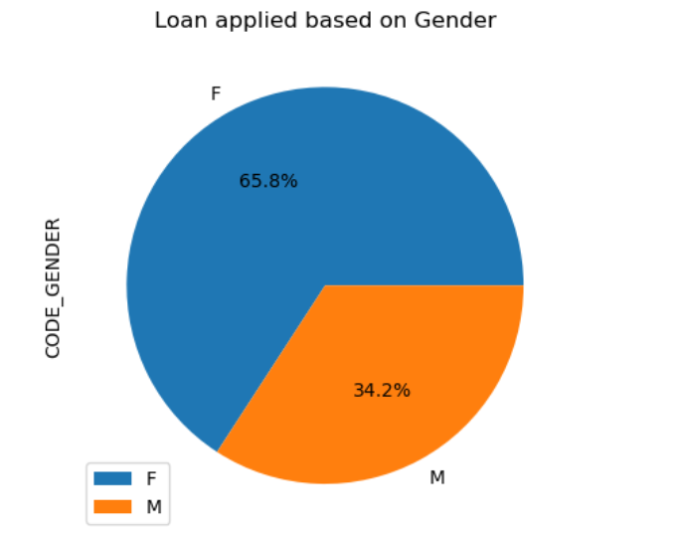
Data Imbalance based on Gender
In the chart we see that percentage of females is more.
So more females have applied for the loan.

Slide 8
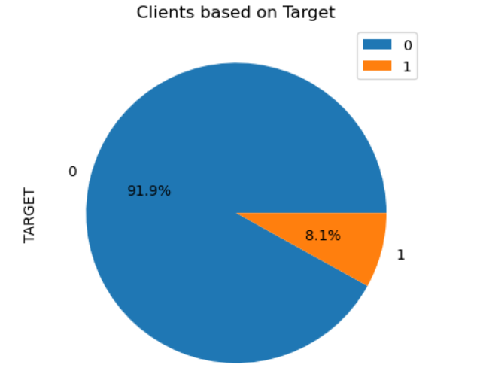
Data Imbalance based on Target
In the chart we see that percentage of clients paying loan properly is more.
Hence more clients are non-defaulters.
Clients with pay difficulties are less as compared to clients will no payment difficulties.

Slide 9
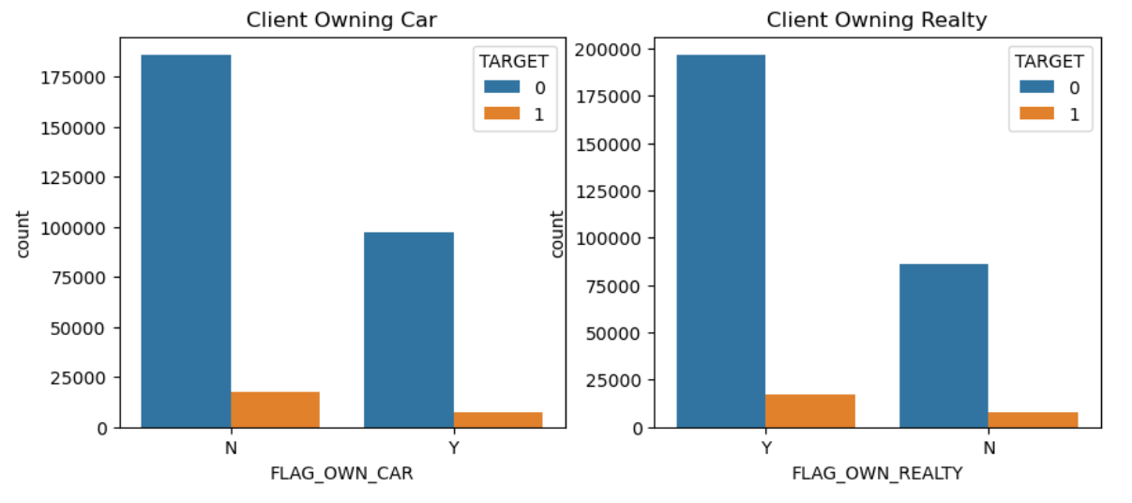
Clients owning car vs Clients owning house
Considering the above chart Clients who don't have car are paying the loan properly.
Clients who own the House are paying the loan properly.
Hence Clients who own house but not car have no payment difficulties.

Slide 10
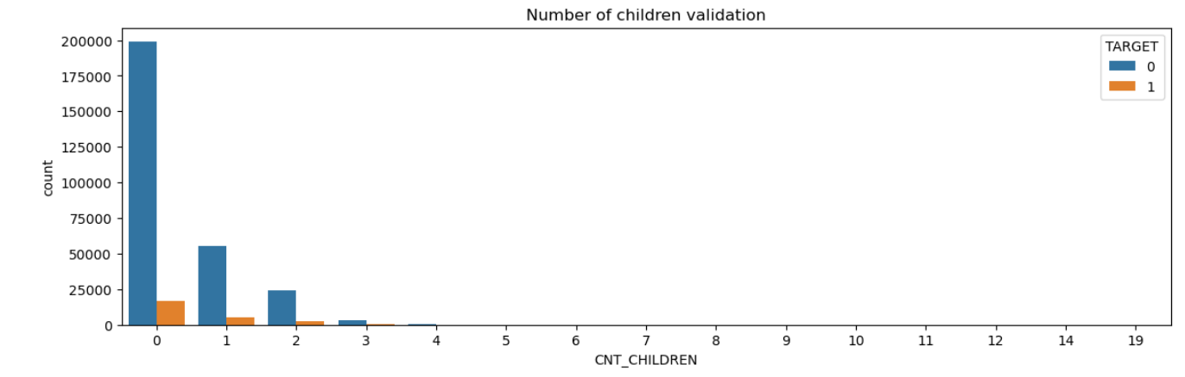
Analysis based on CNT_CHILDREN
Considering the above chart, zero children are more for the one’s who paid loan properly.
Hence, clients having no children are paying the loan properly.

Slide 11
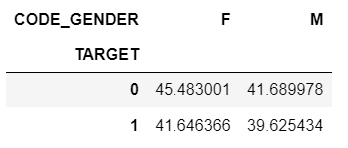
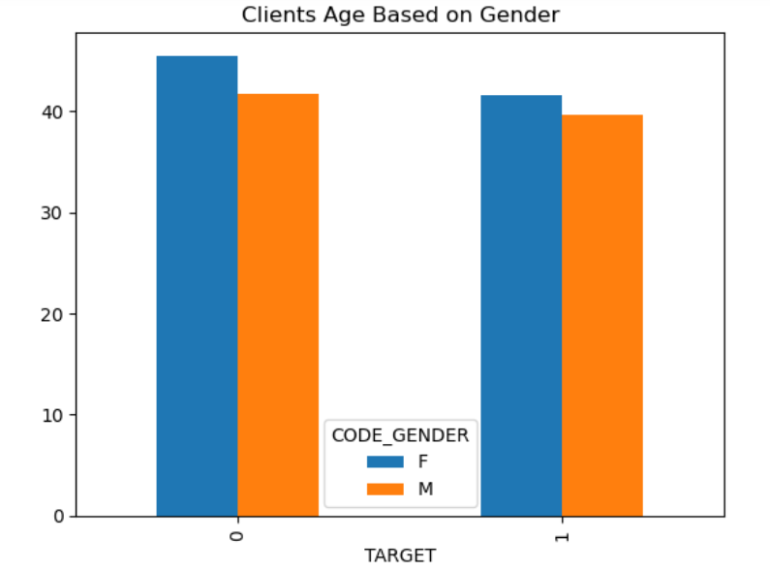
Clients Age Based on Gender
Female population are more who are paying the loan properly.

Slide 12
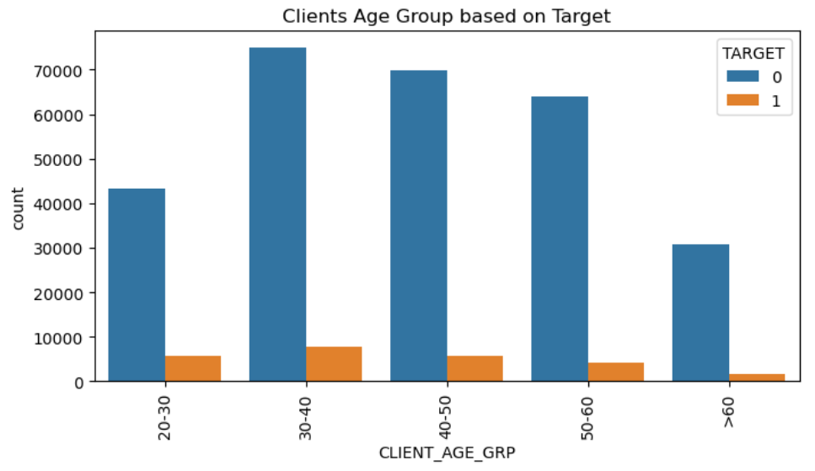
Clients Age Group based on Target
Based on the above chart, we see that 30-40 range have more clients who pays the loan properly.
Hence, majority of clients with age group of 30-40 are paying the loan properly.

Slide 13
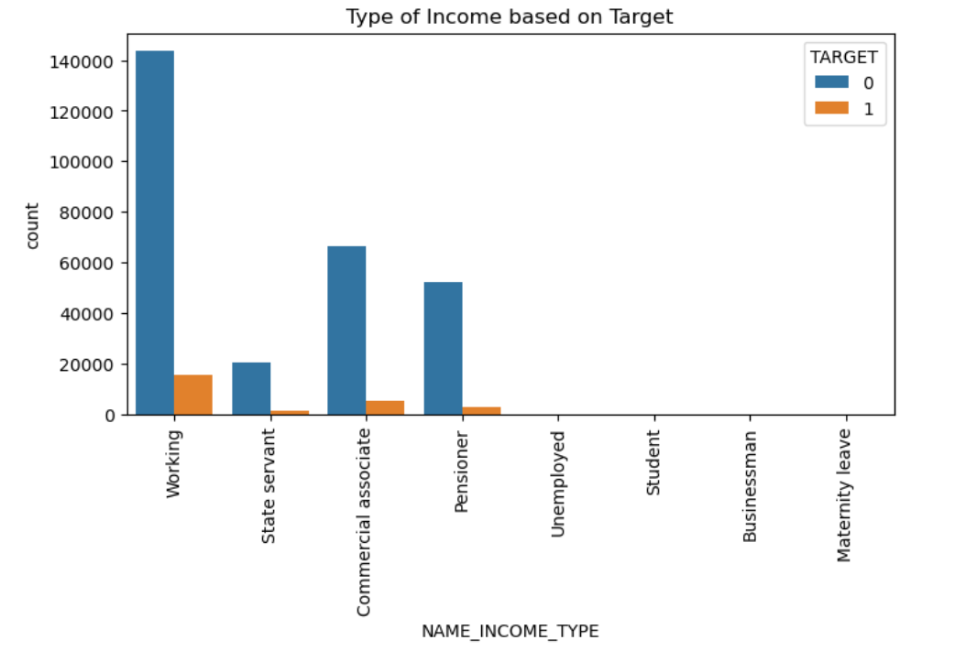
Type of Income based on Target
Based on the above chart, we see that working clients are more.
Hence, working peoples are paying the loans properly.

Slide 14
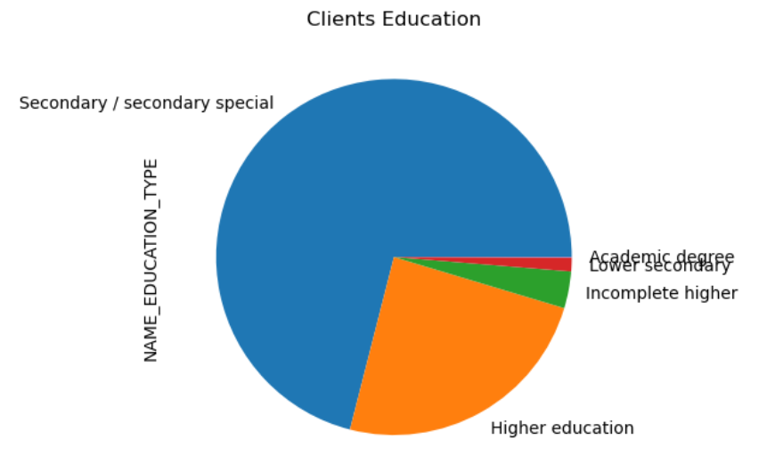
Clients Education
Based on the above chart we see that clients who have education type as 'Secondary/Secondary Special' have taken more loans.

Slide 15
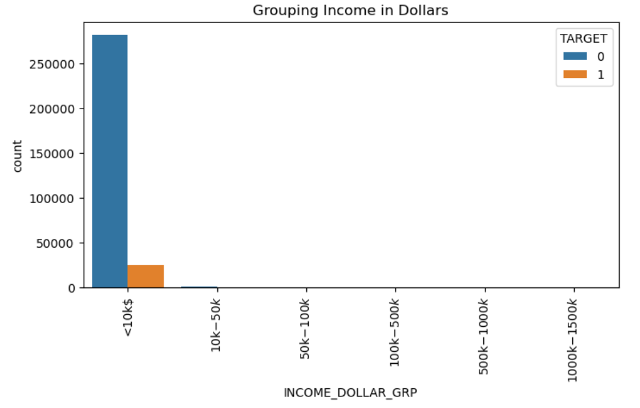
Clients Income Range
NOTE: Amount is converted to dollar ( 1dollar=81 rupees)
Based on the above chart we see that clients having Income range less than 10000 dollar are the one’s who were paying of loans properly.

Slide 16
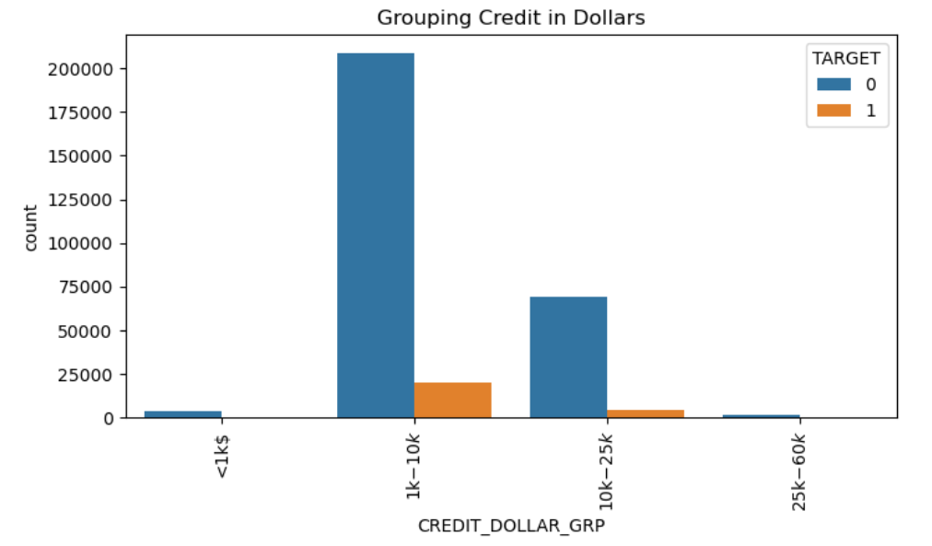
Grouping Credit in Dollars
NOTE: Amount is converted to dollar ( 1dollar=81 rupees)
Based on the above chart we see that many clients have taken credits between 1000 to 10000 dollars are the one's who were paying off the loan properly.

Slide 17
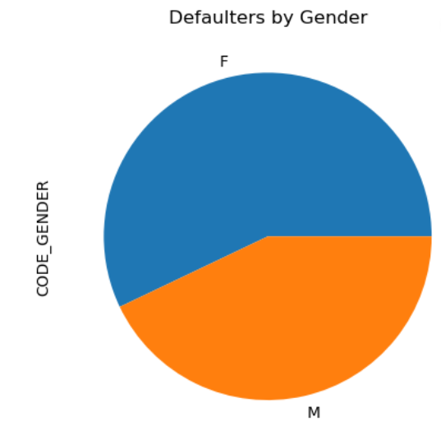
Defaulters by Gender
Based on the above chart we see that more females compared to male are having difficulties in paying the loan.

Slide 18
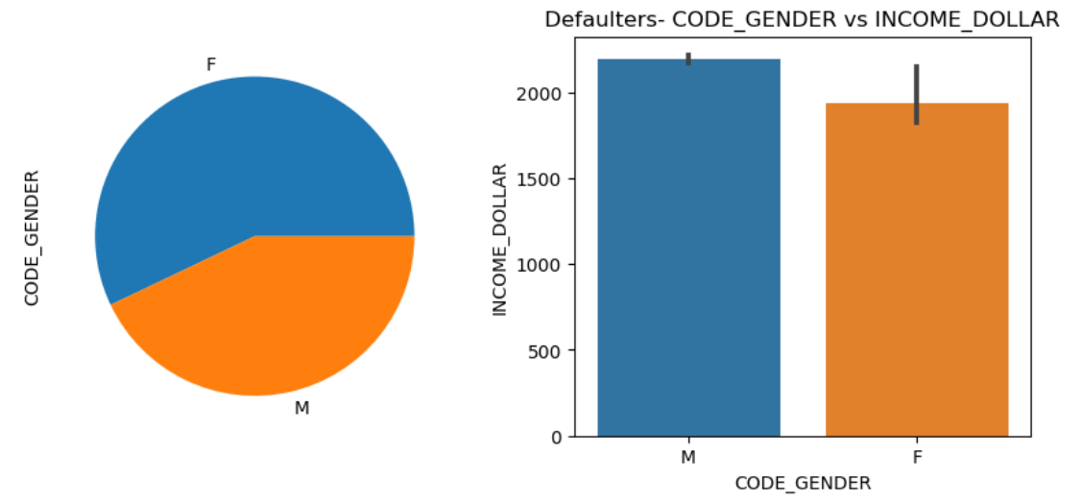
Defaulters- CODE_GENDER vs INCOME_DOLLAR
Based on the above chart we see that males who income more are the defaulters and females who paid less have difficulties in paying off the loans.

Slide 19
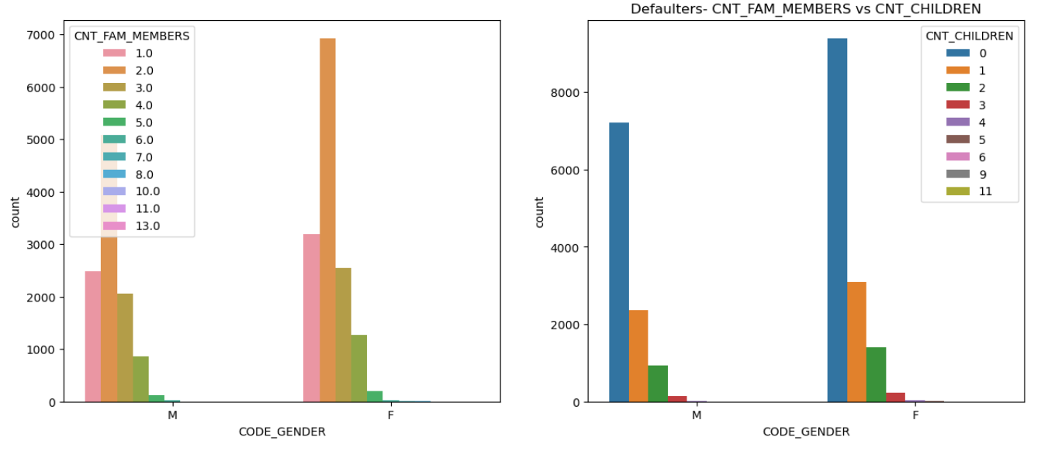
Defaulters- CNT_FAM_MEMBERS & CNT_CHILDREN columns
Based on the above chart we see that clients having 2 family members without children are the defaulters.

Slide 20
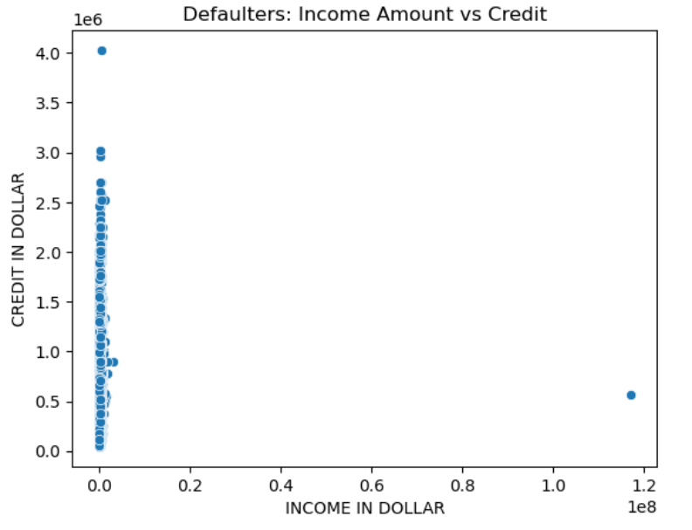
Defaulters: Income Amount vs Credit
Based on the above chart we see that clients with low income range peoples are more defaulters.

Slide 21
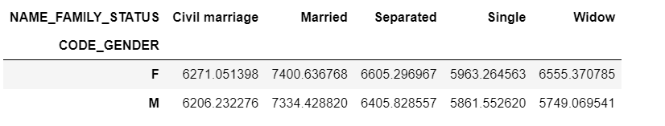
Defaulters: Family Status and Gender based on Credit Dollars
Based on the above chart we see that married male and married female were having difficulties in paying the loan.

Slide 22
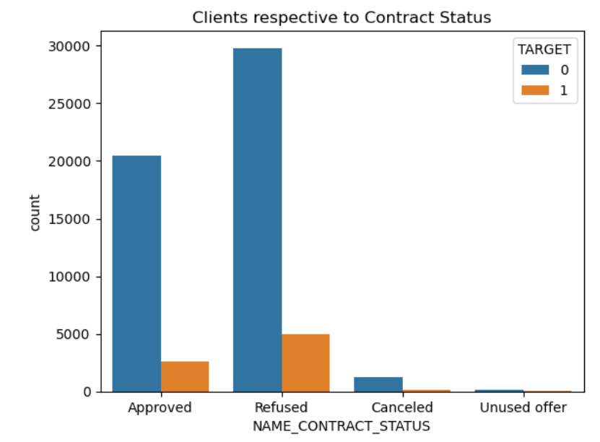
Merged Dataset- Clients respective to Contract Status
Based on the above chart we see that clients whose previous application was refused are the most defaulters.

Slide 23
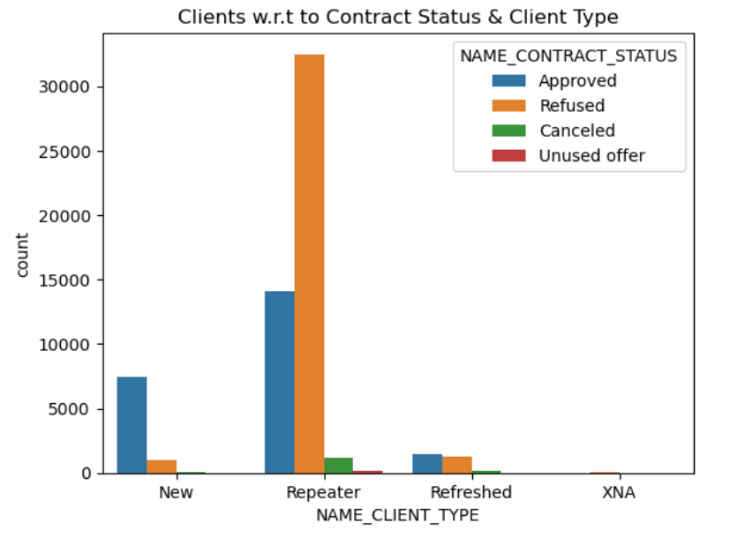
Merged Dataset- Clients w.r.t to Contract Status & Client Type
Based on the above chart we see that repeaters client are more whose loan is refused.

Slide 24
Conclusions
More Females have applied for loan.
Clients with pay difficulties are less as compared to clients will no payment difficulties.
Clients who own house but not car have no payment difficulties.
Clients having no children are paying the loan properly.
Female population are more who are paying the loan properly.
Majority of clients with age group of 30-40 are paying the loan properly.
Working peoples are paying the loans properly.
Clients who have education type as 'Secondary/Secondary Special' have taken more loans.
Clients having Income range less than 10000 dollar are the one’s who were paying of loans properly.
Many clients have taken credits between 1000 to 10000 dollars are the one's who were paying off the loan properly.
More Females compared to men are having difficulties in paying the loan.
Males who income more are the defaulters and females who paid less have difficulties in paying off the loans.
Clients having 2 family members without children are the defaulters.
Clients with low Income range peoples are more defaulters.
Married Male and Female were having difficulties in paying the loan.
Clients whose previous application was refused are the most defaulters.
Repeaters client are more whose loan is Refused.

