Slide 1
Department of MCA
Slide 1: PROJECT TITLE Under the Guidance of Dr/Mr/Mrs
By :
Student Name
Roll No.
Dept. of MCA. KL University.

Slide 2
Slide 2: – Problem Statement -Clearly define the problem -Existing issues / limitations -Why this problem needs a solution

Slide 3
Slide 3 :
– Scope of the Project
What the system covers
What is not included
Target users

Slide 4
Slide 4 – Proposed Solution
Overview of your solution → how it solves the problem
Key features
Innovation / uniqueness (if any)

Slide 5
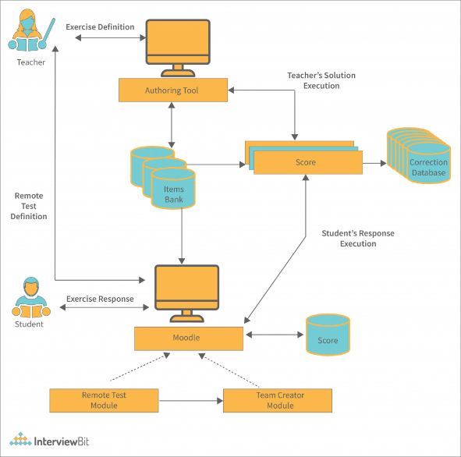
Slide 5 : – System Architecture -Components explanation -Data flow overview

Slide 6
Slide 6 – Technologies Used
Frontend
Backend
Database
Tools & Libraries

Slide 7
Slide 7 – Module Description
Module 1 – description
Module 2 – description
Module 3 – description

Slide 8
Slide 8 – Implementation Status
Completed modules
Current progress (%)
Screenshots (if available)

Slide 9
Slide 9 – Conclusion
Project summary
Achievements

