Slide 1
Department of MCA
A Cloud-Deployed Intelligent Web Platform for Automated Resume Creation and Optimization Using MERN Stack Under the Guidance of Dr Venkat Ramana
By :
Bommineni Soumya
2401600010
Dept. of MCA. KL University.

Slide 2
PROBLEM STATEMENT
Creating a professional resume manually is time-consuming
Students and job seekers lack proper guidance for content and formatting
Existing resume tools offer limited customization and automation
There is a need for an intelligent, cloud-based system to simplify resume creation

Slide 3
SCOPE OF THE PROJECT
What the system covers:
User registration and secure authentication
Manual and PDF-based resume creation
Content enhancement and customization
Public resume sharing and PDF download
What is not included:
Mobile application version
Enterprise-level integrations
Target users:
Students
Job seekers
Working professionals

Slide 4
PROPOSED SOLUTION
A cloud-based intelligent web application for resume creation
Automates resume formatting and content enhancement
Provides real-time preview and customization options
Key Features:
Template selection and color customization
PDF upload and data extraction
Cloud deployment for accessibility
Uniqueness:
Combines automation, cloud deployment, and intelligent content optimization

Slide 5
SYSTEM ARCHITECTURE
Components:
Frontend: React-based user interface
Backend: Node.js and Express API services
Database: MongoDB Atlas
Cloud: Vercel deployment
Data Flow:
User inputs resume data
Backend processes and stores data
Enhanced content returned to frontend
Final resume rendered and shared

Slide 6
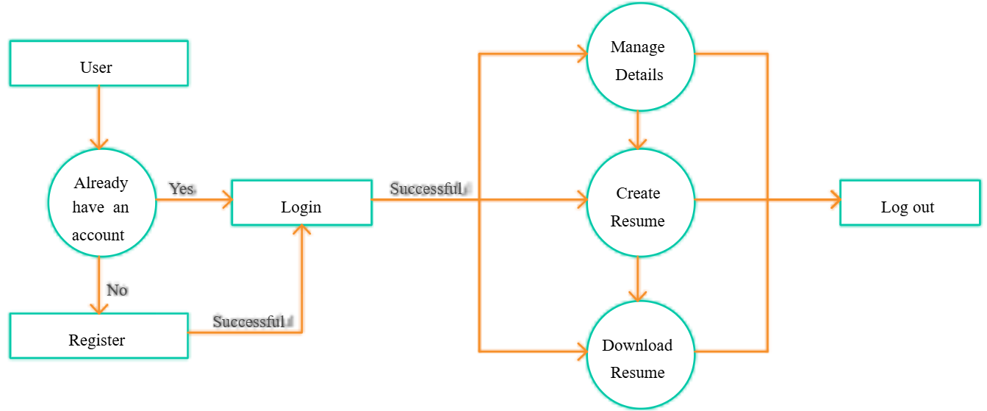

Slide 7
TECHNOLOGIES USED
Frontend:
React.js
Tailwind CSS
Redux Toolkit
Backend:
Node.js
Express.js
Database: MongoDB Atlas
Tools & Libraries:
JWT Authentication
ImageKit
Vercel Cloud Platform

Slide 8
MODULE DESCRIPTION
Module 1: User Management
User registration and login
Secure authentication
Module 2: Resume Builder
Section-wise resume creation
Live preview and customization
Module 3: Sharing & Export
Public resume link generation
PDF download functionality

Slide 9
IMPLEMENTATION STATUS
Completed Work:
User Interface (UI) design for core components
Login and Registration page UI
Resume Builder layout design
Template selection UI components
Current Progress:
UI design phase completed
Implementation phase yet to start
Overall progress: 30–40%

Slide 10
CONCLUSION
Developed an intelligent cloud-based resume builder
Simplifies resume creation for students and professionals
Demonstrates practical use of MERN stack and cloud deployment
The project is scalable, feasible, and industry-relevant

Slide 11
THANK YOU!

