Slide 1
Department of MCA
A Cloud-Deployed Intelligent Web Platform for Automated Resume Creation and Optimization Using MERN Stack Under the Guidance of Dr. Venkat Ramana
By :
Student Name: B. Soumya
Roll No: 2401600010
Dept. of MCA. KL University.

Slide 2
User Interface Development
Login page with validation
Registration page with secure input handling
Dashboard for resume management
Resume creation form
Resume upload feature
Navigation menu

Slide 3
Algorithm / Logic Implementation
JWT-based authentication logic
Password hashing using bcrypt
Resume CRUD operations
User-specific resume mapping
File upload handling logic

Slide 4
Database Design
Collections:
Users
Resumes
Highlights:
One User → Multiple Resumes (One-to-Many relationship)
Resume documents stored in structured JSON format
Passwords hashed using bcrypt
Indexed fields for faster retrieval

Slide 5
Integration
Frontend successfully connected to backend APIs
Authentication middleware validates JWT tokens
Resume creation and upload integrated with MongoDB
Login, Logout, and Registration fully functional

Slide 6
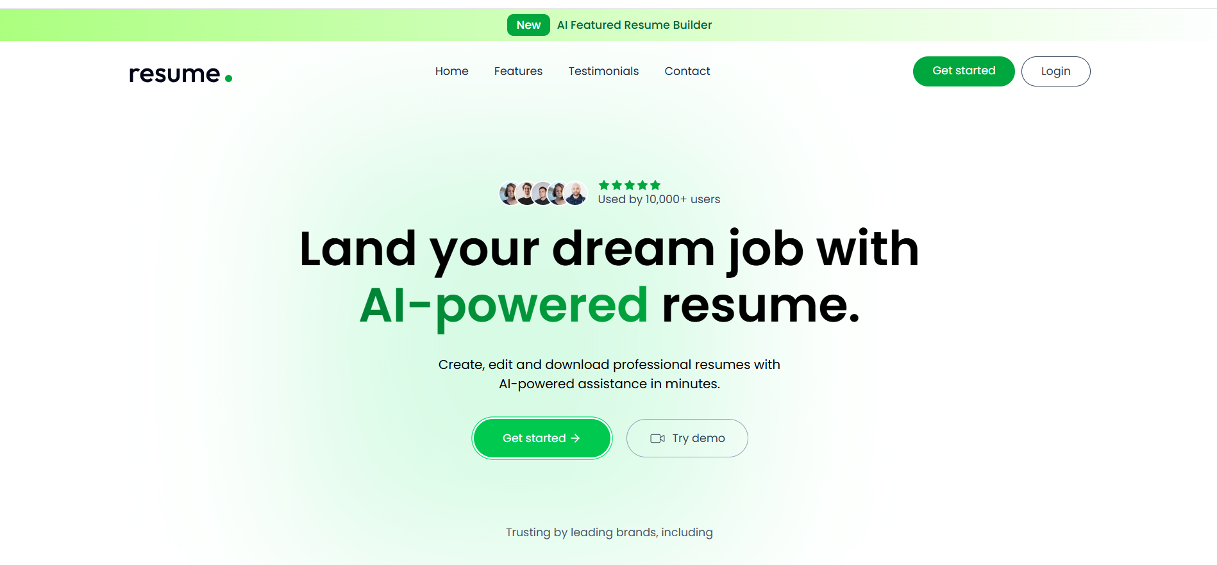

Slide 7
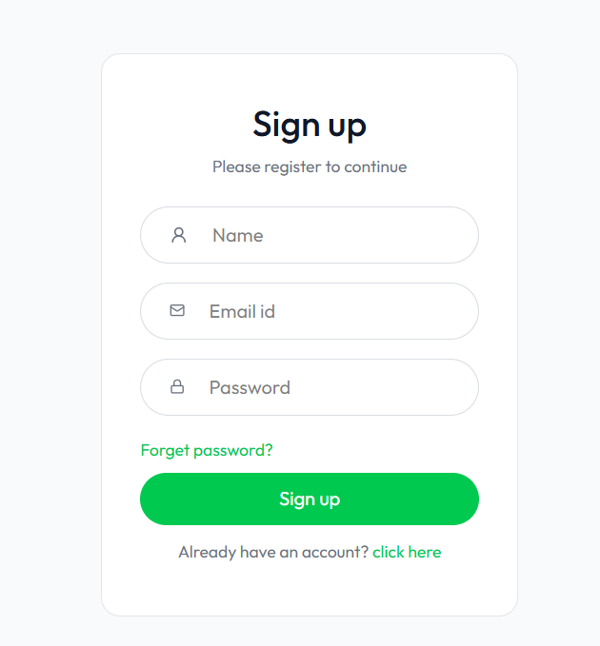
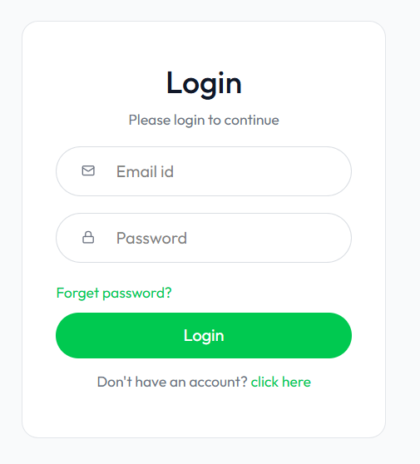

Slide 8
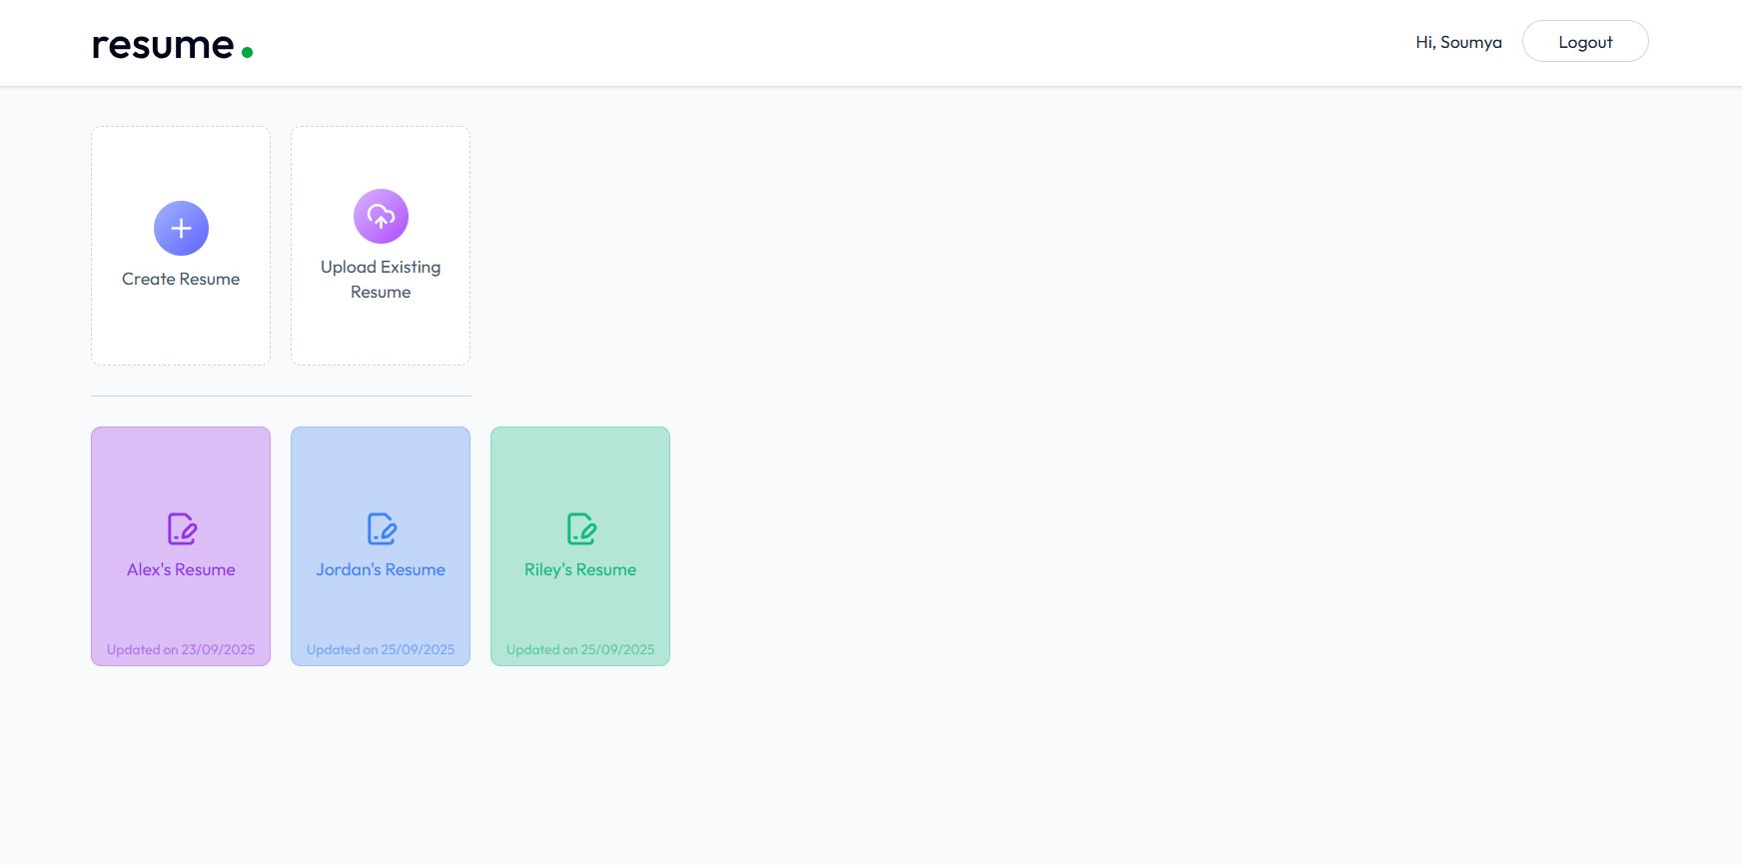

Slide 9
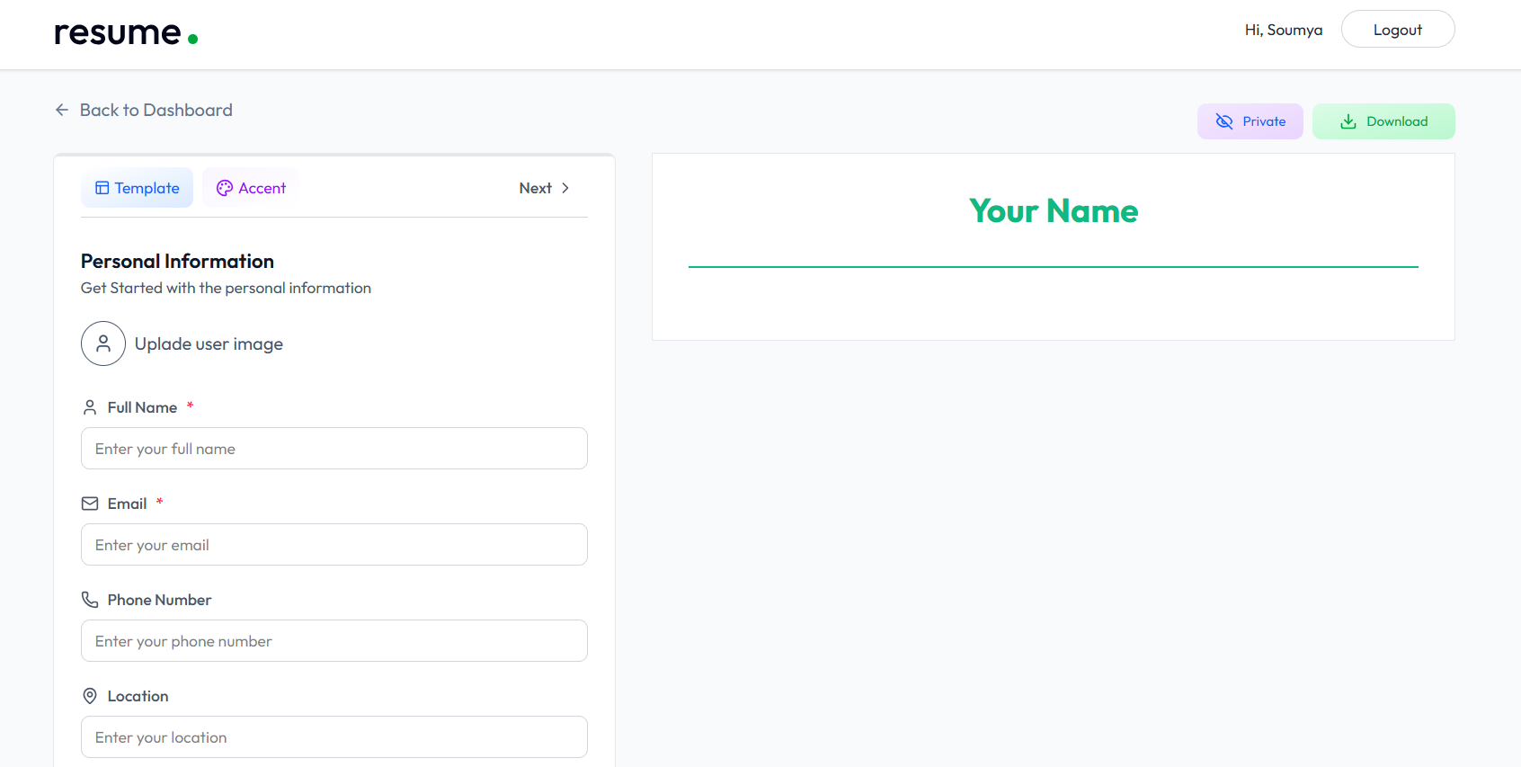

Slide 10
Results & Output
Users can register and login securely
Users can successfully create and upload resumes
Data saved and retrieved from database
Templates applied dynamically

Slide 11
Challenges Faced
Implementing secure JWT authentication
Managing frontend-backend communication
Handling file upload integration
Designing scalable MongoDB schema

Slide 12
Future Enhancements
Advanced AI content suggestions
Recruiter dashboard

Slide 13
Conclusion
Authentication and Resume management completed
Secure and scalable architecture implemented
System ready for advanced feature enhancement
80 percent of the project completed

Slide 14
Thank you…

