Slide 1


< LPG Gas Leak Detection System>
Group Coursework Presentation Slide
CC5068NI - Cloud Computing and the Internet of Things
Section: L2C18
Team: 4
London Met ID | Student Name
23056356 | Soumyata Shakya(Leader)
23056253 | Krijal Maharjan
23057134 | Manish Jung Adhikari
23056292 | Prabhat Lamichhane
23056254 | Krish Bhandari

Slide 2
Introduction
The Internet of Thing (IoT) is network of physical devices that can transfer data to one another without human intervention. IoT devices are not limited to computers or machinery. This can include anything with a sensor that is assigned a unique identifier (UID). IoT based projects are created to mitigate problems and make things convenient, secure and comfortable. The primary goal of the IoT is to create self-reporting devices that can communicate with each other (and users) in real time.
We are entrusted to build a useful IoT project hence, ‘LPG Gas Leak Detection System’ is based upon an IoT device. In this project, we propose an upgraded LPG Gas Leak Detection System using MQ-2 gas sensor which can detect not only LPG but also gases such as Alcohol, Propane, Hydrogen, Methane and Carbon Monoxide hence, is suitable for detecting all these gases. The other required component used to build this system are Arduino Uno, Servo Motor, LCD Display, LED lights Breadboard, Powerbank, Active Buzzer and Jumper wires. This technology reduces potential accidents such as fires, explosions and suffocation by alerting and producing audible sounds or continuous beeping sounds when an electrical signal is applied until it returns to a normal state and automatically turn-off the valve of the regulator and is mostly designed to use for domestic purposes.

Slide 3
System Demonstration
The components that we have used in this Gas detection project are Arduino UNO, LCD Display, MQ-2 sensor, Active Buzzer, Servo motor, Breadboard, Powerbank, LED lights and Jumper wires. We have connected all the parts using jumper wires in a breadboard. Every component communicates with and receives electricity from the Arduino. Arduino is used to connect with breadboard, Buzzer, Servo motor. MQ-2 sensor and LCD Display are connected to breadboard which then connects to Arduino.
Initially, we specified the pins each Arduino component would have. Jumper wires are used to link the output pins of the MQ-2 gas sensors to the corresponding pins on the Arduino through breadboard, allowing us to obtain the necessary data. LCD display continuously gets the information about current Gas level from Arduino and displays the information and if the gas level increases more than or equals to 10% then, Red LED turns on and then after when it returns to it’s normal state, Green LED turns on. Buzzer and Servo motor receive instructions on when to turn on and off using the pins of Arduino and alert the user by alerting sound. The breadboard is linked to Arduino's ground and 5 voltage power supply pins in accordance with arrangement, provides a complete power supply to all the components.

Slide 4
Individual Contribution (WBS)
LPG Gas Leak Detection System
Soumyata Shakya
Krijal Maharjan
Manish Jung Adhikari
Overall Report Making
Designing of the project
Report Formatting
Flowchart
Prabhat Lamichhane
Krish Bhandari
Background and System Overview
Block Diagram, Circuit Diagram and Schematic Diagram
System Development
Future works and Planning
Made hardware component
Idea of the project
Made hardware component
System Development
Testing
Testing
Doing the overall project
Reviewing the code
Doing the overall project
Research of the project
Doing the overall project
Result and Finding
Doing the overall project
Doing the overall project

Slide 5
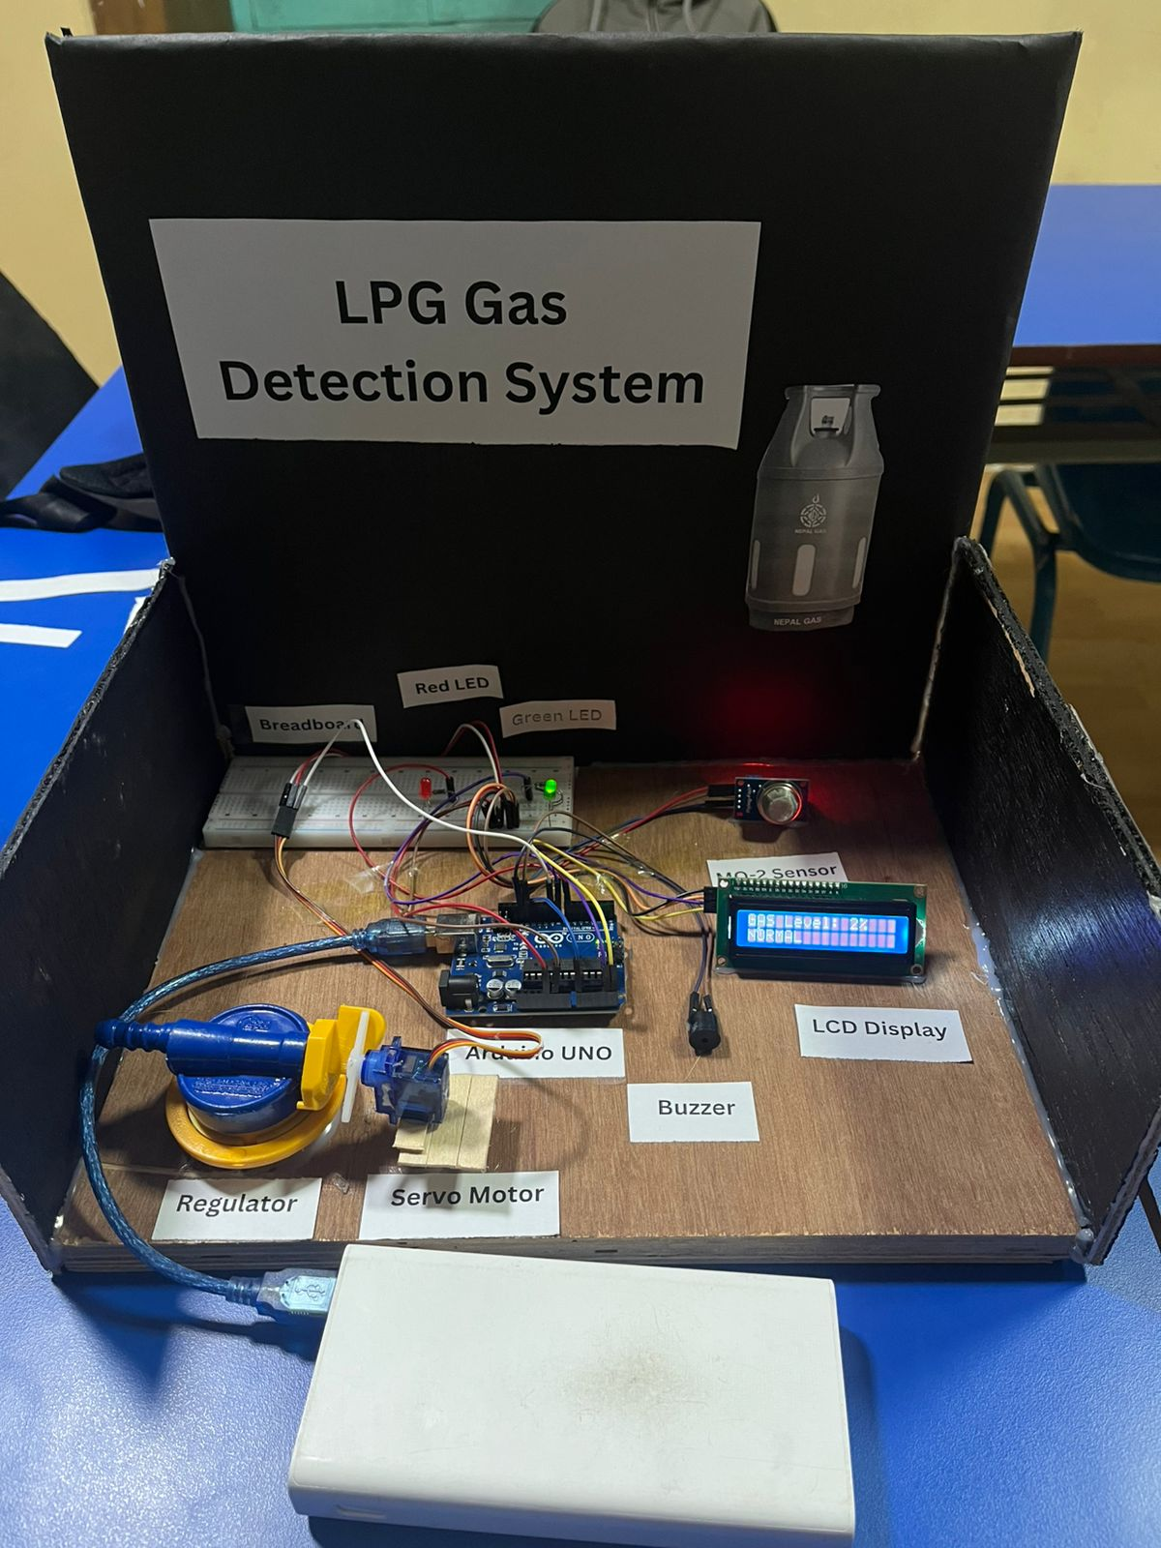
Picture of the Project

Slide 6

Your Feedback Matters!

Slide 7
Thank You

