Slide 1
Novartis/PROTECT adjuvant RCC analysis

Slide 2
DATA 14 samples with disease-free survival (DFS) < 1 year (Short) 50 samples with disease-free survival ~5 years (Long) Sample collection time point- 8 weeks after surgery
We are trying to classify Short vs Long DFS MeDIP samples using
Classification using Tissue Naïve Leave Out Approach
Classification using Tissue Limited Leave Out Approach
Compare rpkm boxplots of Long vs Short samples at Tissue DMRs
Compare Relative Methylation Scores in Short vs Long plasma samples
The classification accuracy was 0.5 for both the models.
Rpkm boxplots of the plasma samples do not have a significant difference in the mean values at the Tissue sites
None of the techniques classified Short vs Long Plasma samples effectively

Slide 3
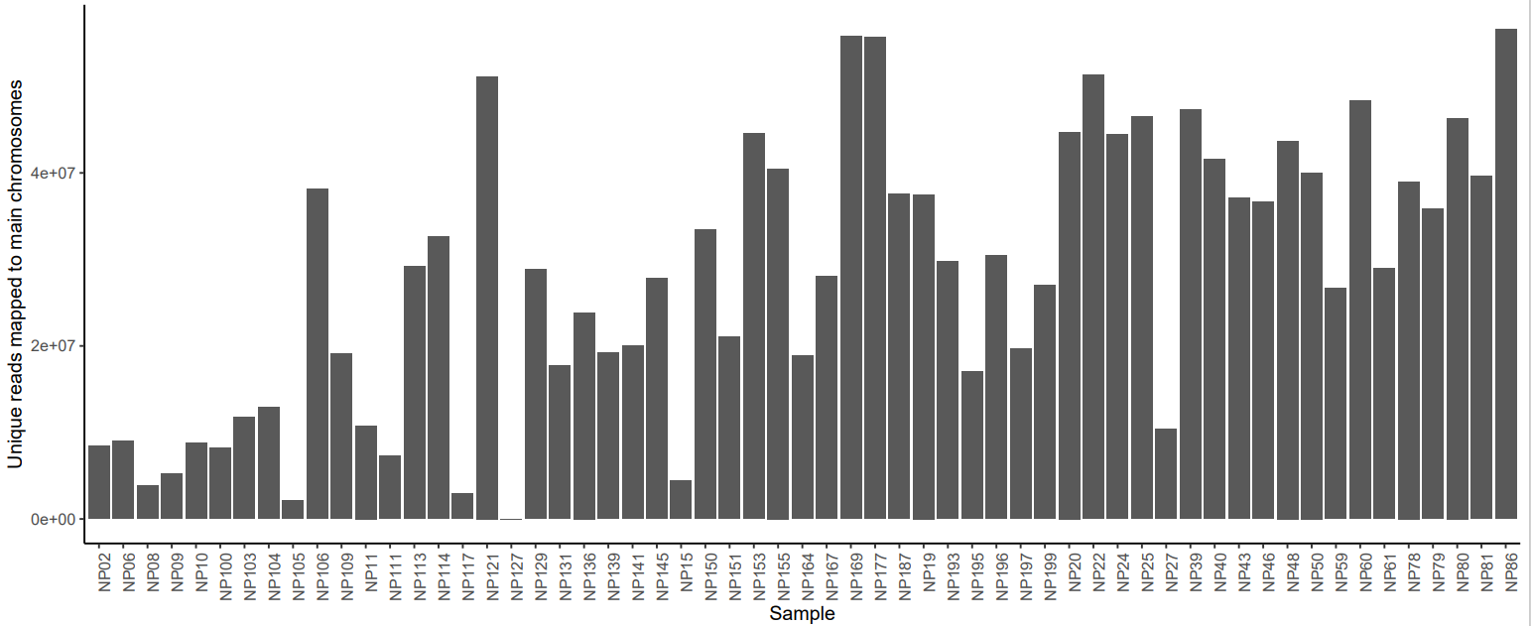
QC Plots Main Chr Unique reads
Removed Samples NP127, NP15, NP105, NP117 from further analyses

Slide 4
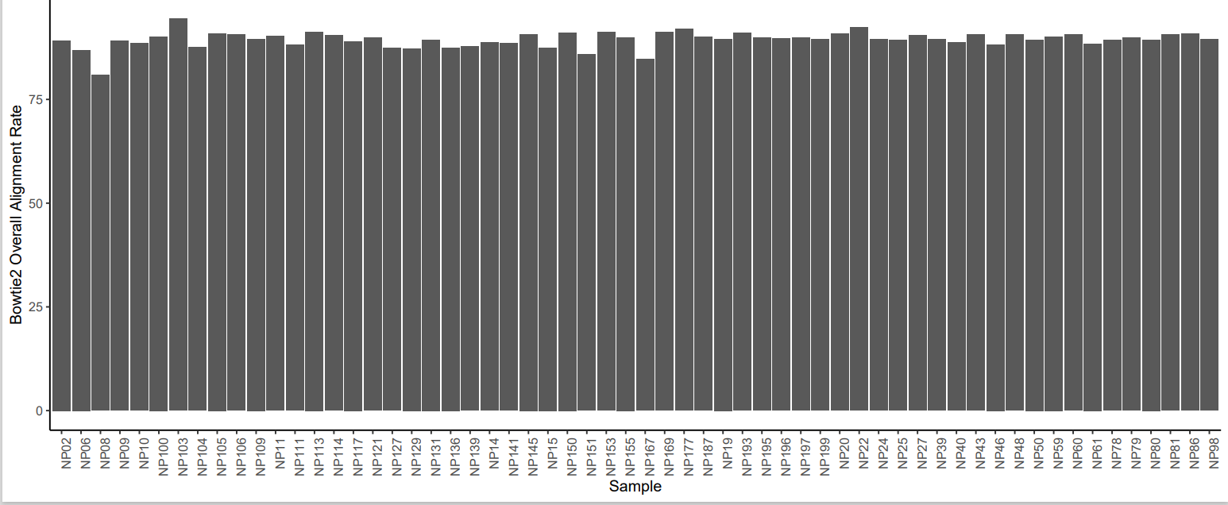
Alignment Rate

Slide 5
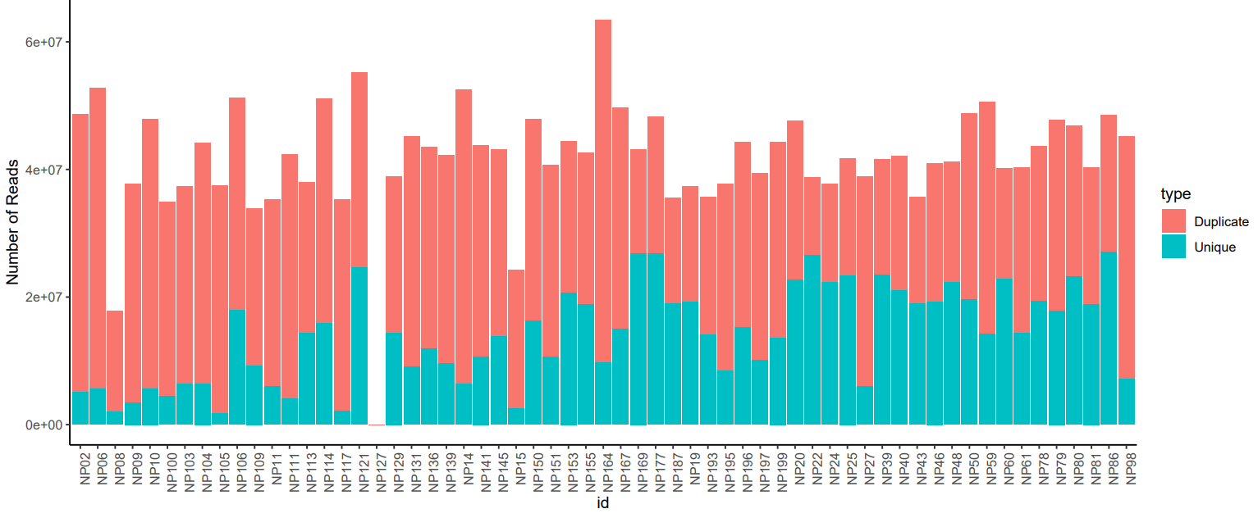
Duplication plot

Slide 6
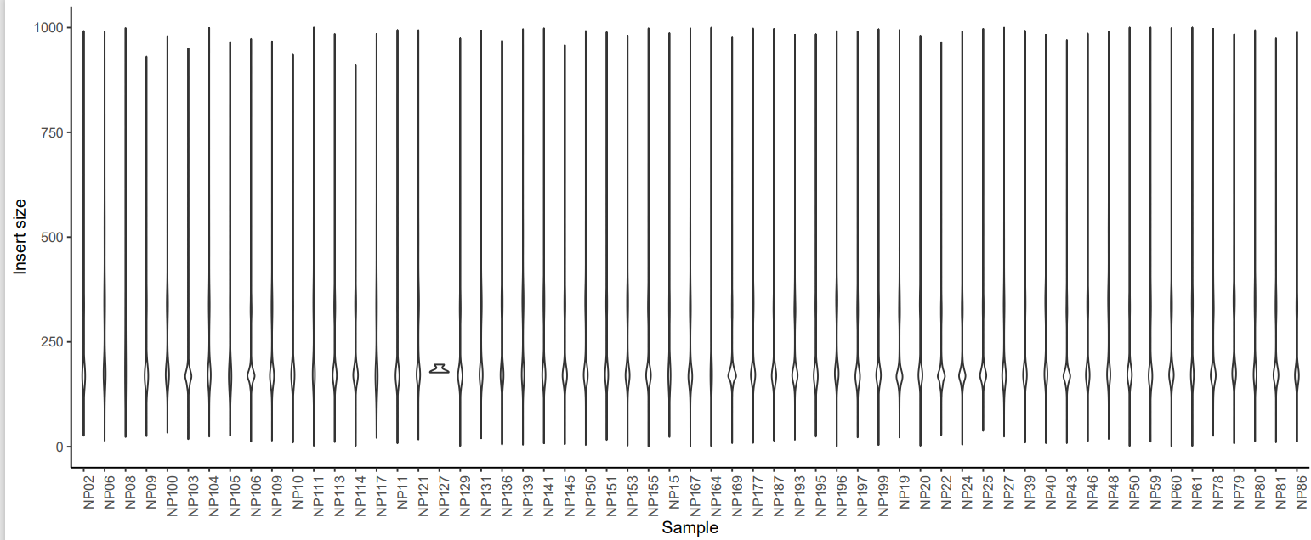
Insert sizes

Slide 7
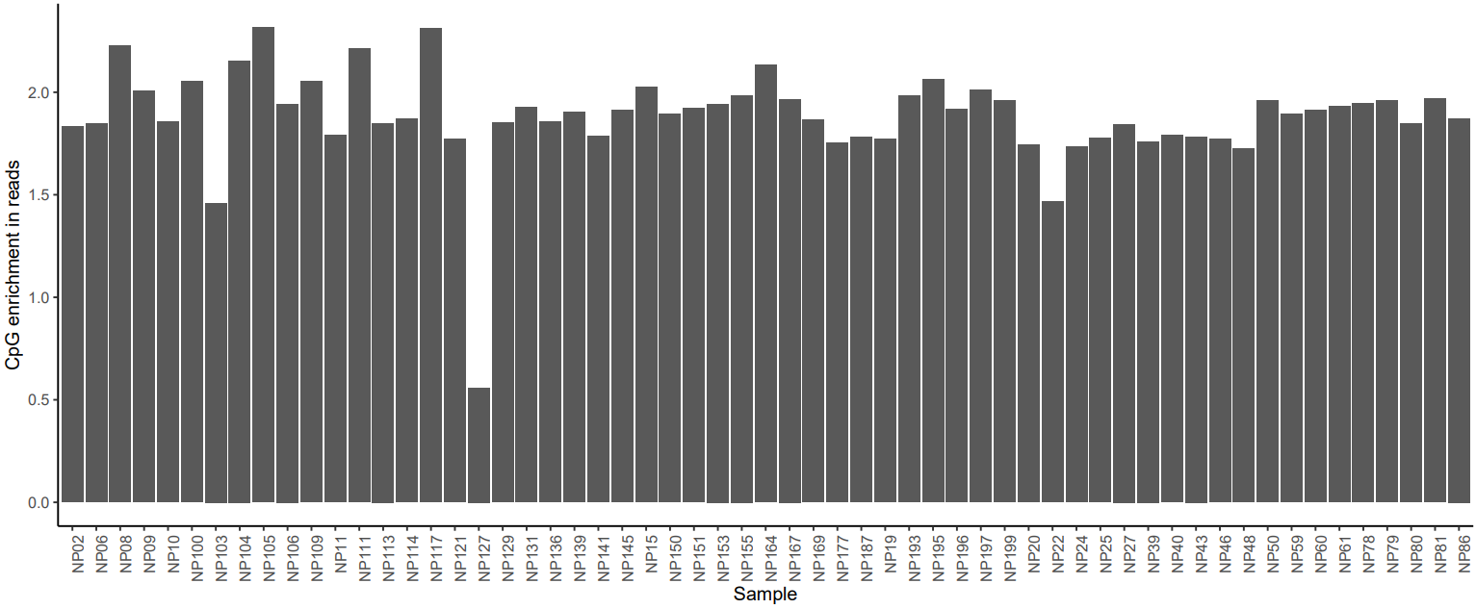
CpG Enrichment

Slide 8
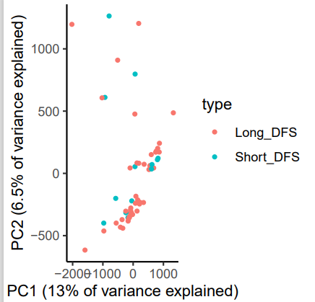
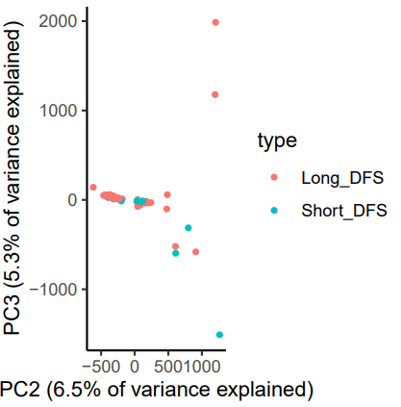
Principal Component Analysis

Slide 9
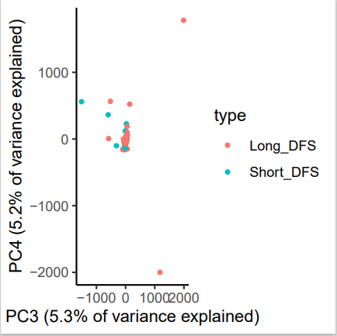
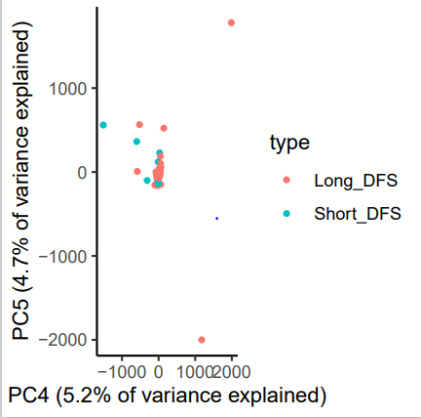

Slide 10
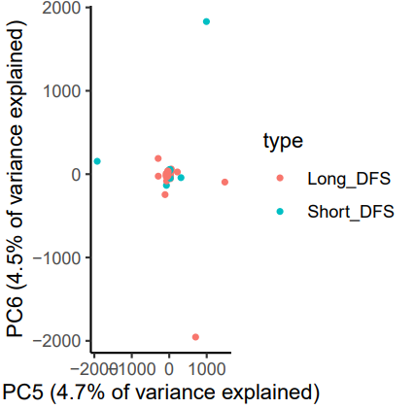
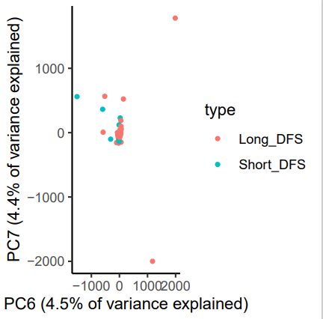

Slide 11
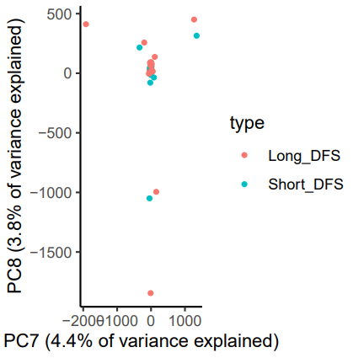
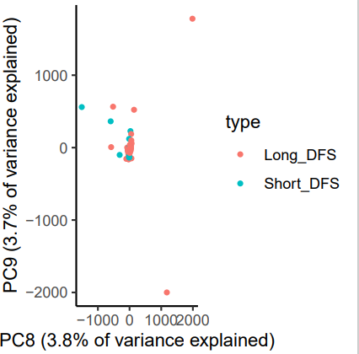

Slide 12
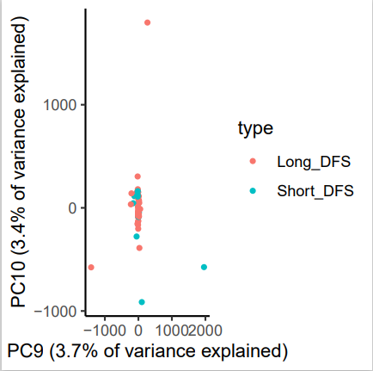

Slide 13
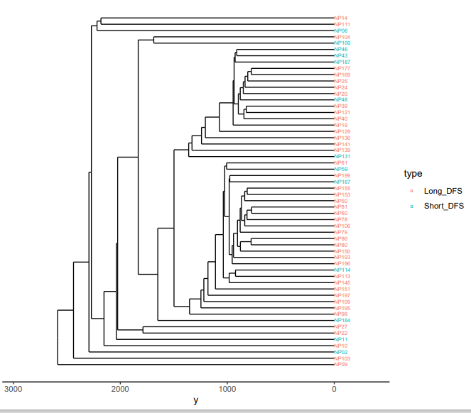
Hierarchical Clustering plot

Slide 14
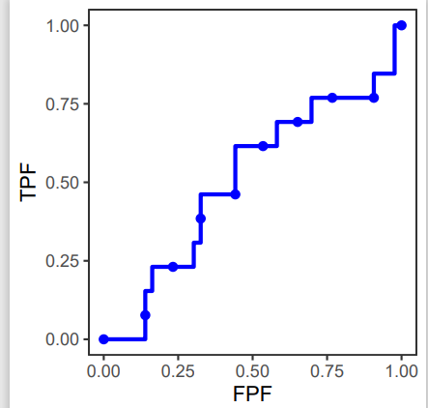
1. Leave one out classification Tissue Naïve Approach- No reference DMRs
Case: Short DFS Plasma samples
Control: Long DFS Plasma samples
AUC=0.5

Slide 15
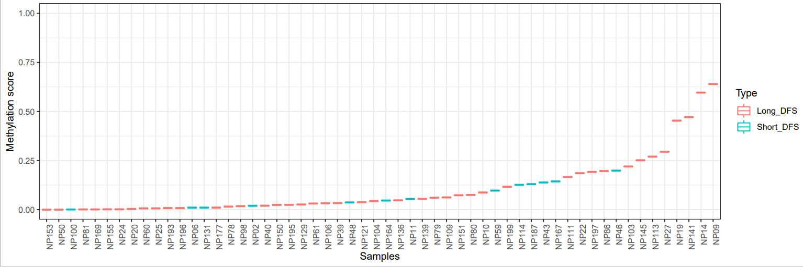
Methylation scores

Slide 16
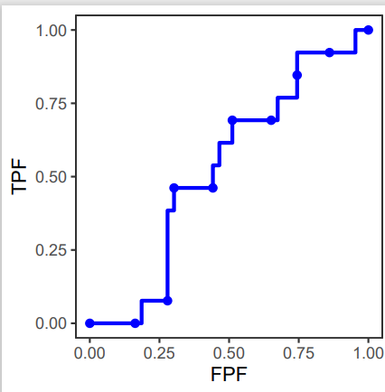
2. Leave one out classification Tissue limited approach Limit DMRs in the classification model to Clear cell Tissue vs WBC DMRs (p <=0.05) Case: Short DFS Plasma samples Control: Long DFS Plasma samples
AUC= 0.506

Slide 17
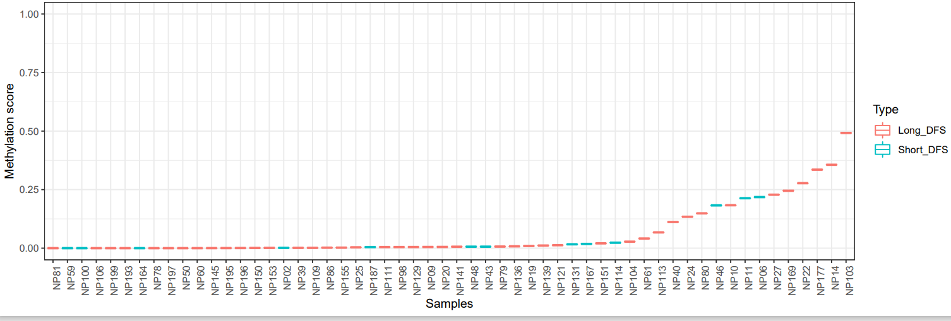
Methylation scores

Slide 18
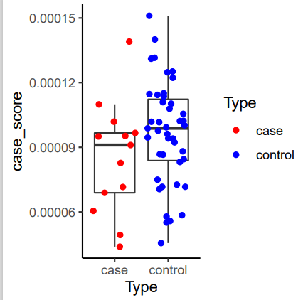
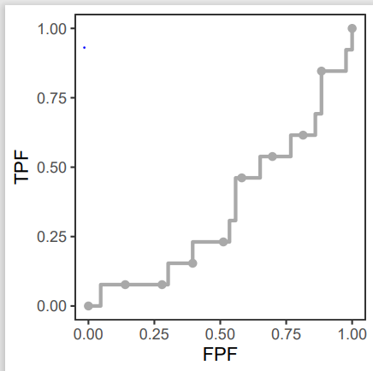
Relative Methylation Scores Normalized sum of reads in plasma at CC Tissue vs WBC, Up sites(DMRs higher in cases) Case: Short DFS samples Controls: Long DFS samples
AUC = 0.35
1364 Up DMRs

Slide 19
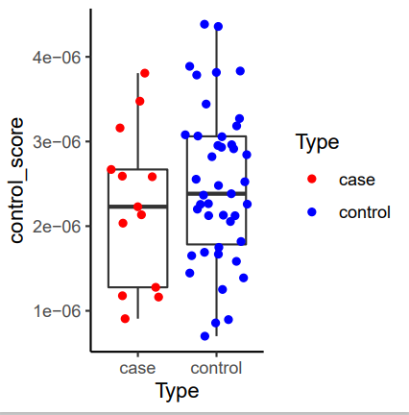
Normalized sum of reads at CC Tissue vs WBC, Down sites (DMRs higher in controls) Case: Short DFS samples Controls: Long DFS samples 23 Down DMRs

Slide 20
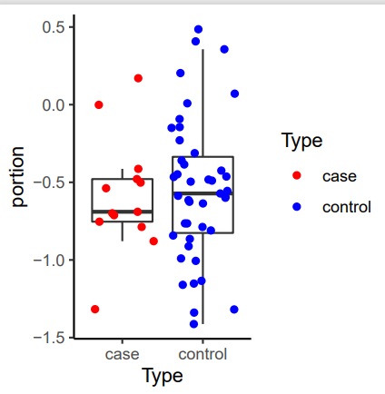
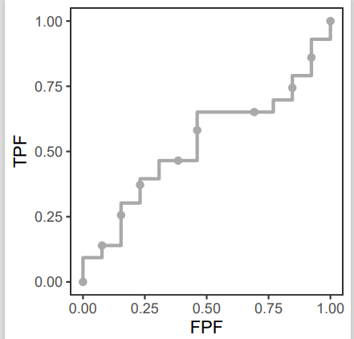
Portion score (case/control score ratio)
AUC: 0.529

Slide 21
3.Tissue Derived approach Evaluate whether the tissue-derived DMRs (CC Tissue vs WBC) correlate with cfDNA RPKM at those sites: Steps: *Find the differentially methylated regions in CC Tissue vs WBC *Select Up and Down DMRs with p<0.05. Up DMRs are higher in CC samples and Down DMRs in WBC Up DMRs :- logFC>0 Down DMRs:- logFC<0 *Plot separate boxplots for Up and Down DMRs at the selected sites, using the RPKM values in Plasma samples. We are hoping to see higher rpkm values in Short DFS plasma samples in the Up regions and higher rpkm values in Long DFS samples in the Down regions * Generate boxplots with more stringent cut offs for p values and logFC values

Slide 22
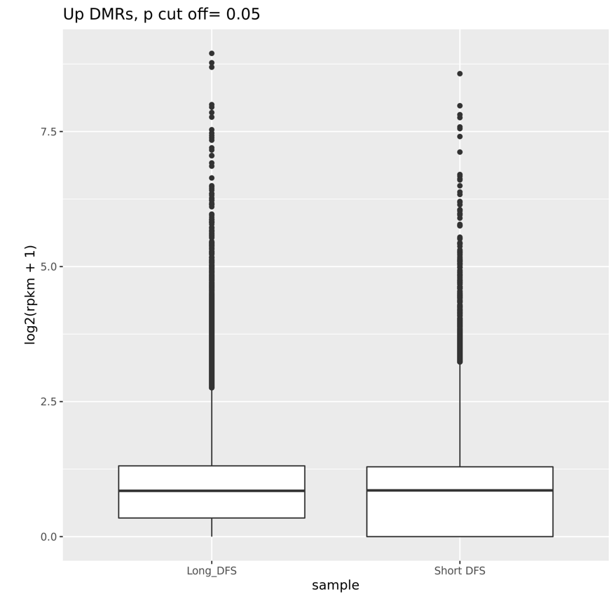
Up DMRs (p<0.05, logFC>=1)
175401 Up DMRs

Slide 23
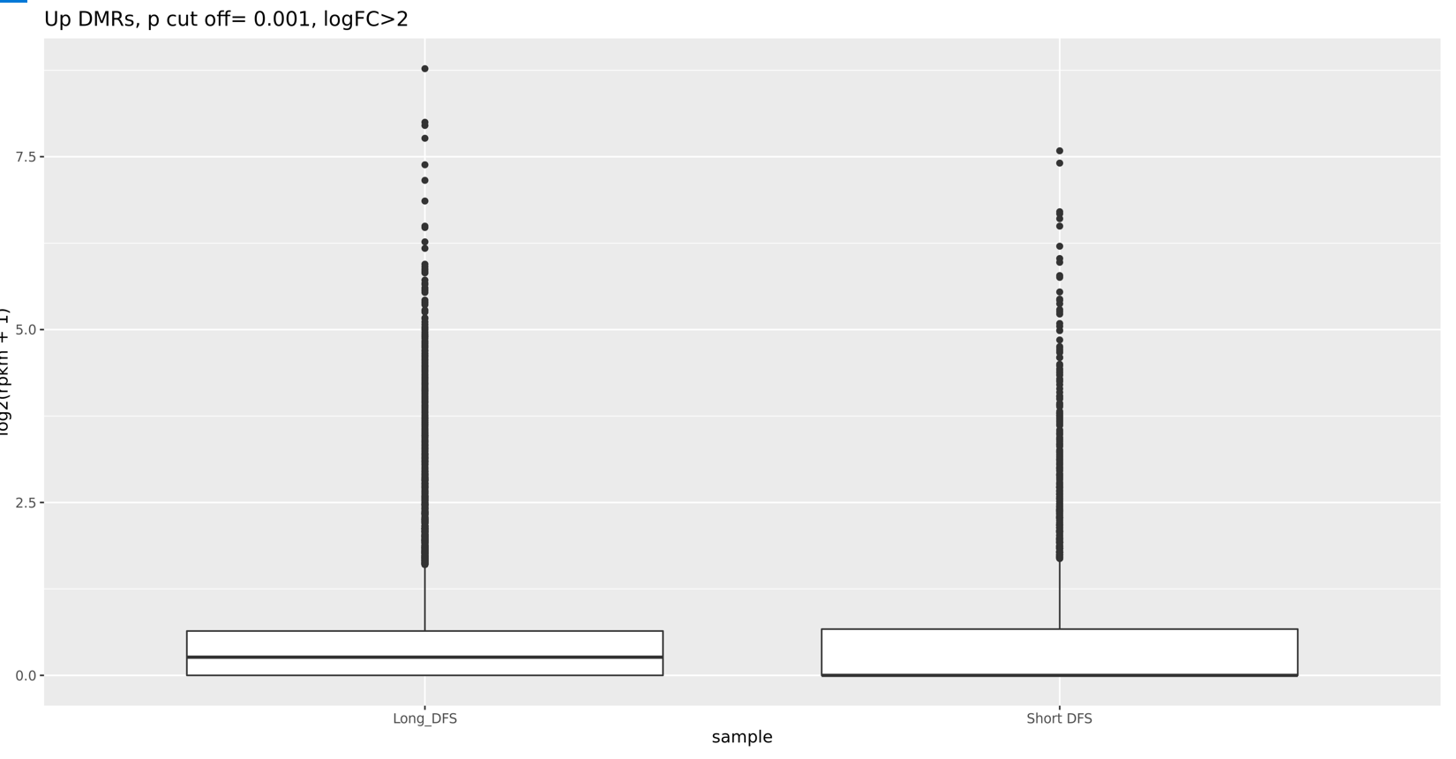
Up DMRs (p<0.001, logFC>=2)
7892 Up DMRs

Slide 24
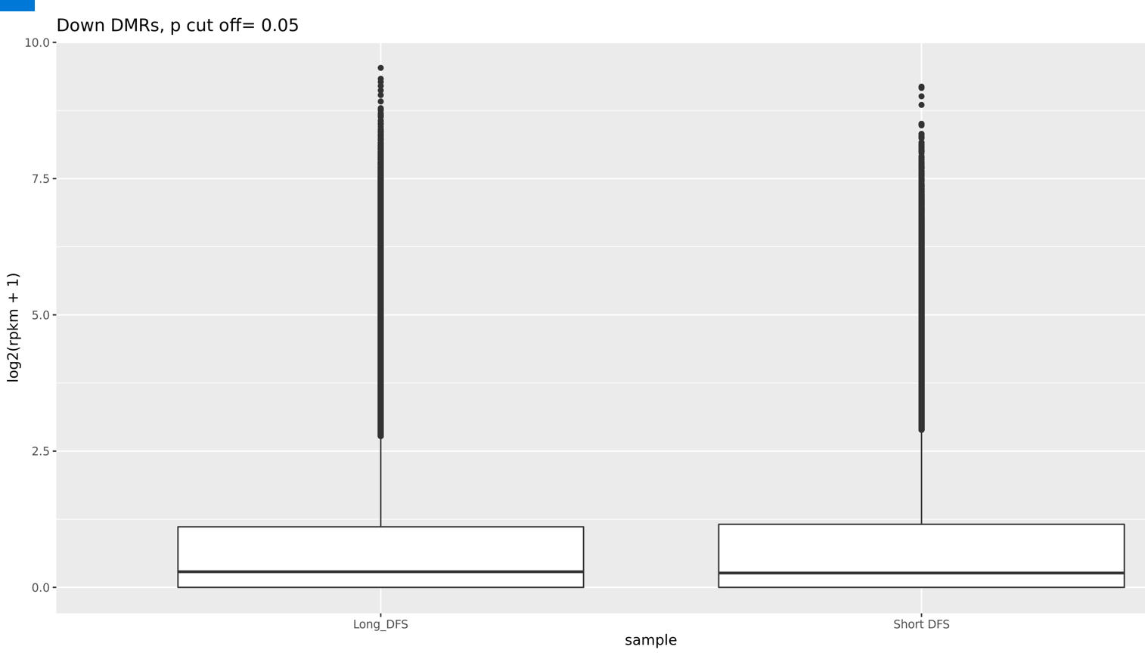
Down DMRs , p cut off <0.05
150539 Down DMRs
Wilcoxon rank sum test with continuity correction
W = 2.6932e+12, p-value < 2.2e-16
alternative hypothesis: true location shift is not equal to 0x

Slide 25
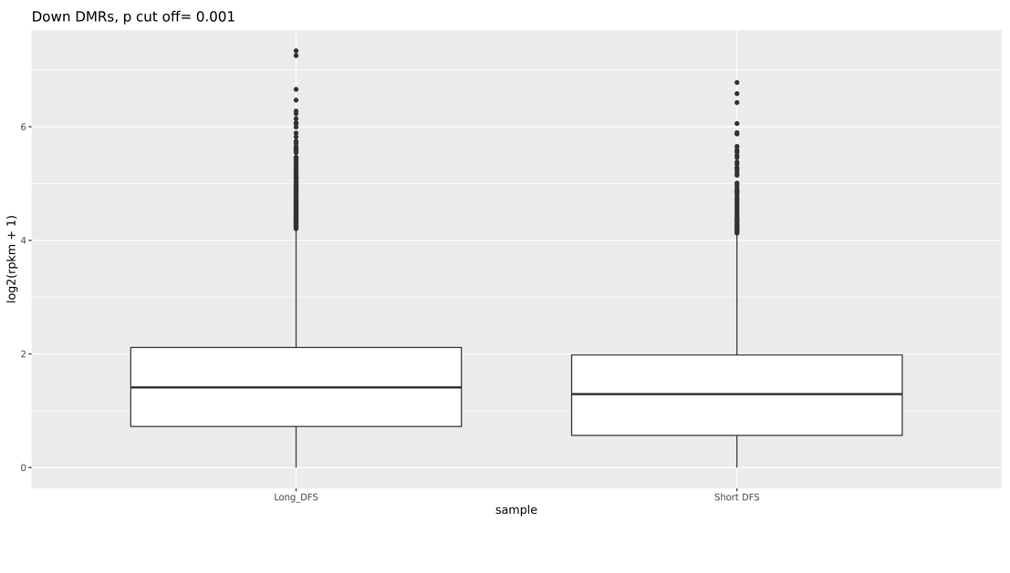
Down DMRs p cut off<0.001, LogFC<-2
1559 Down DMRs
Wilcoxon rank sum test with continuity correction
W = 726108320, p-value < 2.2e-16
alternative hypothesis: true location shift is not equal to 0

