Slide 1


Uber Supply Demand Gap Assignment

Slide 2
Data Exploration
Trip Status between 11/07/2016 and 15/07/2016
Trip Completed: 2831
No Cars Available: 2650
Cancelled: 1264

Slide 3
Data Cleaning and Manipulation
=> ‘Request id’ was set as the index
=> Derived ‘x Date’ and ‘x Time’from The ‘x timestamp’ columns.
=> The ‘x Date’ stores just the date e.g. ‘11’ or ‘12’ etc.
=> Dropped the Month and Year part of ‘Request timestamp’ as it is
consistent across the entire dataset.
=> For ‘x Time’ seonds part were added for the ones missing.
=> ‘NaN’ substitured for ‘Drop Time’ and ‘Drop Date’ rows that were ‘NA’

Slide 4
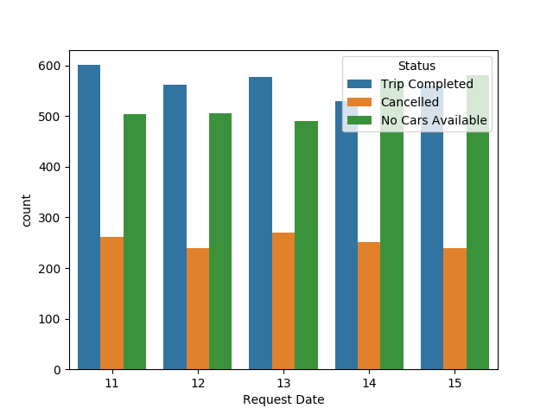
Analysing Trends For Each Day

Slide 5
Analysing Trends For Each Day
1) The trends for each day seems consistent, i.e. the results doesn’t differ based
on the day.
2) The Non-avaibality of cars seems the same across all days and it is quite high,
approximately around 500.
3) The number of ‘Cancelled’ requests are also the same and also quite high,
around 300.
Conclusions:
The problem doesn’t seem to change for a particular day.
Thus, the reason for the problem is prevailing on all days.

Slide 6
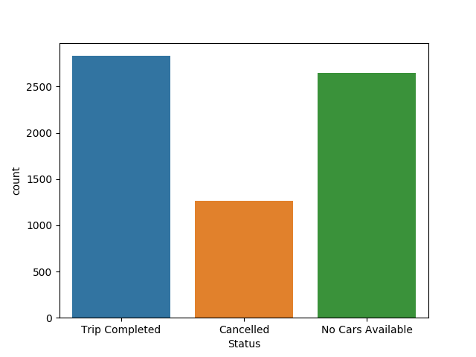
Combining Data For All Days
1) The unavaibility of cars almost equals
the trips completed
2) Which clearly indicates, this problem
Needs more attention, as it would
have double the effect on the success
of the business.
3) Cancelled status prevails around 1000,
Which is a clear indicator that driver are
Avoiding trips to the airport

Slide 7
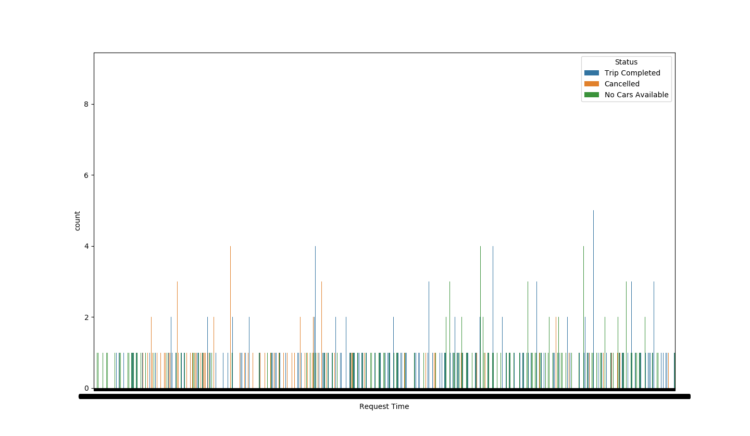
Problem Identification – Morning and Evening
1) Cars are unavailable most of
the time
And mostly during the night.
2) Cars are unavailable mostly
during the night.
3) Many requests are canclled
Throughout.

Slide 8
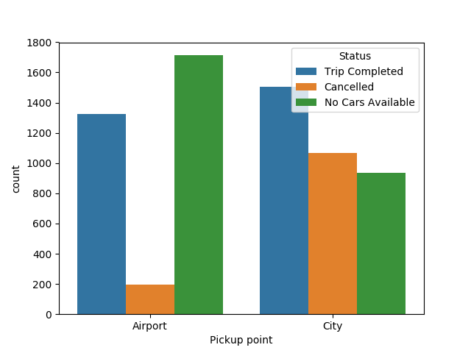
Problem 1 - Cancelled trips
1) Cancelled trips seems to be very high
when cabs are booked from the City to
The Airport.
2) Which indicates that cabs are unwilling to
Accept a trip to the Airport.

Slide 9
Problem 2 - No Cars Available
1) Unavaibility of cars are high for both the
pickup points
2) But is almost double in ‘Airport’ when
compared to the ‘City’
3) And, we already saw that unavaibility of
cars are mostly during the night.
Notes:
<number>

Slide 10
Recommendations
1) Hiring more cars for the night shift can almost double the success of the
business
2) Seems that cars have to spend more fuel and time to go the airport.
>And as a result of that, they are waiting at they airport for a customer as driving
>Back without a customer would cost double on the fuel.
>Due to uncertain landing times, cars have to wait for long.
>In which time, if they were not at airport they could have made a lot of money.
>This is why, most cars cancel trips from City -> Airport.
Thus, IMO, increasing the fare for trips to and from Airport can make a decrease
In the rate of the trip cancellations by the driver.

