Slide 1
Shakespeare text generation
Sounak mandal

Slide 2
This project is all about novel text generation in the style of Shakespeare, using simple deep Recurrent Neural Network. The model is character level, taking and generating text character by character. The model is also stateless, each training example starts with a hidden state with null vector and the hidden state is not preserved across examples. The present architectures simply use GRU cells with dropout and recurrent dropout, with different architectures using different number of GRU cells and different layer count.
The model trains by taking a set of contiguous characters (here 100) and learns to predict the next character. With sufficient training the accuracy of prediction jumped to above 88 percent. This means that the model learns quite well till roughly 100 steps, which is about the length GRU cells are about to learn.
During text generation, the model takes as context any number of characters and the number of characters to generate after which it outputs character by character. The model is expected to be highly coherent till 100 steps, which is observed. However it can even be used to generate reasonable content till 1000 characters.
GitHub link : ML-Projects/shakespeare text generation at main · SounakMandal/ML-Projects (github.com)

Slide 3
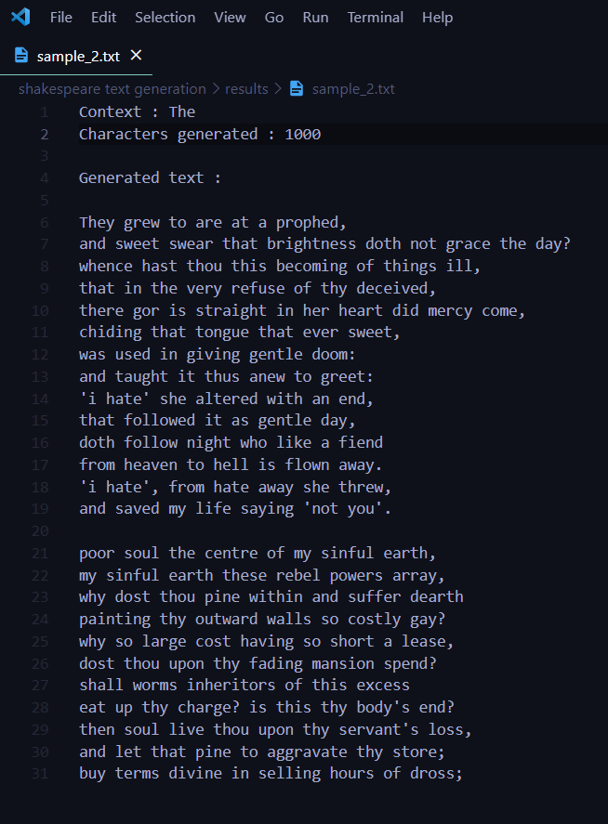

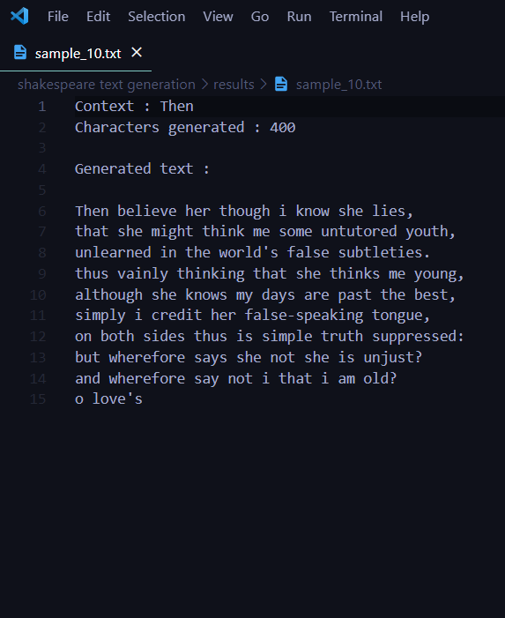
A glimpse of some of the results. The results are also available under the project directory named results.

Slide 4
Thank You

