Slide 1



TEXT SUMMARIZATION
GROUP - 4
PRESENTED BY:
SOUNAK PATRA

Slide 2


INTRODUCTION
This project focuses on developing a comprehensive text summarization application that leverages both abstractive and extractive summarization techniques.
The goal is to provide a user-friendly interface where users can input text and receive concise summaries, improving information consumption and comprehension.

Slide 3


OBJECTIVES
Implement Dual Summarization Methods: Integrate both abstractive and extractive summarization models to offer versatile summarization options.
Create a User-Friendly Interface: Design and develop an intuitive and responsive UI using HTML, CSS, JavaScript, etc.
Evaluate and Optimize: Assess the performance of the summarization models and optimize the application for accuracy and efficiency.
Deploy Using Modern Technologies: Utilize FastAPI for backend processing and Docker for containerized deployment, ensuring scalability and ease of access.

Slide 4
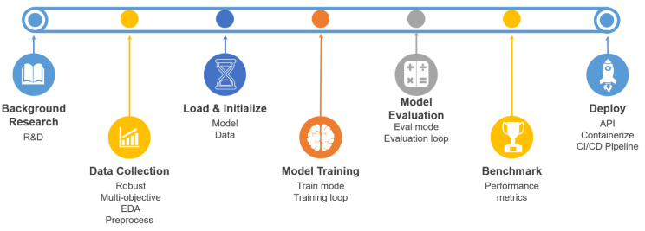
INTENDED PLAN

Slide 5


RESEARCH
2019
EXTRACTIVE SUMMARIZATION :
Selects and extracts key sentences or phrases directly from the original text to form the summary.
Examples of tools: Sentence Transformers, NLTK.
2020
ABSTRACTIVE SUMMARIZATION :
Generates summaries by interpreting and rephrasing the original text.
Examples of models: Pegasus, BART.
2023
MULTI-DOCUMENT SUMMARIZATION :
Combines and condenses information from multiple documents on the same topic into a single summary.
Examples of models: BERT, BART.
2023
GENERAL TEXT SUMMARIZATION :
Text Summarization using Deep Learning Techniques.
Examples of Methods used: Deep Learning (Seq2Seq, Attention, Transformers).

Slide 6
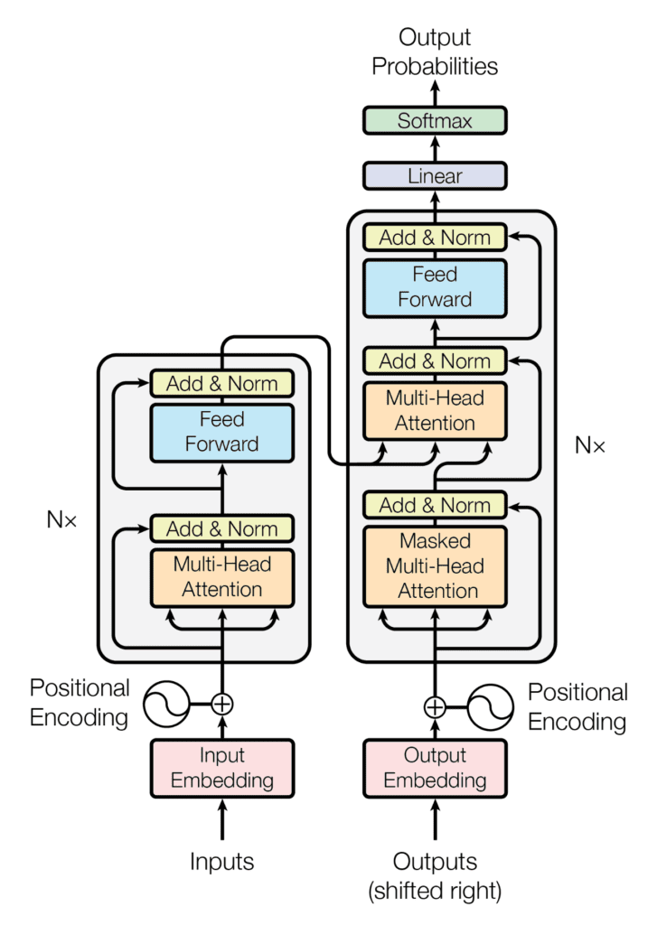



ARCHITECTURE SELECTED

Slide 7
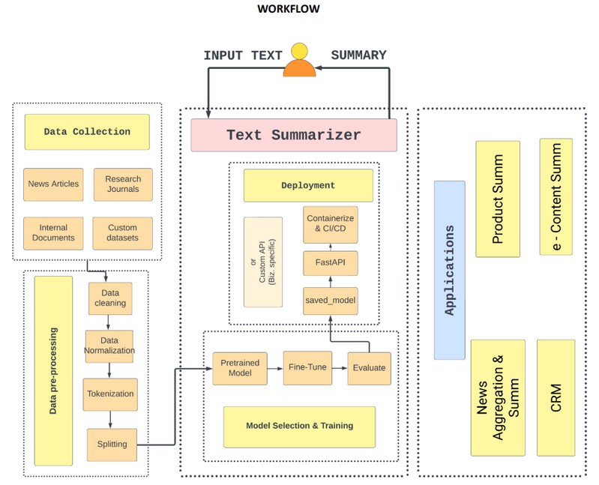
DESIGN WORKFLOW (ABSTRACTIVE)

Slide 8
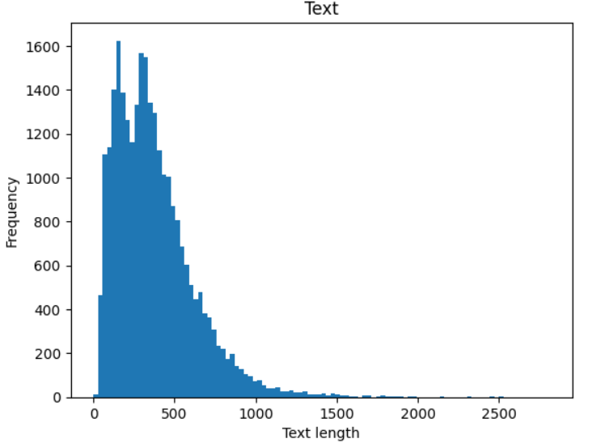

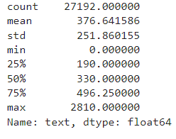
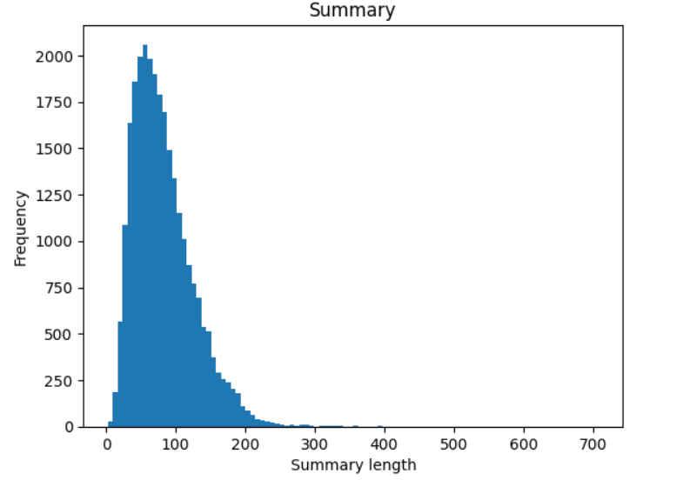
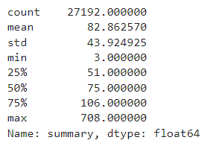

DATASET USED
Datasets have been collected from the Huggingface datasets library.
Data collected from different source : alexfabbri/multi_news : Multi-News, consists of news articles and human- written summaries of these articles from the site newser.com. knkarthick/dialogsum : DialogSum is a large-scale dialogue summarization dataset.
Data Pre-processing : completed
Removed NULL records, punctuation, stop words, Lowercasing, etc.

Slide 9
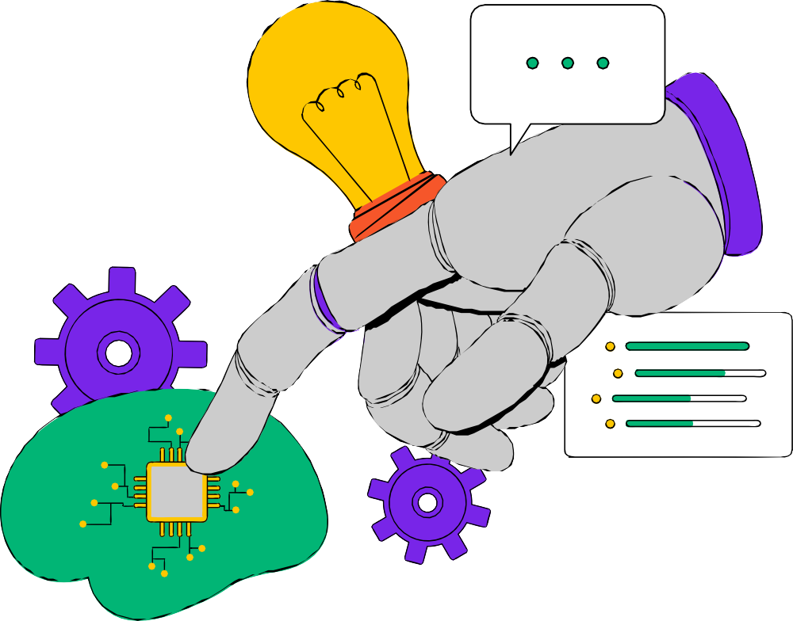
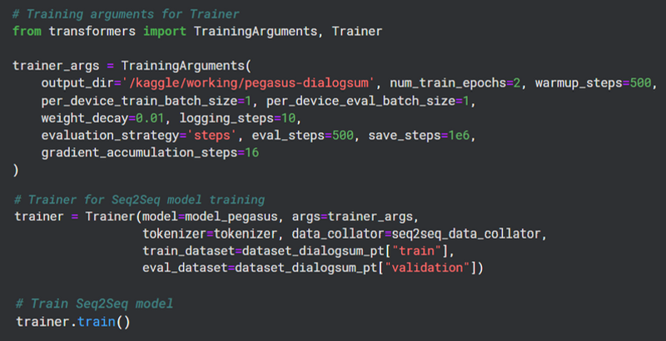

MODEL TRAINING
Load pre-trained transformer model
Google /Pegasus-cnn_dailymail
A function was implemented for the dataset to convert text data into model inputs and targets.
Trainer class from transformer package was utilized for training and evaluation. Trainer is a simple but feature - complete training and eval loop for PyTorch, optimized for transformers.
The model was trained with whole dataset for 2 epochs for 1:15:11, (HH:MM:SS) in 1556 steps. Train loss = 1.32 (final)
Trained model and obtained training history. Saved fine-tuned PEGASUS model and tokenizer.

Slide 10
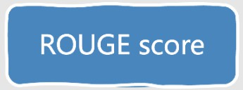




MODEL VALIDATION
We will use the performance metric to validate our model:
ROUGE (Recall-Oriented Understudy for Gisting Evaluation): This metric helps in measuring the quality of summaries by comparing the overlap of n-grams, word sequences, and word pairs between the generated summary and a reference summary.
ROUGE-1: Overlap of unigrams (single words) ROUGE-2: Overlap of bigrams (two word sequences)
ROUGE-L: Measures the longest common subsequence (LCS) b/w candidate and reference summaries.
ROUGE-LSUM: (LCS Summary) - variant of the ROUGE-L metric.
BEFORE FINE-TUNING
AFTER FINE-TUNING

Slide 11
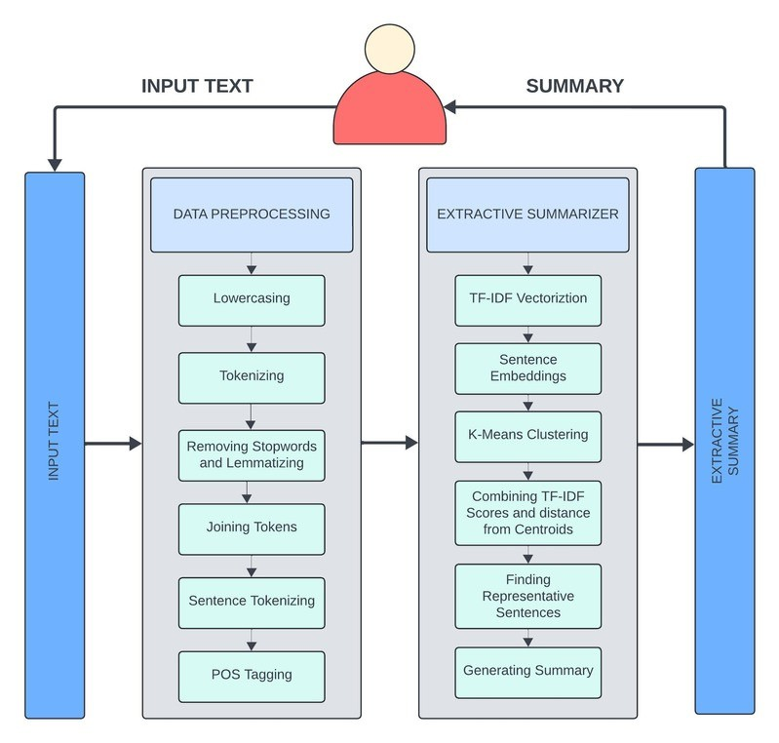

DESIGN WORKFLOW (EXTRACTIVE)

Slide 12


EXTRACTIVE SUMMARIZATION
The process of combining the matrix obtained from TF-IDF scores and KMeans Clustering methodology is used.
Convert the articles/passages into a list of sentences using nltk's sentence tokenizer. For each sentence, extract contextual embeddings using Sentence transformer.
Apply K-means clustering on the embeddings. The idea is to cluster the sentences that are contextually similar to each other & pick one sentence from each cluster that is closest to the mean(centroid).
For each sentence embedding, calculate the distance from centroid. The distance would be zero if centroid itself is the actual sentence embedding.

Slide 13


MODEL VALIDATION
ROUGE(RECALL-ORIENTED UNDERSTUDY FOR GISTING EVALUATION
This metric helps in measuring the quality of summaries by comparing the overlap of n-grams, word sequences, and word pairs between the generated summary and a reference summary.

Slide 14


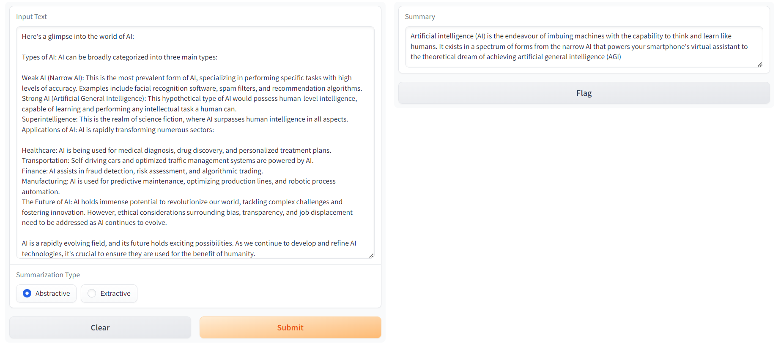

TESTING

Slide 15






DEPLOYMENT
FastAPI
Docker
Azure Portal
Azure Container Instances

Slide 16

DEPLOYMENT
Utilized the FastAPI framework to create a web application for text summarization.
Defined API endpoints. Accepts Text Input
Returns Abstractive and Extractive Summary based on choice.
Containerized the entire Project along with the models used.
Built the image and pushed to docker hub.
Deployed the docker image using docker Azure Container Instances.
4 CPU cores for free Trail is a big advantage.

Slide 17
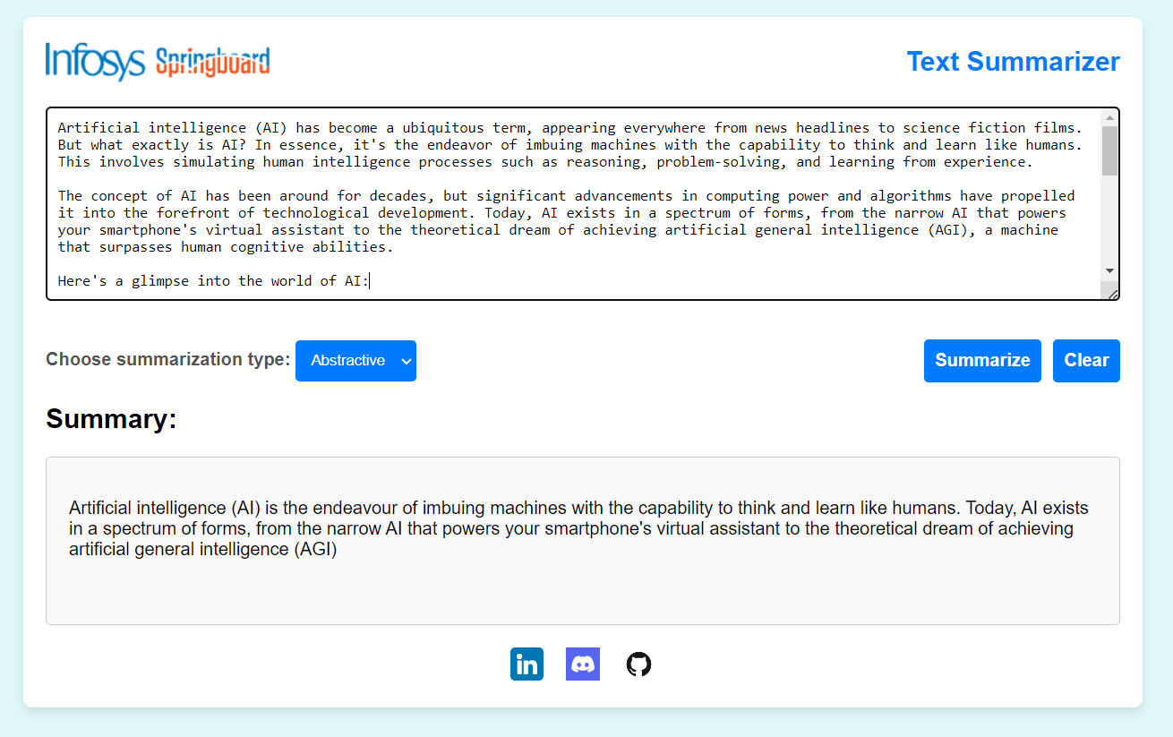
DEPLOYED APPLICATION

Slide 18
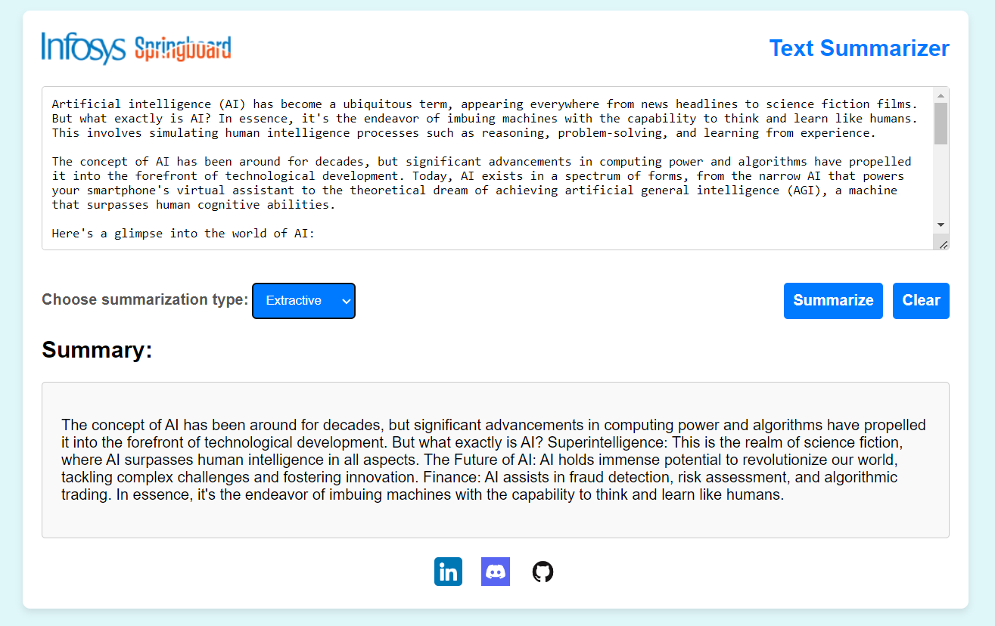

DEPLOYED APPLICATION

Slide 19

CONCLUSION
In this project, we developed a comprehensive text summarization application that supports both extractive and abstractive summarization techniques.
By leveraging state-of-the-art models like Pegasus for abstractive summarization, we ensured high- quality and coherent summaries. The application was implemented using a combination of Python libraries, including the Hugging Face Transformers library for model training and FastAPI for creating an interactive user interface

Slide 20


FUTURE SCOPE
Multilingual Summarization:
Extend the application to support multiple languages, allowing for summarization of text in languages other than English. This would involve training and fine-tuning models on multilingual datasets.
User Feedback & Continuous Improvement: Implement mechanisms for users to provide feedback on the generated summaries, and use this feedback to iteratively improve the models and the application.

Slide 21



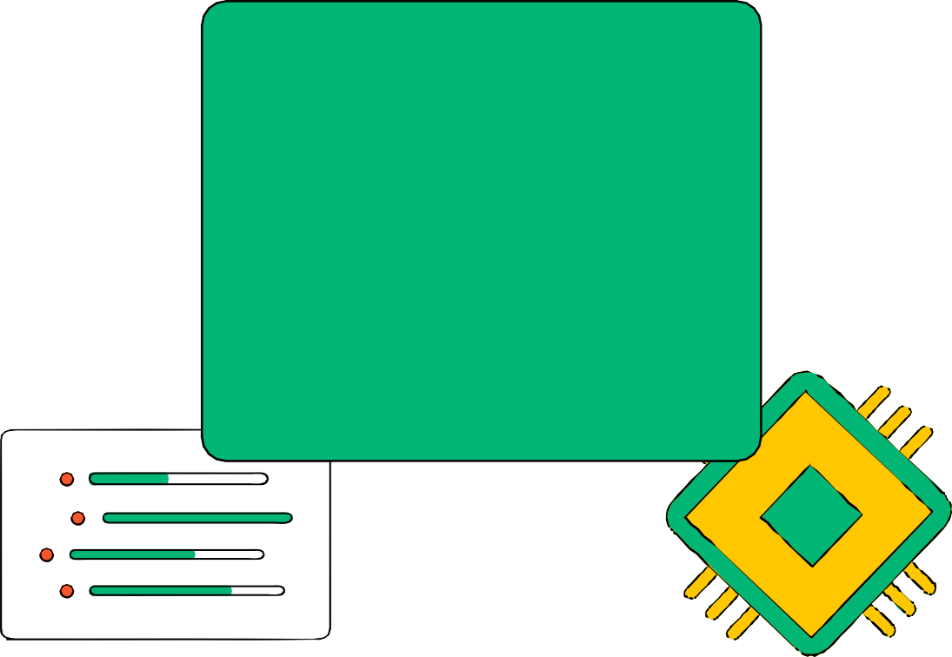

THINK UNLIMITED
WE LEARN FOR THE FUTURE
THANK YOU

