Slide 1
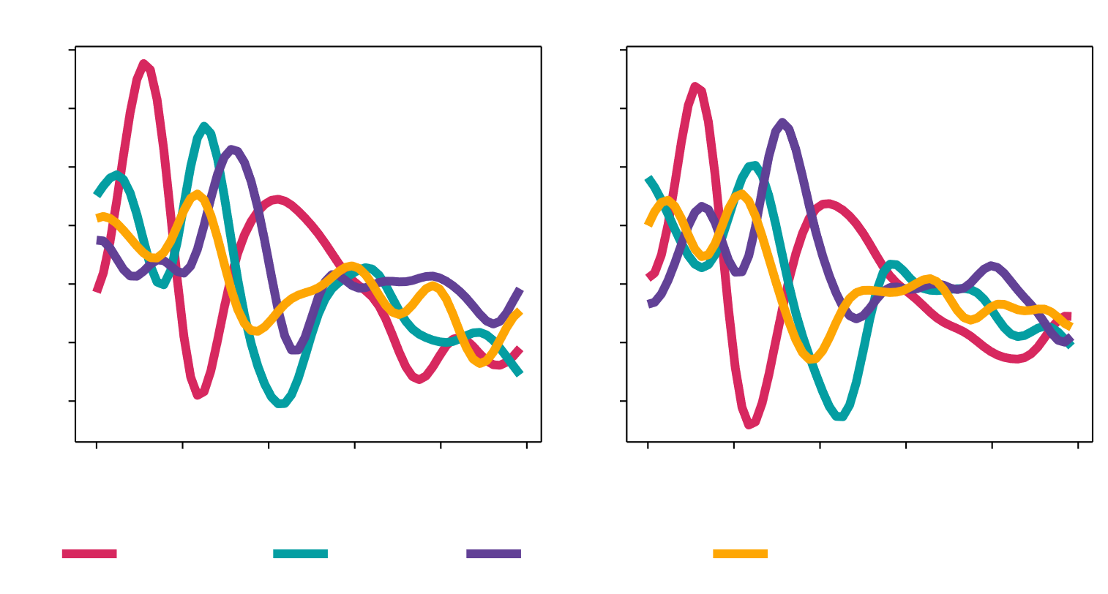
NeuraSpeech

