Slide 1
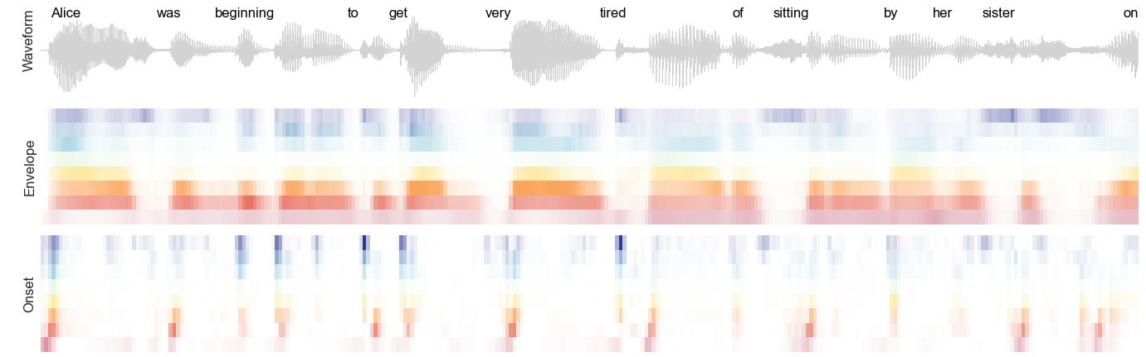
Audio waveform
Acoustic envelope
(8 bands)
Acoustic onsets
(8 bands)
Time

