Slide 1
Soundar N
Final Project
3/21/2024 Annual Review

Slide 2
PROJECT TITLE
Hand Gesture Virtual Mouse
3/21/2024 Annual Review

Slide 3


AGENDA
Introduction
Project Scope and deliverables
Research and Background
Hardware and Software Requirements
System Architecture
Implementation Plan
User Interface Design
Testing and Evaluation
Documentation and Reporting
closing
3/21/2024 Annual Review

Slide 4

PROBLEM STATEMENT
In today's digital age, interaction with computers and devices has become increasingly integral to daily life. One promising solution is the development of a hand gesture virtual mouse, which allows users to control their devices using simple hand movements captured by a camera.
Despite the advancements in technology, conventional input devices like mice and touchpads still present challenges for certain users, particularly those with disabilities or mobility impairments. Additionally, in scenarios where users need to interact with computers from a distance, such as during presentations or while operating multimedia systems, traditional input devices may not be practical.
3/21/2024 Annual Review

Slide 5

PROJECT OVERVIEW
The Hand Gesture Virtual Mouse project aims to create a novel interface for computer interaction by allowing users to control their devices using hand gestures captured by a camera. This innovative approach leverages computer vision and machine learning techniques to interpret hand movements in real-time, translating them into cursor movements and interactions on the screen. By eliminating the need for physical input devices such as mice and touchpads, the hand gesture virtual mouse offers a more intuitive, accessible, and versatile means of interacting with computers and devices.
3/21/2024 Annual Review

Slide 6

WHO ARE THE END USERS?
People with Disabilities
Elderly Users
Presenters and Speakers
Gamers
Digital Artists and Designers
Office Workers
Home Entertainment Users
Education Sector
Healthcare Sector
3/21/2024 Annual Review

Slide 7
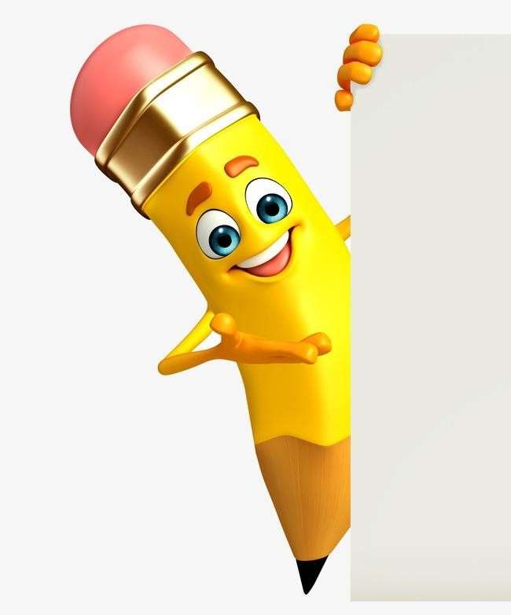
YOUR SOLUTION AND ITS VALUE PROPOSITION
Improved User Experience:
  Enhances user satisfaction and productivity by providing a more intuitive and seamless interaction experience.
  Reduces fatigue and strain associated with prolonged use of traditional input devices.
Enhanced Usability:
  Empowers users with disabilities or mobility impairments to access and interact with digital content more effectively.
  Promotes inclusivity and equal access to technology.
Advancement in Mouse Operation:
  Demonstrates the potential of computer vision and machine learning technologies in redefining human-computer interaction.
3/21/2024 Annual Review

Slide 8

THE WOW IN YOUR SOLUTION
Reduced risk of injury: Repetitive motions like using a mouse can contribute to Repetitive Strain Injury (RSI). A hand gesture virtual mouse can help reduce the risk of RSI by eliminating the need for constant hand and wrist movement.
Hygiene: Especially in situations where multiple people use the same computer, a virtual mouse can reduce the spread of germs since there's no physical device to touch.
Space saving: Especially on small desktops or crowded workspaces, a virtual mouse can eliminate the need for a dedicated mouse pad or extra surface area for maneuvering a physical mouse.
Intuitive control: For some users, interacting with a computer screen using hand gestures may feel more natural and intuitive than using a physical mouse.
Future applications: Hand gesture recognition technology is evolving and could have future applications in virtual reality, gaming, and other interactive technologies.
3/21/2024 Annual Review
8

Slide 9
MODELLING
Teams cam add wireframes
Certainly. Here's a concise version of the hand gesture virtual mouse modelling process:
Data Collection: Gather video/images of hand gestures representing clicks, drags, and scrolls.
Hand Tracking: Use libraries like OpenCV or MediaPipe to identify hands and track keypoints.
Gesture Recognition: Train a model (e.g., CNN) to recognize gestures based on hand landmark configurations.
Action Mapping: Translate recognized gestures to corresponding mouse actions (clicks, drags, scrolls).
User Interface: Design a user-friendly interface for visual feedback and cursor control.
3/21/2024 Annual Review
9

Slide 10
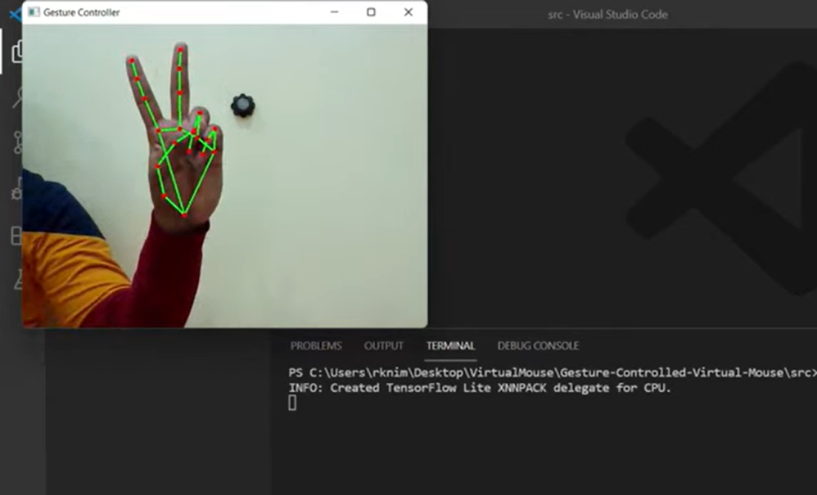
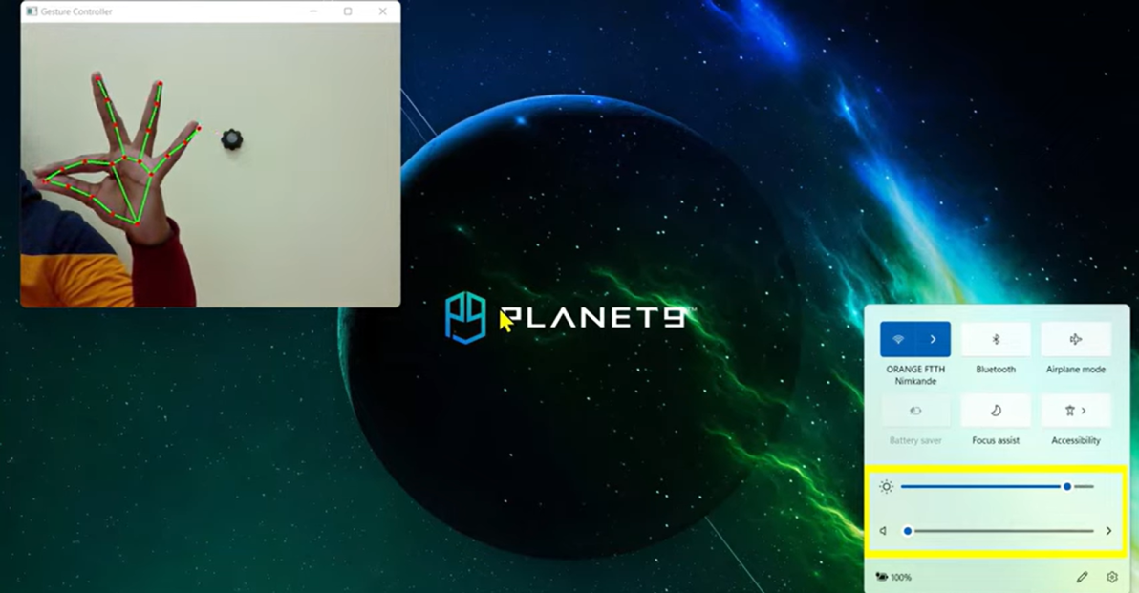
RESULTS
Demo Link
3/21/2024 Annual Review
10

