Slide 1
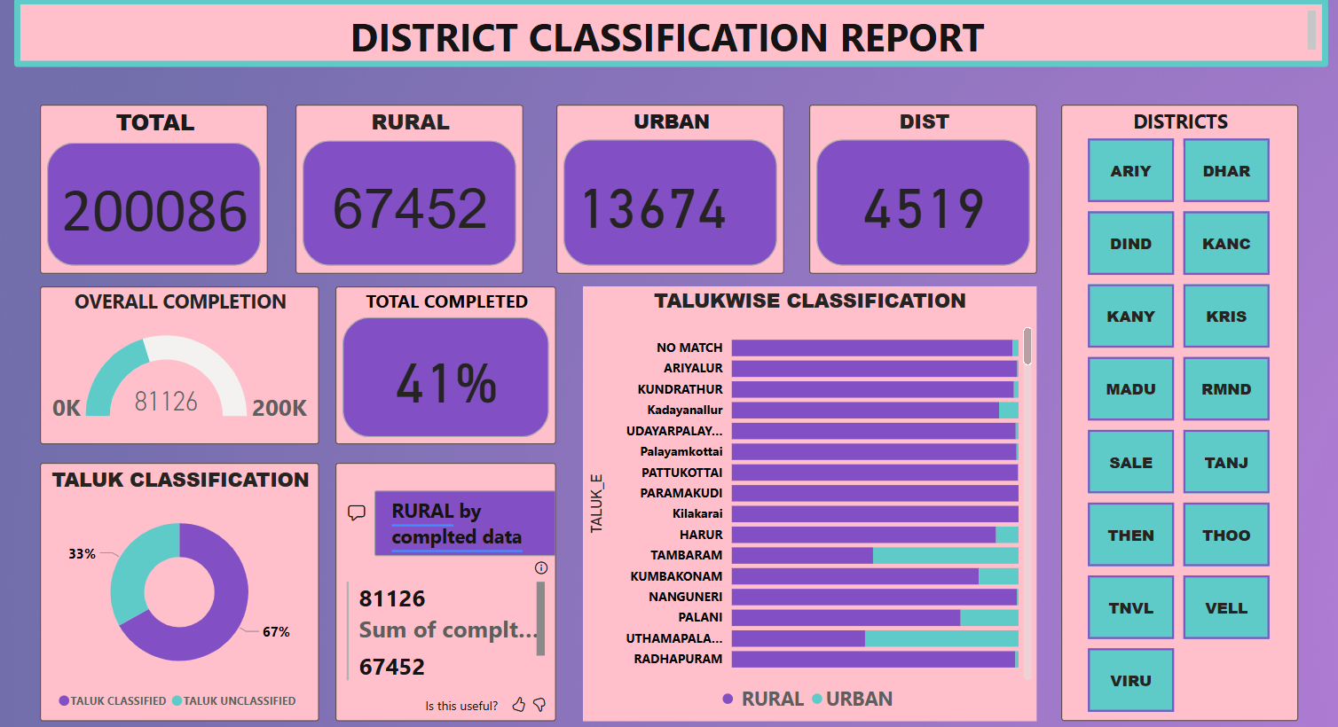

Slide 2
This dashboard project is based on the classification of patient addresses into rural and urban categories across districts and taluks in Tamil Nadu. The work was part of my role as a Technical Assistant in cancer registry data analysis. Click the link below to open the dashboard (Power BI required)
https://app.powerbi.com/reportEmbed?reportId=315b973e-1b69-4fcc-b334-3e0e0faf4a38&autoAuth=true&ctid=c6b95d79-a936-4a75-8ede-246749cd249b

Slide 3
Purpose:
This dashboard visualizes the progress and outcomes of my classification work. It helped track completion metrics, identify bottlenecks, and highlight classification accuracy by district and taluk.
Key Sections & Insights:
Total Cases:
Displays the total number of records handled for classification.
Rural vs Urban Breakdown :
Shows the split between classified rural and urban entries.
District Summary:
Number of districts involved and their classification completion status.

Slide 4
4.Progress Tracker:
Percentage of classification completed so far.
5.Taluk-wise Distribution:
Bar chart visualizing the rural/urban split for each taluk. Helps pinpoint areas needing further review or correction.
6.Taluk Classification:
Donut chart shows how many taluks were classified vs unclassified.
7. Interactive Filters (in Power BI):
Users can click on districts or taluks to drill down into specific data subsets.

