Slide 1
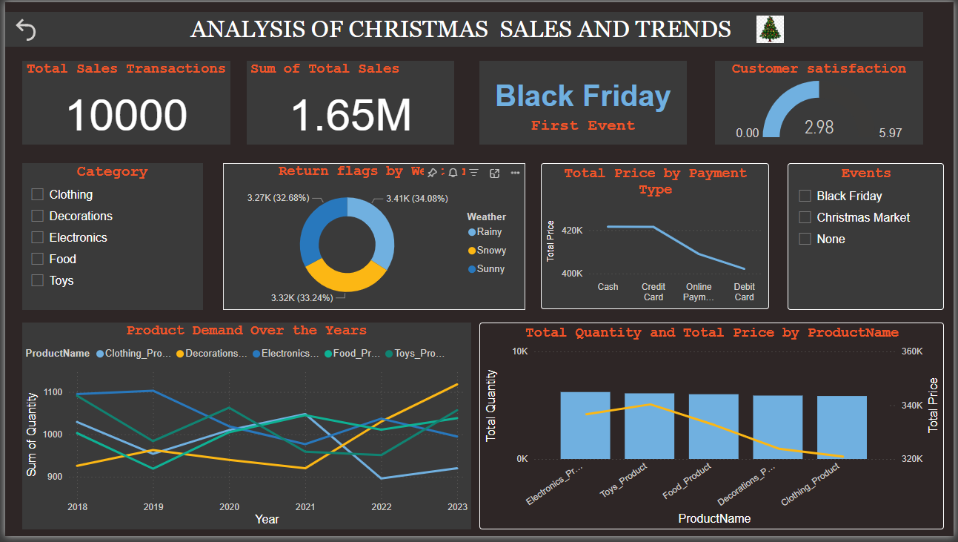

Slide 2
🧮Christmas Sales & Trends – Power BI Dashboard
This Dashboard is created for a Monthly data visualization Challenge hosted by ONYX DATA. I Participated In this competition to enhance my data storytelling skills using powerbi

Slide 3
📦Dataset Overview
Content:
Source: Onyx Data Challenge – Monthly dataset
Records: 10,000+ transactions
Columns included: Product Category, Date, Quantity, Sales, Weather, Payment Type, Events
Objective: Analyze Christmas sales patterns, return behavior, and customer trends

Slide 4
📈 What This Dashboard Reveals
Total sales: 1.65M from 10,000 transactions
Categories like Electronics and Clothing dominated sales
Black Friday was the highest-performing event
Weather impacts return rates — Rainy & Snowy days showed higher returns
Customer satisfaction scored low (avg: 2.98 out of 5.97)
Cash and credit card were the preferred payment methods

Slide 5
🛠️ What I Learned From This Project
Hands-on with Power BI’s interactive visuals
Experience using DAX, slicers, and tooltips
Used bookmarks and formatting to enhance storytelling
Developed end-to-end dashboard design

Slide 6


🔗Submission & Acknowledgement
Submitted to Onyx Data Challenge [onyxdata.co.uk]
“This project was completed independently for educational and portfolio purposes.”
www.linkedin.com/in/soundarya04122001 psoundaryanayagi@gmail.com

