Slide 1
Maharani’s Science College for Women(Autonomous),
Mysuru
Where Is My Bus?
Real-Time Bus Tracking System
Submitted By
1. Rakshitha A (U01AG23S0085)
2. Soundarya A M (U01AG23S0126)
3. Ashwini C (U01AG23S0208)
Submitted To
Dr. Sheela T
Associate Professor,
Department of Computer Science
1 / 12

Slide 2
Abstract
Web-based Real-Time Bus Tracking System for intelligent transportation management.
Live GPS-based bus tracking with route visualization and ETA prediction.
Interactive interface for viewing routes, schedules, and bus details.
Secure seat booking system with digital ticket generation.
User authentication with booking history management.
Admin dashboard for managing buses, routes, crew members, and real-time operations.
Scalable and modern architecture suitable for smart city transportation.
Reduces passenger waiting time and improves transit efficiency
2 / 12

Slide 3
Problem Statement
▸ Urban public bus transit systems in India lack real-time tracking infrastructure, forcing millions of commuters to depend on static, unreliable timetables.
▸ Passengers have no visibility into live bus locations, leading to prolonged and unpredictable waiting times at bus stops.
▸ There is no mechanism for seat reservation, resulting in overcrowded buses and poor commuter experience.
▸ Existing solutions are either city-locked, proprietary, or do not offer an integrated tracking + booking system.
3 / 12

Slide 4
Existing System / Literature Review
Google Maps Transit
• Shows static schedule-based transit data
• No seat booking or crew interaction
• Dependent on third-party transit agencies
City-Specific Apps (BMTC, DTC)
• Tied to a single city's transport authority
• Often lack real-time GPS tracking
• No role-based management dashboards
• Fragmented user experience
SMS / IVRS-Based Systems
• Users must manually request bus status
• No visual map or route visualization
• High latency in information delivery
• No booking capabilities
4 / 12

Slide 5
Disadvantages of Existing System
✗ No Real-Time Tracking — Passengers rely on fixed timetables with no live location data.
✗ No Seat Booking — Passengers cannot reserve seats, leading to overcrowding and uncertainty.
✗ Lack of Role-Based Dashboards — No unified platform for crew members, admins, and passengers.
✗ Poor Scalability — City-specific solutions cannot be adapted to other regions easily.
✗ No crew Accountability — No mechanism to monitor crew trips or routes in real time.
✗ Fragmented Systems — Separate apps for tracking, booking, and management create confusion.
✗ Limited Mobile Responsiveness — Many existing systems are not optimized for mobile devices.
5 / 12

Slide 6
Proposed System
Real-Time GPS Tracking
Live bus location updates every 3–5 sec via Socket.IO WebSockets.
Interactive Map
Mapbox-powered map with moving bus markers and route polylines.
ETA Prediction
Speed & distance-based arrival time calculation updated in real time.
Seat Booking
Full digital booking flow — seat selection, confirmation, e-ticket generation.
Role-Based Dashboards
Tailored panels for Passengers, crew members, and Admins.
Secure Authentication
JWT tokens, CORS protection, and rate limiting.
6 / 12

Slide 7
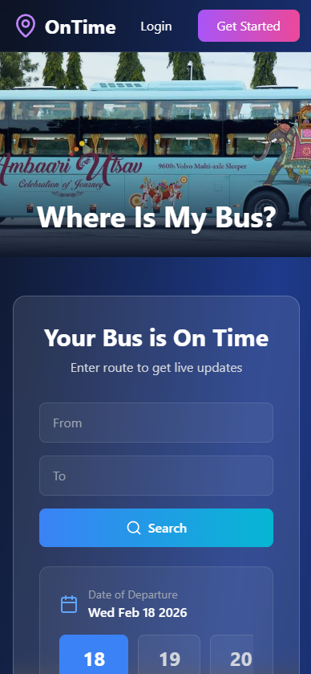
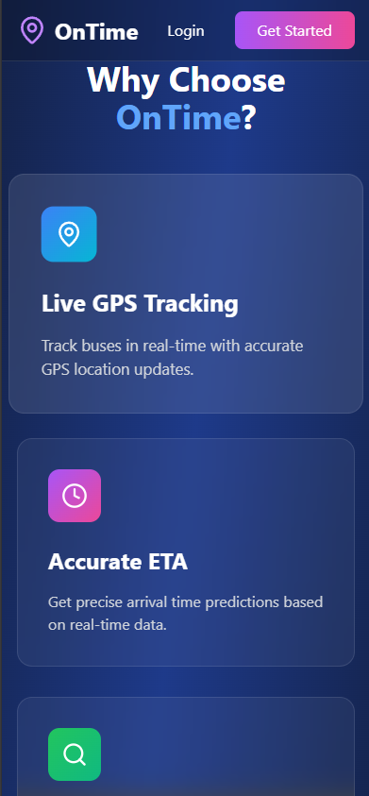
Workflow of The Proposed Solution
User Registration
Search Routes & Buses
Real- Time GPS Tracking / Stop Based Tracking
Book Seats & Get Tickets
BOKING
User interface
Live ETA Updates
10 / 12

Slide 8
Advantages of Proposed System
✓ Real-Time Visibility — Passengers know exactly where their bus is at all times.
✓ Accurate ETAs — Dynamic calculation based on live speed and GPS data.
✓ Seamless Booking — Digital seat selection and e-tickets reduce queues and overcrowding.
✓ Unified Platform — Single app for tracking, booking, and fleet management.
✓ Crew Monitoring — Admins can track all active trips and crew performance in real time.
✓ Secure & Reliable — JWT auth, rate limiting, and CORS protection.
✓ Mobile-First Design — Fully responsive UI works seamlessly on phones and tablets.
7 / 12

Slide 9
System Model & Methodology
Agile Development Methodology
• Iterative development with sprint cycles
• Continuous integration & testing
• Modular MVC architecture (Model-View-Controller)
• RESTful API design principles
• WebSocket event-driven communication
• Role-Based Access Control (RBAC)
3-Tier Architecture
• Presentation Layer — React.js + Tailwind CSS
• Business Logic Layer — Node.js + Express.js
• Data Layer — MongoDB Atlas (NoSQL)
• Real-Time Layer — Socket.IO (WebSocket)
• Auth Layer — JWT
• Map Layer — Mapbox GL / Leaflet
8 / 12

Slide 10
Model Explanation — Data Flow & Modules
1
User Module
Registration, login, JWT auth, profile management, role assignment (Passenger / crew / Admin).
2
Route Module
CRUD for routes with stops, distances, durations. Admin-managed.
3
Bus Module
Bus registration, capacity management, crew assignment, route linking.
4
Trip Module
crew starts/ends trips. GPS coordinates broadcast via Socket.IO every 3–5 sec.
5
Booking Module
Passengers select seats, confirm bookings, generate digital e-tickets.
6
Real-Time Module
Socket.IO handles location broadcast, ETA updates, trip status events.
9 / 12

Slide 11
Hardware & Software Requirements
Hardware Requirements
• Processor: Intel Core i3 or higher
• RAM: 4 GB minimum (8 GB recommended)
• Storage: 500 MB free disk space
• Network: Stable internet connection
• GPS: Device with GPS capability (for crew members)
• Display: 1366×768 resolution or higher
Software Requirements
• OS: Windows 10+ / macOS / Linux
• Runtime: Node.js v16 or higher
• Database: MongoDB Atlas (Cloud)
• Browser: Chrome / Firefox / Edge (latest)
• IDE: VS Code (recommended)
• Tools: Git, npm
• Maps API: Mapbox / Leaflet
• Deployment: Vercel (frontend), Railway (backend)
11 / 12

Slide 12
Conclusion
Improves efficiency and reliability of public transportation.
Provides accurate, real-time information on bus locations and arrival times.
Uses GPS, mobile connectivity, and data processing technologies.
Reduces passenger uncertainty and waiting time.
Enhances overall travel convenience.
Supports improved route planning and operational decision-making.
Increases user satisfaction.
Future Scope
• Push notifications for delays • QR code ticket scanning
12 / 12

Slide 13
Thank You!
12 / 12

