Slide 1

Research Question –
Tutorial Presentation for Feedback
Date: 19 – 11 – 2025
Group Name: B111 Name of Student Presenting: Soundarya Halanuru Rajan

Slide 2
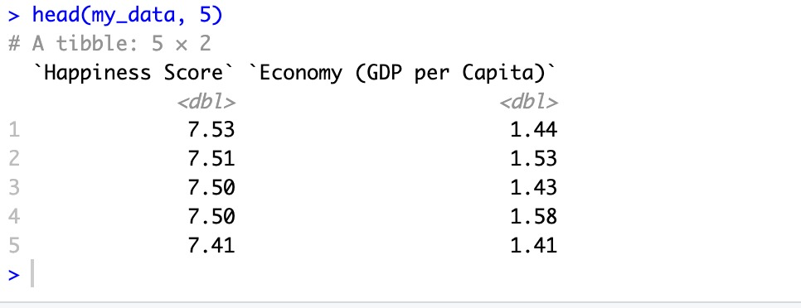
The columns/variable names you include in your research question.
Happiness Score and Economy (GDP per Capita)
At least 5 rows of the data :
Tell us how many rows your dataset has.
The dataset contains 157 rows (countries).
Here is a sample of our dataset:

Slide 3
This dataset is interesting to us because : This dataset is interesting to us because it allows us to compare how economic conditions relate to people’s overall happiness across different countries.
Our Independent variable is: Economy (GDP per Capita)
This Independent variable datatype is : Interval/measurement data
(Reason: It is a numerical, continuous variable measured on a meaningful scale.)
Our Dependent variable is: Happiness Score
This Dependent variable datatype is : Interval/measurement data
(Reason: Happiness Score is a numerical, continuous value.)
Dataset ID: (DS283 , 2016.csv(Happiness Score )
Notes:
Before specifying your Research Question you must define the type of data you are analysing. Are the variables you select interval data (measurement data you can divide, multiple, etc), OR are they ordinal (there is a definite order but the intervals between each variable are not necessarily equal, or the terms might be subjective like in a likert scale); OR are they just categorical/nominal (Items such as film names, cities, etc., that you can count numbers of occurrences? You also need to understand whether the variable is either dependent or independent and this will vary according to the context. Independent variables may cause an effect, whereas the dependent variable might be effected by the independent variable. Check the lecture notes on the RQ for more information and examples.
You will get only one opportunity to present your Research Question ahead of the submission date. Have your questions ready, and be ready to take notes on feedback.

Slide 4
Template ¹: Interval/Ordinal vs Interval/Ordinal: “Is there a correlation between “Happiness Score” and “Economy (GDP per Capita)” ?
“This study investigates whether there is a correlation between Happiness Score and Economy (GDP per Capita) across countries in the 2016 World Happiness dataset. By examining this relationship, we aim to understand whether higher economic prosperity is associated with higher levels of national happiness.”
Our Research Question is

Slide 5
Hypotheses:
Null hypothesis (H₀): There is no correlation between Happiness Score and Economy (GDP per Capita).
Alt hypothesis (H₁): There is a correlation between Happiness Score and Economy (GDP per Capita).
Leave the hypotheses as two statements for now – after your statistical analysis test, you will choose one or the other. (You will report: "We fail to reject the null hypothesis" with no significant result, or if you do have significance [p-value = < 0.05] you can state "We reject the null hypothesis". More guidance on hypothesis testing is given in the lectures.)

Slide 6
Pearson correlation test results: r = 0.79 p-value < 2.2e-16 n = 157 countries
Final Conclusion :
The Pearson correlation test showed a strong positive relationship between Happiness Score and Economy (GDP per Capita) (r = 0.79). The p-value (< 2.2e-16) is significantly below the 0.05 threshold, so we reject the null hypothesis. This confirms that countries with higher GDP per capita tend to have higher happiness scores.

Slide 7
Thank You

