Slide 1
PHISHING ATTACKS
*Recognizing and avoid phishing emails, website and social engineering tactics.*

Slide 2
PHISHING
Phishing attacks are the practice of sending fraudulent communications that appear to come from reputable source.
Phishing email messages, websites and phone calls are designed to steal money or sensitive information. Cybercriminals can do this by installing malicious software on your computer, tricking you into giving them sensitive information or outright stealing personal information off of your computer.

Slide 3
TYPES OF PHISHING
1.Social engineering
2. Link manipulation
Social engineering is a type that usually steals information from the users by asking the login or sign up credentials' like linkedin or instagram.
This is everything a cybercriminal needs in order to fool into thinking that the message or email is legitimate.
Some links in some emails seems to be from spoofed organization or person. Misspelled URLs or the use of subdomains are common by phishers .
If we move the cursor over some link if it directs to some other external website then that can be a phishing email.

Slide 4
TYPES OF PHISHING
3. Spear phishing
4. Clone phishing
Spear phishing usually occurs on a specific companies or an individual.
First the attackers will do the social gatherings to increase the probability of the success rate of this.
This is the most successful technique today on the internet.
Sending the exact copy of the already sent email.
This is a cloned email.
The attachment or link within the email is replaced with a malicious version .
Then sent from an email spoofed to appear to come from the original sender.

Slide 5
TYPES OF PHISHING
5. Voice phishing
Collecting the social gatherings over a telephone call to access the personal information or the financial information like credit card details or bank details or account details.
It is also called as vishing.

Slide 6
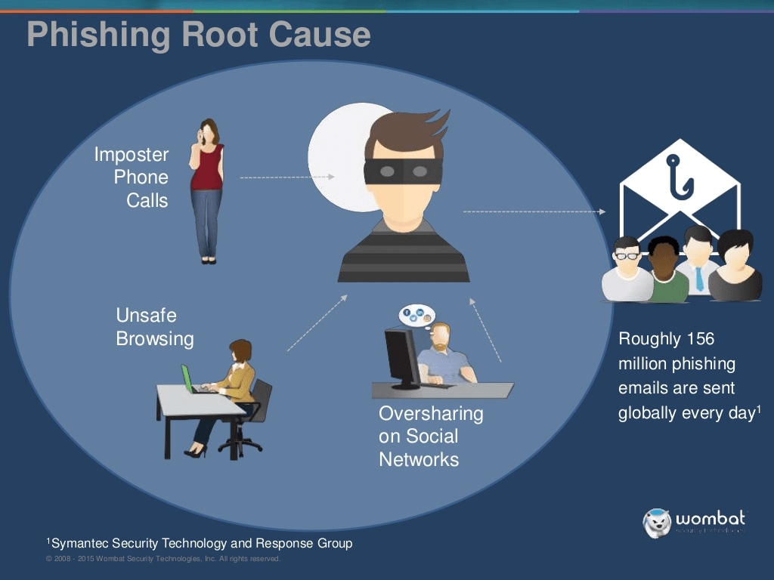
THE ROOT CAUSE OF PHISHING EMAILS ARE:
Users lack security awareness.
Criminals are following money
Companys are not identifying the weaker users
Low cost phishing and ransome tools are easy to get hold off.
Malware is becoming more sophisticated.

Slide 7
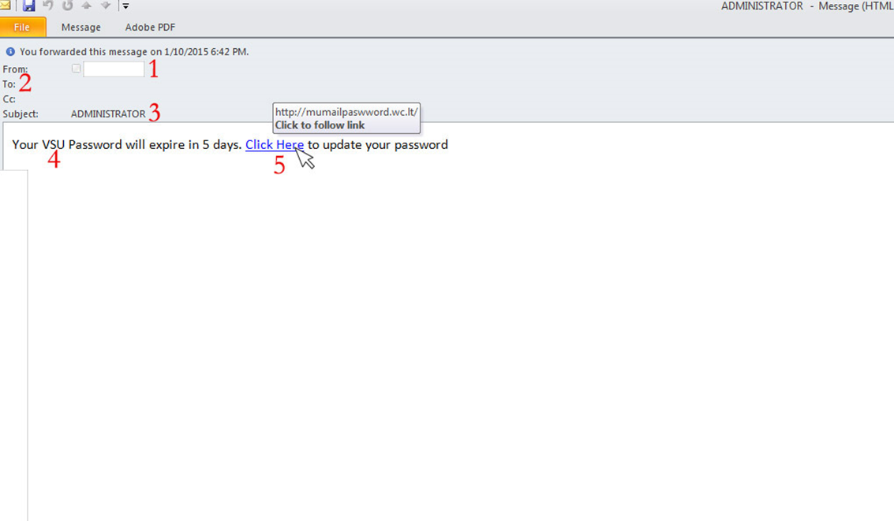
SPEAR PHISHING ATTACK EXAMPLE
The first question you have to ask is, “Do I know this person?” or “Am I expecting an email from the person?” If you answered no to either question, you must take a harder look at other aspects of the email
A large amount of phishing emails will blank out the To: or Cc: fields so that you cannot see that this is a mass email to a large group of people.
Phishing emails will often come with subjects that are in all capitals or have multiple exclamation marks in order for you to think that this email is important or that you should take the recommended action within the email.

Slide 8
4. This is a targeted email (Spear Phishing) to VSU, so more than likely,
this was sent to everyone at VSU that the sender had in their address book.
5. Hovering your mouse over the link, you can see that this is not taking you to a valdosta.edu address, but rather to an external site. This site would either prompt you for a password, then steal that password, or would download a malicious file infecting your computer

Slide 9
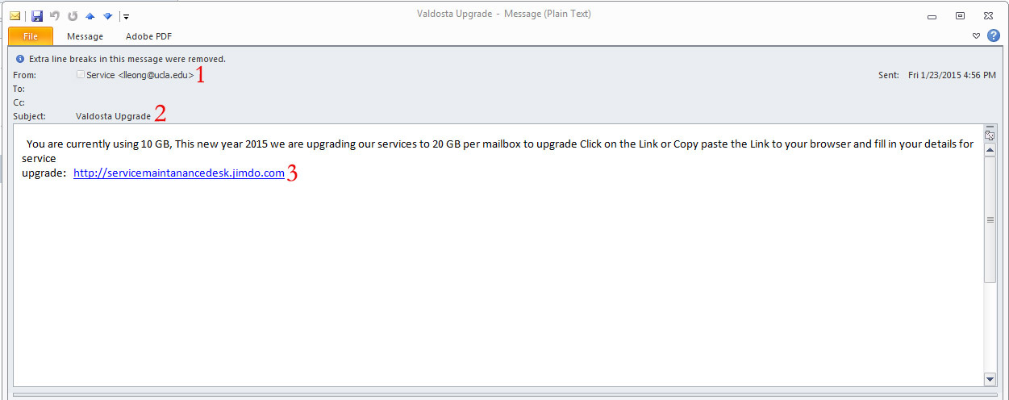
Looking at the Sender, you can see that this is not from a valdosta.edu email address, but rather a ucla.edu address. This should be the first warning that this is not a legitimate emaiL.
Once again, the To: and Cc: fields are greyed out so that you can’t see this is a mass email. Also, as referenced by the Subject line, “Valdosta Upgrade”, this is a targeted attack to VSU email addresses.
As you can see, this link is not a part of the original domain, but an external site at jimdo.com. This should be another warning that this is not a legitimate email, and more than likely phishing for your credentials.

Slide 10
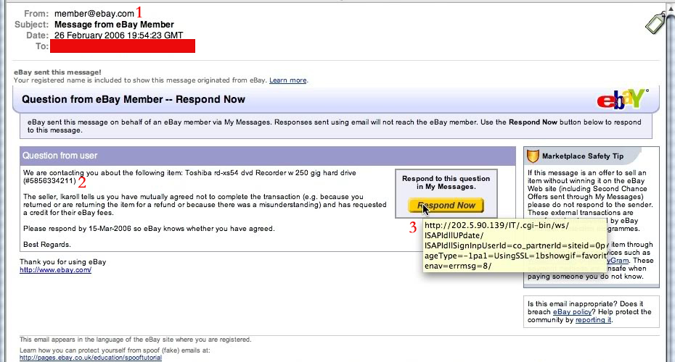
CLONE PHISHING EXAMPLE
1.These emails are harder to spot because they look exactly like legitimate emails you would normally receive. The first cue that something is not right with this email is the sender. It is a generic address, member@ebay.com. You would never see this from a legitimate email, you would see the username of the buyer/seller.

Slide 11
The question you have to ask yourself is did I buy anything from ebay recently, and if I did, is this what I purchased? If no to these questions, then you more than likely have a phishing email.
The last piece is the most critical in seeing if the email is in fact a phishing email. If you hover your mouse over the button it is wanting you to press, you see that this is not taking you to an ebay.com site, but rather an external site that will more than likely try to steal your ebay credentials.

Slide 12
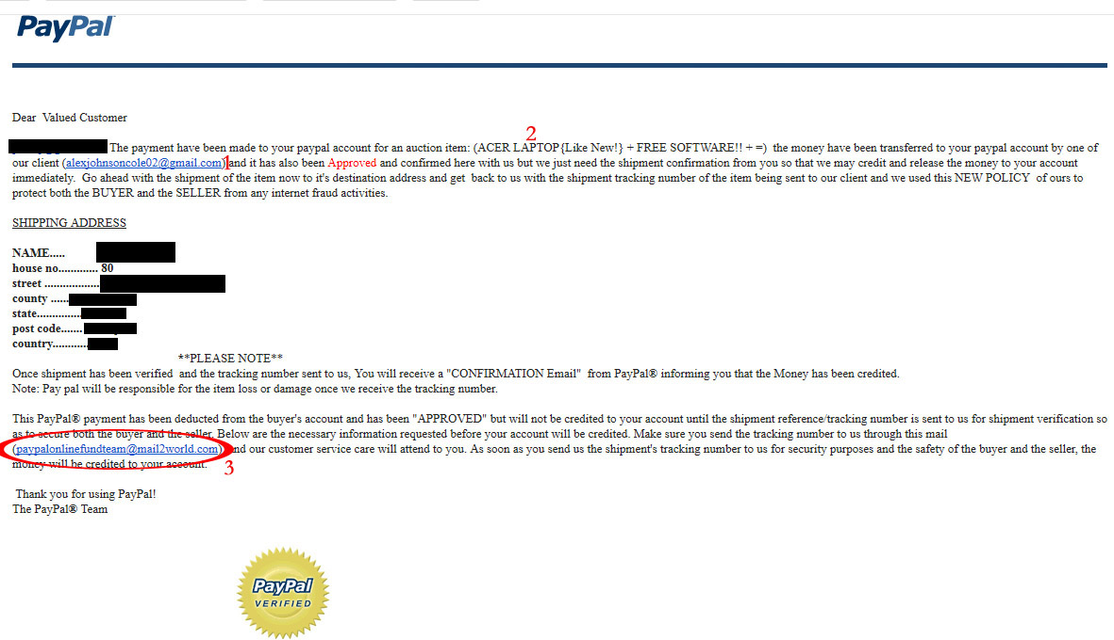
Just like in the previous example, this email looks like a legit PayPal email that you would normally see. So the first thing to do is to see if you recognize the email, or if you have done any kind of transaction with this email address. Also look through the email for spelling and grammatical errors, as Cybercriminals will often leave these errors in the body of the email. Second, see if the item in question is one that you actually bought or sold. If not, then delete and move on.
Look at the email circled, if this was an official email from paypal, it would end in “@paypal.com” not mail2world.

Slide 13
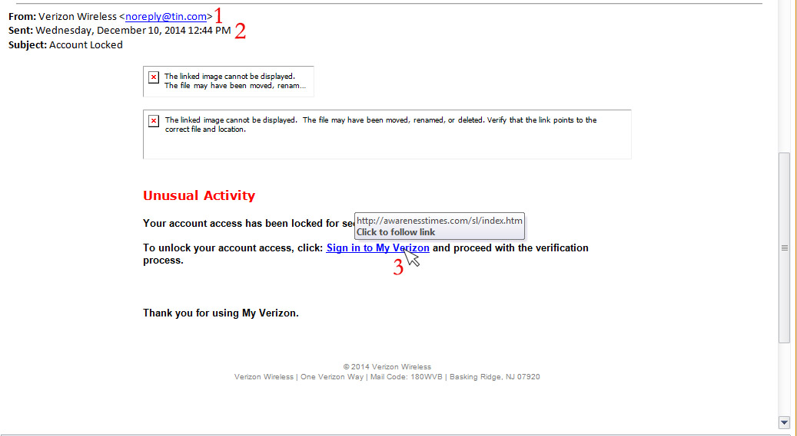
LINK MANIPULATION EXAMPLE
This is a common phishing email and looks completely legit, with the name of “Verizon Wireless”, but if you look at the actual email, it is an @tin.com address rather than a @verizon.com address.
Once again, the To: line is missing, indicating that this is a mass email that they want to avoid you seeing.
Hovering your mouse over the link, you can see that this does not take you to a Verizon website, but rather to a random website which would more than likely take your login information and take over your account to take your billing information

Slide 14
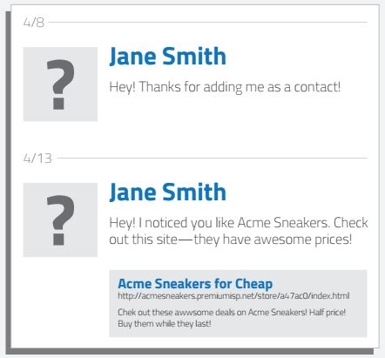
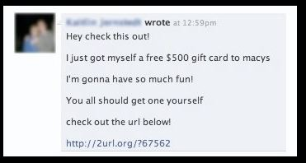
SOCIAL ENGINEERING ATTACKS EXAMPLE
The example on the left is a targeted social engineering attack. Cybercriminals scan your profile for your likes and then send you a crafted message over social media trying to trick you into clicking the link, which would then steal your social media login and take over your profile sending out more phishing attacks to your friends/contact list.
The one on the right is an example of a mass phishing attack through social media. No doubt many of you have seen these in Facebook, from random people in messages, or from your friends through their timelines. Upon clicking the link, it would prompt you to log in again, but this time to a fake Facebook page, and steal your log in information and take over your profile sending out the same or another mass phishing attack to your friends and contacts.

Slide 15
Tips to protect yourself from Phishing emails.
I.T. will NEVER ask for your password over email. Please be wary of any emails asking for passwords. Never send passwords, bank account numbers, or other private information in an email.
Be cautious about opening attachments and downloading files from emails, regardless of who sent them. These files can contain viruses or other malware that can weaken your computer's security. If you are not expecting an email with an attachment from someone, such as a fax or a PDF, please call and ask them if they indeed sent the email. If not, let them know they are sending out Phishing emails and need to change their email password immediately.
Never enter private or personal information into a popup window.
If there is a link in an email, use your mouse to hover over that link to see if it is sending you to where it claims to be, this can thwart many phishing attempts.
Look for 'https://' and a lock icon in the address bar before entering any private information on a website.
Look for spelling and bad grammar. Cybercriminals are not known for their grammar and spelling. Professional companies or organizations usually have staff that will not allow a mass email like this to go out to its users. If you notice mistakes in an email, it might be a scam.

Slide 16
THE THINGS TO DO WHEN YOU RECEIVE A PHISHING EMAIL.
First, do not click on any links within the email or download any attachment.
If there is an attachment in the email, and you recognize the sender but aren't expecting an attachment from them, please call them and ask if it is legitimate.

Slide 17
THANK YOU!!

