Slide 1
CS513 - HW1 Automatic Lens Smear Detection
Team:
Soundarya Hiriyanna Matti(A20435453)
Nikita Wali(A20445324)
Srihari Gururaj(A20426340)

Slide 2
Outline
Introduction
Steps
Methodology
Results

Slide 3
INTRODUCTION
Lens smear and other image artifacts are usually introduced in images because of the presence of occluding agents like dirt, smudges etc. on camera lens.
These dirt and dust particles create a persistent pattern on all captured images.
In this assignment we have used the approach of creating a mask which shows smear on each camera. Each camera has images in a sequence of street view taken at different angles. So we input these sequence of street view images and get an output of smear on the lens

Slide 4
STEPS
Parse the input images
Convert to gray scale
Gaussian
Blur
Sobel
Generate mean image
Threshold
Mask Image
RESOURCES
Python 3.7.4
Open CV
Numpy

Slide 5
METHODOLOGY
To detect smear for a given camera, we performed the following steps
We loop through the images from each camera and parse the images.
To create an average image, the image directories are accessed to get the required list of images
We pre-process the images by perforating below step:
Convert to gray scale
Apply Gaussian filter to remove noise
Calculate mean image

Slide 6
METHODOLOGY
THRESHOLDING:
First step for threshold is that the image should be grayscale. Therefore we use the image obtained in above step. If pixel value is less than the threshold value which is 100, it is assigned a value of one (white), else it is assigned different value (black).
On the mean image we perform Morphological operations (Erosion and Dilation). Dilation is used to Increases the object area. We erode our image using a 10X10 kernel to remove the noise due to changing road patterns and panoramic camera effect. We have performed 4 series of iteration for erosion and dilation.
CREATE MASK:
Apply Threshold method to create mask, with smear shown as black.

Slide 7
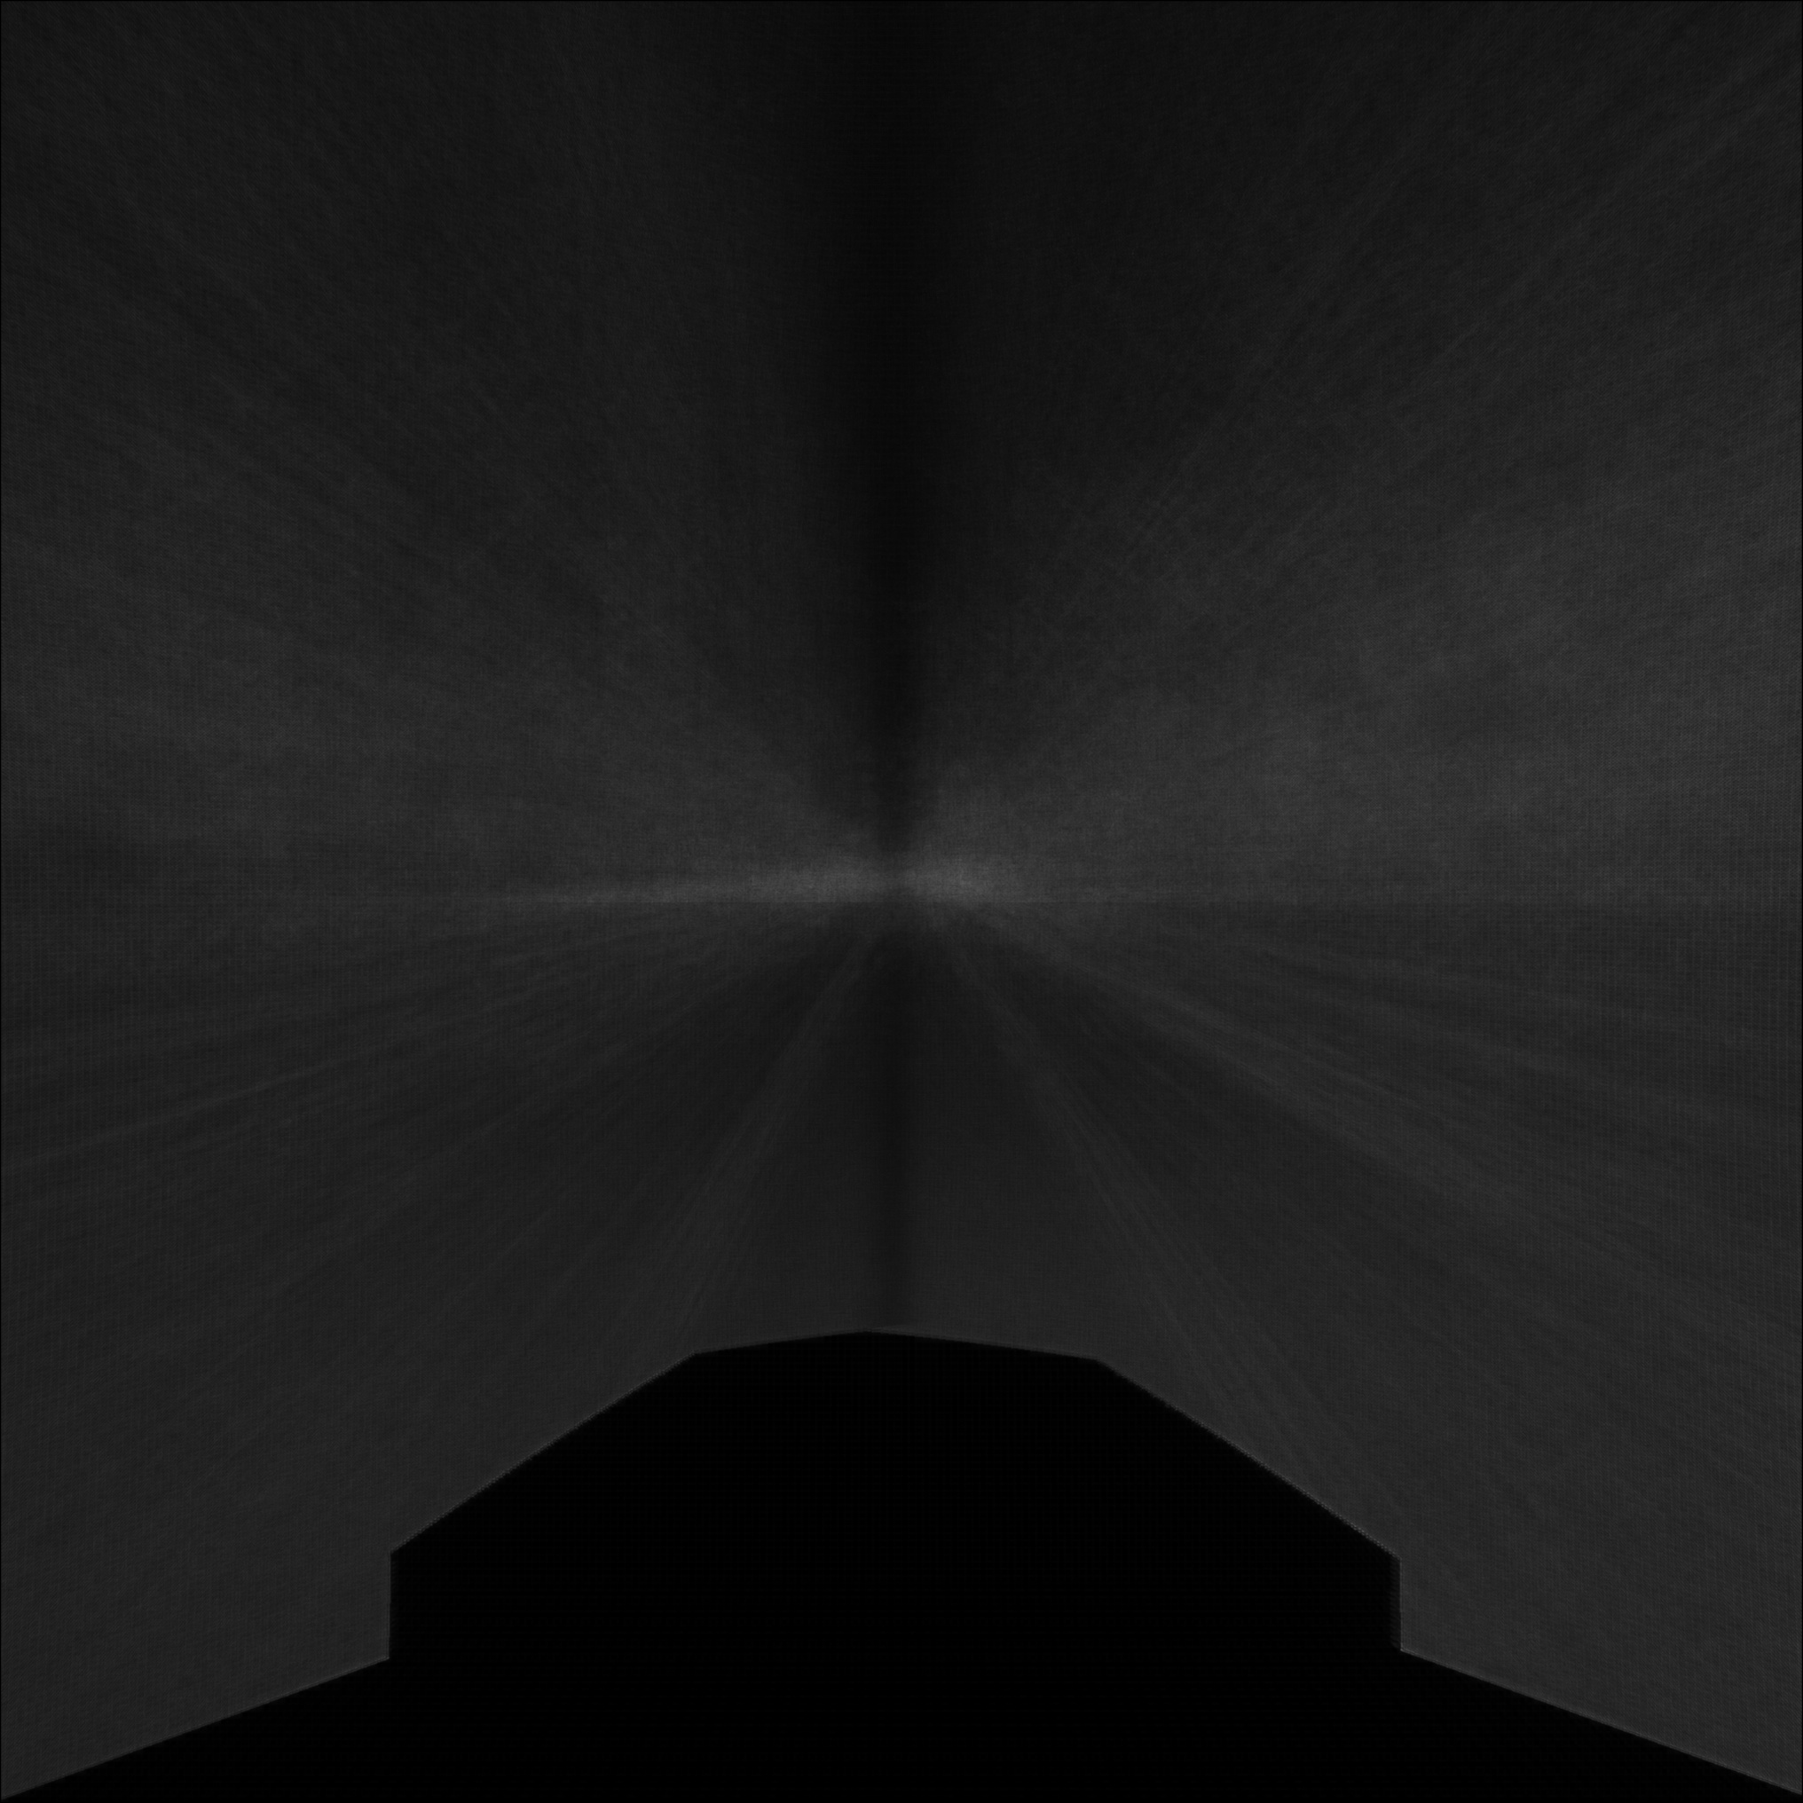
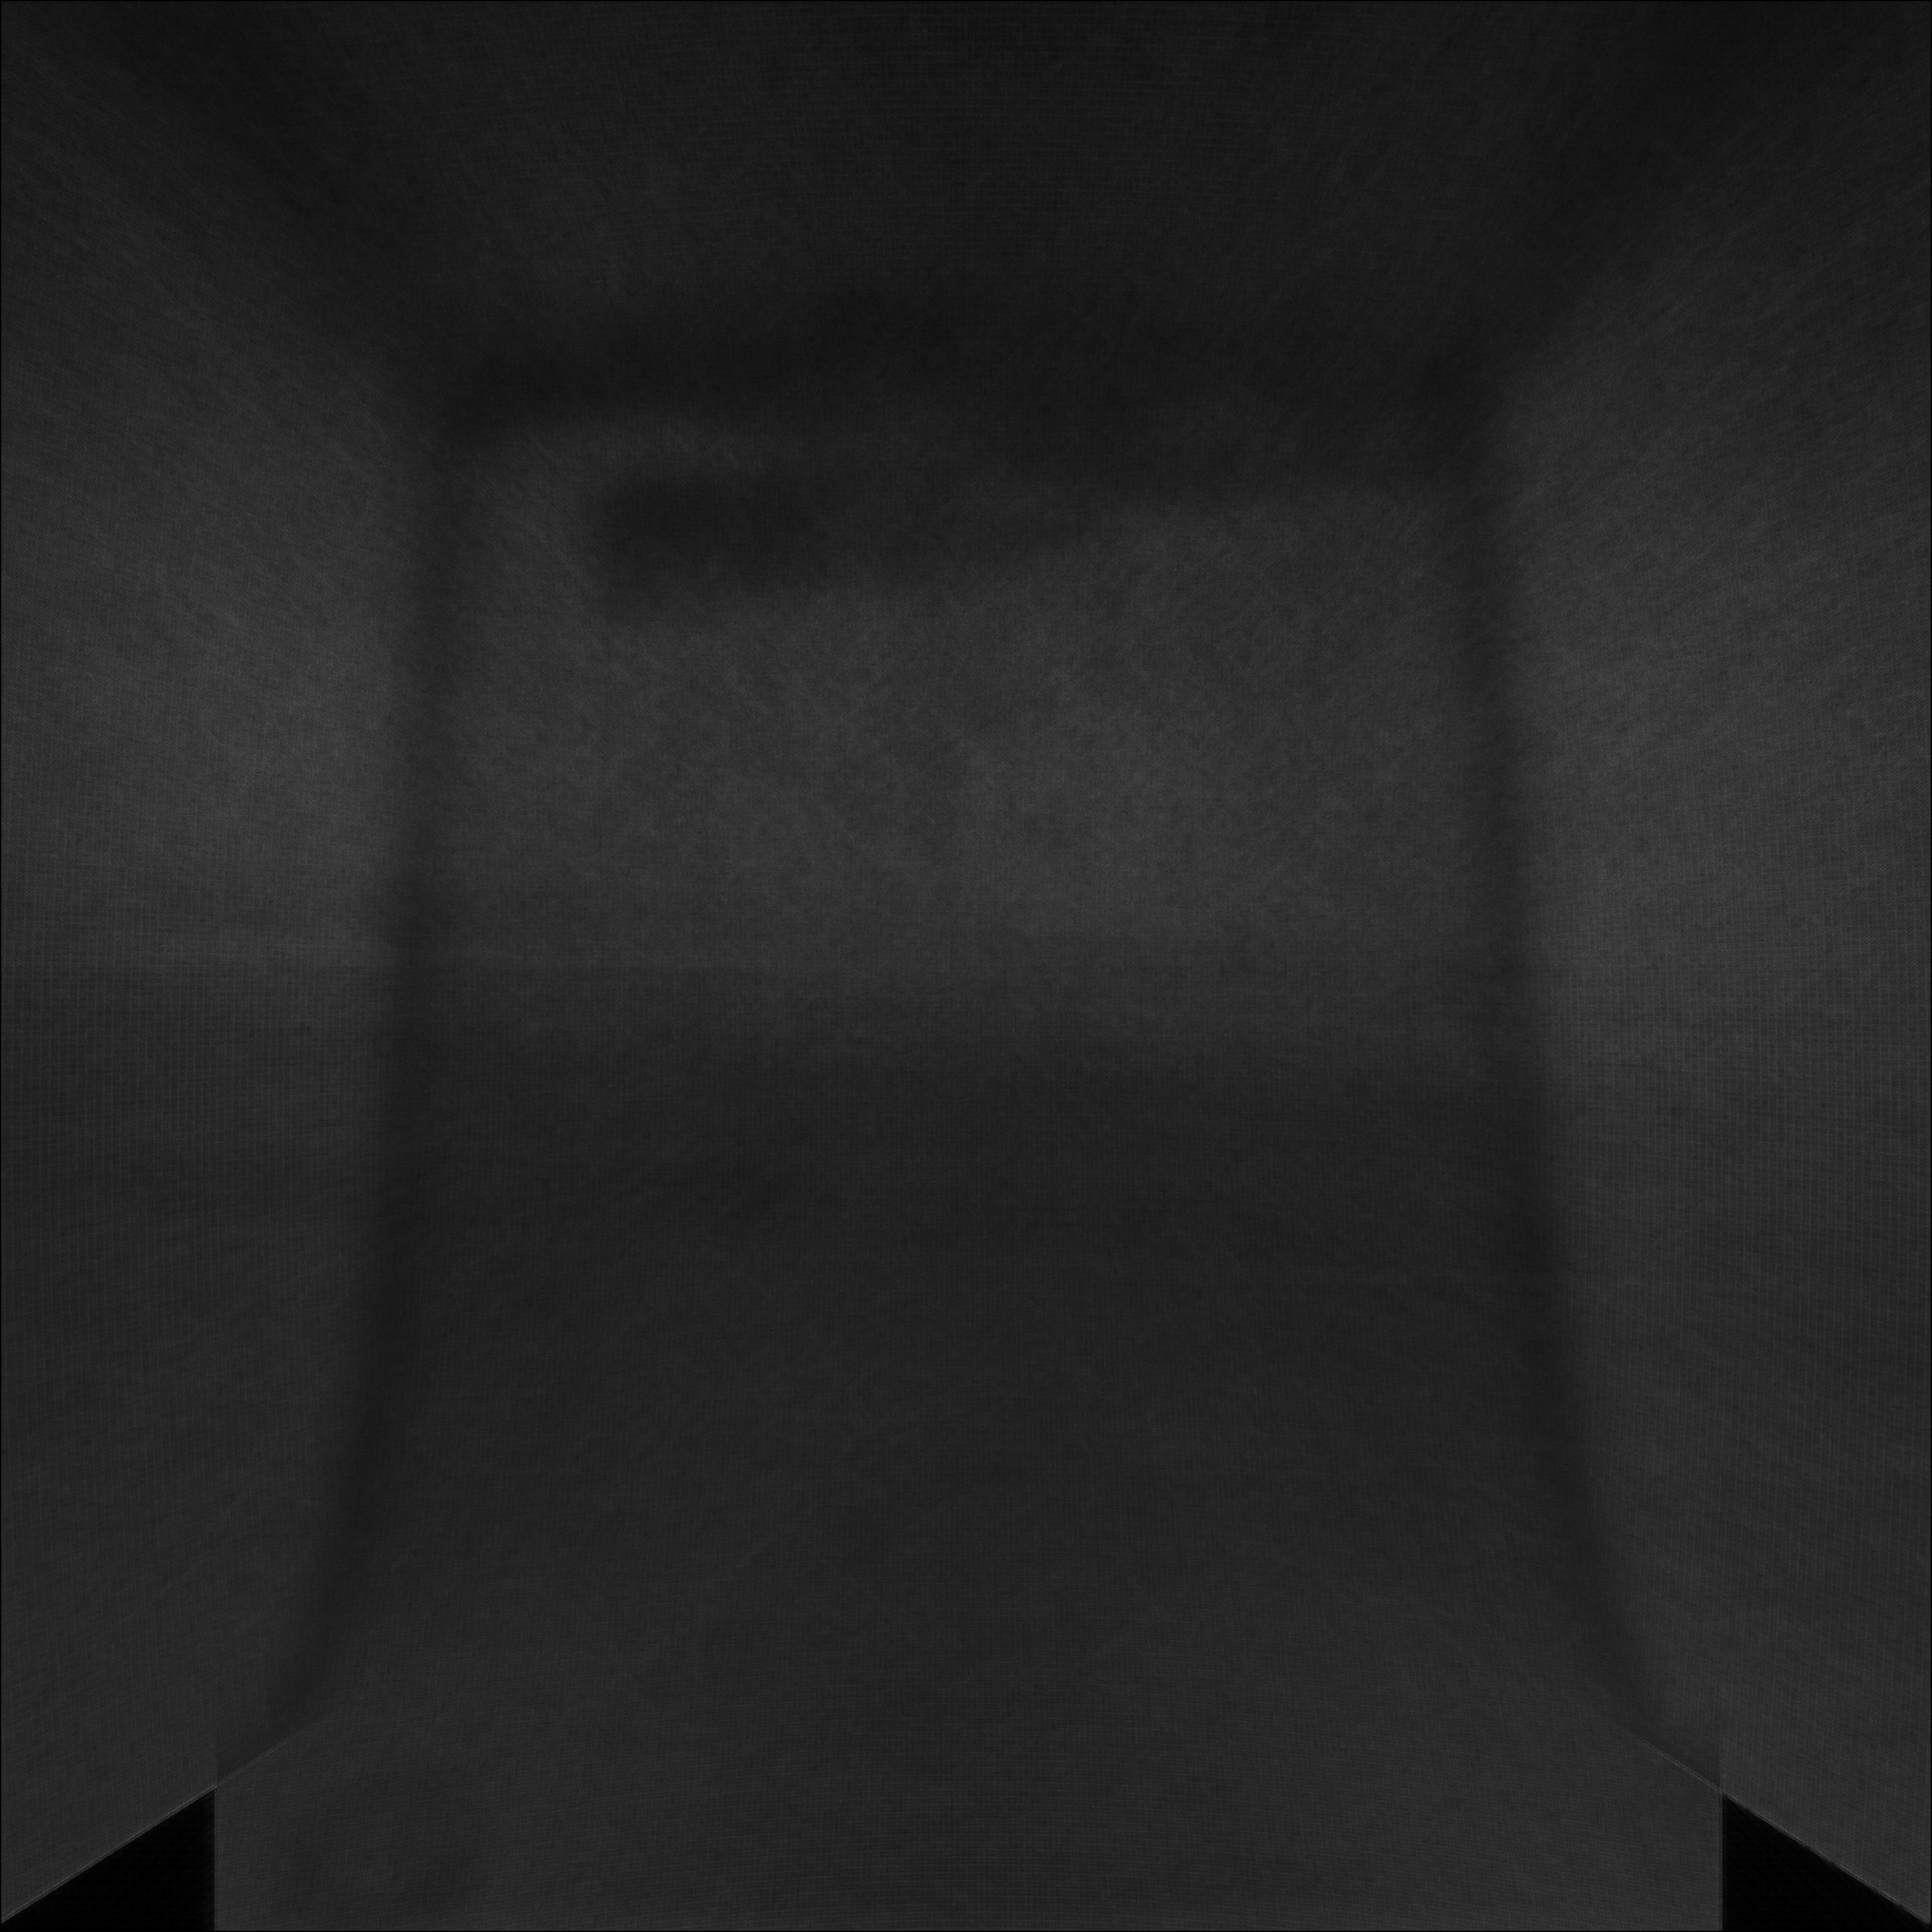
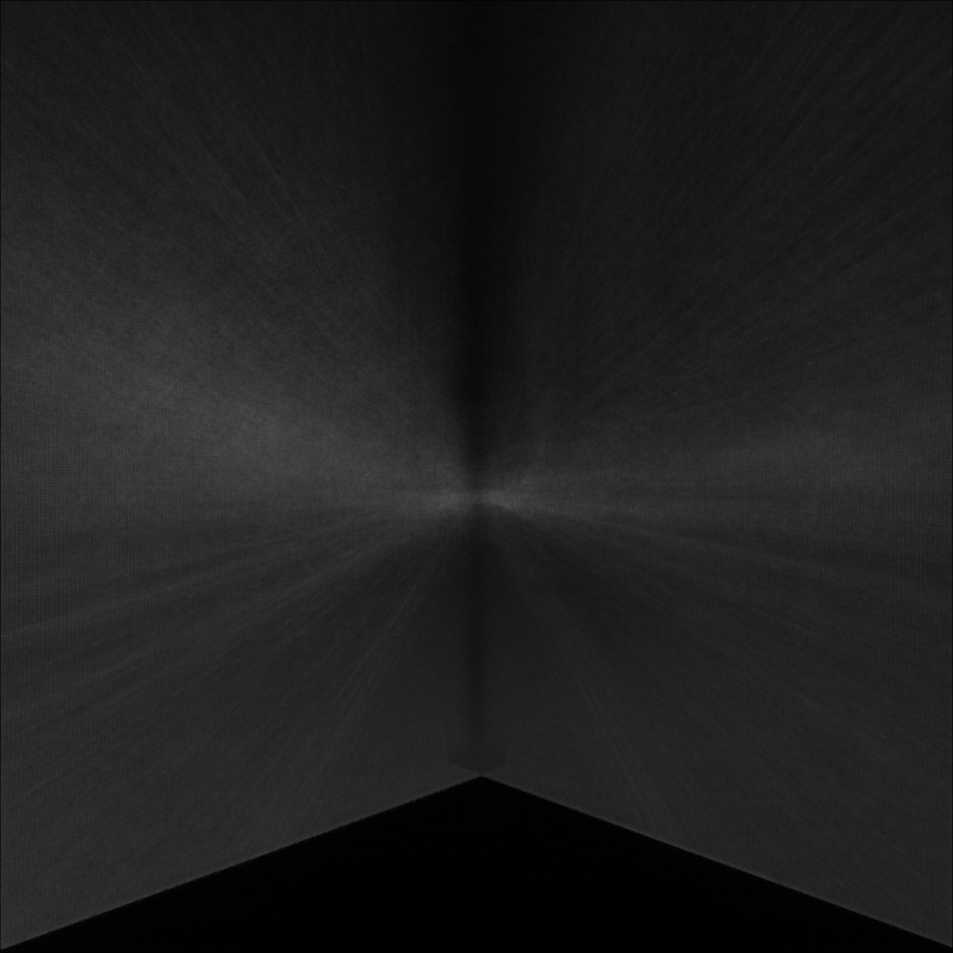
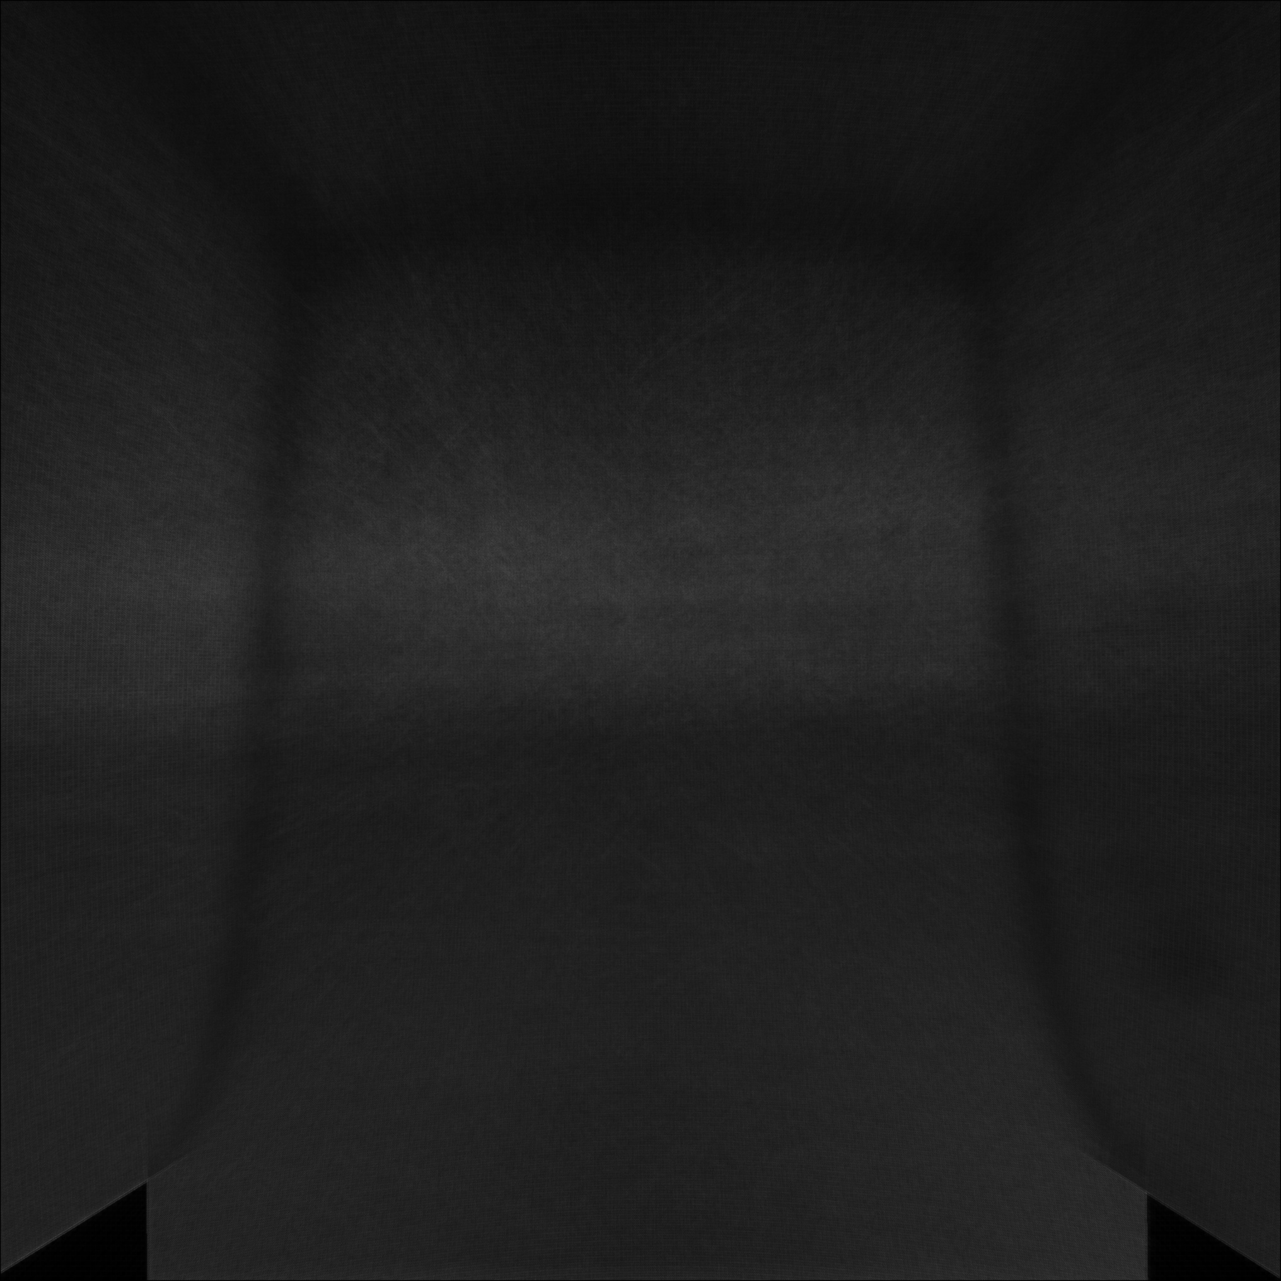

RESULTS
Average grayscale image of 400 samples:
cam_0 cam_1 cam_2
cam_3 cam_5

Slide 8

RESULTS
MASK image for sample com_0: (check the rest result in result folder)

Slide 9
DISCUSSION AND CONCLUSIONS
As a result of adding up images, the edges that are not present in all the pictures will turn white. Only the edges that are constant will all pictures will remain black.
Since series of iterations of erosion was performed, this approach may not detect very small dirt on lens
A lot of false-positives are generated if background doesn’t change.
Can’t detect thin and transparent smears.

