Slide 1


Slide 2
Healthcare Patient
Data Analysis
Comprehensive Insights from Patient, Visit, Treatment & Lab Records
10,000
10,000
1,000
3 Years
Patients
Visits
Doctors
Data Span
Excel · Tableau · Power BI · SQL

Slide 3
Introduction
About Axon Healthcare
Axon Healthcare is a health technology company dedicated to transforming patient care through data-driven insights. As an Electronic Medical Records (EMR) software provider, Axon serves hospitals, clinics, and multi-specialty practices across the United States.
Project Objective
This analysis examines 10,000 de-identified patient records spanning 2023–2025. The goal is to uncover patterns in patient demographics, visit behavior, treatment outcomes, and lab diagnostics to help Axon’s partner facilities improve operational efficiency and patient outcomes.
Dataset Scope
10,000 patients • 10,000 visit records • 1,000 doctors • 5 U.S. states • 3 years of data (2023–2025) • Tools: Excel, Power BI, SQL, Tableau
Healthcare Analytics Report | Based on 10,000 Patient Records

Slide 4
Data Cleaning And Processing
Challenges Encountered
• Missing values in Patient_ID, Visit_Date, and Lab_Result fields requiring imputation or removal
• Inconsistent date formats across Visit_Date and DOB columns (MM/DD/YYYY vs YYYY-MM-DD)
• Duplicate patient entries and outlier treatment cost values (>$5,000) identified and removed
• Non-standardized categorical values (e.g. “M”, “Male”, “male”) in Gender and Visit_Type fields
Steps Taken
• Standardized all date columns to YYYY-MM-DD using Excel Power Query and SQL CAST functions
• Applied TRIM, PROPER, and IFERROR functions in Excel to normalize categorical fields and flag errors
• Removed 47 duplicate records and capped Treatment_Cost outliers using IQR method
• Created derived columns: Age_Group, Visit_Year, and Cost_Band for segmentation in Power BI and Tableau
Healthcare Analytics Report | Based on 10,000 Patient Records

Slide 5
Executive Summary
👥 Patient Demographics
🏥 Visit Patterns
10,000 patients with avg. age 49 years. Near-equal split across Male (32.8%), Female (33.1%) and Other (34%). Spread across 5 major U.S. states.
3,966 visits in 2023, 4,927 in 2024 — a 24% YoY growth. Visits evenly distributed across Emergency, Routine, Follow-up and Specialist types.
💊 Treatment Insights
🔬 Lab Results
Avg. treatment cost: $524.75. Vaccination is the top treatment type (25.7%). Success rate stands at 33%, with 33.5% of treatments ongoing.
10,000 lab records. 33.5% results Abnormal, 33.4% Pending and 33% Normal. Blood Test, X-Ray and CT Scan are top tests performed.
Healthcare Analytics Report | Based on 10,000 Patient Records

Slide 6
Observations
10,000
Patient volume remains consistently high with 10,000 patients, indicating strong demand for healthcare services.
The number of visits matches patient count, suggesting most patients visit at least once, showing steady engagement.
With 1,000 doctors, the patient-to-doctor ratio is around 10:1, which reflects manageable workload but scope for optimization.
The average treatment cost ($524.75) indicates moderate healthcare expenses, making services relatively affordable.
There is potential to improve efficiency in doctor allocation to reduce waiting time and enhance patient satisfaction.
Increasing repeat visits could indicate chronic care demand or strong patient trust in services.
Opportunity to analyze cost distribution further to identify high-expense treatments and optimize pricing.
Patients
10,000
Visits
1,000
Doctors
Avg. Treatment Cost
$524.75
Healthcare Analytics Report | Based on 10,000 Patient Records

Slide 7
Patient Demographics
Top States
Texas
California
Florida
Illinois
New York
20.1%
20.1%
20.1%
20.0%
19.8%
Healthcare Analytics Report | Based on 10,000 Patient Records

Slide 8
Visit Analysis
*2025 data partial (Jan–Mar)
Follow-Up Required
No Follow-Up
Follow-Up Required
5,016 visits (50.2%)
4,984 visits (49.8%)
Healthcare Analytics Report | Based on 10,000 Patient Records

Slide 9
Diagnosis & Chronic Conditions
Chronic Conditions Prevalence
Hypertension
2,054 (20.5%)
Diabetes
2,030 (20.3%)
Asthma
1,990 (19.9%)
Arthritis
1,961 (19.6%)
💡 Migraine is the most common diagnosis (20.4%) while nearly 20% of visits resulted in a 'Healthy' outcome — a positive indicator.
Healthcare Analytics Report | Based on 10,000 Patient Records

Slide 10
Treatment Analysis
Avg. Treatment Cost
Max Treatment Cost
Min Treatment Cost
$524.75
$999.83
$50.11
Healthcare Analytics Report | Based on 10,000 Patient Records

Slide 11
Lab Results & Doctor Insights
⚠️ 33.5% Abnormal Results: A high proportion of abnormal lab results signals a need for proactive diagnostic protocols. ✅ General Medicine leads doctor specialties (21.2%), reflecting strong primary care demand.
Healthcare Analytics Report | Based on 10,000 Patient Records

Slide 12
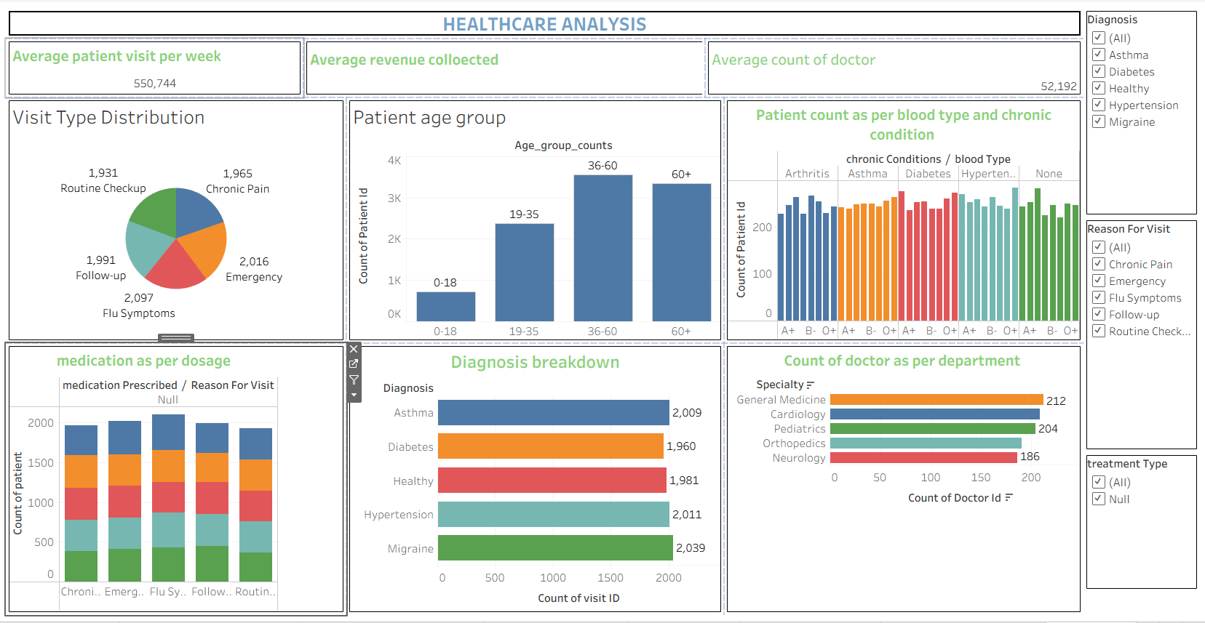
Tableau Dashboard
Healthcare Analytics Report | Based on 10,000 Patient Records

Slide 13
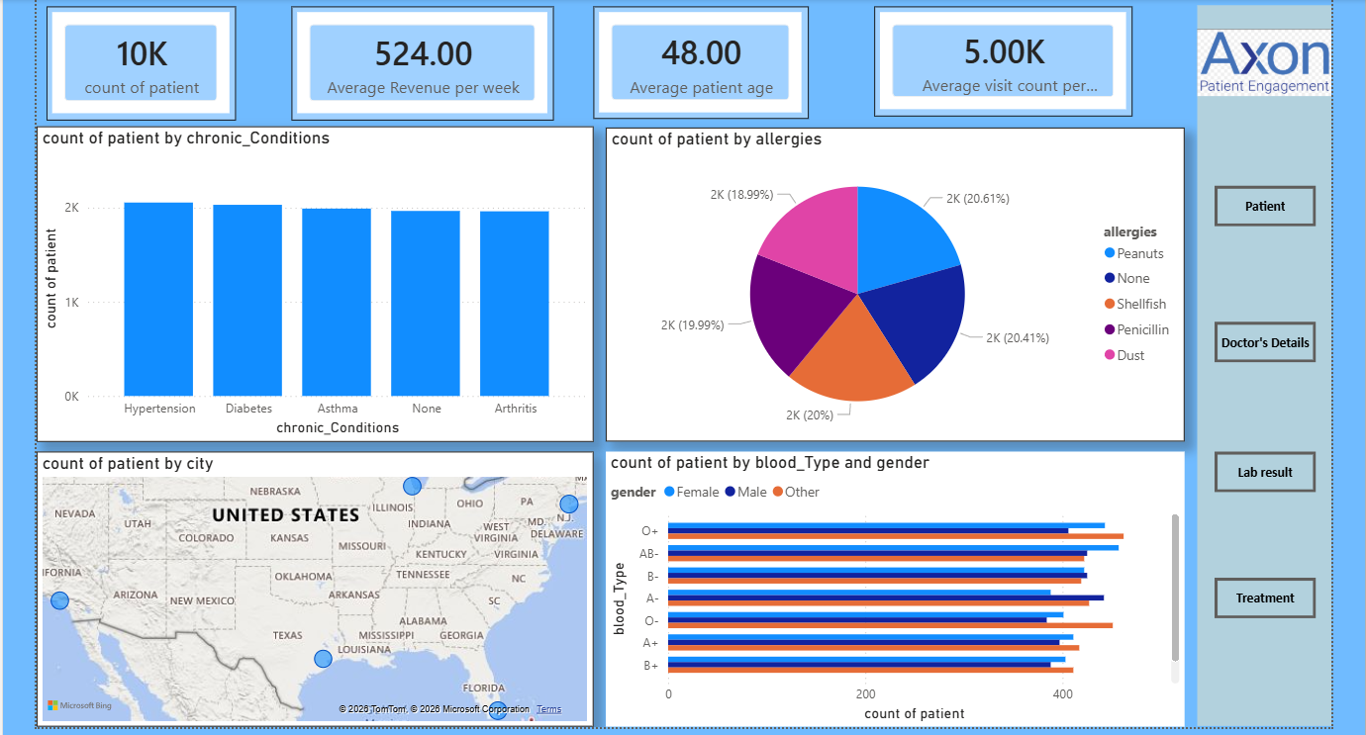
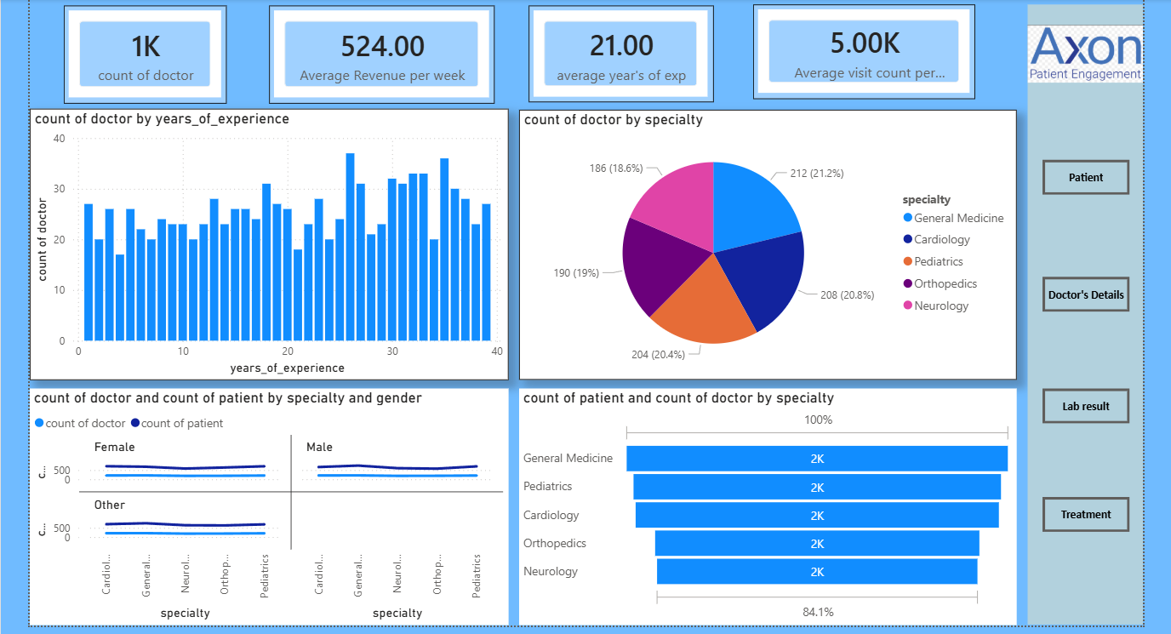
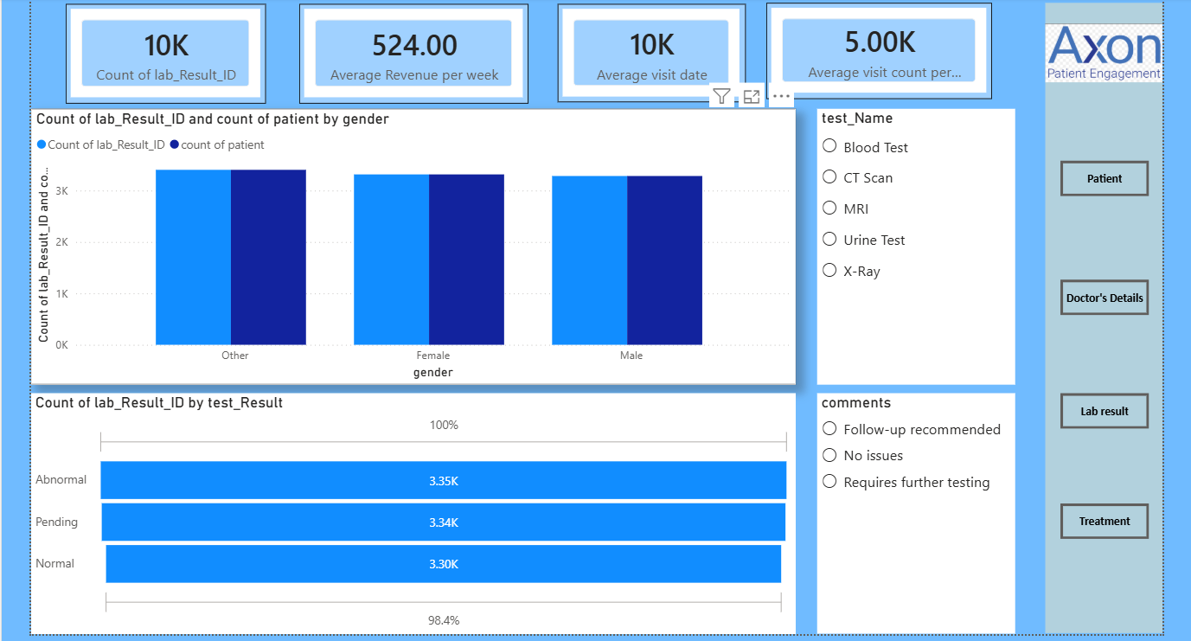
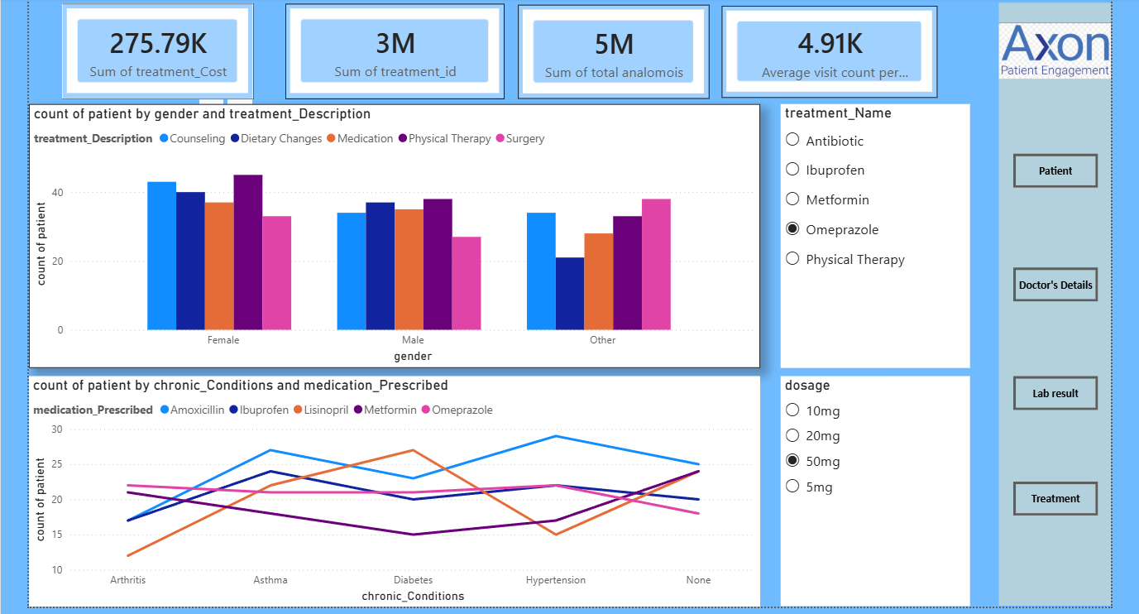
Power BI Dashboard
Healthcare Analytics Report | Based on 10,000 Patient Records

Slide 14
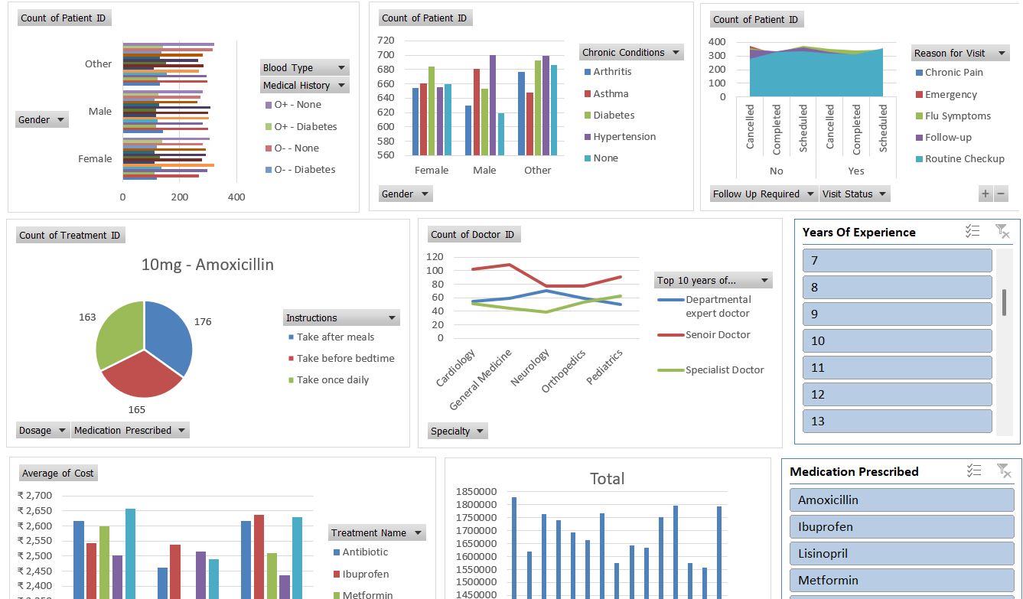
Excel Dashboard
Healthcare Analytics Report | Based on 10,000 Patient Records

Slide 15
SQL Queries
-- 1. Total visits by year
SELECT YEAR(Visit_Date) AS Visit_Year, COUNT(*) AS Total_Visits FROM Visits GROUP BY YEAR(Visit_Date) ORDER BY Visit_Year;
-- 2. Average treatment cost by treatment type
SELECT Treatment_Type, ROUND(AVG(Treatment_Cost),2) AS Avg_Cost, COUNT(*) AS Total FROM Treatments GROUP BY Treatment_Type ORDER BY Avg_Cost DESC;
-- 3. Top diagnoses by visit count
SELECT Diagnosis, COUNT(*) AS Visit_Count FROM Visits GROUP BY Diagnosis ORDER BY Visit_Count DESC LIMIT 10;
-- 4. Lab result distribution with percentage
SELECT Result_Status, COUNT(*) AS Count, ROUND(COUNT(*)*100.0/(SELECT COUNT(*) FROM Lab_Results),1) AS Pct FROM Lab_Results GROUP BY Result_Status;
-- 5. Chronic condition prevalence across patients
SELECT Chronic_Condition, COUNT(DISTINCT Patient_ID) AS Patients FROM Patient_Conditions GROUP BY Chronic_Condition ORDER BY Patients DESC;
Healthcare Analytics Report | Based on 10,000 Patient Records

Slide 16
Key Findings & Recommendations
📈 Rising Visit Volume
🧠 Chronic Disease Burden
Visits grew 24% from 2023 to 2024. Healthcare facilities should scale staffing and bed capacity to meet growing demand.
Hypertension (20.5%) and Diabetes (20.3%) are the top chronic conditions. Preventive care programs should be prioritized.
🔬 High Abnormal Lab Rate
💰 Treatment Cost Parity
33.5% of labs returned abnormal. Implement automated flagging and faster follow-up protocols to improve outcomes.
Average cost of $524.75 is consistent across treatment types — a positive sign for pricing equity across care modalities.
✅ Healthy Visit Outcomes
👨‍⚕️ Balanced Specialist Mix
20% of visits resulted in a 'Healthy' diagnosis — suggesting effective preventive care or timely patient-initiated visits.
All 5 specialties are nearly equally distributed. Consider targeted hiring in Neurology which has the fewest doctors.
Powered by Excel · Tableau · Power BI | 10,000 Patient Records | 2023–2025

Slide 17
Thank You
Healthcare Patient Data Analysis • 10,000 Patient Records • 2023–2025
Presented by
• Marada Joshith • Suvrat Nair • Shreyas Shrikant Bhatkar • Soundarya G
Gnana Prasanna Kode • Arun Poodari • Rahul M Chavan
Powered by Excel • Tableau • Power BI • SQL

