Slide 1


Supply Chain and Logistics Optimization
Presented by: Omkar Jadhav
Yash Shiwalkar
Chetana Jumle
Soundarya Sakthi

Slide 2

 | Introduction |  | Conclusion
 | Problem Statement |  | The Team
 | Flowchart
 | Tools and Technologies Used
 | Insights Drawn
 | Areas of Improvement
Outline

Slide 3


INTRODUCTION
World's largest online retailer and marketplace
Exploring the intricacies of Amazon's supply chain logistics system
Amazon's system is renowned for its speed and reliability, it is not without its challenges.

Slide 4



Faces challenges due to a variety of factors, including unpredictable weather conditions, traffic congestion, area-specific constraints, and vehicle performance
Problem Statement
Can cause delays in deliveries, increase transportation costs, and disrupt the flow of goods across Amazon’s vast network of fulfillment centers, distribution hubs, and delivery routes.
Our proposed dashboard will visualize and analyze these critical factors, allowing Amazon to proactively adjust routes and make data-driven decisions.

Slide 5

FLOWCHART
START
Data Collection
Data Cleaning
Transform & Load
Creating Visuals
Drawing Insights
END

Slide 6
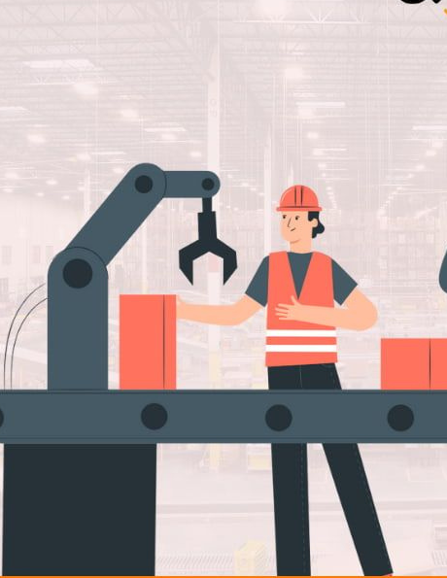



Tools and Technologies:-
Microsoft Excel
Microsoft PowerBI
Data Source:- Kaggle

Slide 7
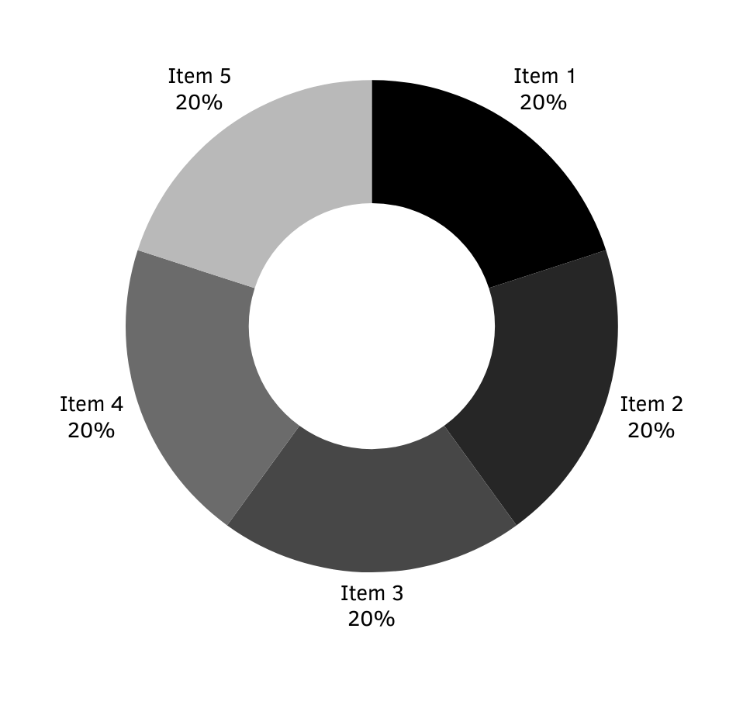
Insights Drawn :
Less orders placed at the end of each Month
Large number of orders in metropolitan regions
Number of orders increased in foggy weather
Delivery times differ according to vehicle type and traffic Conditions

Slide 8
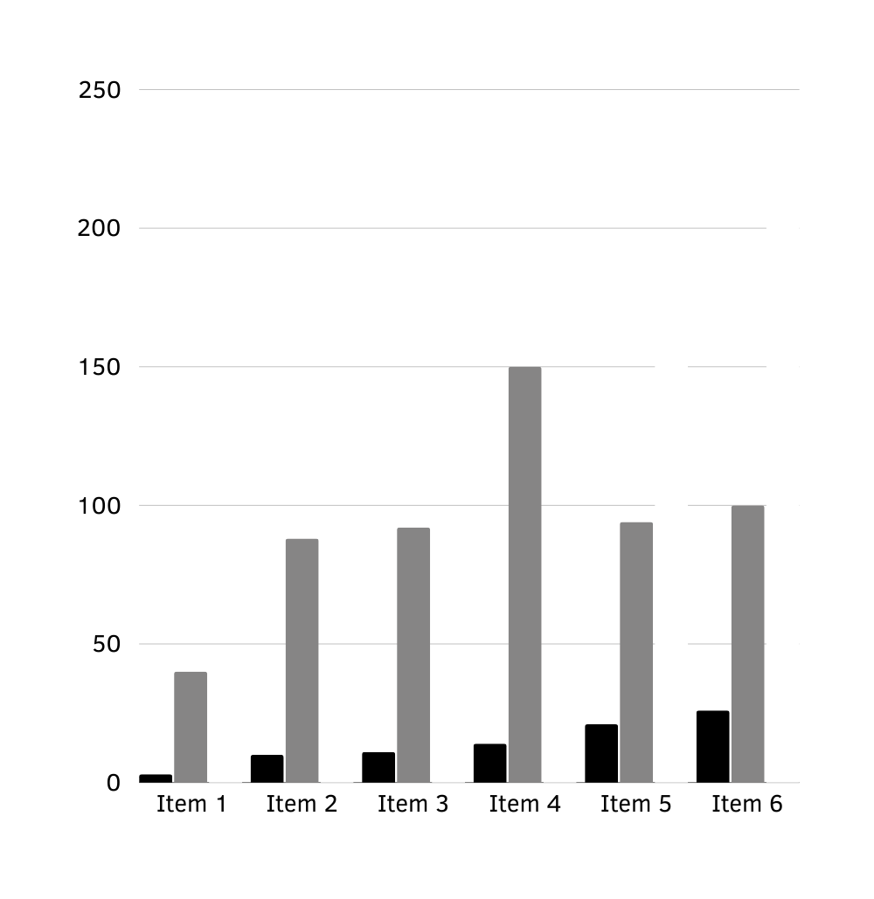
Feasible Solutions :
Offering discounts and Coupons might increase sales at the end of month
Increasing Warehouses in urban and semi-urban areas
Scaling supply chain as per changes in weather
Enhancing transportation and logistics
Allocating delivery agents as per requirements in different regions

Slide 9
Revealed several key insights that can inform strategic decisions to enhance customer experience and drive sales
Decline in orders at the end of each month, a high concentration of orders in metropolitan regions, and increased orders during foggy weather.
By implementing feasible solutions, Amazon can capitalize on the identified trends, improve customer satisfaction, and drive business growth.
Conclusion :

Slide 10




The Team
Omkar Jadhav
Yash Shiwalkar
Chetana Jumle
Soundarya Sakthi

Slide 11
Thank you!

