Slide 1
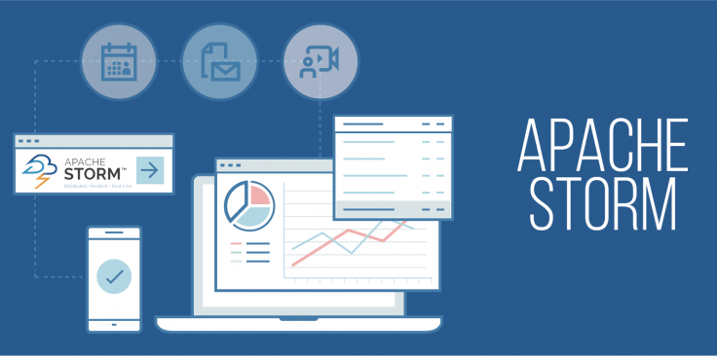

Slide 2
CONTENTS
Big Data
Types of Processing of Big Data
Introduction of Storm
How Storm Works
Features of Storm
Use Cases of Storm
Conclusion

Slide 3
BIG DATA
What is Big Data?
It is a term used to refer to data sets that are too large or complex for traditional data-processing application software to adequately deal with.
3 V’s of Big Data
Volume
Velocity
Variety

Slide 4
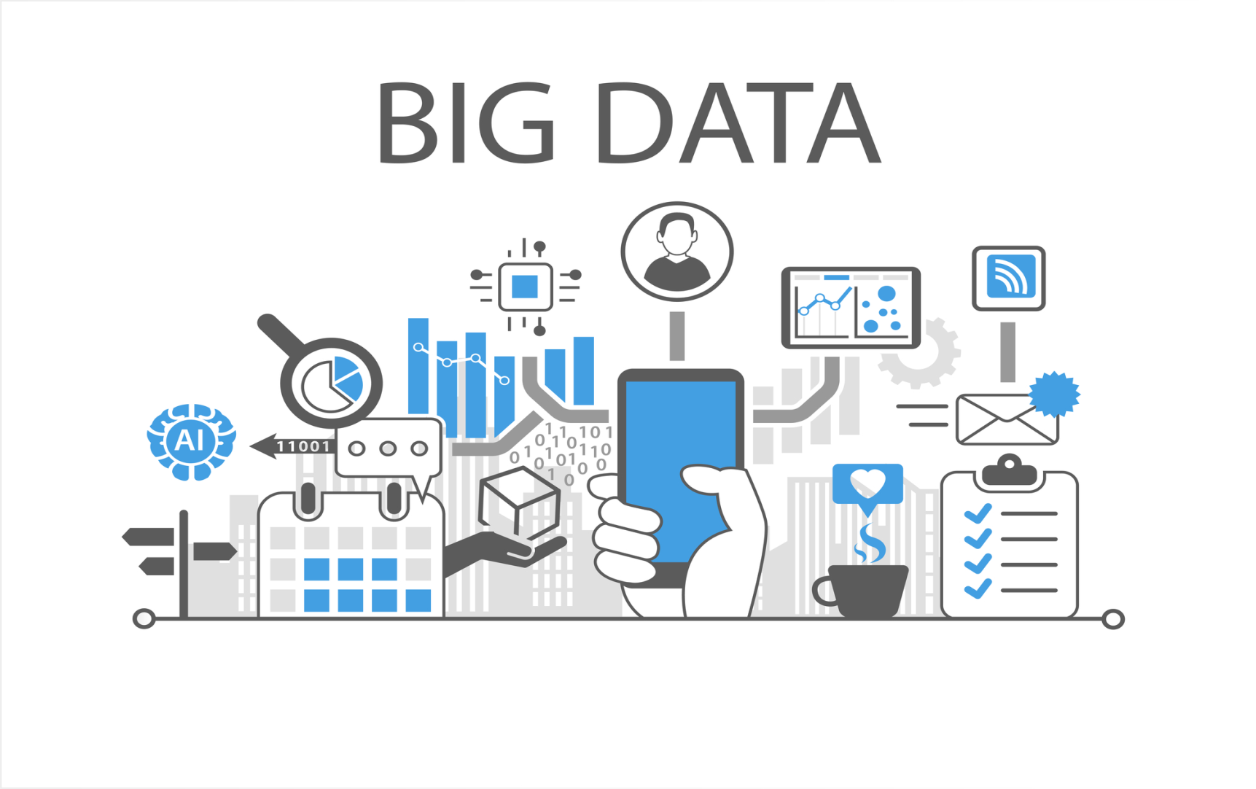
What can we do with Big Data?

Slide 5
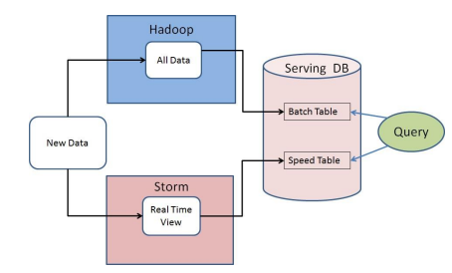
TYPES OF PROCESSING OF BIG DATA
Batch Processing
Hadoop
Real-Time Processing
Storm

Slide 6
INTRODUCTION TO STORM
Apache Storm is an open-source distributed real-time computational system for processing data streams.
Storm was developed by Nathan Marz.
It was acquired and open sourced by Twitter.
Currently being incubated at the Apache Software Foundation.

Slide 7
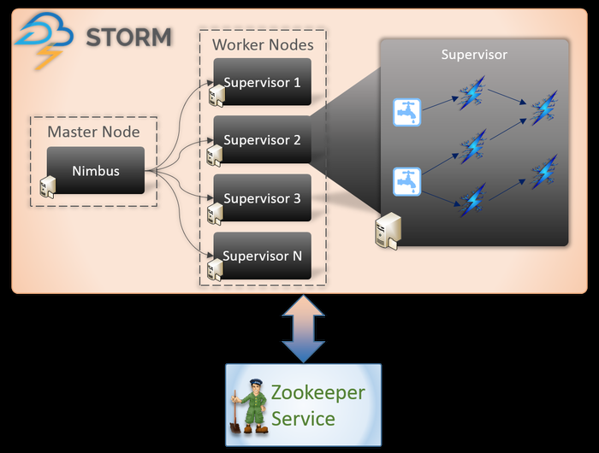
HOW STORM WORKS
Master-Slave Architecture
Nimbus is the master daemon
Supervisor is the worker daemon

Slide 8
ZooKeeper
coordination between Nimbus and Worker Nodes
monitors the message processing tasks as all the worker nodes update their tasks status in it.
Workers get the input from file system or database.
Storm data model consists of tuples and streams.
Storm components consists of spouts and bolts

Slide 9
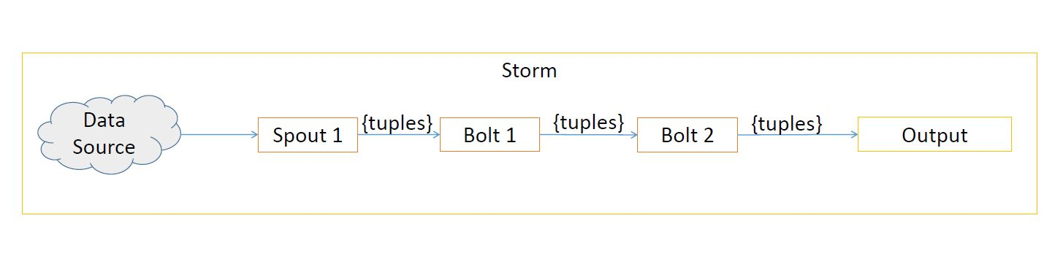
Spouts ingest the data and process it into stream of tuples and send them to bolts.
Bolts process tuples and produce some output tuples.
Spouts and bolts run in parallel and can distribute across machines in the storm cluster.

Slide 10
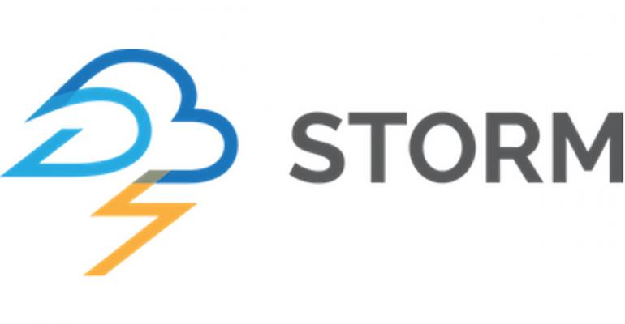
FEATURES OF STORM
Fast
Reliable
Scalable
Fault tolerant
Guaranteed data processing
Easy to operate
Programming language agnostic

Slide 11
ONE OF THE MOST IMPORTANT FEATURE OF STORM
Fault tolerant
What happens when a worker dies?
What happens when a node dies?
What happens when Nimbus or Supervisor daemons die?
Is Nimbus a single point of failure?

Slide 12
USE CASES OF STORM
Twitter
to search, process and save hashtags.
Yahoo! Finance
to monitor the financial details of websites.
Klout
to create complex topologies.
Weather Channel
To ingest weather data.

Slide 13
CONCLUSION
Storm is a complete framework for the development, deployment and maintenance of distributed stream applications.

Slide 14


Slide 15
THANK YOU

