Slide 1
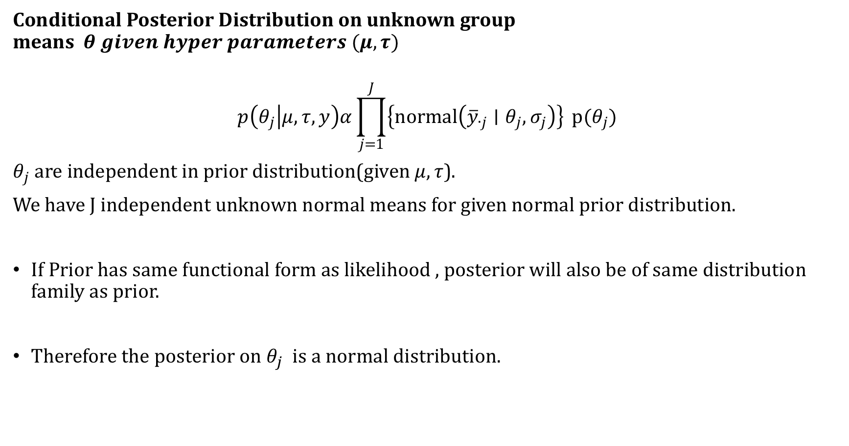
Conditional Posterior Distribution on unknown group means$θ given hyper parameters (μ,τ)$
$$p\left(θ_{j} | μ,τ,y\right)α\prod_{j=1}^{J}{\left\{normal\left({\overline{y}}_{∙j}∣θ_{j},σ_{j}\right)\right\}} p(θ_{j})$$
$θ_{j}$ are independent in prior distribution(given $μ,τ$).
We have J independent unknown normal means for given normal prior distribution.
If Prior has same functional form as likelihood , posterior will also be of same distribution family as prior.
Therefore the posterior on $θ_{j}$ is a normal distribution.

Slide 2
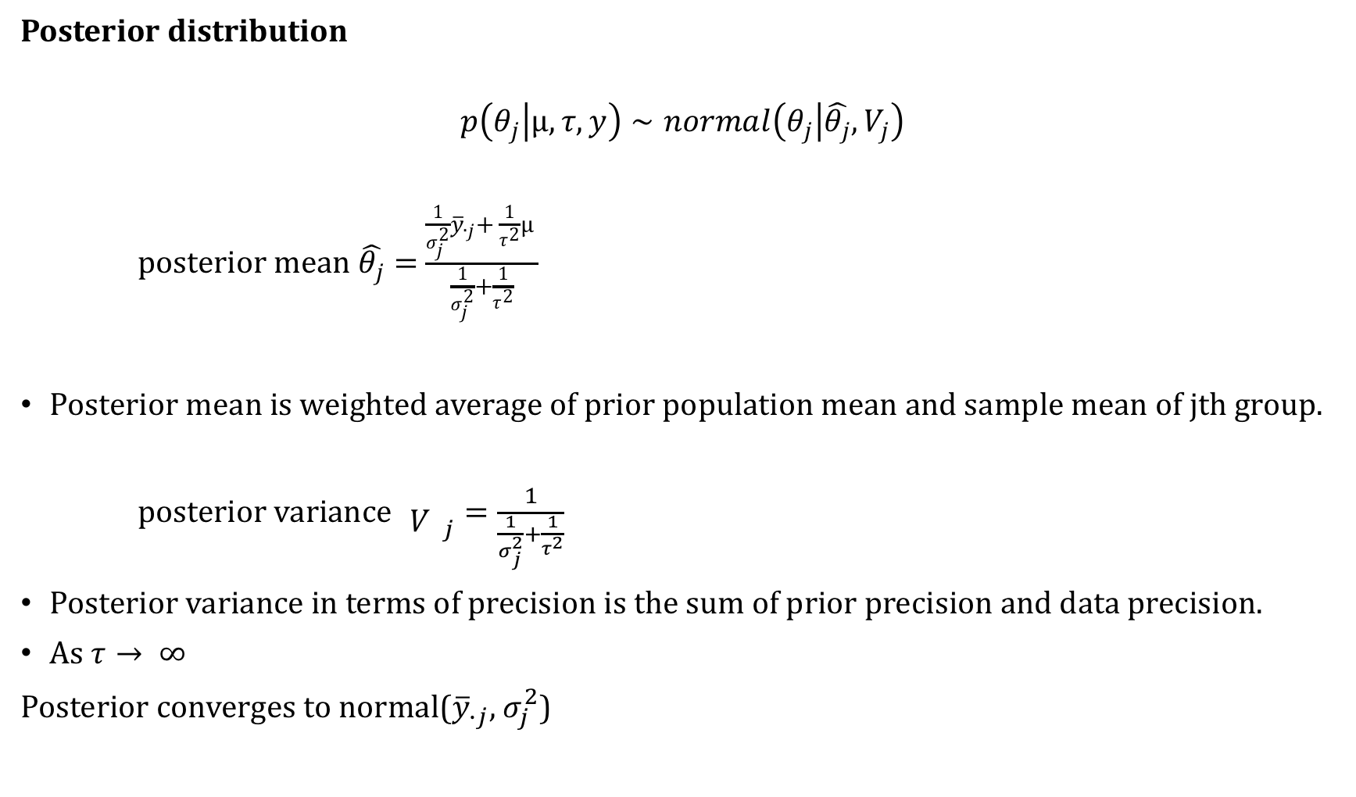
Posterior distribution
$$p\left(θ_{j} | μ,τ,y\right)∼normal\left(θ_{j} | \hat{θ_{j}},V_{j}\right)$$
posterior mean $\hat{θ_{j}}=$ $\frac{\frac{1}{σ_{j}^{2}}{\overline{y}}_{∙j}+ \frac{1}{τ^{2}}μ }{\frac{1}{σ_{j}^{2}}+\frac{1}{τ^{2}}}$
Posterior mean is weighted average of prior population mean and sample mean of jth group.
posterior variance ${\begin{aligned} \\ V\end{aligned}}_{j}=\frac{1}{\frac{1}{σ_{j}^{2}}+\frac{1}{τ^{2}}}$
Posterior variance in terms of precision is the sum of prior precision and data precision.
As $τ→ ∞$
Posterior converges to normal(${\overline{y}}_{∙j}$, $σ_{j}^{2}$)

Slide 3
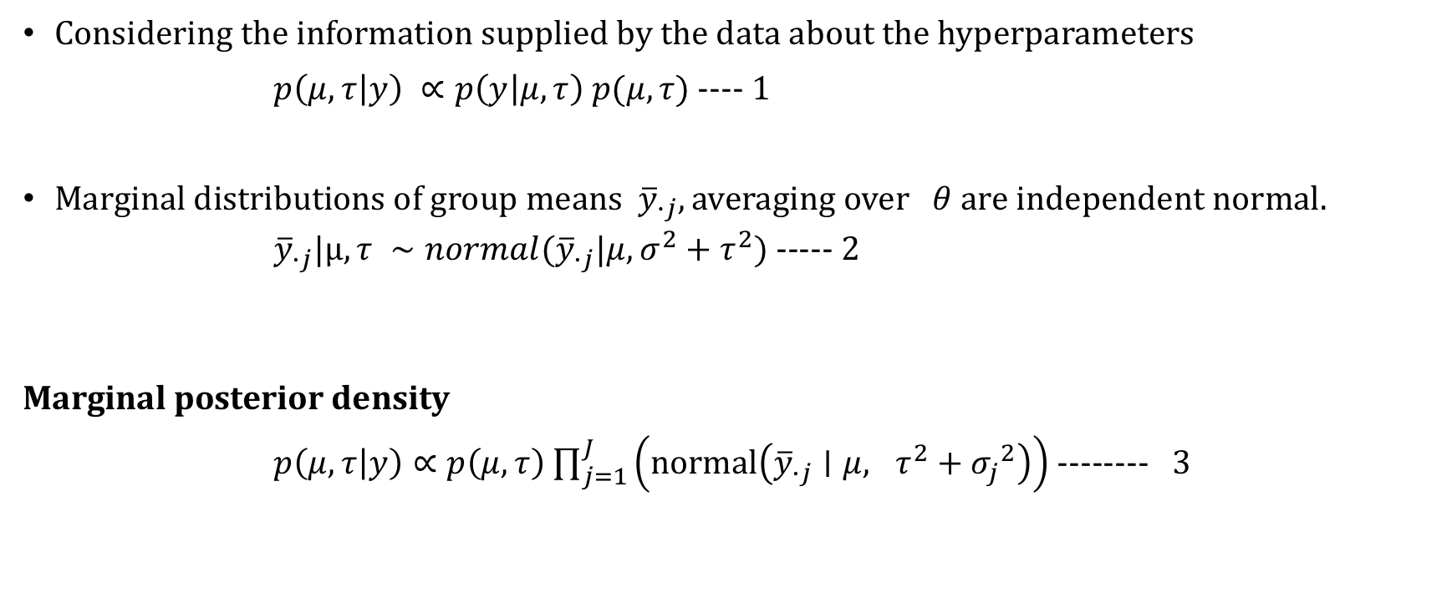
Marginal posterior distribution of hyperparameters
Considering the information supplied by the data about the hyperparameters
$p\left(μ,τ | y\right) ∝p\left(y | μ,τ\right) p(μ,τ)$ ---- 1
Marginal distributions of group means ${\overline{y}}_{∙j}, averaging over$ $θ$ are independent normal.
${\overline{y}}_{∙j}|μ,τ ∼normal({\overline{y}}_{∙j}|μ,σ^{2}+τ^{2})$ ----- 2
Marginal posterior density
$p\left(μ,τ | y\right)∝p\left(μ, τ\right)$ $\prod_{j=1}^{J}{\left(normal\left({\overline{y}}_{∙j}∣μ, τ^{2}+{σ_{j}}^{2}\right)\right)}$ -------- 3

Slide 4

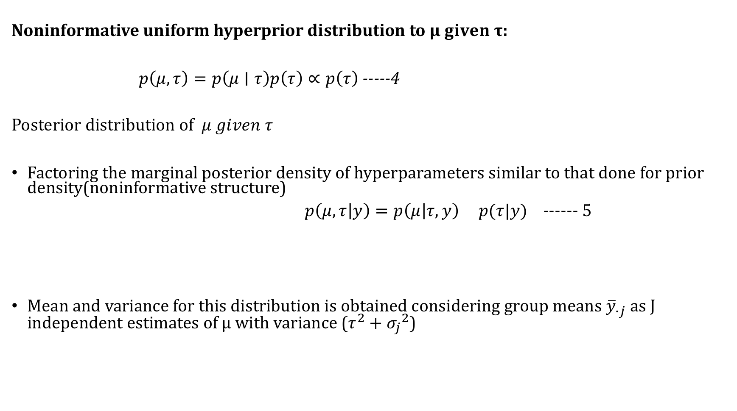
Noninformative uniform hyperprior distribution to $μ given τ$:
$p\left(μ,τ\right)=p\left(μ∣τ\right)p\left(τ\right)∝p\left(τ\right)$ -----4
Posterior distribution of $μ given τ$
Factoring the marginal posterior density of hyperparameters similar to that done for prior density(noninformative structure)
$p\left(μ,τ | y\right)=p\left(μ | τ,y\right) p(τ|y)$ ------ 5
Mean and variance for this distribution is obtained considering group means ${\overline{y}}_{∙j}$ as J independent estimates of μ with variance ($τ^{2}+{σ_{j}}^{2}$)
Posterior distribution of $μ if τ is known$

Slide 5

Combining data with uniform prior density $p\left(μ | τ\right)yields$
$μ|τ,y ∼norm(\hat{μ},V_{μ}$),
$\hat{μ}$ is precision weighted average of the ${\overline{y}}_{∙j}$ values, ${V_{μ}}^{−1}$ is total precision.
$\hat{μ}$ = $\frac{\sum_{j=1}^{J}{\left(\frac{1}{σ_{j}^{2}+ τ^{2}}\right){\overline{y}}_{∙j}}}{\sum_{j=1}^{J}{\left(\frac{1}{σ_{j}^{2}+ τ^{2}}\right)}} {V_{μ}}^{−1}$= $\sum_{j=1}^{J}{\left(\frac{1}{σ_{j}^{2}+ τ^{2}}\right)}$

