Slide 1
INFSCI 2910
Hierarchical model with fixed likelihood sigma
Probabilistic model

Slide 2

We will use a different prior setup on the hyperparameters compared to BDA3
Instead of the non-informative style, we will specify that $μ$ and $τ$ are a-prior independent.
$$p\left(μ,τ\right)=p\left(μ\right)p\left(τ\right)$$

Slide 3


The hyperprior on $μ$ will be Gaussian with mean $m_{0}$ and standard deviation $s_{0}$
The prior on $μ$ is: $μ∣m_{0},s_{0}∼normal\left(μ∣m_{0},s_{0}\right)$

Slide 4


The hyperprior on $τ$ will be Exponential with the rate parameter $λ_{0}$
$$τ∣λ_{0}∼Exp\left(τ∣λ_{0}\right)$$

Slide 5

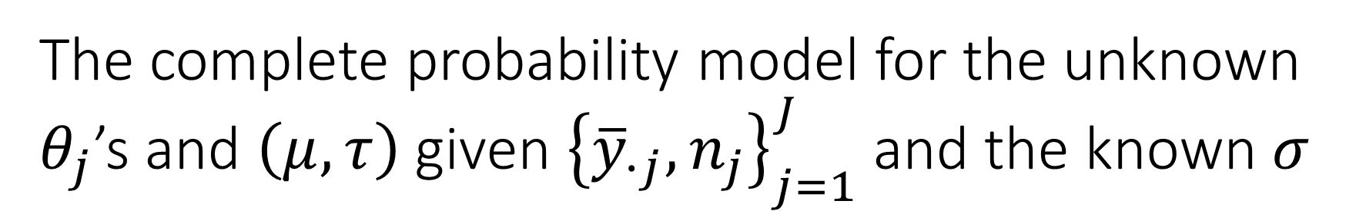

The complete probability model for the unknown $θ_{j}$’s and $\left(μ,τ\right)$ given ${\left\{{\overline{y}}_{∙j},n_{j}\right\}}_{j=1}^{J}$ and the known $σ$
$${\overline{y}}_{∙j}∣θ_{j},σ,n_{j}∼normal\left({\overline{y}}_{∙j}∣θ_{j},σ_{j}=σ/{\sqrt{n_{j}}}\right)$$
$$θ_{j}∣μ,τ∼normal\left(θ_{j}∣μ,τ\right)$$
$$μ∣m_{0},s_{0}∼normal\left(μ∣m_{0},s_{0}\right)$$
$$τ∣λ_{0}∼Exp\left(τ∣λ_{0}\right)$$
For $j=1,…,J$

Slide 6

Or equivalently we can write the joint posterior as:
$$p\left({\left\{θ_{j}\right\}}_{j=1}^{J},μ,τ∣{\left\{{\overline{y}}_{∙j},n_{j}\right\}}_{j=1}^{J},σ\right)∝\left(\prod_{j=1}^{J}{\left\{normal\left({\overline{y}}_{∙j}∣θ_{j},σ_{j}\right)\right\}}\right)×\left(\prod_{j=1}^{J}{\left\{normal\left(θ_{j}∣μ,τ\right)\right\}}\right)×normal\left(μ∣m_{0},s_{0}\right)×Exp\left(τ∣λ_{0}\right)$$

Slide 7
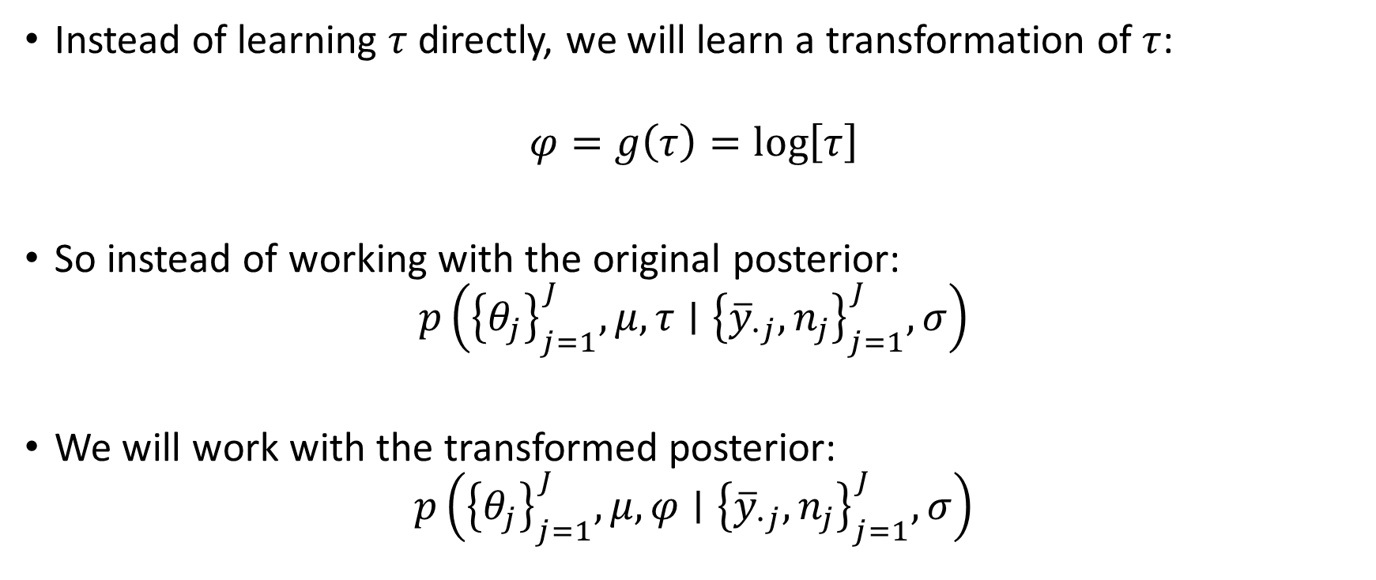

Apply a transformation in order to make it easier to apply the Laplace Approximation to $τ$
Instead of learning $τ$ directly, we will learn a transformation of $τ$:
$$φ=g\left(τ\right)=\log\left[τ\right]$$
So instead of working with the original posterior:
$$p\left({\left\{θ_{j}\right\}}_{j=1}^{J},μ,τ∣{\left\{{\overline{y}}_{∙j},n_{j}\right\}}_{j=1}^{J},σ\right)$$
We will work with the transformed posterior:
$$p\left({\left\{θ_{j}\right\}}_{j=1}^{J},μ,φ∣{\left\{{\overline{y}}_{∙j},n_{j}\right\}}_{j=1}^{J},σ\right)$$

Slide 8


We need to apply the change-of-variables “process” in order to work with the unbounded $φ$
We have to do this because the PRIOR is defined in terms of $τ$ and NOT in terms of $φ$.
“The distribution we want” = “distribution we have” $×$ “derivative”
Substitution

Slide 9
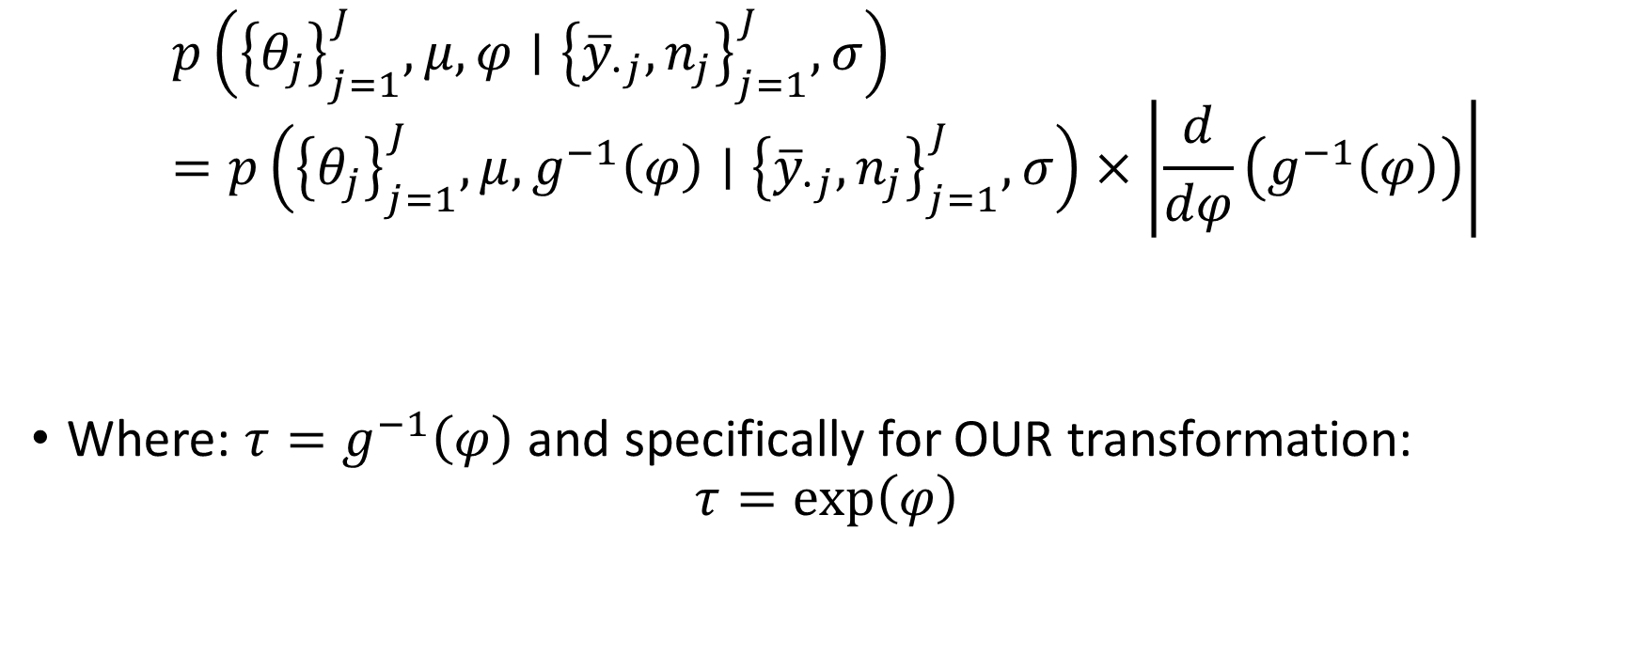

We need to apply the change-of-variables “process” in order to work with the unbounded $φ$
$$p\left({\left\{θ_{j}\right\}}_{j=1}^{J},μ,φ∣{\left\{{\overline{y}}_{∙j},n_{j}\right\}}_{j=1}^{J},σ\right)=p\left({\left\{θ_{j}\right\}}_{j=1}^{J},μ,g^{−1}\left(φ\right)∣{\left\{{\overline{y}}_{∙j},n_{j}\right\}}_{j=1}^{J},σ\right)×\left|\frac{d}{dφ}\left(g^{−1}\left(φ\right)\right)\right|$$
Where: $τ=g^{−1}\left(φ\right)$ and specifically for OUR transformation:
$$τ=\exp\left(φ\right)$$
$$τ$$

Slide 10
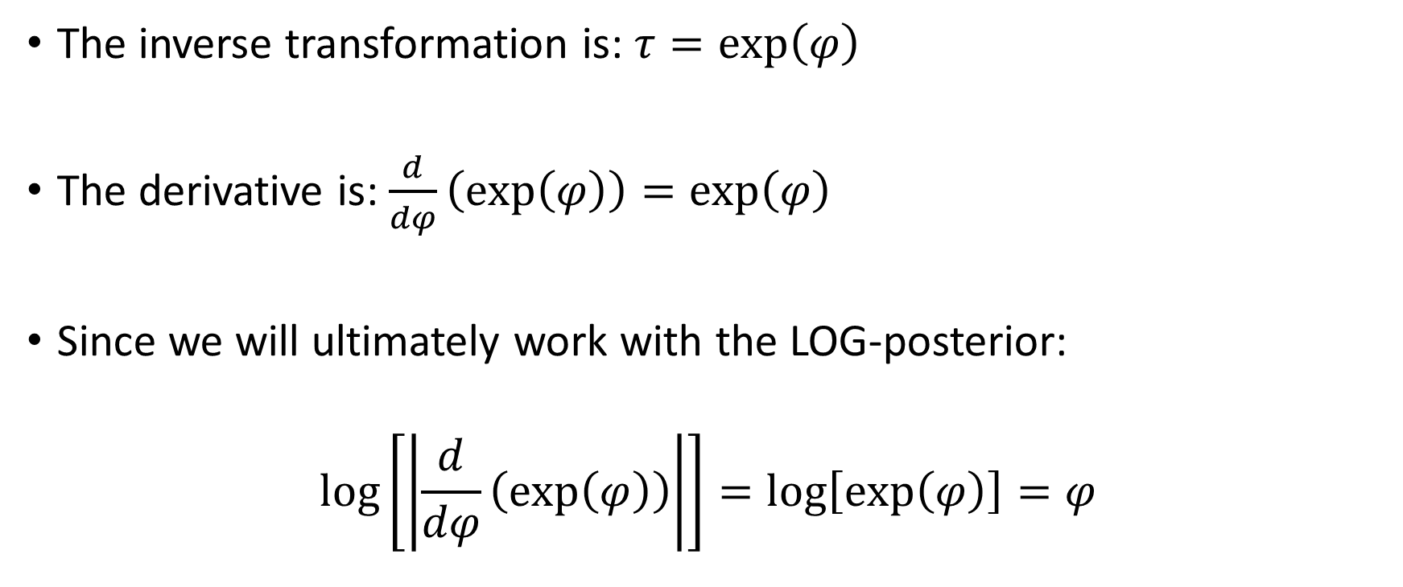
Specifically for our transformation
The inverse transformation is: $τ=\exp\left(φ\right)$
The derivative is: $\frac{d}{dφ}\left(\exp\left(φ\right)\right)=\exp\left(φ\right)$
Since we will ultimately work with the LOG-posterior:
$$\log\left[\left|\frac{d}{dφ}\left(\exp\left(φ\right)\right)\right|\right]=\log\left[\exp\left(φ\right)\right]=φ$$

Slide 11
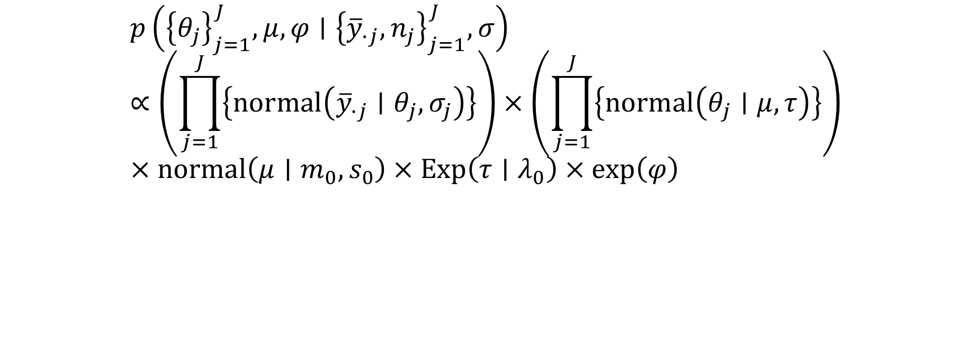
The posterior distribution we are interested in:
$$p\left({\left\{θ_{j}\right\}}_{j=1}^{J},μ,φ∣{\left\{{\overline{y}}_{∙j},n_{j}\right\}}_{j=1}^{J},σ\right)∝\left(\prod_{j=1}^{J}{\left\{normal\left({\overline{y}}_{∙j}∣θ_{j},σ_{j}\right)\right\}}\right)×\left(\prod_{j=1}^{J}{\left\{normal\left(θ_{j}∣μ,τ\right)\right\}}\right)×normal\left(μ∣m_{0},s_{0}\right)×Exp\left(τ∣λ_{0}\right)×\exp\left(φ\right)$$

Slide 12
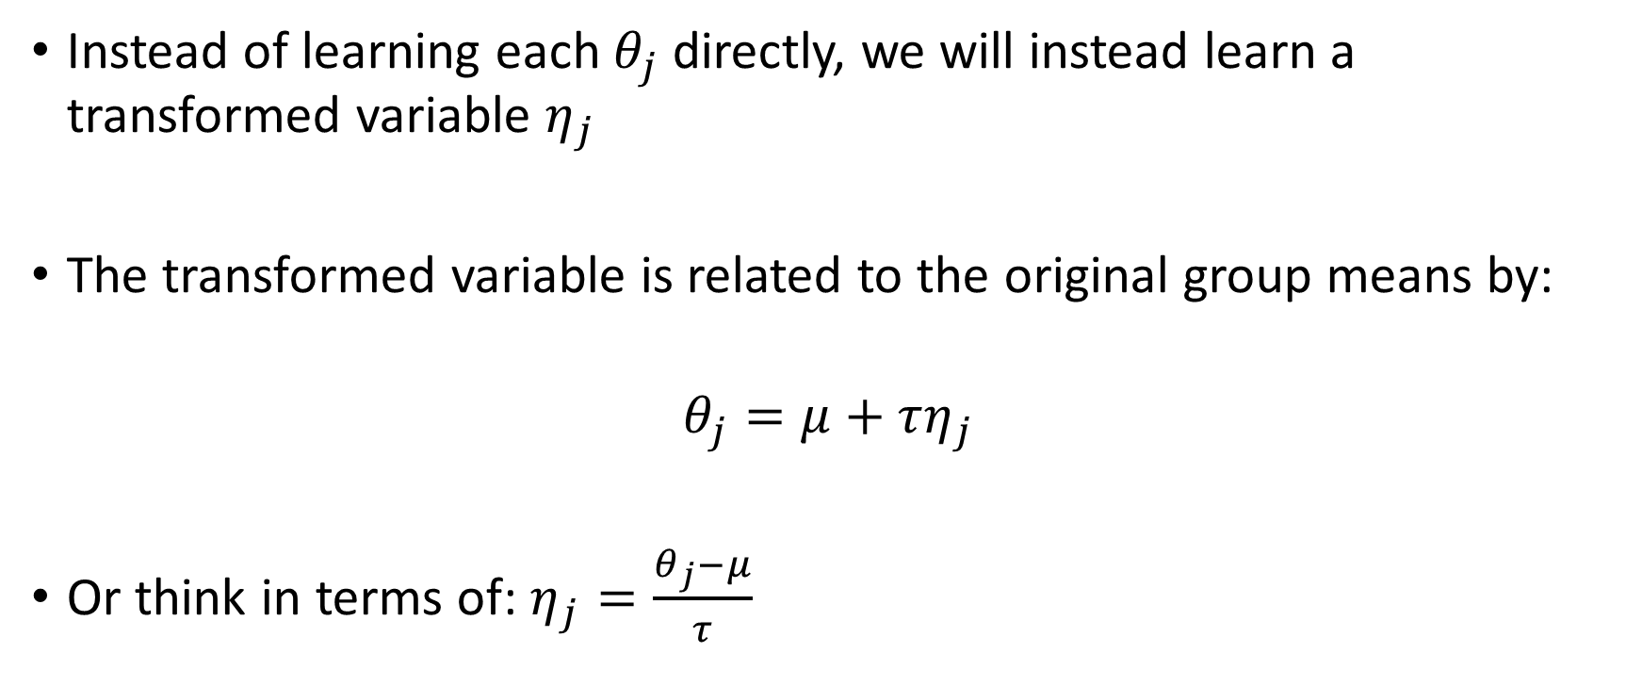

Before implementing the model, we will make a Reparameterization of the GROUP means, $θ_{j}$’s
Instead of learning each $θ_{j}$ directly, we will instead learn a transformed variable $η_{j}$
The transformed variable is related to the original group means by:
$$θ_{j}=μ+τη_{j}$$
Or think in terms of: $η_{j}=\frac{θ_{j}−μ}{τ}$

Slide 13
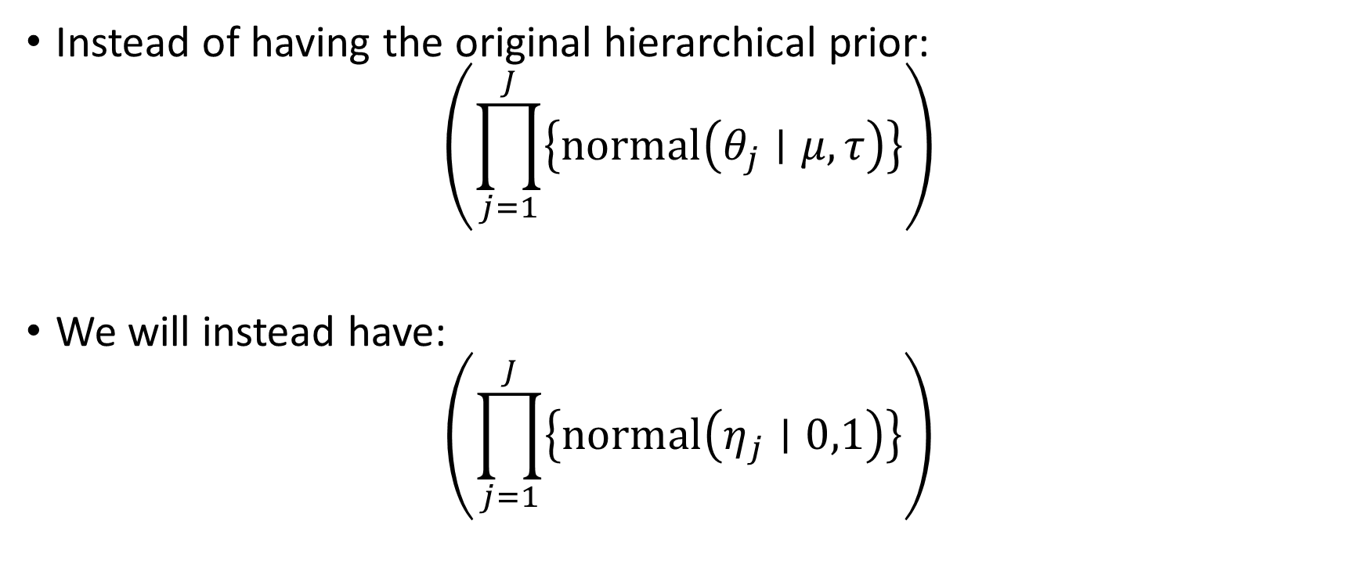
This “z-score” reparameterization (formal name is the non-centered parameterization) allows us to work with independent STANDARD NORMALS as the hierarchical prior
Instead of having the original hierarchical prior:
$$\left(\prod_{j=1}^{J}{\left\{normal\left(θ_{j}∣μ,τ\right)\right\}}\right)$$
We will instead have:
$$\left(\prod_{j=1}^{J}{\left\{normal\left(η_{j}∣0,1\right)\right\}}\right)$$

Slide 14


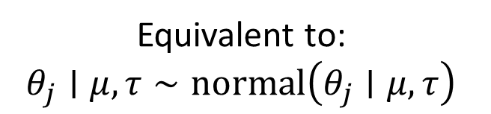
The probability model for the unknown ${\left\{η_{j}\right\}}_{j=1}^{J}$ and $μ$ and $φ$ given given ${\left\{{\overline{y}}_{∙j},n_{j}\right\}}_{j=1}^{J}$ and the known $σ$:
$${\overline{y}}_{∙j}∣θ_{j},σ,n_{j}∼normal\left({\overline{y}}_{∙j}∣θ_{j},σ_{j}=σ/{\sqrt{n_{j}}}\right)$$
$$θ_{j}=μ+τη_{j}$$
$$η_{j}∼normal\left(η_{j}∣0,1\right)$$
$$μ∣m_{0},s_{0}∼normal\left(μ∣m_{0},s_{0}\right)$$
$$τ=\exp\left(φ\right)$$
$$τ∣λ_{0}∼Exp\left(τ∣λ_{0}\right)$$
Equivalent to:
$$θ_{j}∣μ,τ∼normal\left(θ_{j}∣μ,τ\right)$$

Slide 15


Lastly, we’ll make use of a similar reparameterization but for the unknown $μ$ hyperparameter
Define the transformed “grand average”, $\tilde{μ}$, as:
$$μ=m_{0}+s_{0}\tilde{μ}$$
So the prior on $\tilde{μ}$ is just a standard normal:
$$\tilde{μ}∼normal\left(\tilde{μ}∣0,1\right)$$

Slide 16
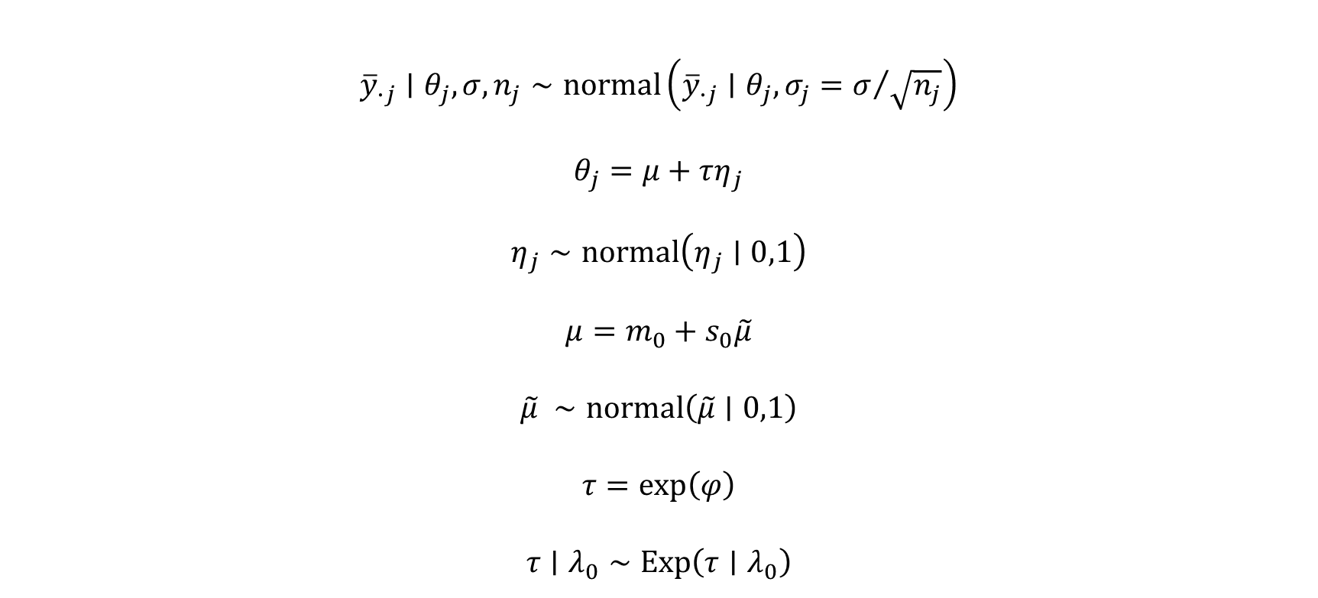

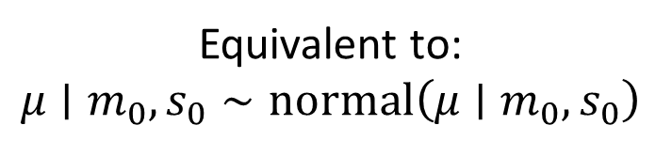
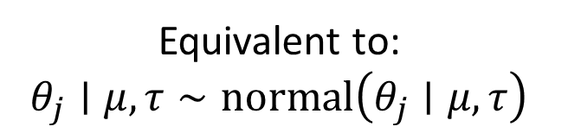
The probability model for the unknown ${\left\{η_{j}\right\}}_{j=1}^{J}$ and $\tilde{μ}$ and $φ$ given given ${\left\{{\overline{y}}_{∙j},n_{j}\right\}}_{j=1}^{J}$ and the known $σ$:
$${\overline{y}}_{∙j}∣θ_{j},σ,n_{j}∼normal\left({\overline{y}}_{∙j}∣θ_{j},σ_{j}=σ/{\sqrt{n_{j}}}\right)$$
$$θ_{j}=μ+τη_{j}$$
$$η_{j}∼normal\left(η_{j}∣0,1\right)$$
$$μ=m_{0}+s_{0}\tilde{μ}$$
$$\tilde{μ} ∼normal\left(\tilde{μ}∣0,1\right)$$
$$τ=\exp\left(φ\right)$$
$$τ∣λ_{0}∼Exp\left(τ∣λ_{0}\right)$$
Equivalent to:
$$θ_{j}∣μ,τ∼normal\left(θ_{j}∣μ,τ\right)$$
Equivalent to:
$$μ∣m_{0},s_{0}∼normal\left(μ∣m_{0},s_{0}\right)$$
We can’t forget the derivative adjustment: $\exp\left(φ\right)$

Slide 17
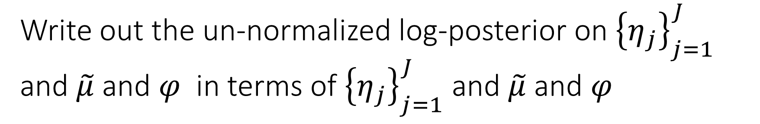
Write out the un-normalized log-posterior on ${\left\{η_{j}\right\}}_{j=1}^{J}$ and $\tilde{μ}$ and $φ$ in terms of ${\left\{η_{j}\right\}}_{j=1}^{J}$ and $\tilde{μ}$ and $φ$
Drop all constants in the expressions.
Write out the expressions for the densities and drop all constants to get a sense what the my_logpost() function is evaluating.

