Slide 1
Hierarchical model with varying intercept and varying slopes
Review prior specification used in rstanarm

Slide 2
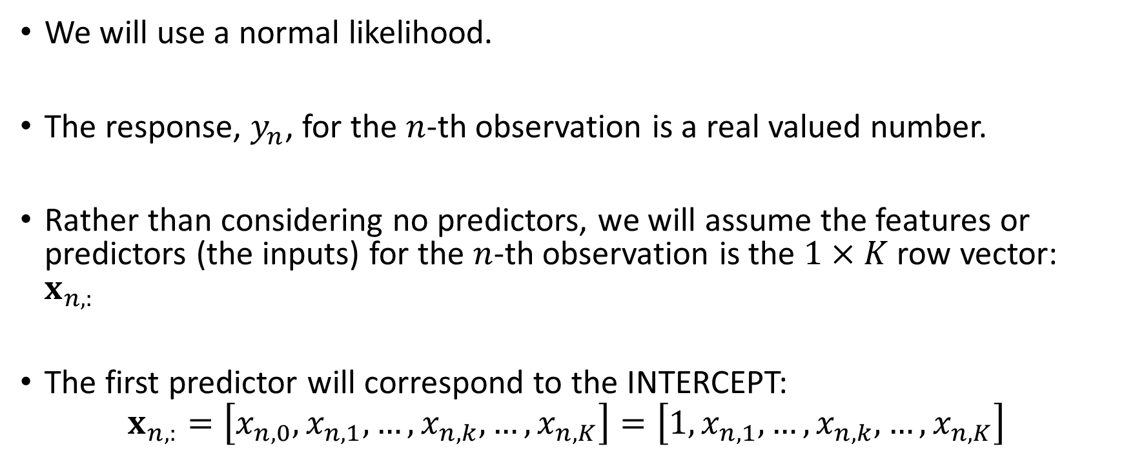
Use a continuous response rather than a binary response for the observation of interest
We will use a normal likelihood.
The response, $y_{n}$, for the $n$-th observation is a real valued number.
Rather than considering no predictors, we will assume the features or predictors (the inputs) for the $n$-th observation is the $1×K$ row vector: $x_{n,:}$
The first predictor will correspond to the INTERCEPT:
$$x_{n,:}=\left[x_{n,0},x_{n,1},…,x_{n,k},…,x_{n,K}\right]=\left[1,x_{n,1},…,x_{n,k},…,x_{n,K}\right]$$

Slide 3
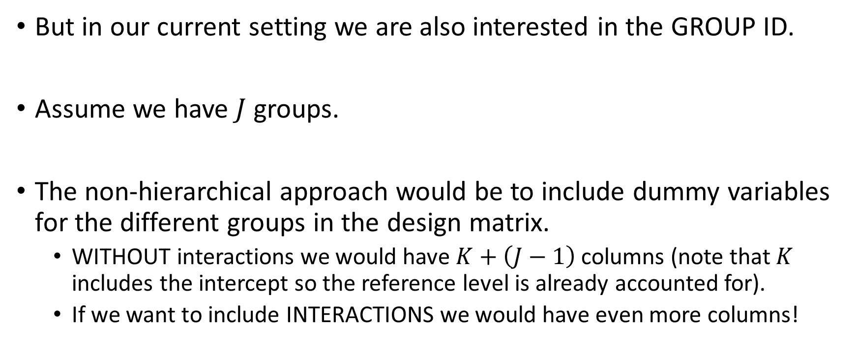

The predictors for all observations can be combined into a $N×K$ design matrix $X$
But in our current setting we are also interested in the GROUP ID.
Assume we have $J$ groups.
The non-hierarchical approach would be to include dummy variables for the different groups in the design matrix.
WITHOUT interactions we would have $K+\left(J−1\right)$ columns (note that $K$ includes the intercept so the reference level is already accounted for).
If we want to include INTERACTIONS we would have even more columns!

Slide 4
We will use a hierarchical (multilevel) to help us learn parameters across all groups all at once.
As we have seen the hierarchical structure can be viewed as the data “created a prior” on the regression coefficients for us.

Slide 5
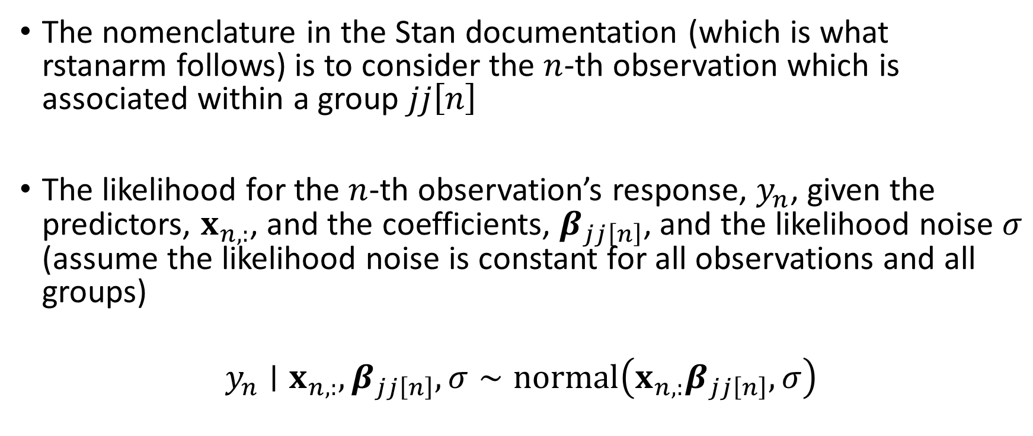
The likelihood in the hierarchical can be written several ways
The nomenclature in the Stan documentation (which is what rstanarm follows) is to consider the $n$-th observation which is associated within a group $jj\left[n\right]$
The likelihood for the $n$-th observation’s response, $y_{n}$, given the predictors, $x_{n,:}$, and the coefficients, $β_{jj\left[n\right]}$, and the likelihood noise $σ$ (assume the likelihood noise is constant for all observations and all groups)
$$y_{n}∣x_{n,:},β_{jj\left[n\right]},σ∼normal\left(x_{n,:}β_{jj\left[n\right]},σ\right)$$

Slide 6
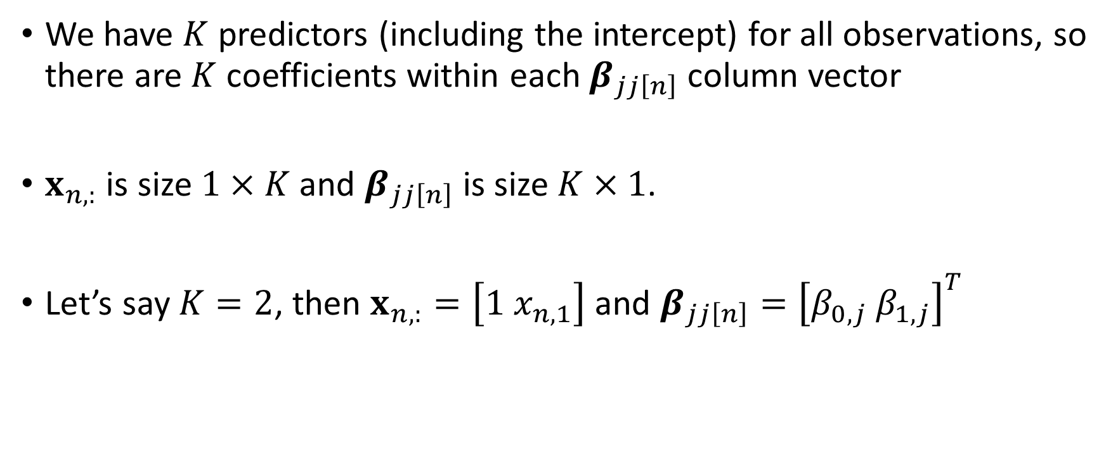

The group-specific coefficients $β_{jj\left[n\right]}$
We have $K$ predictors (including the intercept) for all observations, so there are $K$ coefficients within each $β_{jj\left[n\right]}$ column vector
$x_{n,:}$ is size $1×K$ and $β_{jj\left[n\right]}$ is size $K×1$.
Let’s say $K=2$, then $x_{n,:}=\left[1 x_{n,1}\right]$ and $β_{jj\left[n\right]}={\left[β_{0,j} β_{1,j}\right]}^{T}$

Slide 7
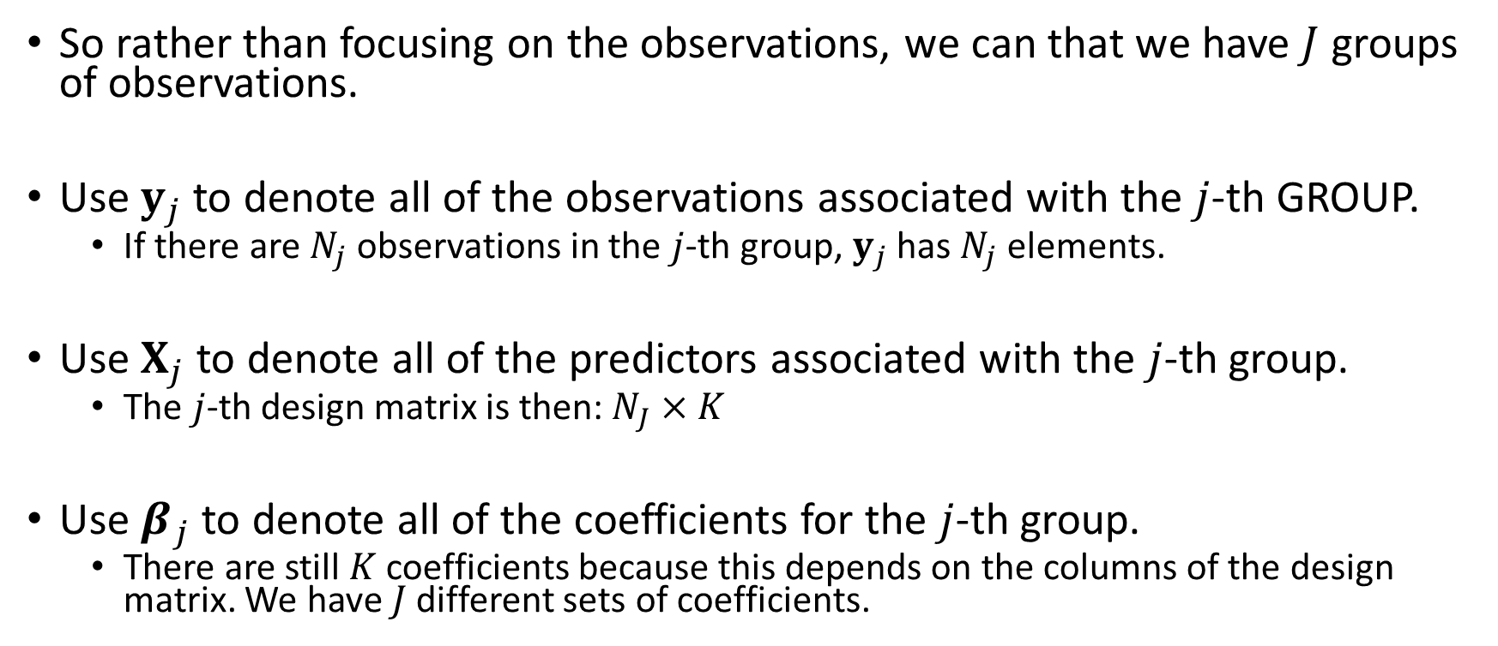
Alternatively, we can consider the likelihood in terms of the separate groups
So rather than focusing on the observations, we can that we have $J$ groups of observations.
Use $y_{j}$ to denote all of the observations associated with the $j$-th GROUP.
If there are $N_{j}$ observations in the $j$-th group, $y_{j}$ has $N_{j}$ elements.
Use $X_{j}$ to denote all of the predictors associated with the $j$-th group.
The $j$-th design matrix is then: $N_{J}×K$
Use $β_{j}$ to denote all of the coefficients for the $j$-th group.
There are still $K$ coefficients because this depends on the columns of the design matrix. We have $J$ different sets of coefficients.

Slide 8

The group focused likelihood assuming constant likelihood noise:
$$y_{j}∣X_{j},β_{j},σ∼multivariate normal\left(X_{j}β_{j},σ^{2}𝕀_{N_{j}}\right)$$

Slide 9
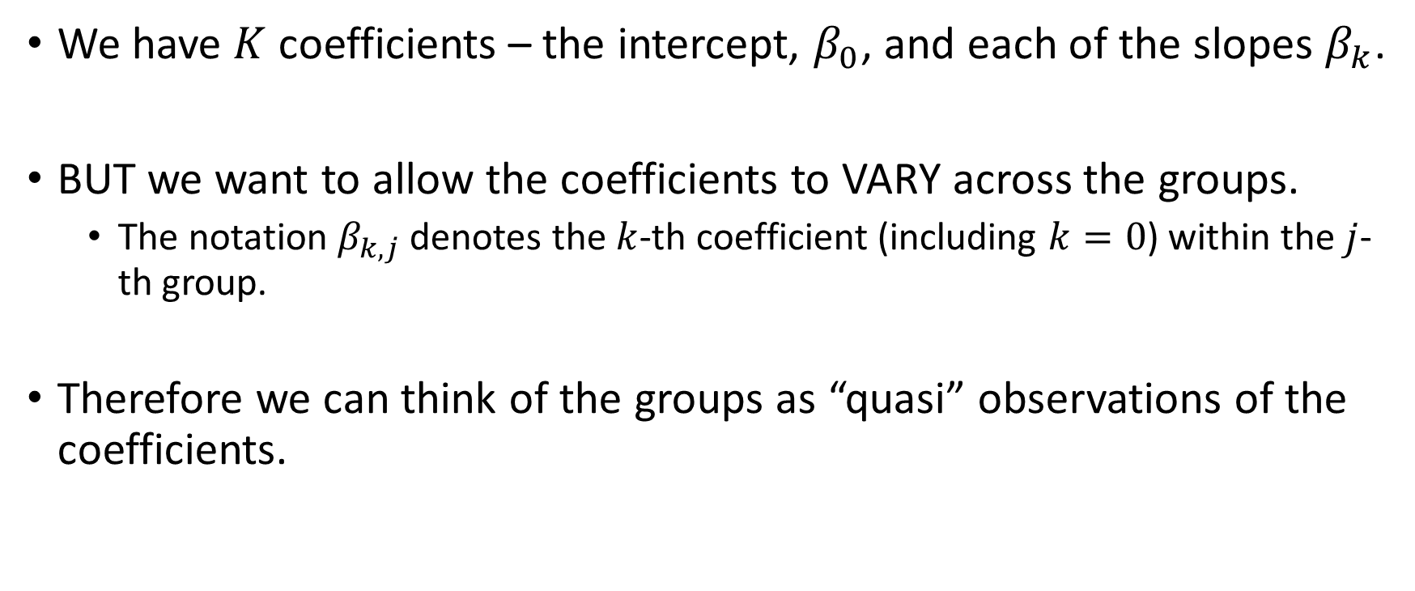
We have the likelihood, but next we need to consider the hierarchical prior on the coefficients
We have $K$ coefficients – the intercept, $β_{0}$, and each of the slopes $β_{k}$.
BUT we want to allow the coefficients to VARY across the groups.
The notation $β_{k,j}$ denotes the $k$-th coefficient (including $k=0$) within the $j$-th group.
Therefore we can think of the groups as “quasi” observations of the coefficients.

Slide 10
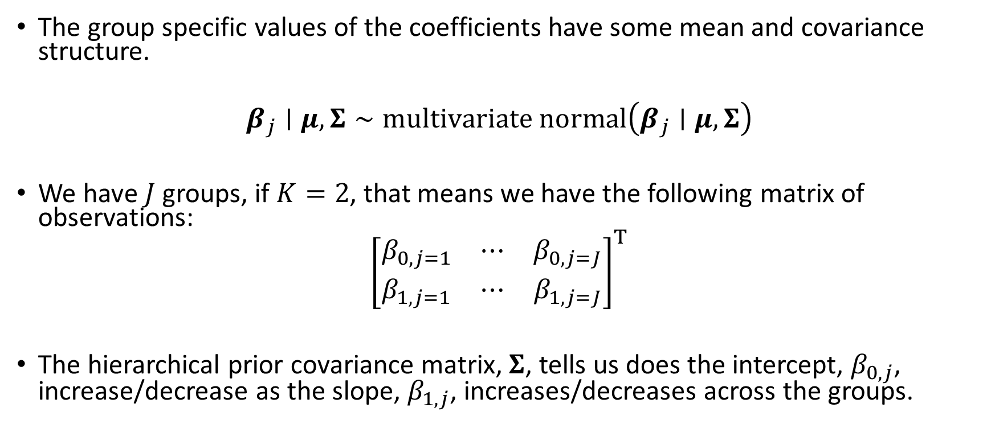
Using the mindset of the “quasi” observation we can view the hierarchical prior as a kind of likelihood
The group specific values of the coefficients have some mean and covariance structure.
$$β_{j}∣μ,Σ∼multivariate normal\left(β_{j}∣μ,Σ\right)$$
We have $J$ groups, if $K=2$, that means we have the following matrix of observations:
$${\left[\begin{matrix}β_{0,j=1} & ⋯ & β_{0,j=J} \\ β_{1,j=1} & ⋯ & β_{1,j=J}\end{matrix}\right]}^{T}$$
The hierarchical prior covariance matrix, $Σ$, tells us does the intercept, $β_{0,j}$, increase/decrease as the slope, $β_{1,j}$, increases/decreases across the groups.

Slide 11
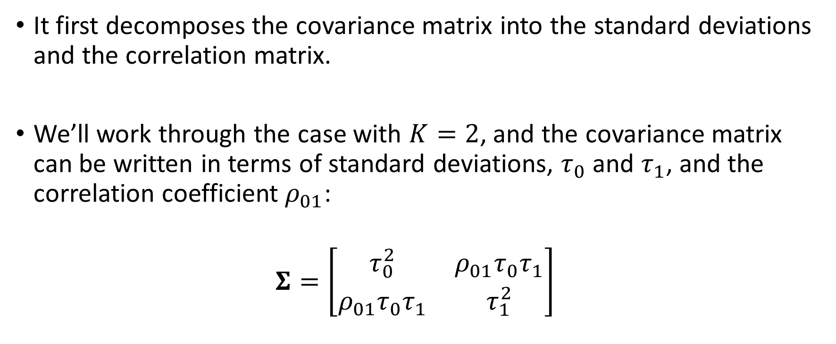
rstanarm does not directly place a hyperprior on the covariance matrix.
It first decomposes the covariance matrix into the standard deviations and the correlation matrix.
We’ll work through the case with $K=2$, and the covariance matrix can be written in terms of standard deviations, $τ_{0}$ and $τ_{1}$, and the correlation coefficient $ρ_{01}$:
$$Σ=\left[\begin{matrix}τ_{0}^{2} & ρ_{01}τ_{0}τ_{1} \\ ρ_{01}τ_{0}τ_{1} & τ_{1}^{2}\end{matrix}\right]$$

Slide 12

The decomposition “separates” the covariance matrix into the marginal standard diagonal matrix and the correlation matrix
$$Σ=diag\left(τ\right)×Ω×diag\left(τ\right)$$
Where $τ=\left[τ_{0}, τ_{1}\right]$.
As matrices these are:
$$Σ=\left[\begin{matrix}τ_{0} & 0 \\ 0 & τ_{1}\end{matrix}\right]×\left[\begin{matrix}1 & ρ_{01} \\ ρ_{01} & 1\end{matrix}\right]×\left[\begin{matrix}τ_{0} & 0 \\ 0 & τ_{1}\end{matrix}\right]$$

Slide 13
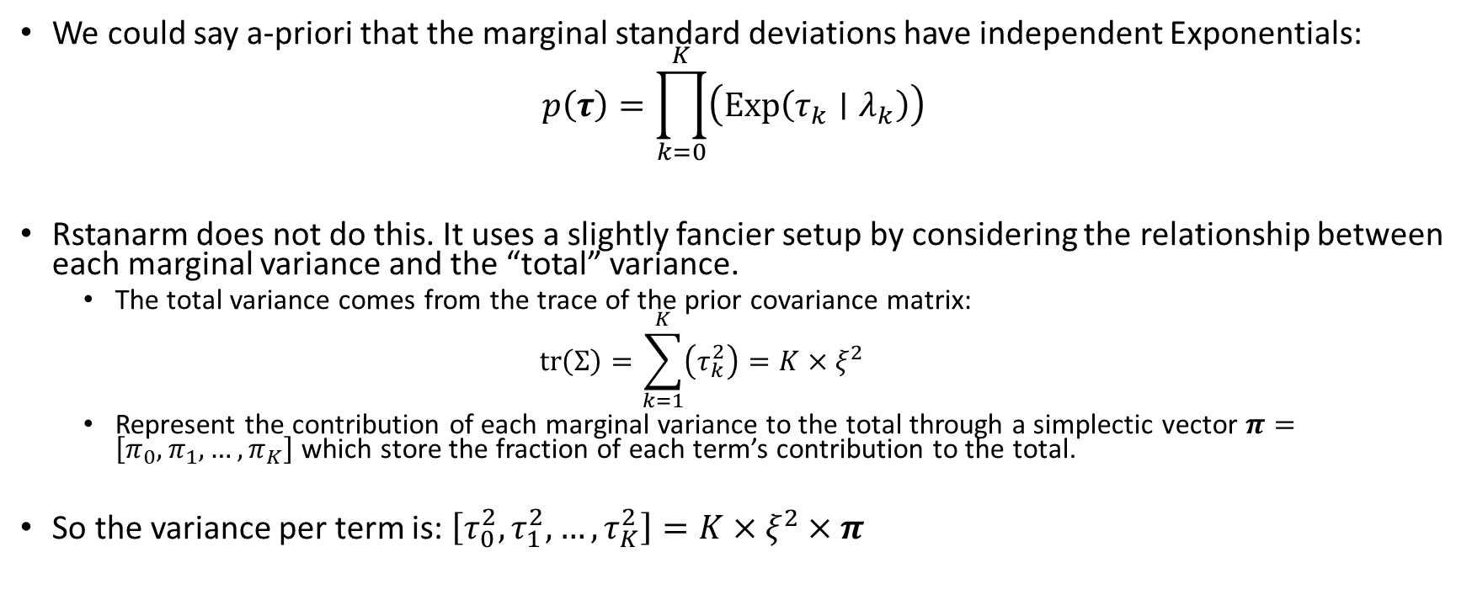
We could place separate hyper-priors on each marginal standard deviation
We could say a-priori that the marginal standard deviations have independent Exponentials:
$$p\left(τ\right)=\prod_{k=0}^{K}{\left(Exp\left(τ_{k}∣λ_{k}\right)\right)}$$
Rstanarm does not do this. It uses a slightly fancier setup by considering the relationship between each marginal variance and the “total” variance.
The total variance comes from the trace of the prior covariance matrix:
$$tr\left(Σ\right)=\sum_{k=1}^{K}{\left(τ_{k}^{2}\right)}=K×ξ^{2}$$
Represent the contribution of each marginal variance to the total through a simplectic vector $π=\left[π_{0},π_{1},…,π_{K}\right]$ which store the fraction of each term’s contribution to the total.
So the variance per term is: $\left[τ_{0}^{2},τ_{1}^{2},…,τ_{K}^{2}\right]=K×ξ^{2}×π$

Slide 14
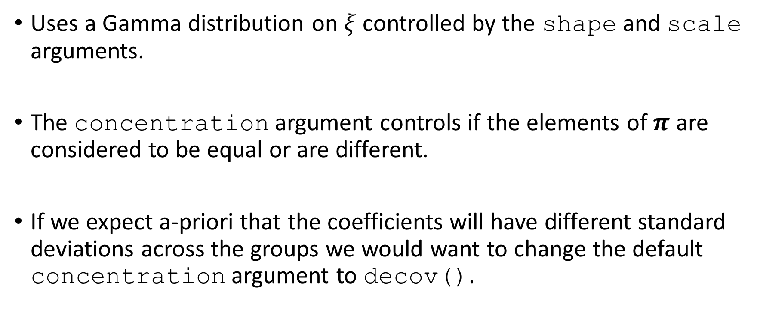

So rstanarm parameterizes the hyperprior on the standard deviations via $ξ$ and $π$
Uses a Gamma distribution on $ξ$ controlled by the shape and scale arguments.
The concentration argument controls if the elements of $π$ are considered to be equal or are different.
If we expect a-priori that the coefficients will have different standard deviations across the groups we would want to change the default concentration argument to decov().

Slide 15
The hyperprior on the correlation matrix is setup as the LKJ prior
The LKJ prior controls if we think the correlation is uniform in the interval -1 and +1 or if we think it’s more concentrated around 0.
The regularization argument in the decov() function controls how uniform we expect the correlation matrix to be.

Slide 16
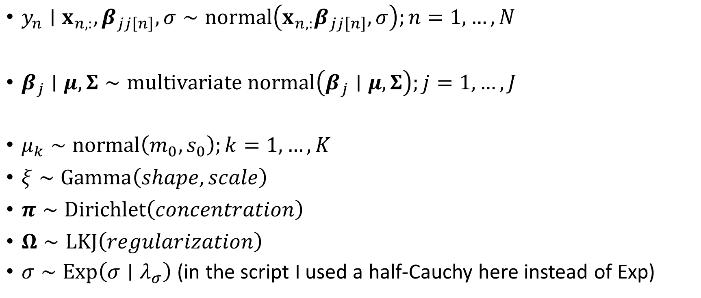
The complete probability model for the varying INTERCEPT and varying SLOPES multilevel model
$y_{n}∣x_{n,:},β_{jj\left[n\right]},σ∼normal\left(x_{n,:}β_{jj\left[n\right]},σ\right);n=1,…,N$
$β_{j}∣μ,Σ∼multivariate normal\left(β_{j}∣μ,Σ\right);j=1,…,J$
$μ_{k}∼normal\left(m_{0},s_{0}\right);k=1,…,K$
$ξ∼Gamma\left(shape,scale\right)$
$π∼Dirichlet\left(concentration\right)$
$Ω∼LKJ\left(regularization\right)$
$σ∼Exp\left(σ∣λ_{σ}\right)$ (in the script I used a half-Cauchy here instead of Exp)

