Slide 1
INFSCI 2910
Group specific mean and standard deviation

Slide 2
Multi-level (hierarchical) model formulation
Several levels of “errors” – the way frequentists think of the structure
Several levels of distributions that work together to create the complete or total model – the way Bayesians think of the structure

Slide 3
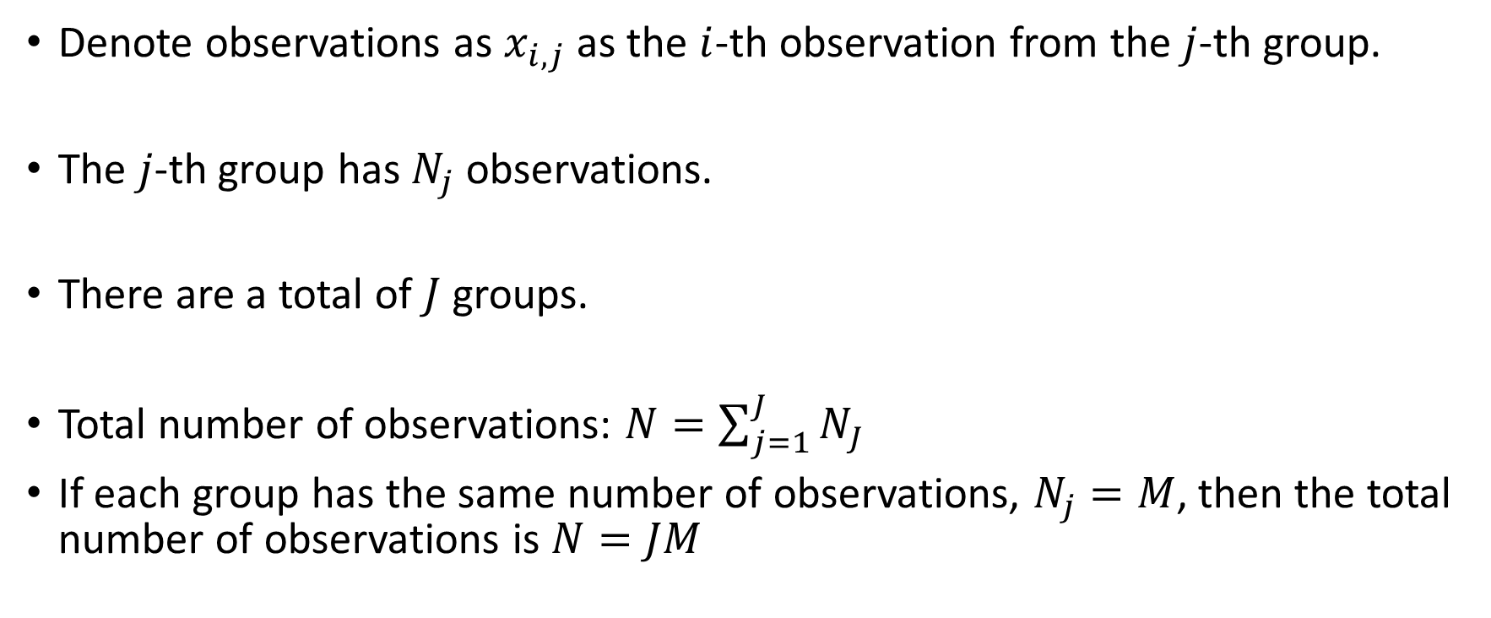
Multi-level model formulation – notation
Denote observations as $x_{i,j}$ as the $i$-th observation from the $j$-th group.
The $j$-th group has $N_{j}$ observations.
There are a total of $J$ groups.
Total number of observations: $N=\sum_{j=1}^{J}{N_{J}}$
If each group has the same number of observations, $N_{j}=M$, then the total number of observations is $N=JM$

Slide 4
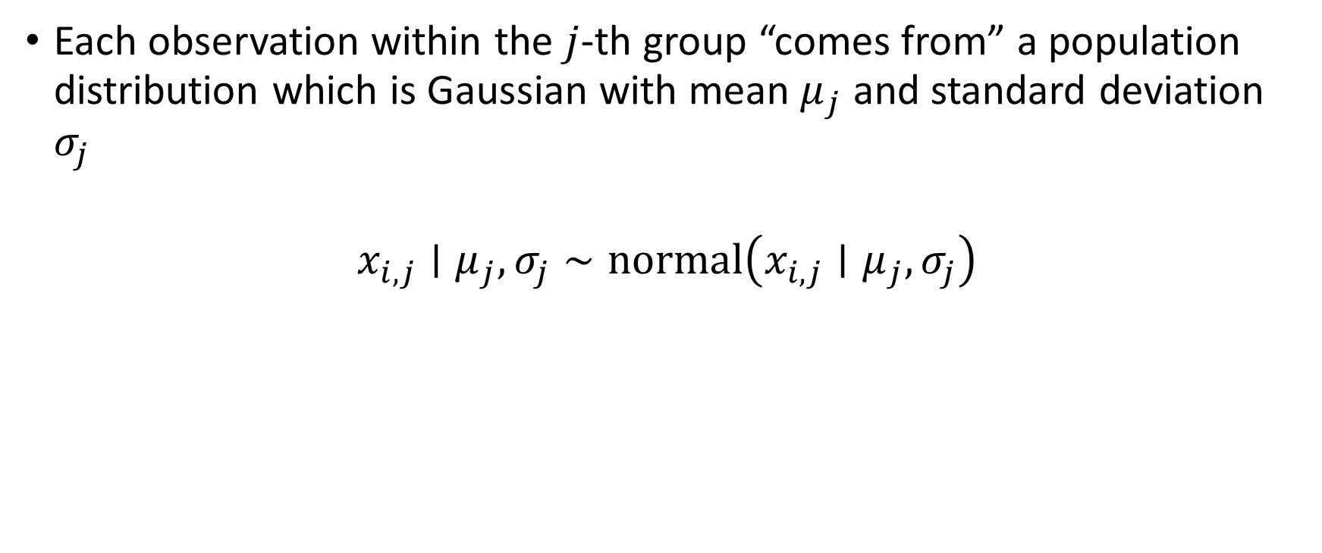
OBSERVATION level – Gaussian distribution
Each observation within the $j$-th group “comes from” a population distribution which is Gaussian with mean $μ_{j}$ and standard deviation $σ_{j}$
$$x_{i,j}∣μ_{j},σ_{j}∼normal\left(x_{i,j}∣μ_{j},σ_{j}\right)$$

Slide 5
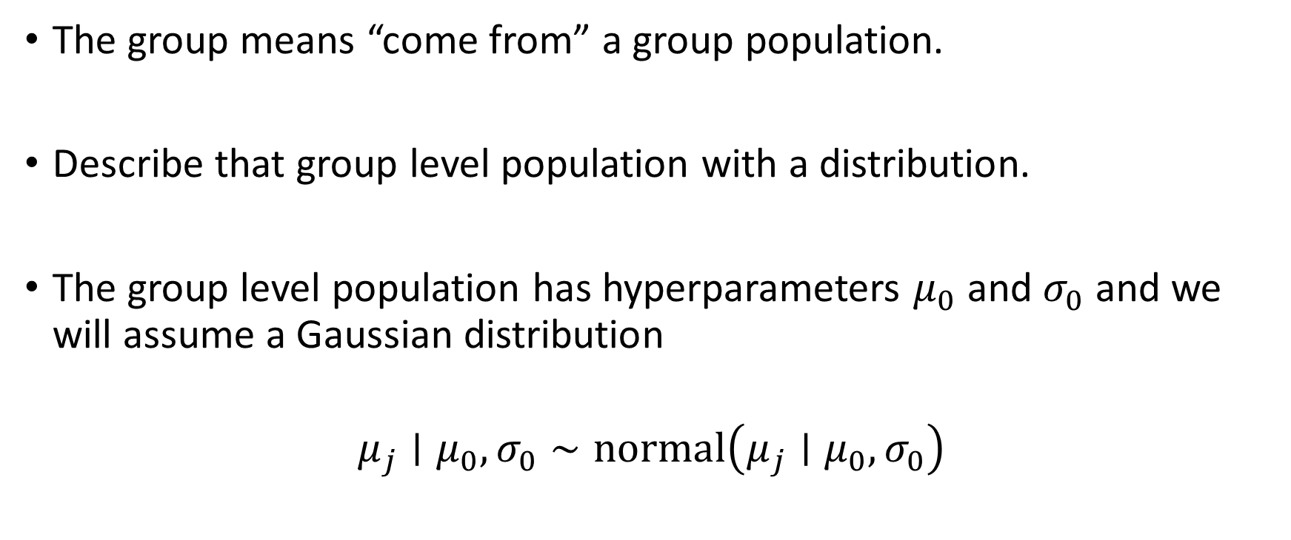
GROUP LEVEL distribution
The group means “come from” a group population.
Describe that group level population with a distribution.
The group level population has hyperparameters $μ_{0}$ and $σ_{0}$ and we will assume a Gaussian distribution
$$μ_{j}∣μ_{0},σ_{0}∼normal\left(μ_{j}∣μ_{0},σ_{0}\right)$$

Slide 6

Complete model requires bringing together the observation level and the group level
$$x_{i,j}∣μ_{j},σ_{j}∼normal\left(x_{i,j}∣μ_{j},σ_{j}\right)$$
$$μ_{j}∣μ_{0},σ_{0}∼normal\left(μ_{j}∣μ_{0},σ_{0}\right)$$

Slide 7
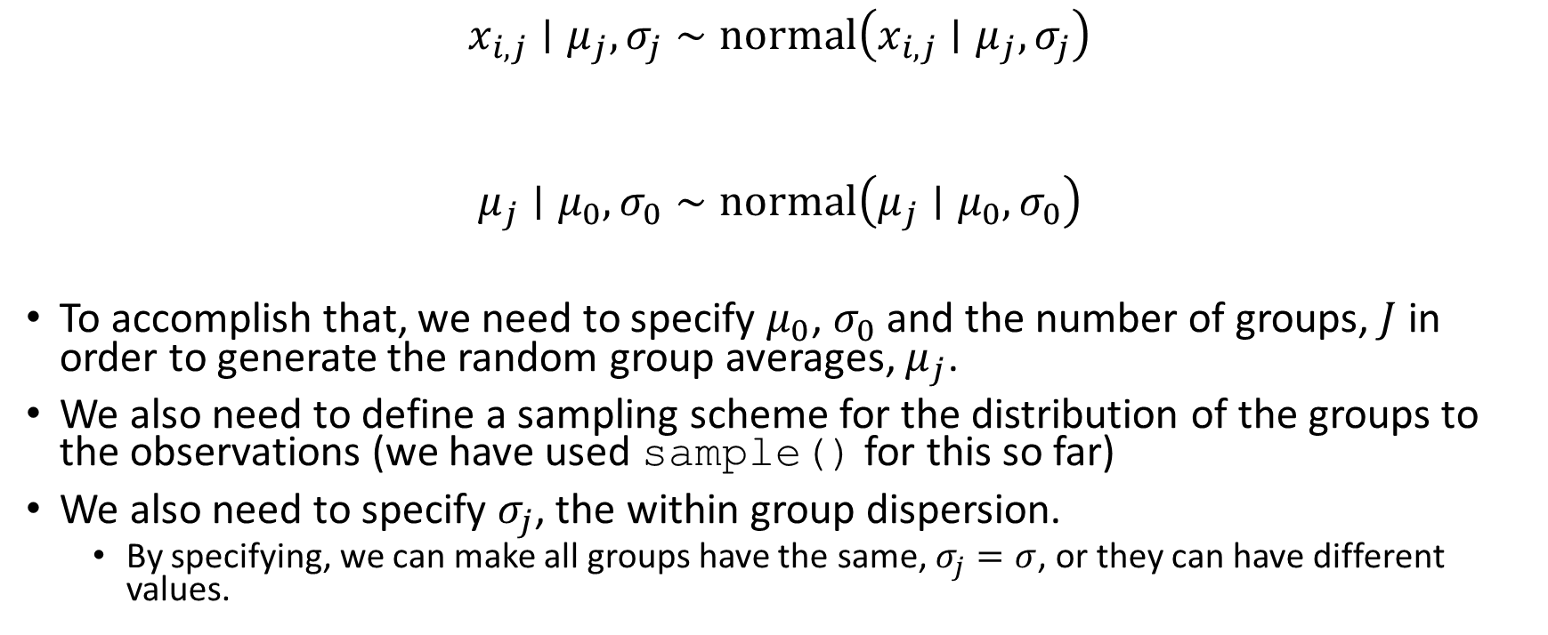

Our current data generating examples are focused on GENERATING the $x_{i,j}$
$$x_{i,j}∣μ_{j},σ_{j}∼normal\left(x_{i,j}∣μ_{j},σ_{j}\right)$$
$$μ_{j}∣μ_{0},σ_{0}∼normal\left(μ_{j}∣μ_{0},σ_{0}\right)$$
To accomplish that, we need to specify $μ_{0}$, $σ_{0}$ and the number of groups, $J$ in order to generate the random group averages, $μ_{j}$.
We also need to define a sampling scheme for the distribution of the groups to the observations (we have used sample() for this so far)
We also need to specify $σ_{j}$, the within group dispersion.
By specifying, we can make all groups have the same, $σ_{j}=σ$, or they can have different values.

Slide 8
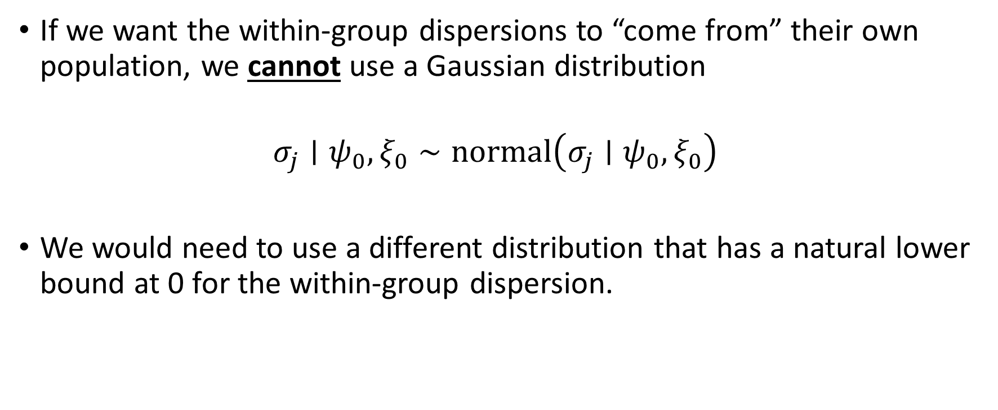
More complex, allow the within-group dispersion to come from it’s own population
If we want the within-group dispersions to “come from” their own population, we cannot use a Gaussian distribution
$$σ_{j}∣ψ_{0},ξ_{0}∼normal\left(σ_{j}∣ψ_{0},ξ_{0}\right)$$
We would need to use a different distribution that has a natural lower bound at 0 for the within-group dispersion.

Slide 9

In multi-level models with group-specific dispersions it’s common to use a transformation
Instead of saying $σ_{j}$ has a Gaussian population distribution, we say that $\log\left[σ_{j}\right]$ has a Gaussian population distribution:
$$\log\left[σ_{j}\right]∣ψ_{0},ξ_{0}∼normal\left(\log\left[σ_{j}\right]∣ψ_{0},ξ_{0}\right)$$

Slide 10

Our complete model with group-specific means and group-specific standard deviations
$$x_{i,j}∣μ_{j},σ_{j}∼normal\left(x_{i,j}∣μ_{j},σ_{j}\right)$$
$$μ_{j}∣μ_{0},σ_{0}∼normal\left(μ_{j}∣μ_{0},σ_{0}\right)$$
$$\log\left[σ_{j}\right]∣ψ_{0},ξ_{0}∼normal\left(\log\left[σ_{j}\right]∣ψ_{0},ξ_{0}\right)$$

Slide 11


The learning problem is given ALL $x_{i,j}$ learn the unknowns
The posterior distribution is:
$$p\left({\left\{μ_{j}\right\}}_{j=1}^{J},{\left\{σ_{j}\right\}}_{j=1}^{J},μ_{0},σ_{0},ψ_{0},ξ_{0}∣{\left\{{\left\{x_{i,j}\right\}}_{i=1}^{N_{j}}\right\}}_{j=1}^{J}\right)∝p\left({\left\{{\left\{x_{i,j}\right\}}_{i=1}^{N_{j}}\right\}}_{j=1}^{J}∣{\left\{μ_{j}\right\}}_{j=1}^{J},{\left\{σ_{j}\right\}}_{j=1}^{J} \right)p\left({\left\{μ_{j}\right\}}_{j=1}^{J}∣μ_{0},σ_{0}\right)p\left({\left\{\log\left[σ_{j}\right]\right\}}_{j=1}^{J}∣ψ_{0},ξ_{0}\right)p\left(μ_{0},σ_{0},ψ_{0},ξ_{0}\right)$$

