Slide 2



Centroids – population of the centroids
$$x=0$$
$$x$$
$$x=1$$
$$Beta\left(x∣α \left(shape1\right),β (shape2)\right)$$

Slide 3

Centroid population is defined by a distribution
For our example that distribution is a Beta distribution
$$x_{c}∣α_{0},β_{0}∼Beta\left(x_{c}∣α_{0},β_{0}\right)$$

Slide 4
Observation level – random locations around each centroid – use another distribution per centroid
Group level behavior
Observation level behavior
$$x=0$$
$$x$$
$$x=1$$

Slide 5
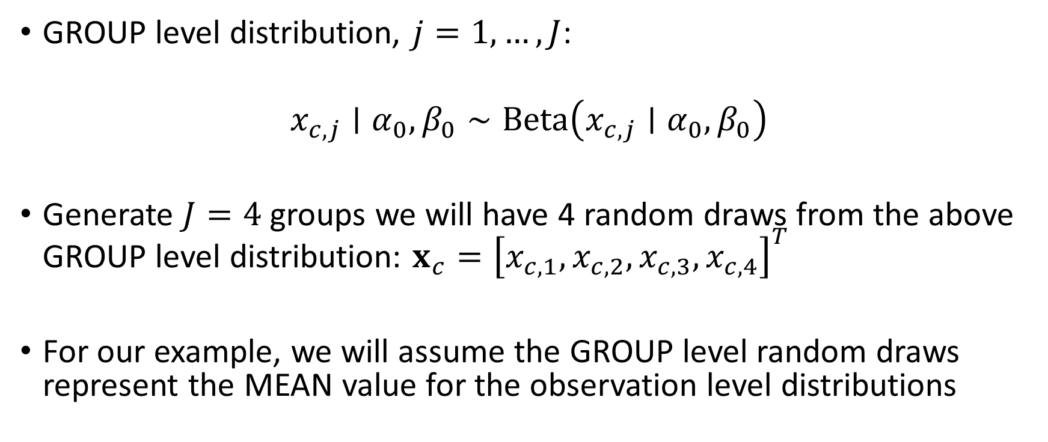
Observation level distributions DEPEND on the GROUP level random DRAWS
GROUP level distribution, $j=1,…,J$:
$$x_{c,j}∣α_{0},β_{0}∼Beta\left(x_{c,j}∣α_{0},β_{0}\right)$$
Generate $J=4$ groups we will have 4 random draws from the above GROUP level distribution: $x_{c}={\left[x_{c,1},x_{c,2},x_{c,3},x_{c,4}\right]}^{T}$
For our example, we will assume the GROUP level random draws represent the MEAN value for the observation level distributions

Slide 6
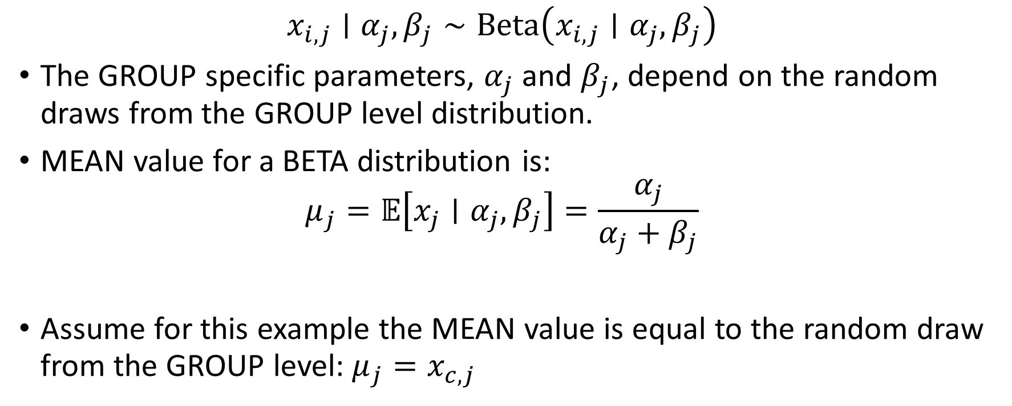
Observation level distribution – still use BETA distributions
$$x_{i,j}∣α_{j},β_{j}∼Beta\left(x_{i,j}∣α_{j},β_{j}\right)$$
The GROUP specific parameters, $α_{j}$ and $β_{j}$, depend on the random draws from the GROUP level distribution.
MEAN value for a BETA distribution is:
$$μ_{j}=𝔼\left[x_{j}∣α_{j},β_{j}\right]=\frac{α_{j}}{α_{j}+β_{j}}$$
Assume for this example the MEAN value is equal to the random draw from the GROUP level: $μ_{j}=x_{c,j}$

Slide 7
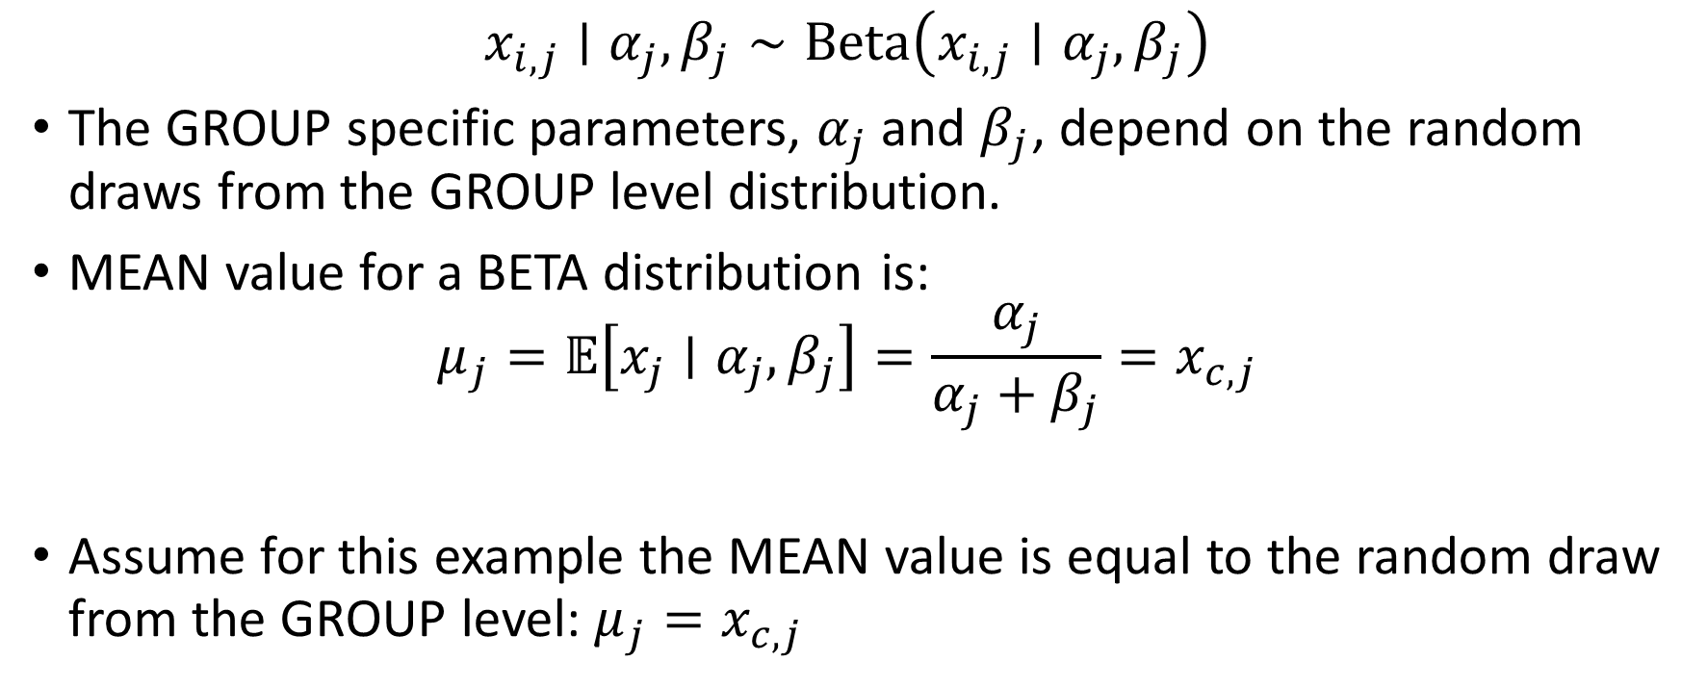
Relate the observation level distribution MEANS to the random draws from the GROUP level
$$x_{i,j}∣α_{j},β_{j}∼Beta\left(x_{i,j}∣α_{j},β_{j}\right)$$
The GROUP specific parameters, $α_{j}$ and $β_{j}$, depend on the random draws from the GROUP level distribution.
MEAN value for a BETA distribution is:
$$μ_{j}=𝔼\left[x_{j}∣α_{j},β_{j}\right]=\frac{α_{j}}{α_{j}+β_{j}}=x_{c,j}$$
Assume for this example the MEAN value is equal to the random draw from the GROUP level: $μ_{j}=x_{c,j}$

Slide 8
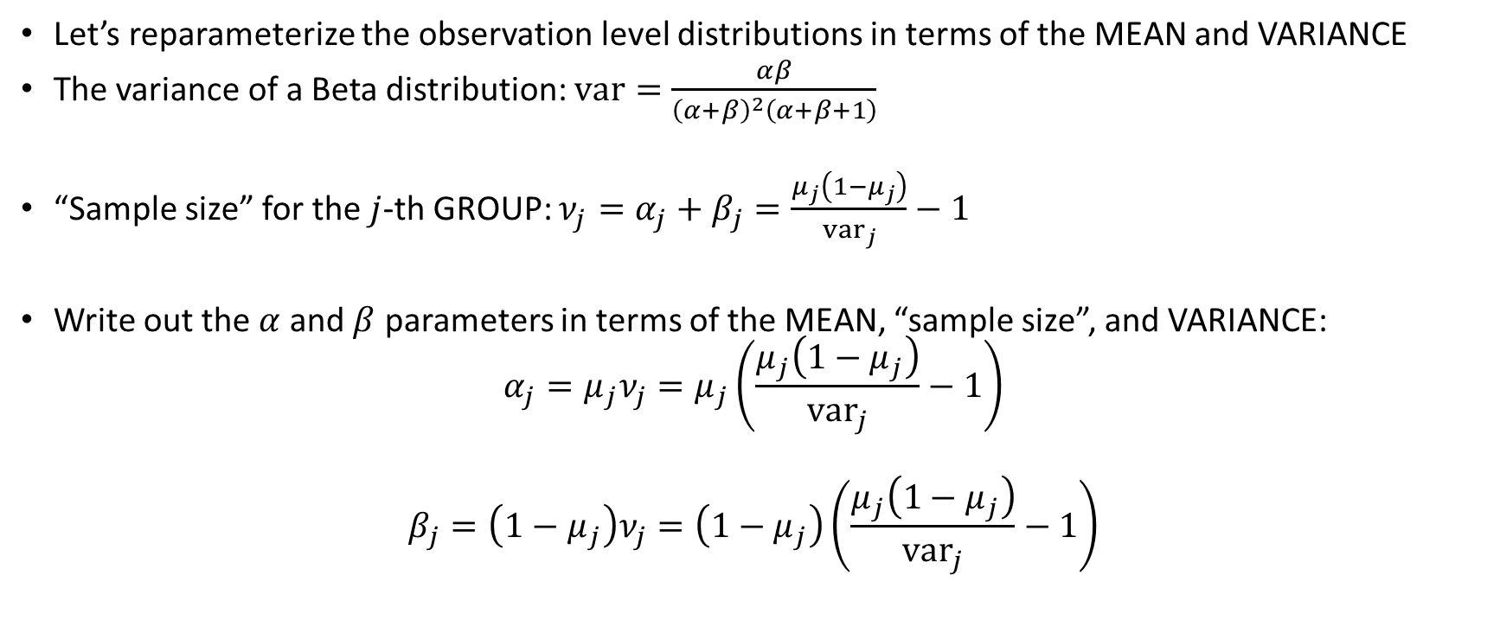
For this example, we will assume some aspect of the dispersion (the variance) at the observation level
Let’s reparameterize the observation level distributions in terms of the MEAN and VARIANCE
The variance of a Beta distribution: $var=\frac{αβ}{{\left(α+β\right)}^{2}\left(α+β+1\right)}$
“Sample size” for the $j$-th GROUP: $ν_{j}=α_{j}+β_{j}=\frac{μ_{j}\left(1−μ_{j}\right)}{{var}_{j}}−1$
Write out the $α$ and $β$ parameters in terms of the MEAN, “sample size”, and VARIANCE:
$$α_{j}=μ_{j}ν_{j}=μ_{j}\left(\frac{μ_{j}\left(1−μ_{j}\right)}{{var}_{j}}−1\right)$$
$$β_{j}=\left(1−μ_{j}\right)ν_{j}=\left(1−μ_{j}\right)\left(\frac{μ_{j}\left(1−μ_{j}\right)}{{var}_{j}}−1\right)$$

Slide 9
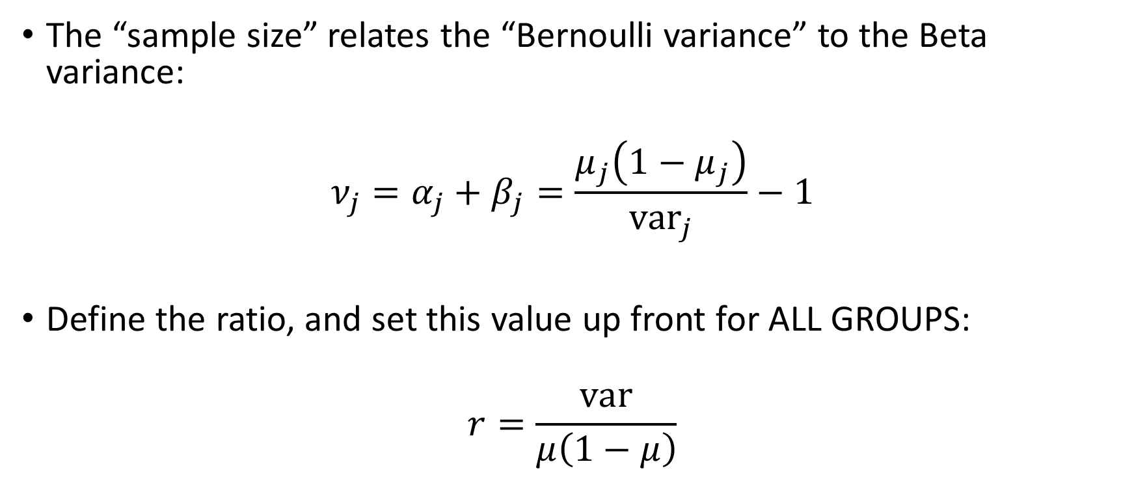
For simplicity in this example, let’s set the variance based on a “variance ratio” constant for all GROUPS
The “sample size” relates the “Bernoulli variance” to the Beta variance:
$$ν_{j}=α_{j}+β_{j}=\frac{μ_{j}\left(1−μ_{j}\right)}{{var}_{j}}−1$$
Define the ratio, and set this value up front for ALL GROUPS:
$$r=\frac{var}{μ\left(1−μ\right)}$$

Slide 10
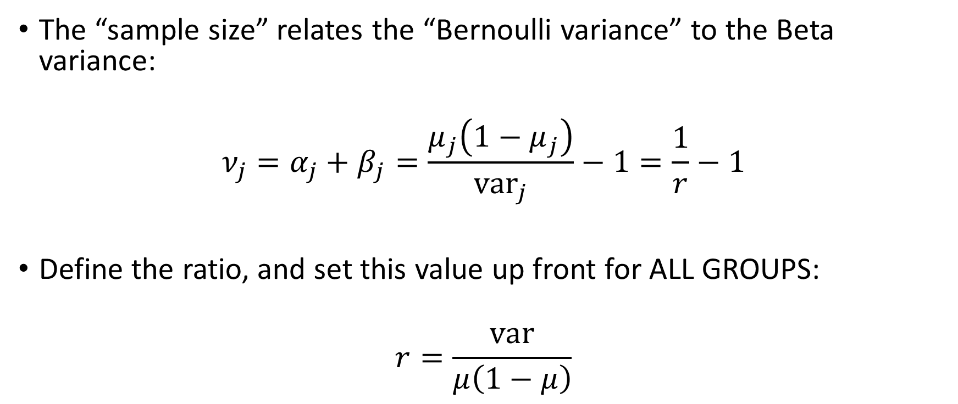
For simplicity in this example, let’s set the variance based on a “variance ratio” constant for all GROUPS
The “sample size” relates the “Bernoulli variance” to the Beta variance:
$$ν_{j}=α_{j}+β_{j}=\frac{μ_{j}\left(1−μ_{j}\right)}{{var}_{j}}−1=\frac{1}{r}−1$$
Define the ratio, and set this value up front for ALL GROUPS:
$$r=\frac{var}{μ\left(1−μ\right)}$$

Slide 11
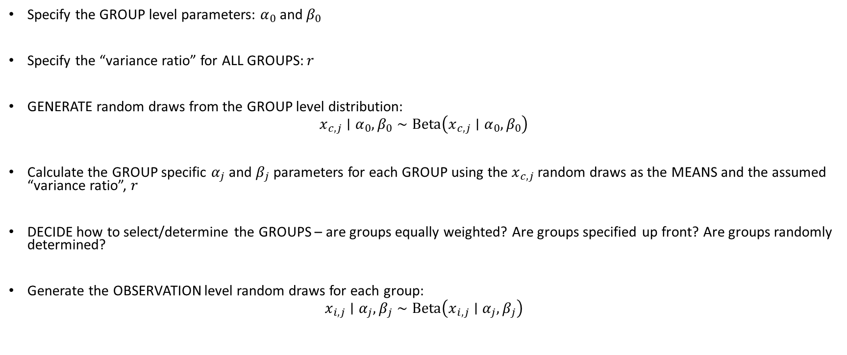
Steps to generate random observations
Specify the GROUP level parameters: $α_{0}$ and $β_{0}$
Specify the “variance ratio” for ALL GROUPS: $r$
GENERATE random draws from the GROUP level distribution:
$$x_{c,j}∣α_{0},β_{0}∼Beta\left(x_{c,j}∣α_{0},β_{0}\right)$$
Calculate the GROUP specific $α_{j}$ and $β_{j}$ parameters for each GROUP using the $x_{c,j}$ random draws as the MEANS and the assumed “variance ratio”, $r$
DECIDE how to select/determine the GROUPS – are groups equally weighted? Are groups specified up front? Are groups randomly determined?
Generate the OBSERVATION level random draws for each group:
$$x_{i,j}∣α_{j},β_{j}∼Beta\left(x_{i,j}∣α_{j},β_{j}\right)$$

