Slide 1
INFSCI 2910
Introduction to learning from a multilevel or hierarchical model

Slide 2
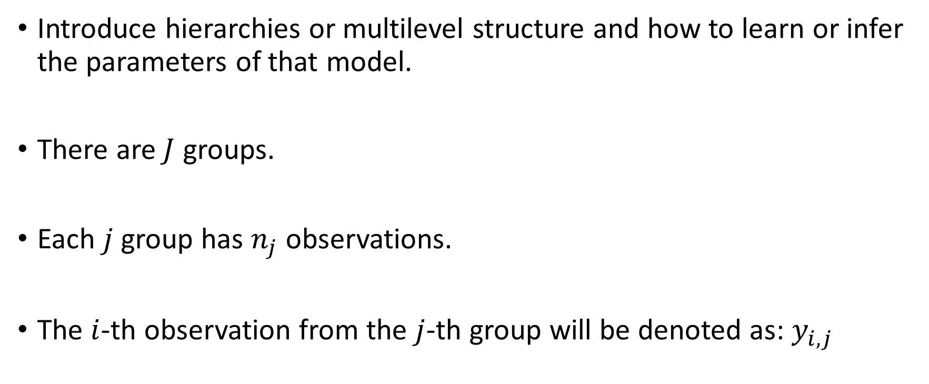
Notation is consistent with Ch. 5 from BDA3 (Bayesian Data Analysis 3rd edition)
Introduce hierarchies or multilevel structure and how to learn or infer the parameters of that model.
There are $J$ groups.
Each $j$ group has $n_{j}$ observations.
The $i$-th observation from the $j$-th group will be denoted as: $y_{i,j}$

Slide 3

Simplifying assumptions for now
We will assume that the observation error or noise, $σ$, is known.
Our goal is to learn the unknown group-specific MEANS: $θ_{j}$

Slide 4
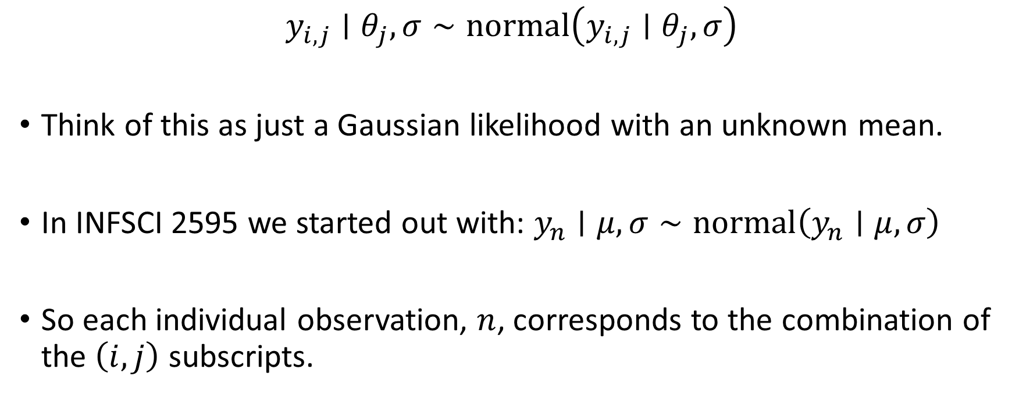
Observation level likelihood
$$y_{i,j}∣θ_{j},σ∼normal\left(y_{i,j}∣θ_{j},σ\right)$$
Think of this as just a Gaussian likelihood with an unknown mean.
In INFSCI 2595 we started out with: $y_{n}∣μ,σ∼normal\left(y_{n}∣μ,σ\right)$
So each individual observation, $n$, corresponds to the combination of the $\left(i,j\right)$ subscripts.

Slide 5
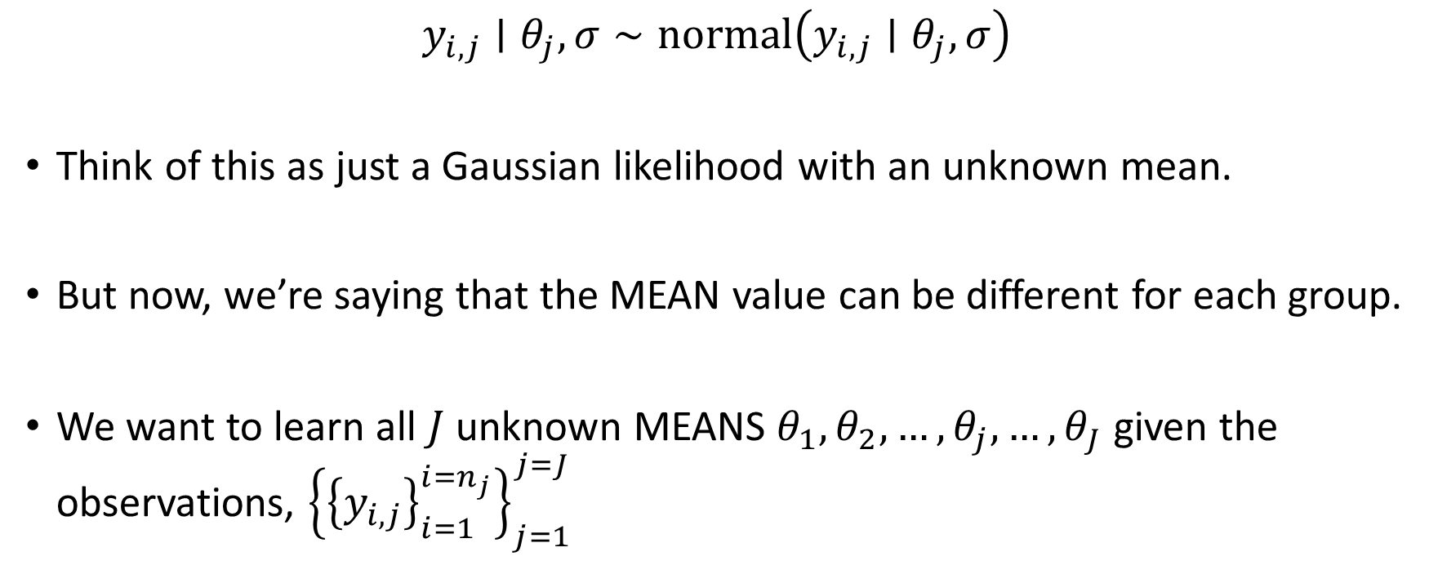
Observation level likelihood
$$y_{i,j}∣θ_{j},σ∼normal\left(y_{i,j}∣θ_{j},σ\right)$$
Think of this as just a Gaussian likelihood with an unknown mean.
But now, we’re saying that the MEAN value can be different for each group.
We want to learn all $J$ unknown MEANS $θ_{1},θ_{2},…,θ_{j},…,θ_{J}$ given the observations, ${\left\{{\left\{y_{i,j}\right\}}_{i=1}^{{i=n}_{j}}\right\}}_{j=1}^{j=J}$

Slide 6
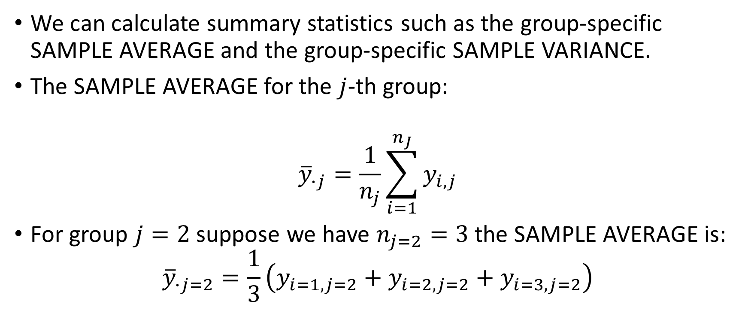

For each group we observe $n_{j}$ observations
We can calculate summary statistics such as the group-specific SAMPLE AVERAGE and the group-specific SAMPLE VARIANCE.
The SAMPLE AVERAGE for the $j$-th group:
$${\overline{y}}_{∙j}=\frac{1}{n_{j}}\sum_{i=1}^{n_{J}}{y_{i,j}}$$
For group $j=2$ suppose we have $n_{j=2}=3$ the SAMPLE AVERAGE is:
$${\overline{y}}_{∙j=2}=\frac{1}{3}\left(y_{i=1,j=2}+y_{i=2,j=2}+y_{i=3,j=2}\right)$$

Slide 7
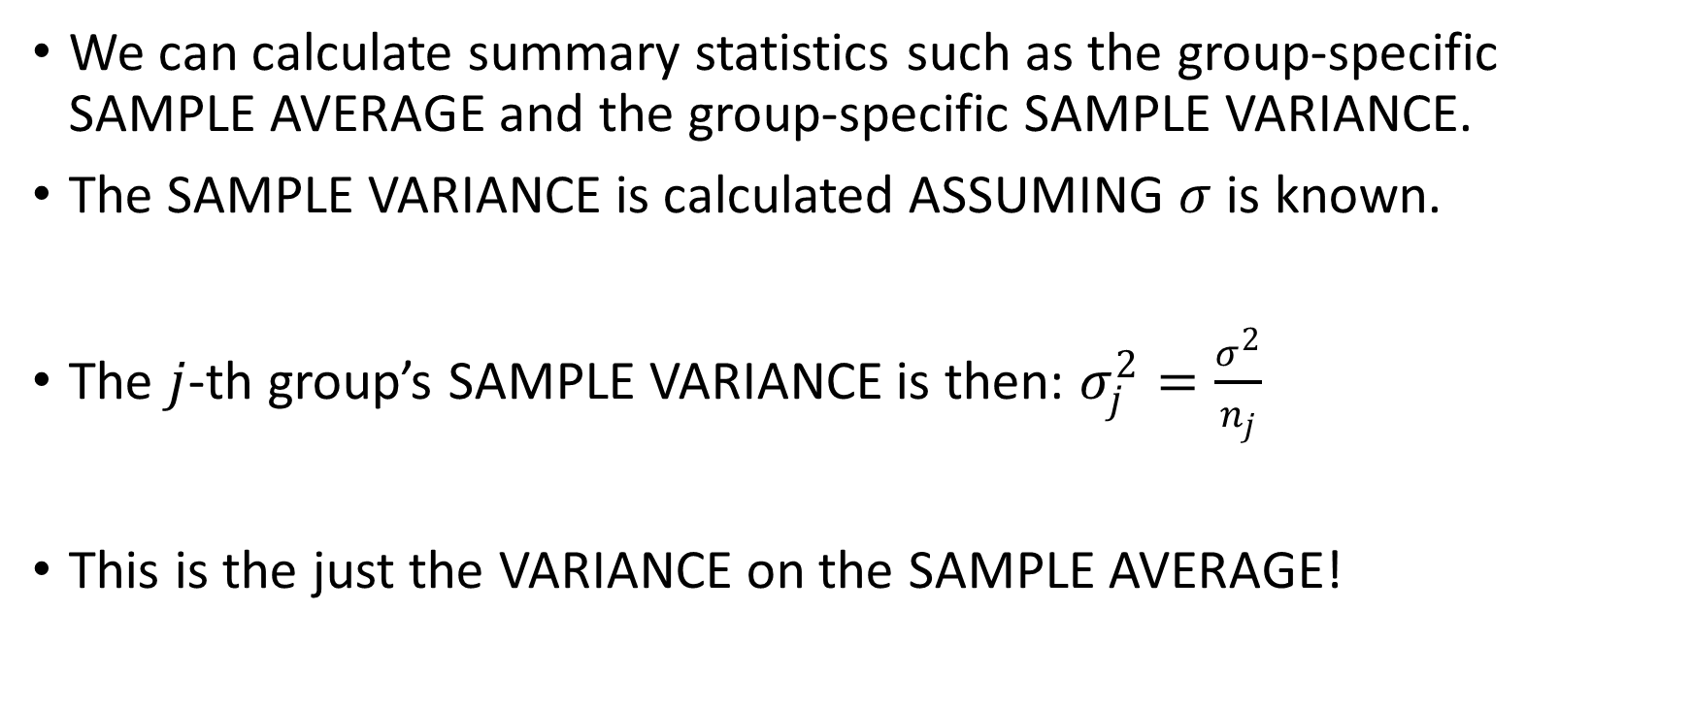
For each group we observe $n_{j}$ observations
We can calculate summary statistics such as the group-specific SAMPLE AVERAGE and the group-specific SAMPLE VARIANCE.
The SAMPLE VARIANCE is calculated ASSUMING $σ$ is known.
The $j$-th group’s SAMPLE VARIANCE is then: $σ_{j}^{2}=\frac{σ^{2}}{n_{j}}$
This is the just the VARIANCE on the SAMPLE AVERAGE!

Slide 8
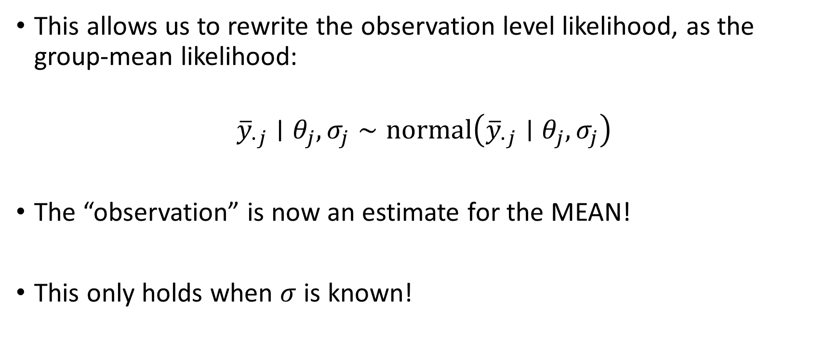
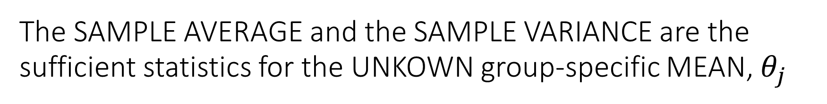
The SAMPLE AVERAGE and the SAMPLE VARIANCE are the sufficient statistics for the UNKOWN group-specific MEAN, $θ_{j}$
This allows us to rewrite the observation level likelihood, as the group-mean likelihood:
$${\overline{y}}_{∙j}∣θ_{j},σ_{j}∼normal\left({\overline{y}}_{∙j}∣θ_{j},σ_{j}\right)$$
The “observation” is now an estimate for the MEAN!
This only holds when $σ$ is known!

Slide 9
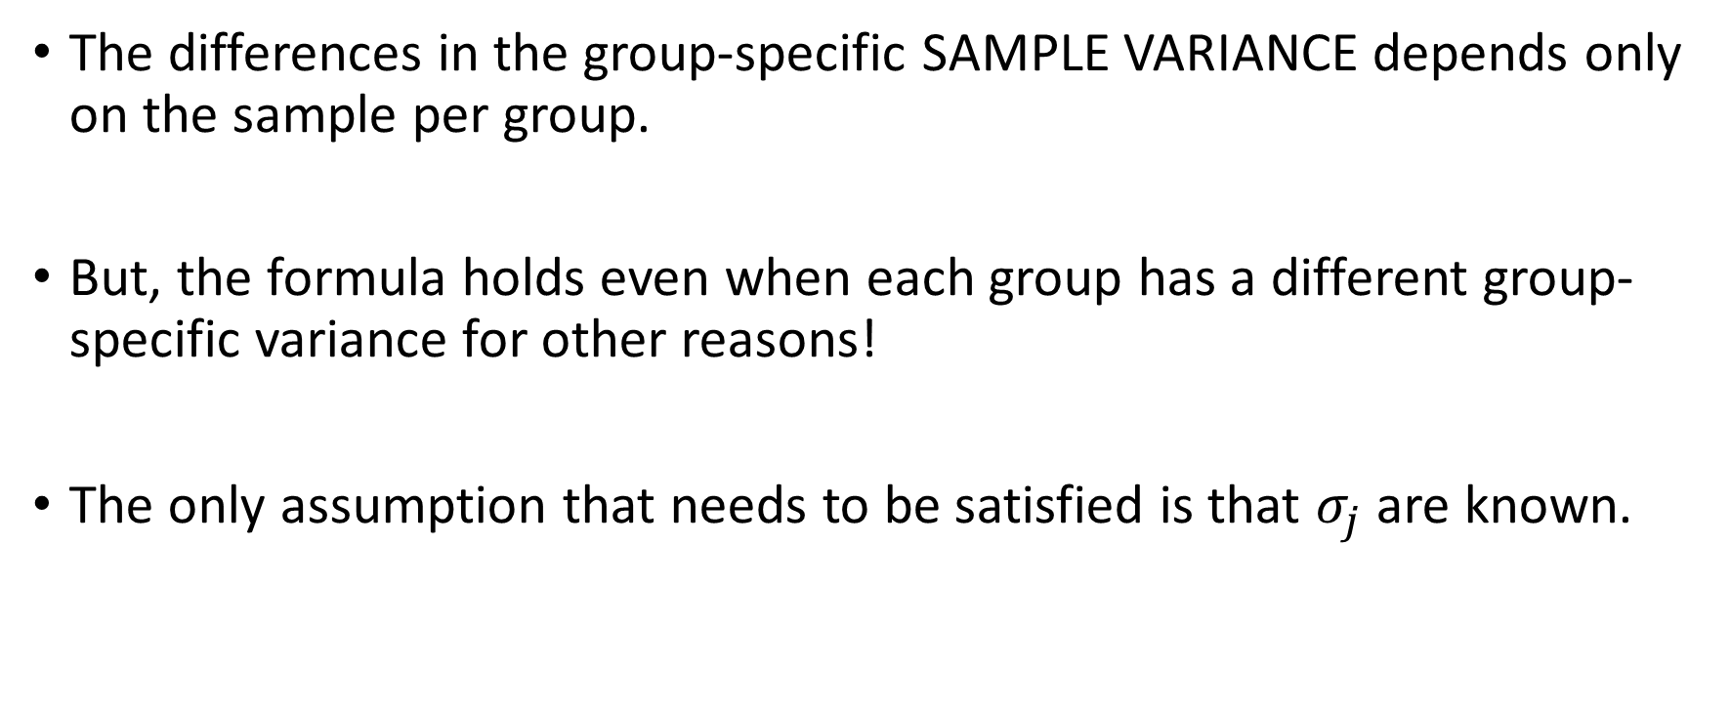
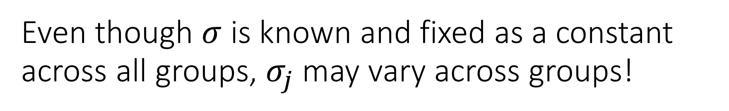
Even though $σ$ is known and fixed as a constant across all groups, $σ_{j}$ may vary across groups!
The differences in the group-specific SAMPLE VARIANCE depends only on the sample per group.
But, the formula holds even when each group has a different group-specific variance for other reasons!
The only assumption that needs to be satisfied is that $σ_{j}$ are known.

Slide 10
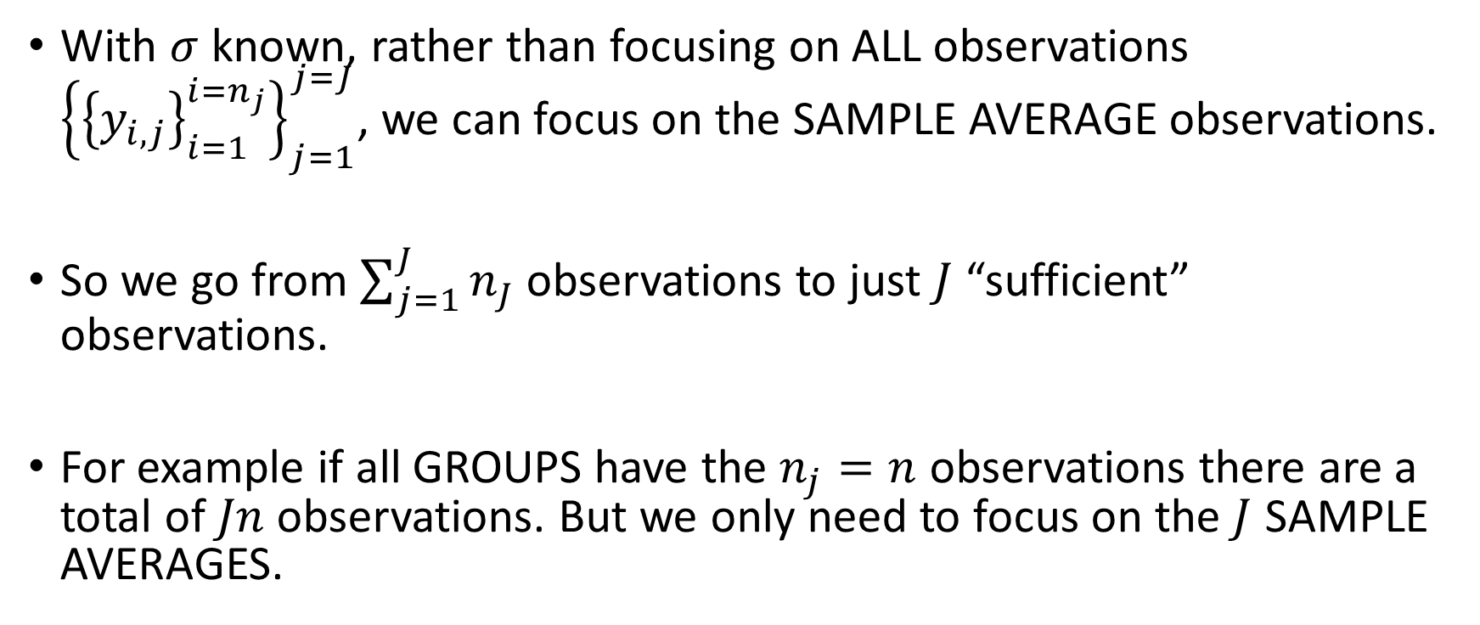
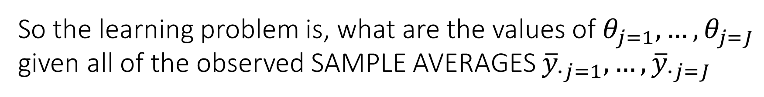
So the learning problem is, what are the values of $θ_{j=1},…,θ_{j=J}$ given all of the observed SAMPLE AVERAGES ${\overline{y}}_{∙j=1},…,{\overline{y}}_{∙j=J}$
With $σ$ known, rather than focusing on ALL observations ${\left\{{\left\{y_{i,j}\right\}}_{i=1}^{{i=n}_{j}}\right\}}_{j=1}^{j=J}$, we can focus on the SAMPLE AVERAGE observations.
So we go from $\sum_{j=1}^{J}{n_{J}}$ observations to just $J$ “sufficient” observations.
For example if all GROUPS have the $n_{j}=n$ observations there are a total of $Jn$ observations. But we only need to focus on the $J$ SAMPLE AVERAGES.

Slide 11
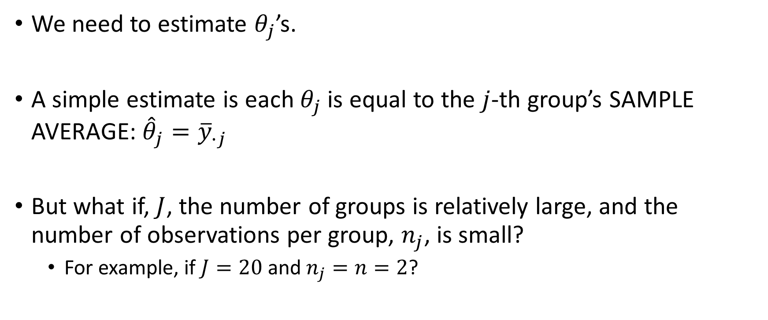
Classical non-Bayesian approaches to the learning problem.
We need to estimate $θ_{j}$’s.
A simple estimate is each $θ_{j}$ is equal to the $j$-th group’s SAMPLE AVERAGE: ${\hat{θ}}_{j}={\overline{y}}_{∙j}$
But what if, $J$, the number of groups is relatively large, and the number of observations per group, $n_{j}$, is small?
For example, if $J=20$ and $n_{j}=n=2$?

Slide 12

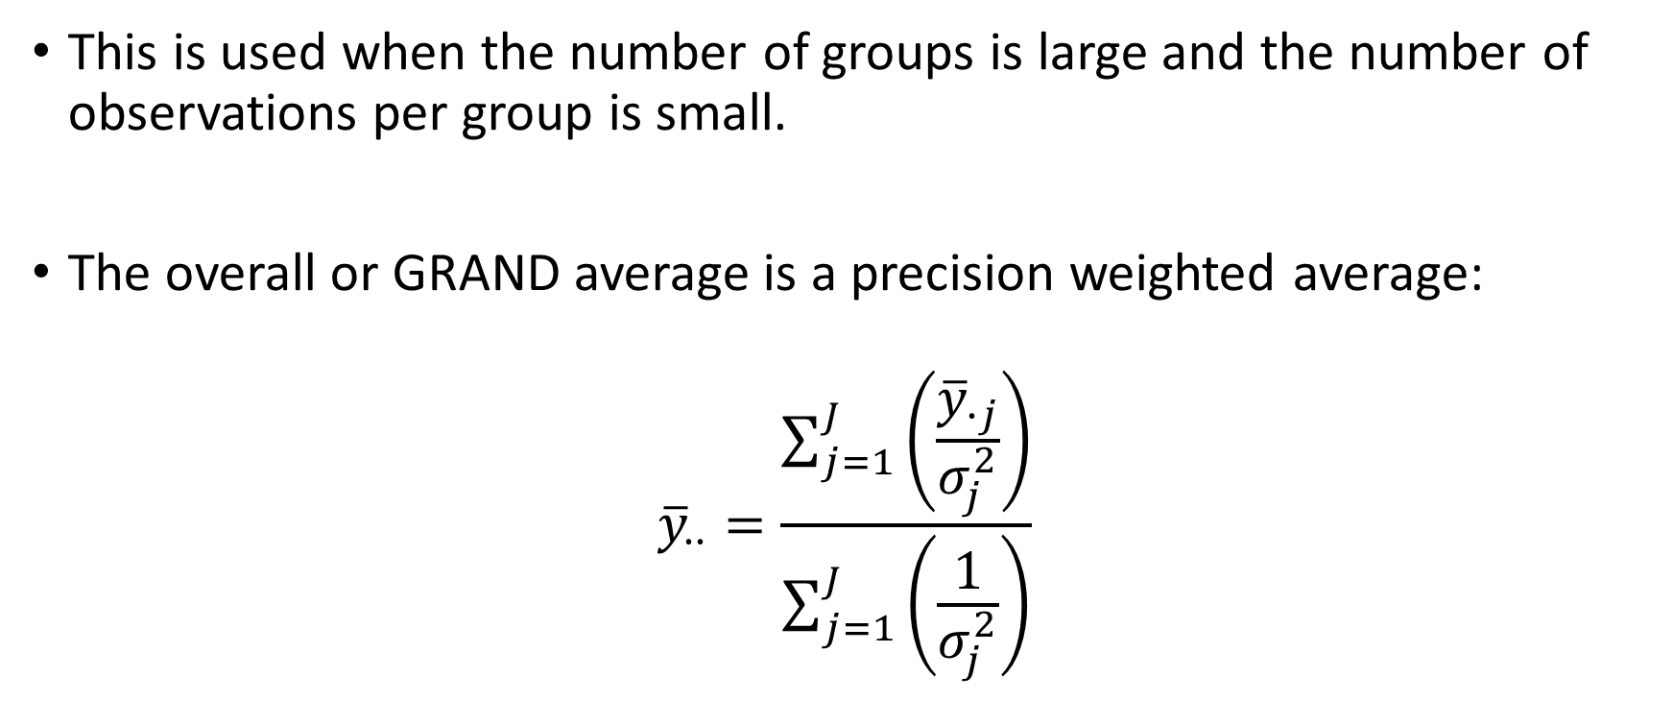
In a classical setting, a second type of estimate is simple the overall or GRAND average.
This is used when the number of groups is large and the number of observations per group is small.
The overall or GRAND average is a precision weighted average:
$${\overline{y}}_{∙∙}=\frac{\sum_{j=1}^{J}{\left(\frac{{\overline{y}}_{∙j}}{σ_{j}^{2}}\right)}}{\sum_{j=1}^{J}{\left(\frac{1}{σ_{j}^{2}}\right)}}$$
If we use the GRAND average as the estimate for each group, each group then has the SAME estimate for the unknown mean: ${\hat{θ}}_{j}={\overline{y}}_{∙∙}$

Slide 13
So there are two competing estimates.
Group-specific averages and the GRAND average.
Classically, analysis of variance (ANOVA) is used to decide between which type of estimate to use.

Slide 14
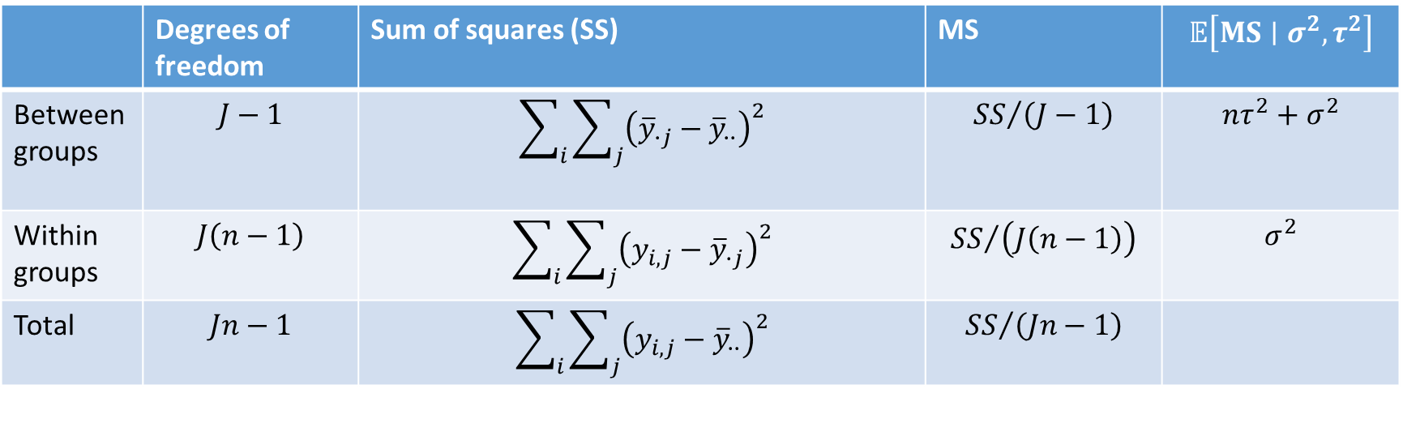
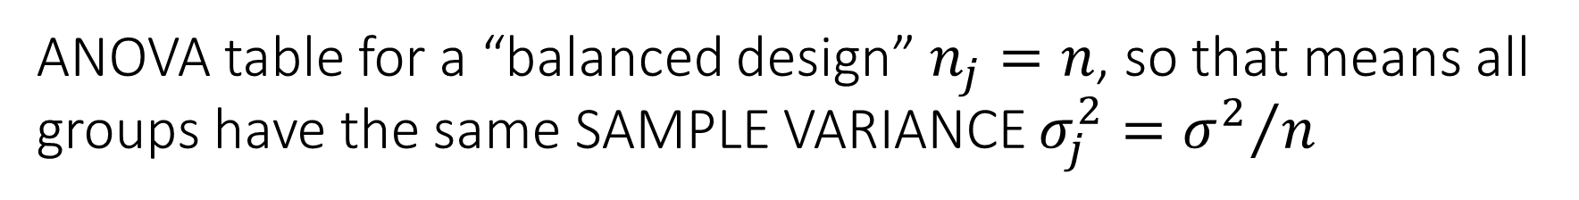
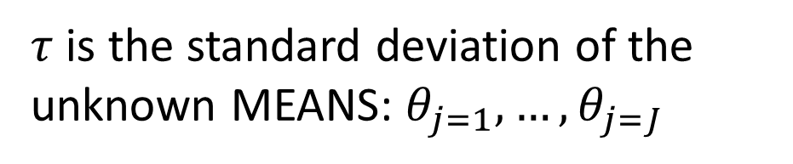
ANOVA table for a “balanced design” $n_{j}=n$, so that means all groups have the same SAMPLE VARIANCE $σ_{j}^{2}={σ^{2}}/n$
 | Degrees of freedom | Sum of squares (SS) | MS | $$𝔼\left[MS∣σ^{2},τ^{2}\right]$$
Between groups | $$J−1$$ | $$\sum_{i}{\sum_{j}{{\left({\overline{y}}_{∙j}−{\overline{y}}_{∙∙}\right)}^{2}}}$$ | $${SS}/{\left(J−1\right)}$$ | $$nτ^{2}+σ^{2}$$
Within groups | $$J\left(n−1\right)$$ | $$\sum_{i}{\sum_{j}{{\left(y_{i,j}−{\overline{y}}_{∙j}\right)}^{2}}}$$ | $${SS}/{\left(J\left(n−1\right)\right)}$$ | $$σ^{2}$$
Total | $$Jn−1$$ | $$\sum_{i}{\sum_{j}{{\left(y_{i,j}−{\overline{y}}_{∙∙}\right)}^{2}}}$$ | $${SS}/{\left(Jn−1\right)}$$
$τ$ is the standard deviation of the unknown MEANS: $θ_{j=1},…,θ_{j=J}$

Slide 15
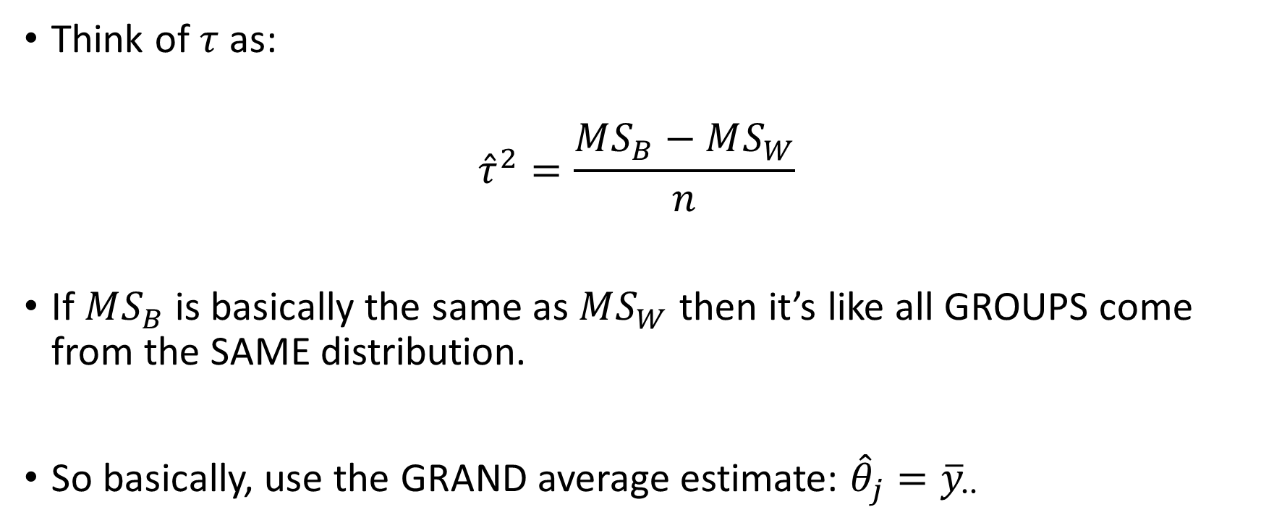
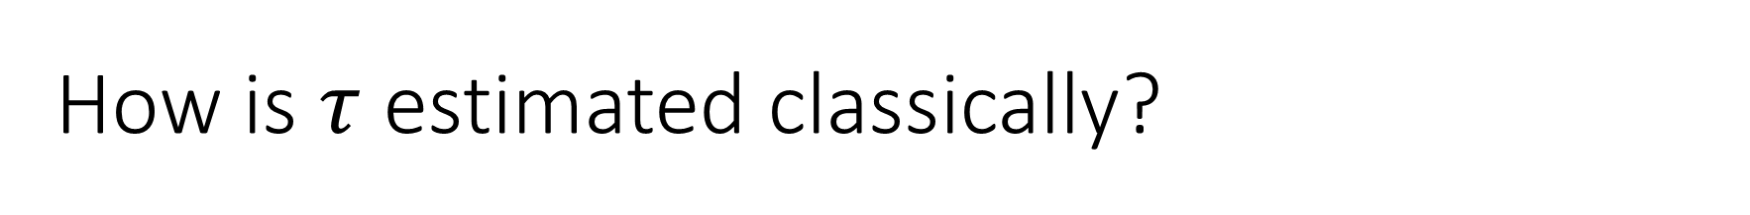
How is $τ$ estimated classically?
Think of $τ$ as:
$${\hat{τ}}^{2}=\frac{MS_{B}−MS_{W}}{n}$$
If $MS_{B}$ is basically the same as $MS_{W}$ then it’s like all GROUPS come from the SAME distribution.
So basically, use the GRAND average estimate: ${\hat{θ}}_{j}={\overline{y}}_{∙∙}$

Slide 16
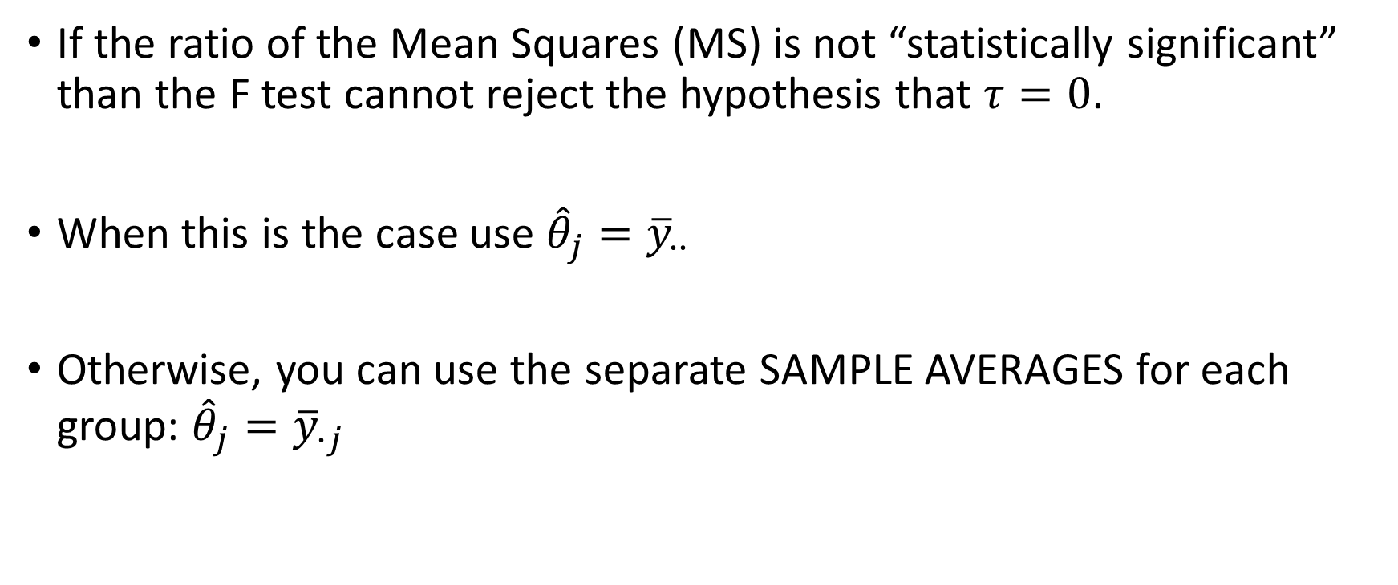
Technically…non-Bayesians are concerned with the result of the F test
If the ratio of the Mean Squares (MS) is not “statistically significant” than the F test cannot reject the hypothesis that $τ=0$.
When this is the case use ${\hat{θ}}_{j}={\overline{y}}_{∙∙}$
Otherwise, you can use the separate SAMPLE AVERAGES for each group: ${\hat{θ}}_{j}={\overline{y}}_{∙j}$

Slide 17
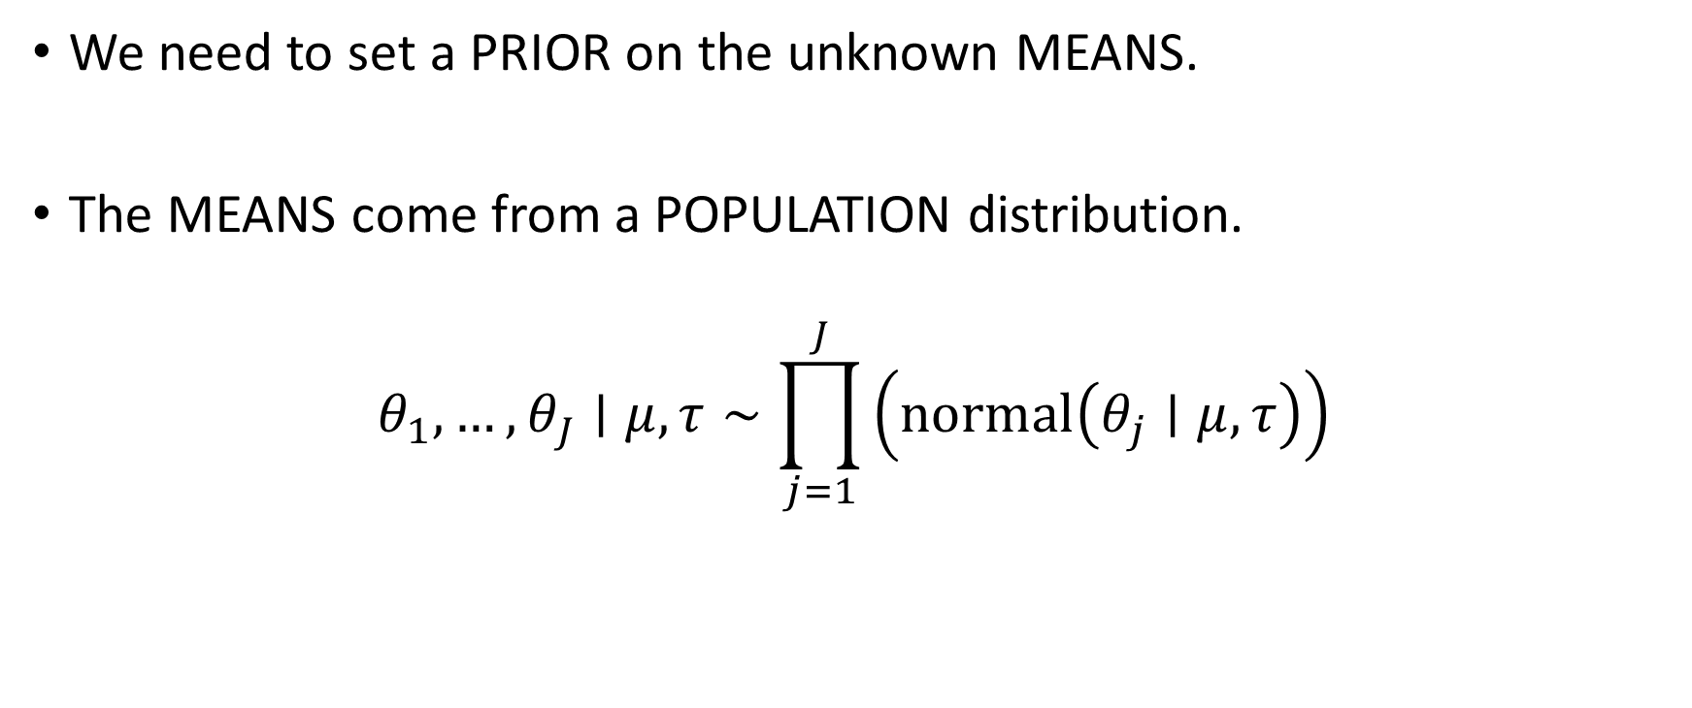
Rather than trying to simply PICK one of the two estimates, we want to BLEND or AVERAGE together the extremes.
We need to set a PRIOR on the unknown MEANS.
The MEANS come from a POPULATION distribution.
$$θ_{1},…,θ_{J}∣μ,τ∼\prod_{j=1}^{J}{\left(normal\left(θ_{j}∣μ, τ\right)\right)}$$

Slide 18
Rather than trying to simply PICK one of the two estimates, we want to BLEND or AVERAGE together the extremes.
We need to set a PRIOR on the unknown MEANS.
The MEANS come from a POPULATION distribution.
$$θ_{1},…,θ_{J}∣μ,τ∼\prod_{j=1}^{J}{\left(normal\left(θ_{j}∣μ, τ\right)\right)}$$
The unknown MEANS are CONDITIONALLY INDEPENDENT given two HYPERPARAMETERS

Slide 19
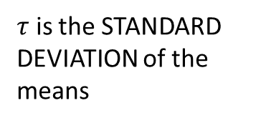
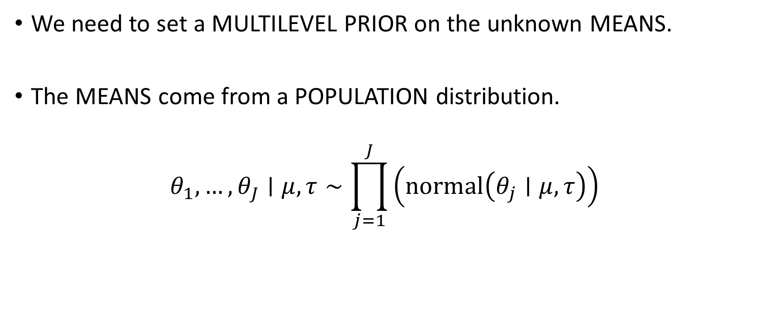
Rather than trying to simply PICK one of the two estimates, we want to BLEND or AVERAGE together the extremes.
We need to set a MULTILEVEL PRIOR on the unknown MEANS.
The MEANS come from a POPULATION distribution.
$$θ_{1},…,θ_{J}∣μ,τ∼\prod_{j=1}^{J}{\left(normal\left(θ_{j}∣μ, τ\right)\right)}$$
$τ$ is the STANDARD DEVIATION of the means
The unknown MEANS are CONDITIONALLY INDEPENDENT given two HYPERPARAMETERS

Slide 20
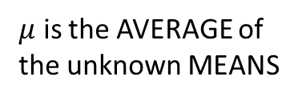
Rather than trying to simply PICK one of the two estimates, we want to BLEND or AVERAGE together the extremes.
We need to set a PRIOR on the unknown MEANS.
The MEANS come from a POPULATION distribution.
$$θ_{1},…,θ_{J}∣μ,τ∼\prod_{j=1}^{J}{\left(normal\left(θ_{j}∣μ, τ\right)\right)}$$
$μ$ is the AVERAGE of the unknown MEANS
The unknown MEANS are CONDITIONALLY INDEPENDENT given two HYPERPARAMETERS

Slide 21
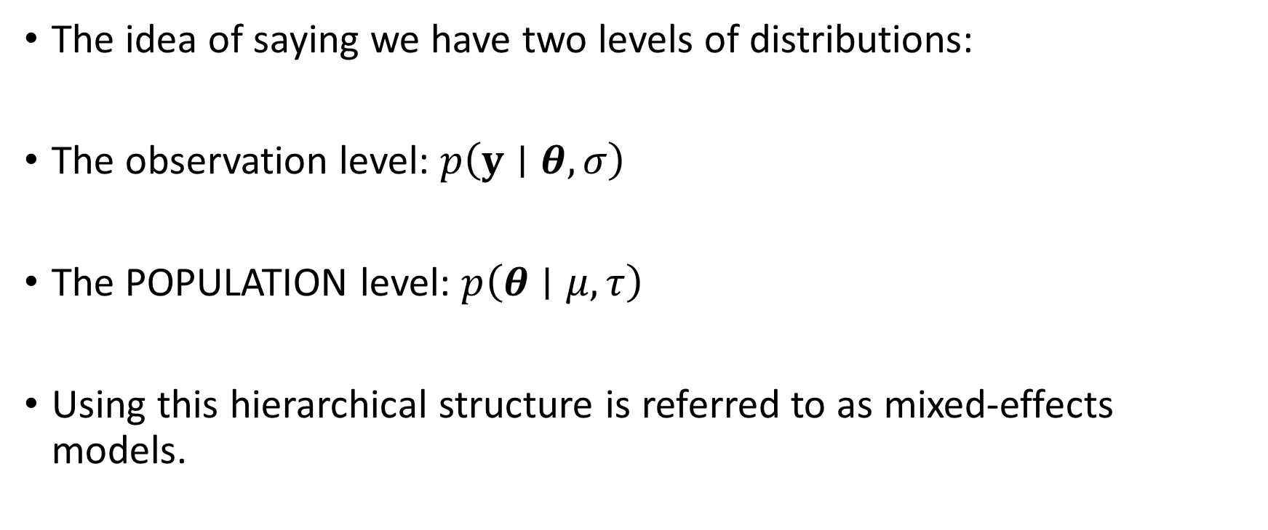
This structure, the MULTILEVEL structure, is not Bayesian
The idea of saying we have two levels of distributions:
The observation level: $p\left(y∣θ,σ\right)$
The POPULATION level: $p\left(θ∣μ, τ\right)$
Using this hierarchical structure is referred to as mixed-effects models.

Slide 22

What makes the model Bayesian is that we also include a PRIOR on the hyperparameters
We must specify the PRIOR belief on $μ$ and $τ$: $p\left(μ,τ\right)$

Slide 23
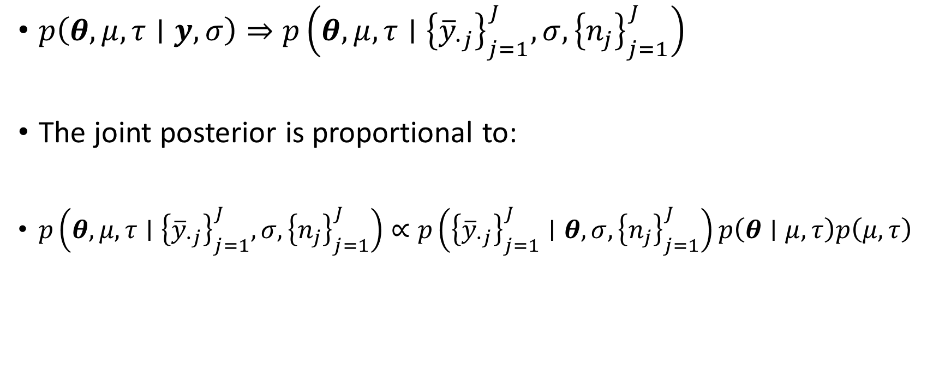
The complete joint posterior distribution
$p\left(θ,μ,τ∣y,σ\right)⇒p\left(θ,μ,τ∣{\left\{{\overline{y}}_{∙j}\right\}}_{j=1}^{J},σ,{\left\{n_{j}\right\}}_{j=1}^{J}\right)$
The joint posterior is proportional to:
$p\left(θ,μ,τ∣{\left\{{\overline{y}}_{∙j}\right\}}_{j=1}^{J},σ,{\left\{n_{j}\right\}}_{j=1}^{J}\right)∝p\left({\left\{{\overline{y}}_{∙j}\right\}}_{j=1}^{J}∣θ,σ,{\left\{n_{j}\right\}}_{j=1}^{J}\right)p\left(θ∣μ, τ\right)p\left(μ,τ\right)$

Slide 24

Plug in for the expressions, the joint posterior is proportional to:
$$p\left(θ,μ,τ∣∙\right)∝\prod_{j=1}^{J}{\left\{normal\left({\overline{y}}_{∙j}∣θ_{j},σ_{j}\right)\right\}}\prod_{j=1}^{J}{\left\{normal\left(θ_{j}∣μ,τ\right)\right\}}p\left(μ,τ\right)$$

Slide 25
Components of the model
$$p\left(θ,μ,τ∣∙\right)∝\prod_{j=1}^{J}{\left\{normal\left({\overline{y}}_{∙j}∣θ_{j},σ_{j}\right)\right\}}\prod_{j=1}^{J}{\left\{normal\left(θ_{j}∣μ,τ\right)\right\}}p\left(μ,τ\right)$$
The “observed” SAMPLE AVERAGE likelihood – given the unknown MEAN and known GROUP specific standard deviation

Slide 26
Components of the model
$$p\left(θ,μ,τ∣∙\right)∝\prod_{j=1}^{J}{\left\{normal\left({\overline{y}}_{∙j}∣θ_{j},σ_{j}\right)\right\}}\prod_{j=1}^{J}{\left\{normal\left(θ_{j}∣μ,τ\right)\right\}}p\left(μ,τ\right)$$
The GROUP unknown MEANS come from a POPULATION distribution with UNKNOWN hyperparameters

Slide 27
Components of the model
$$p\left(θ,μ,τ∣∙\right)∝\prod_{j=1}^{J}{\left\{normal\left({\overline{y}}_{∙j}∣θ_{j},σ_{j}\right)\right\}}\prod_{j=1}^{J}{\left\{normal\left(θ_{j}∣μ,τ\right)\right\}}p\left(μ,τ\right)$$
The prior on the hyperparameters, sometimes called the HYPERPRIOR

Slide 28
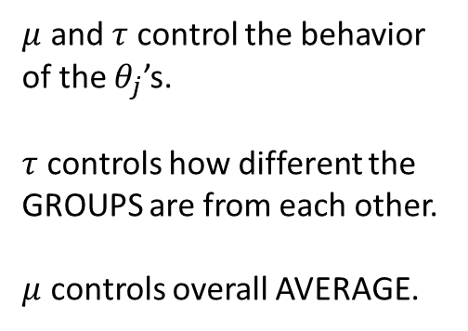
Concept of HIERARCHY or MULTI-LEVEL
$$p\left(θ,μ,τ∣∙\right)∝\prod_{j=1}^{J}{\left\{normal\left({\overline{y}}_{∙j}∣θ_{j},σ_{j}\right)\right\}}\prod_{j=1}^{J}{\left\{normal\left(θ_{j}∣μ,τ\right)\right\}}p\left(μ,τ\right)$$
$μ$ and $τ$ control the behavior of the $θ_{j}$’s.
$τ$ controls how different the GROUPS are from each other.
$μ$ controls overall AVERAGE.

Slide 29

Concept of HIERARCHY or MULTI-LEVEL
$$p\left(θ,μ,τ∣∙\right)∝\prod_{j=1}^{J}{\left\{normal\left({\overline{y}}_{∙j}∣θ_{j},σ_{j}\right)\right\}}\prod_{j=1}^{J}{\left\{normal\left(θ_{j}∣μ,τ\right)\right\}}p\left(μ,τ\right)$$
$θ_{j}$ controls the LOCATION of each GROUP.
The individual observations, $y_{i,j}$ will be scattered around $θ_{j}$ with standard deviation $σ$

Slide 30

Ch.5 in BDA3 goes through deriving analytic results for the posteriors under particular assumptions
They specify the following HYPERPRIOR which uses an uninformative prior structure on $μ$:
$$p\left(μ,τ\right)=p\left(μ∣τ\right)p\left(τ\right)∝p\left(τ\right)$$

