Slide 1
Employee Task Tracker Application –Process Flow

Slide 2
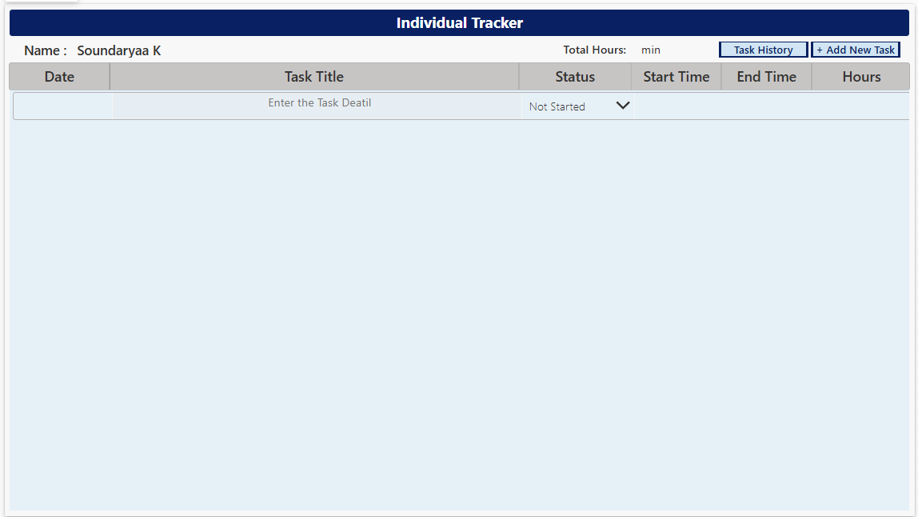
Individual Tracker Screen

Slide 3
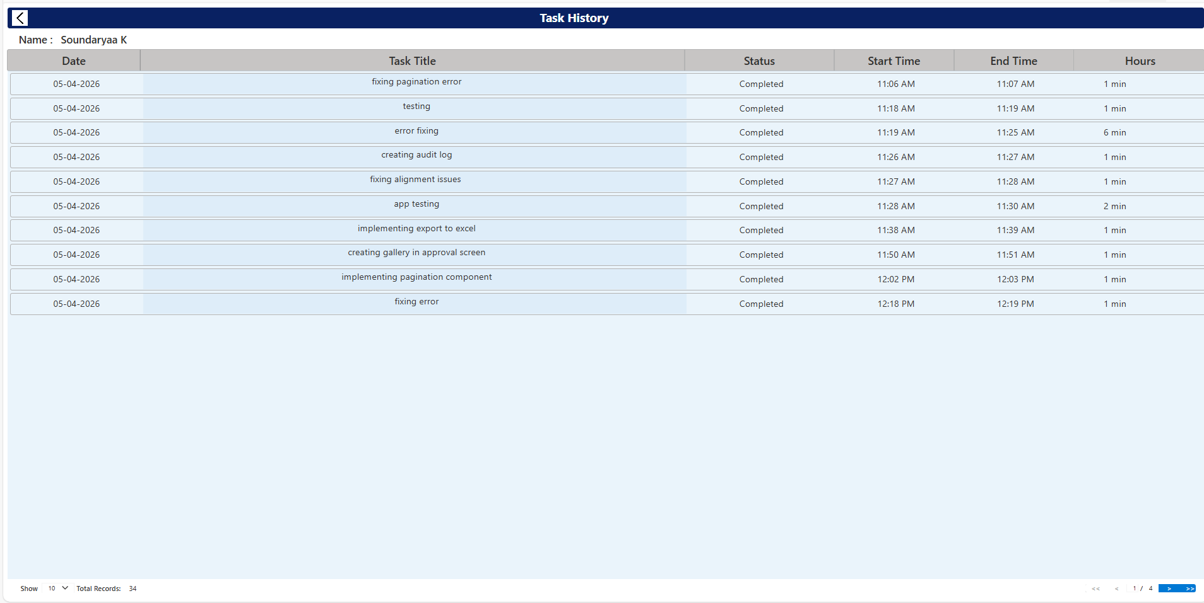
Task History View Screen

Slide 4
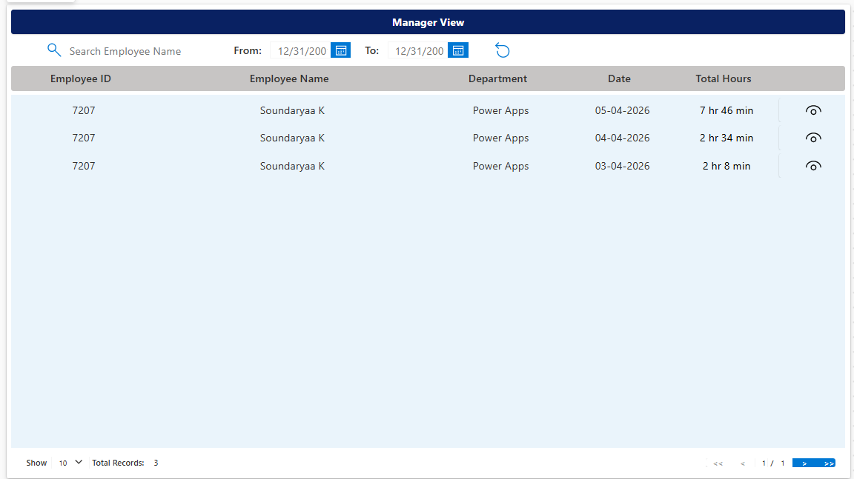
Manager View Screen

Slide 5
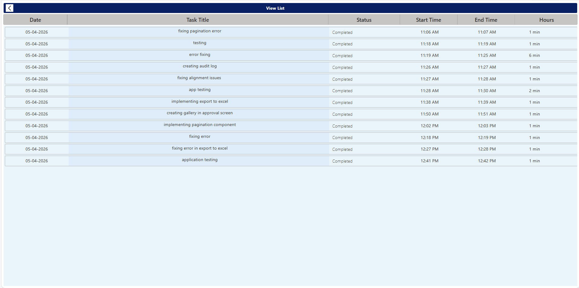
View List Screen

Slide 6
SharePoint Lists

Slide 7
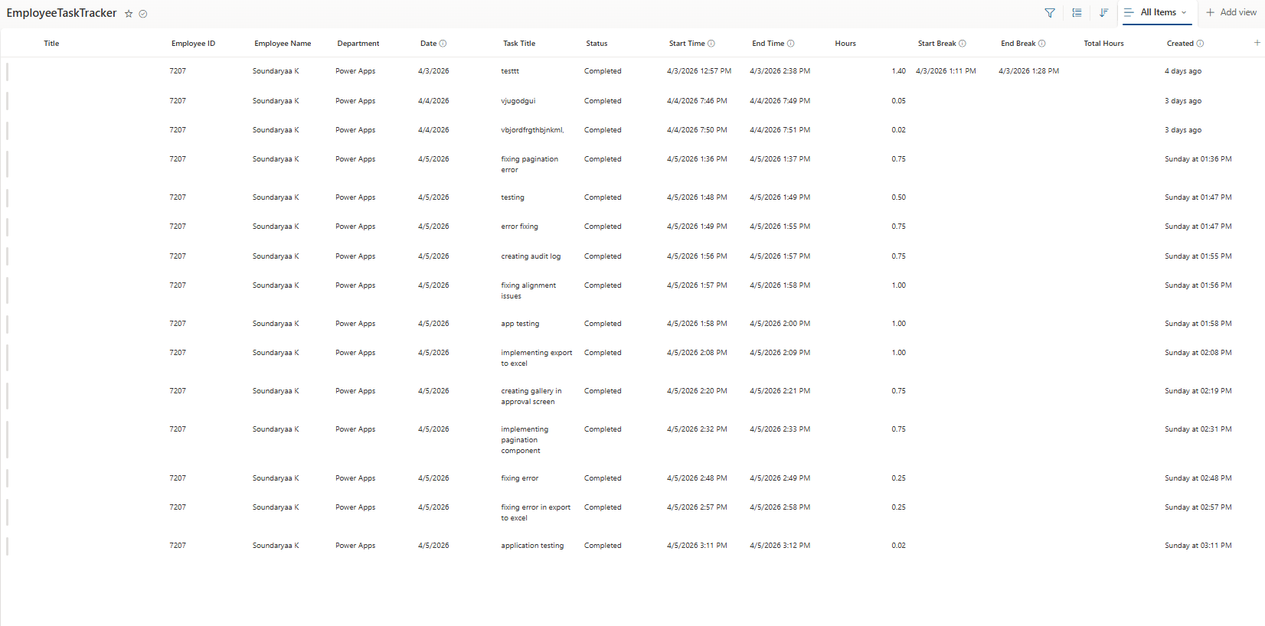
Employee Task Tracker List

Slide 8
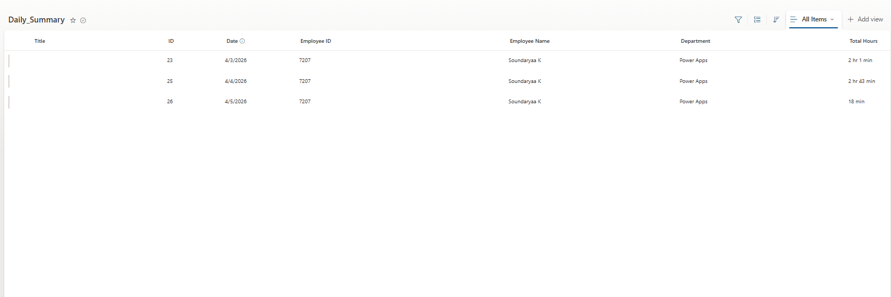
Daily Summary List

Slide 9
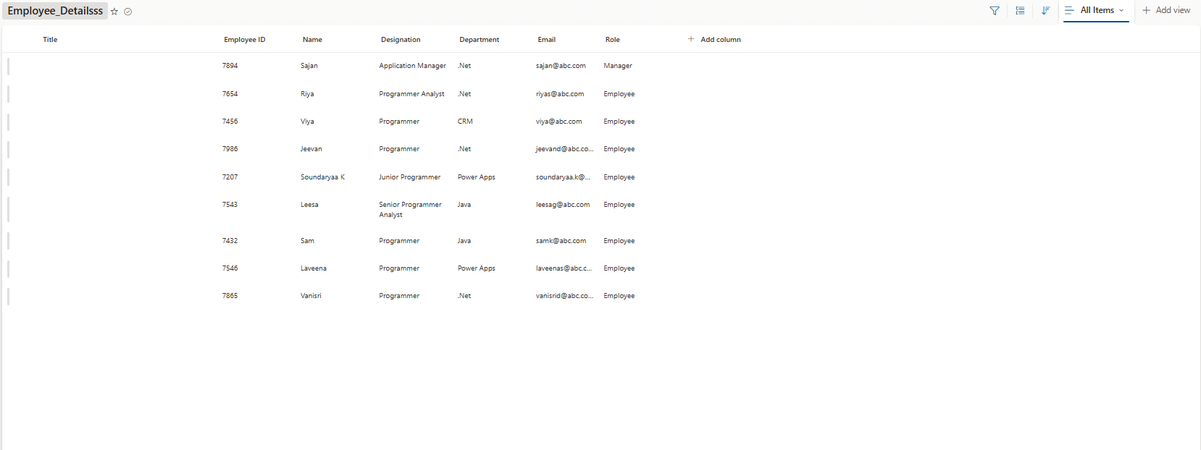
Employee Details List

Slide 10
Email WorkFlow

Slide 11
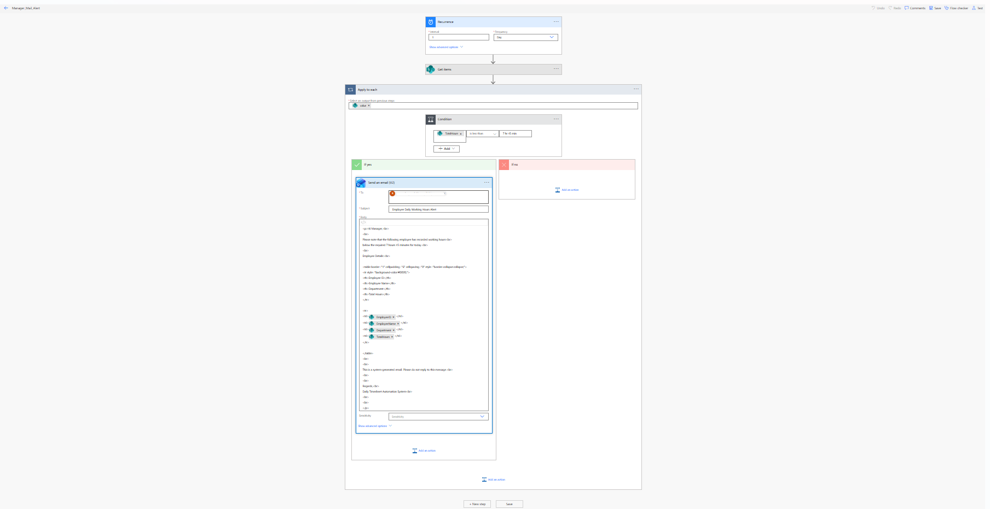
Employee Task Tracker Application Flow

Slide 12
Email Notification

Slide 13
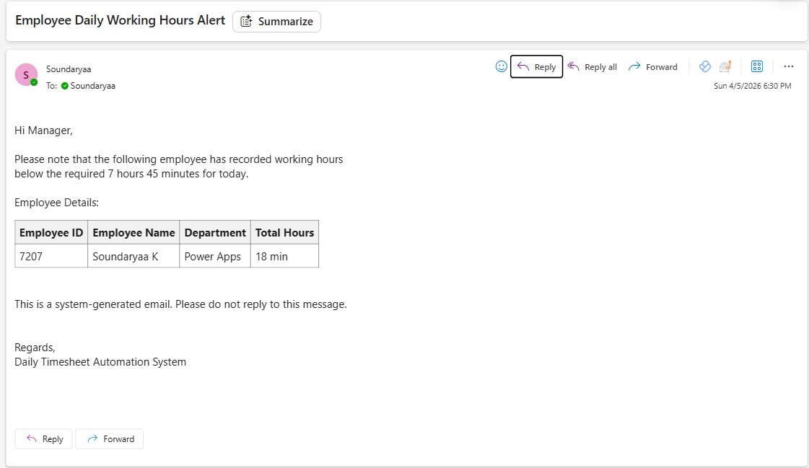
Email Notification to Manager

