Slide 1
CS583: Aspect Analysis
Erik osland
Enze Liu

Slide 2
Preprocessing and Methods
Preprocessing
TF-IDF
Custom
Algorithms
Decision Tree
Random Forest
Naïve Bayes
Neural Networks

Slide 3
Issue with TF-IDF
The fish was good but the service was terrible: fish
The fish was good but the service was terrible: service
TF-IDF
Notes:
If the feature vectors are the same, how could the label be diffferent?

Slide 4
Custom Feature Representation
Distance
to Aspect
The fish was good but the service was terrible: fish
1 0 1 2 3 - 5 - 7
The fish was good but the service was terrible: service
- 5 - 3 2 1 0 1 2
The fish was good but the service was terrible: fish
The fish was good but the service was terrible: service
Take Reciprocal
The fish was good but the service was terrible: fish
1 0 1 1/2 1/3 - 1/5 - 1/7
The fish was good but the service was terrible: service
- 1/5 - 1/3 1/2 1 0 1 1/2
Notes:
May want to mention that this works with ngrams of any length and you do have the option of removing stop words. Experiments with stop word removal showed that stop word position is important.

Slide 5
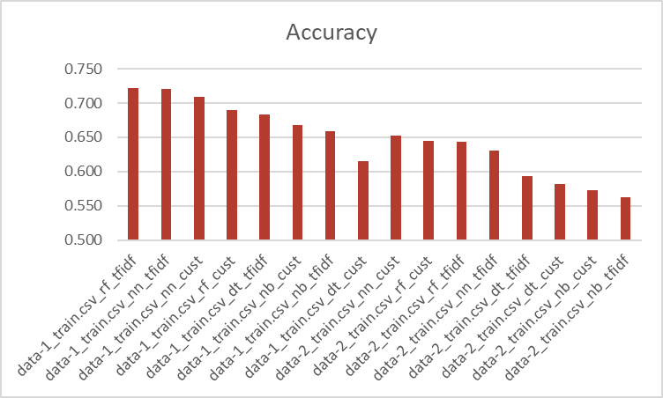
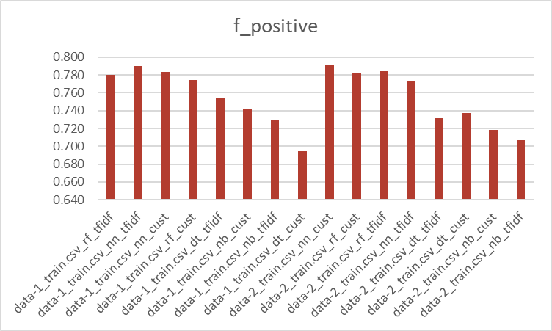
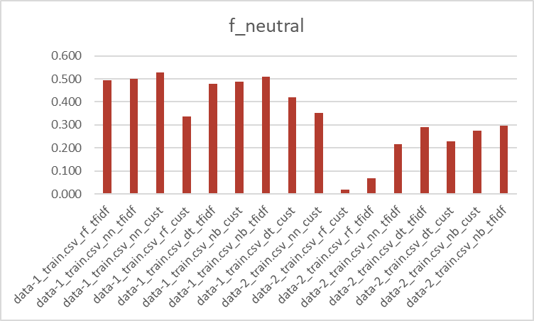
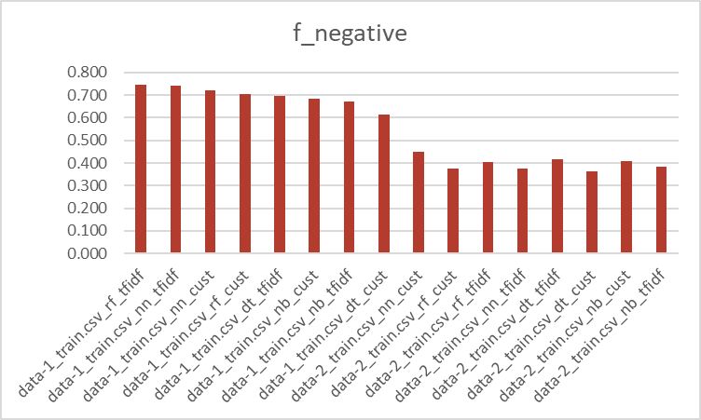
Result Charts

Slide 6
Result Data

Slide 7
References
Bhoi, A., Joshi, S. Various Approaches to Aspect-based Sentiment Analysis May 5, 2018, https://arxiv.org/pdf/1805.01984.pdf
Mayank G. Aspect-Based Sentiment Analysis Master’s thesis National College of Ireland, December 21, 2016, http://trap.ncirl.ie/2529/1/mayankgulaty.pdf
Wang, B., Liu, M. Deep Learning for Aspect-Based Sentiment Analysis https://cs224d.stanford.edu/reports/WangBo.pdf

