Slide 1
CS583: Aspect Analysis
Erik osland
Enze Liu

Slide 2
Preprocessing and Methods
Preprocessing
TF-IDF
Custom
Algorithms
Decision Tree
Random Forest
Naïve Bayes
Neural Networks
SVM*
*Needs additional hyperparameter tuning

Slide 3
Issue with TF-IDF
The fish was good but the service was terrible: fish
The fish was good but the service was terrible: service
TF-IDF

Slide 4
Custom Feature Representation
Distance
To aspect
The fish was good but the service was terrible: fish
1 0 1 2 3 4 5 6 7
The fish was good but the service was terrible: service
6 5 4 3 2 1 0 1 2
The fish was good but the service was terrible: fish
The fish was good but the service was terrible: service
Take reciprocal
The fish was good but the service was terrible: fish
1 0 1 1/2 1/3 1/4 1/5 1/6 1/7
The fish was good but the service was terrible: service
1/6 1/5 1/4 1/3 1/2 1 0 1 1/2

Slide 5
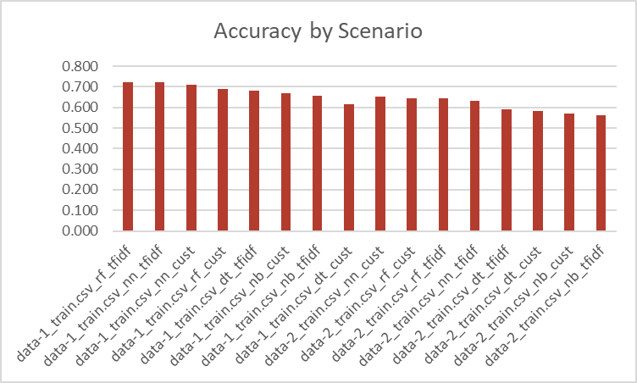
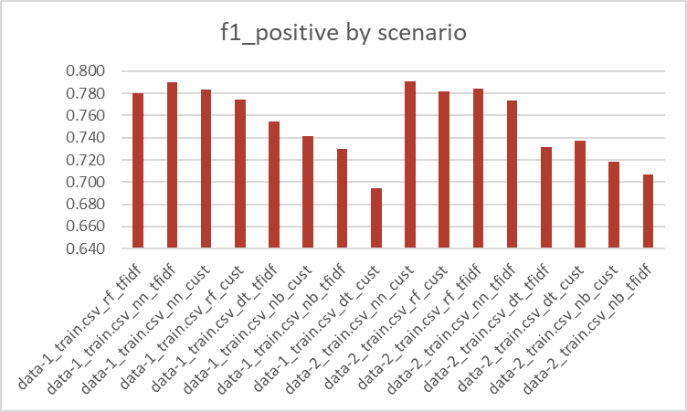
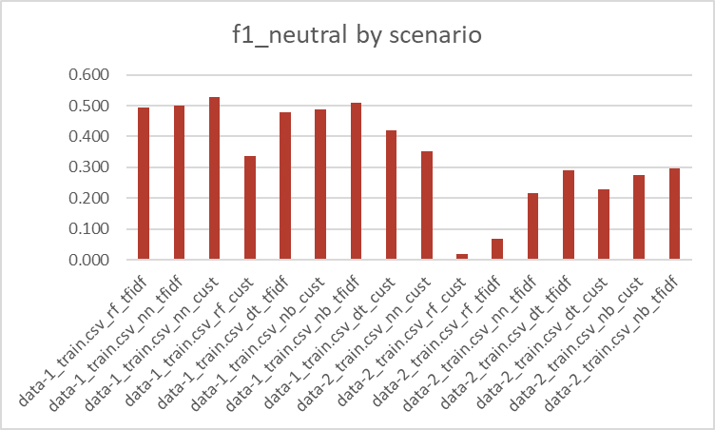
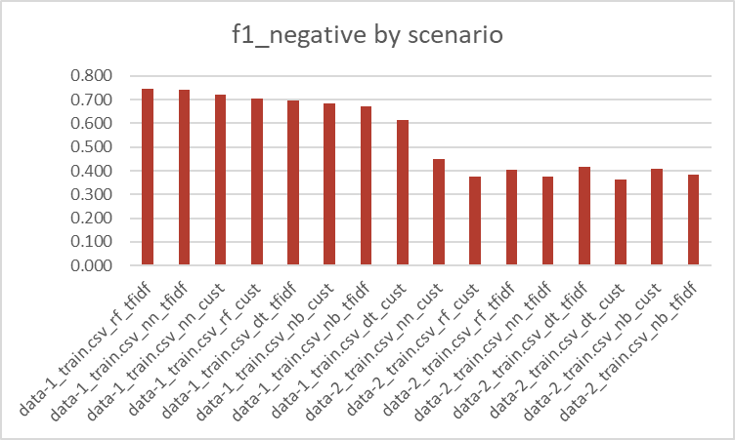
Result Charts

Slide 6
Result Data

