Slide 1
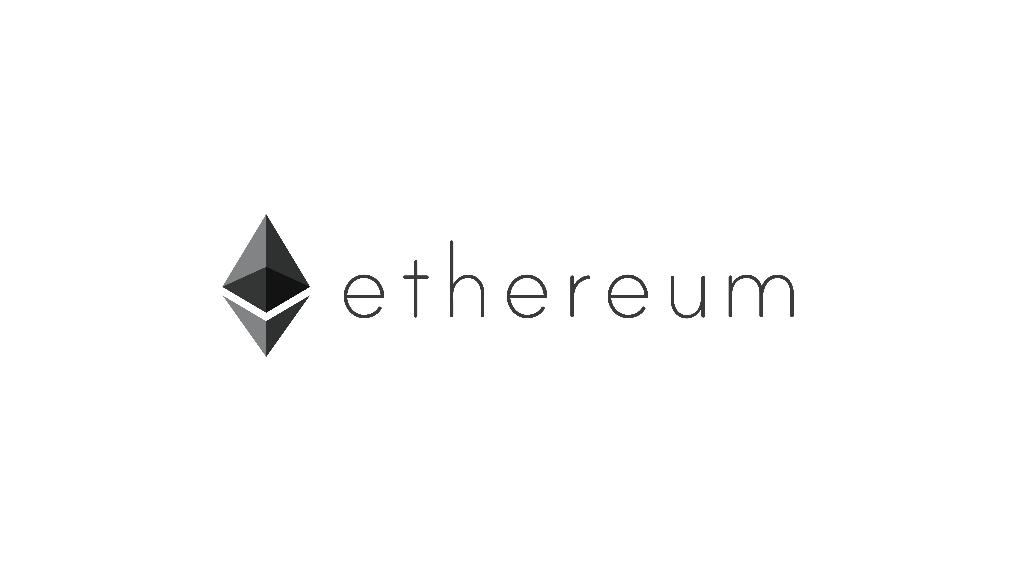


Dev Tools, Dapps, & Future Developments
#construct2017

Slide 2
topics
Ethereum Roadmap
Ethereum Software Ecosystem
What Makes Us Different

Slide 3
Ethereum Roadmap
Then. Now. Future. Far Future

Slide 4
Where we’ve been
January 2014 - Ethereum formerly announced at North American Bitcoin Conference.
July 2015 – “Frontier” phase: Ethereum blockchain goes live.
March 2016 – “Homestead” phase: Many protocol improvements.

Slide 5
Where We are Now
Light-clients
Tons of Dapps
Ethereum on mobile/embedded devices
Improvements in smart contract safety and formal verification
Interest from many industries

Slide 6
Where We Are Going: “Metropolis”
ETA: 3-6 months.
Provide flexibility to smart contract devs
Initial steps towards Ethereum “abstraction”
Separate consensus, logic, and data layers.
Eventual support for different consensus protocols, account security, and scalability solutions.
zk-SNARKs on Ethereum (check out Project Alchemy)

Slide 7
Super cool stuff after metropolis: “Serenity”
ETA: Not finalized.
Change from PoW to PoS: CASPER consensus algo.
Finish “abstraction” of Ethereum.
UTXO based token management.
Advanced contract execution schemes
Swap out consensus mechanisms (Tendermint, PoW, etc.).
Blockchain sharding and < 4 sec. block times.

Slide 8

Ethereum Software Ecosystem

Slide 9



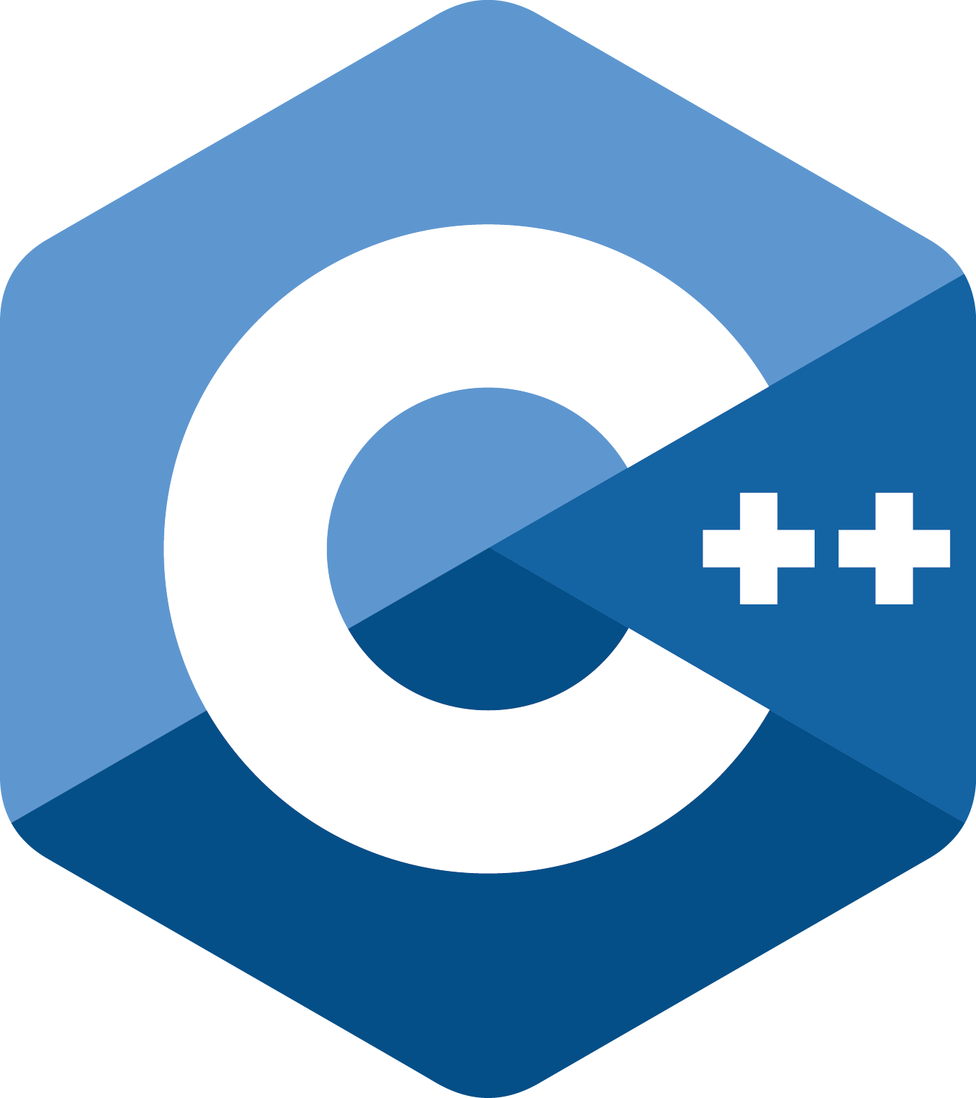














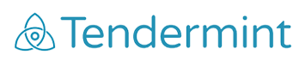












Clients
Dev Tools
Enterprise
Quorum by J.P. Morgan
Dapps
Community

Slide 10
What makes Ethereum different?
Then. Now. Future. Far Future

Slide 11
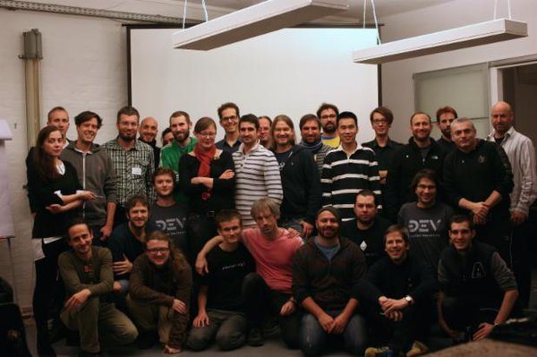

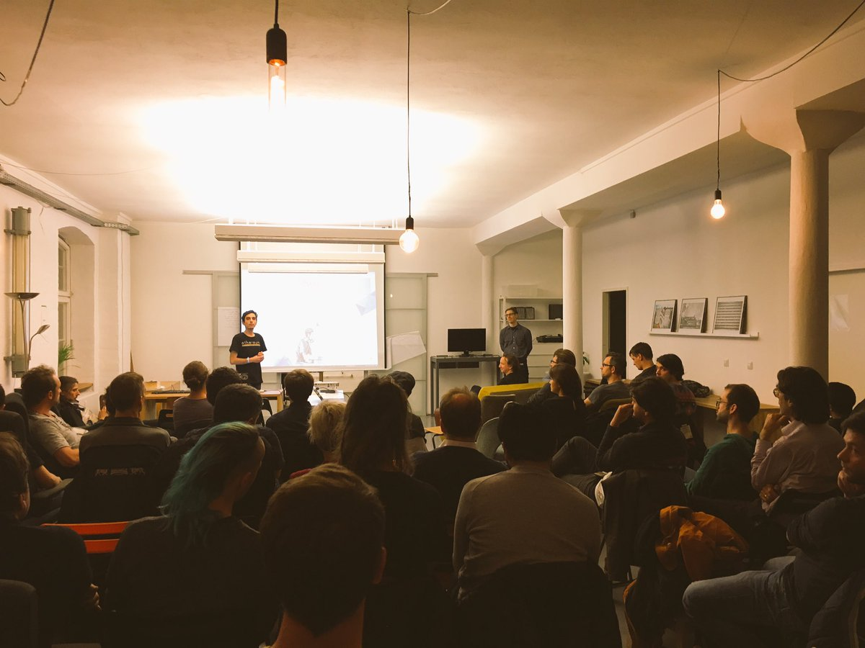
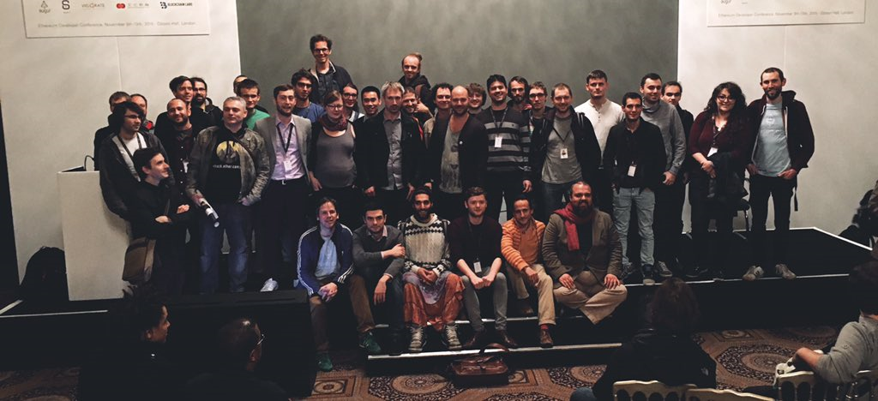
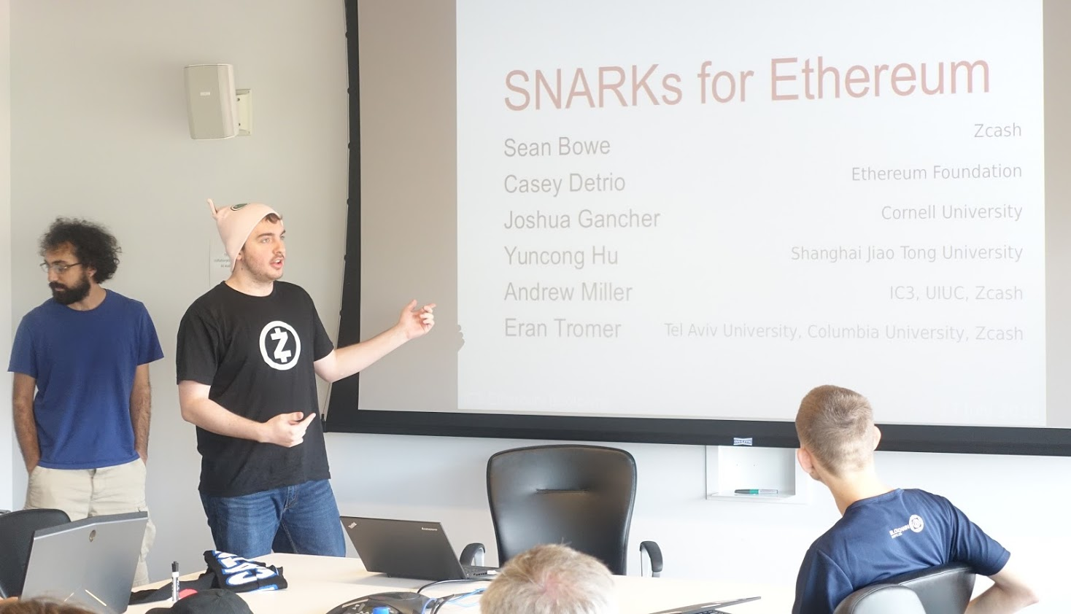


Slide 12



Scavenger Hunt!
Starting tomorrow…

