Slide 1
An Introduction to Blockchain and Smart Contract Technology
Hudson Jameson
@hudsonjameson

Slide 2

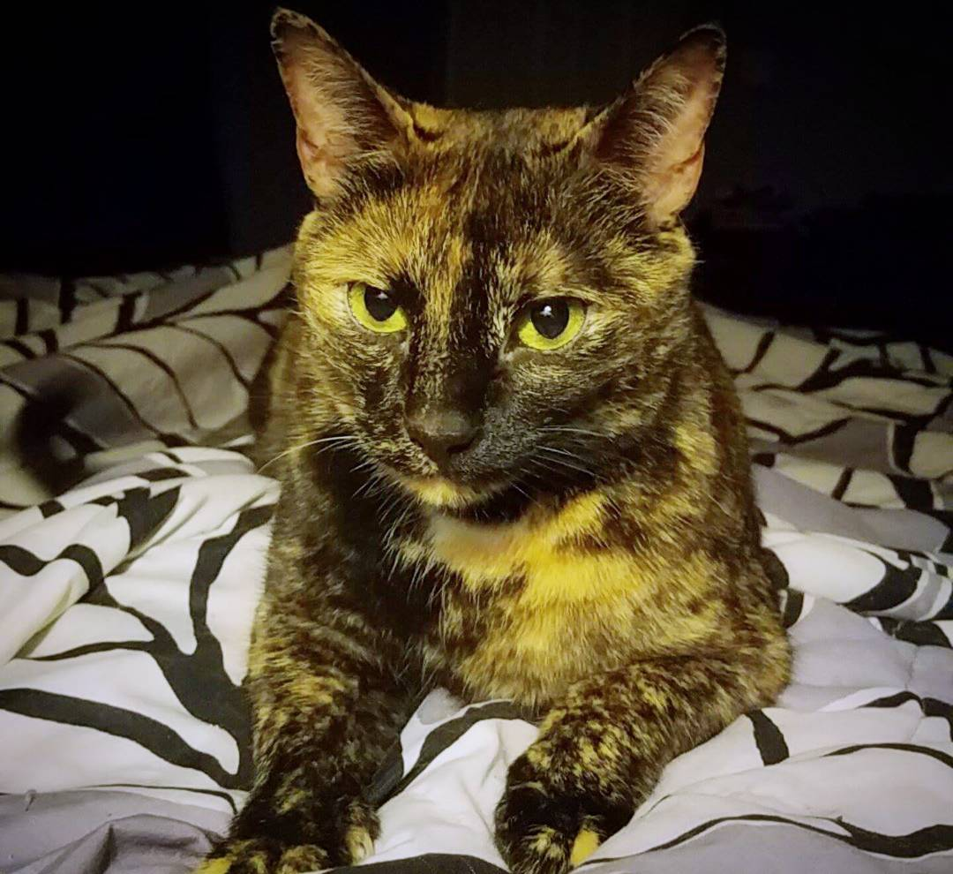
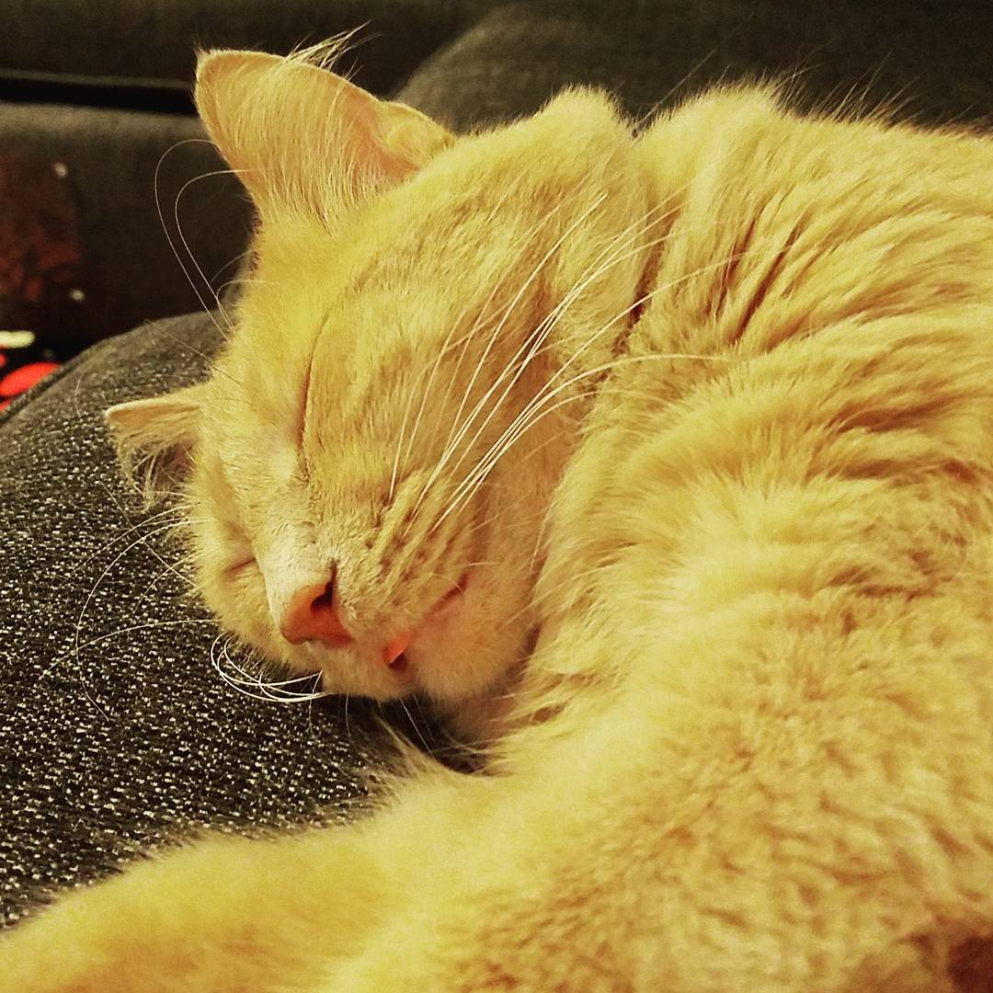
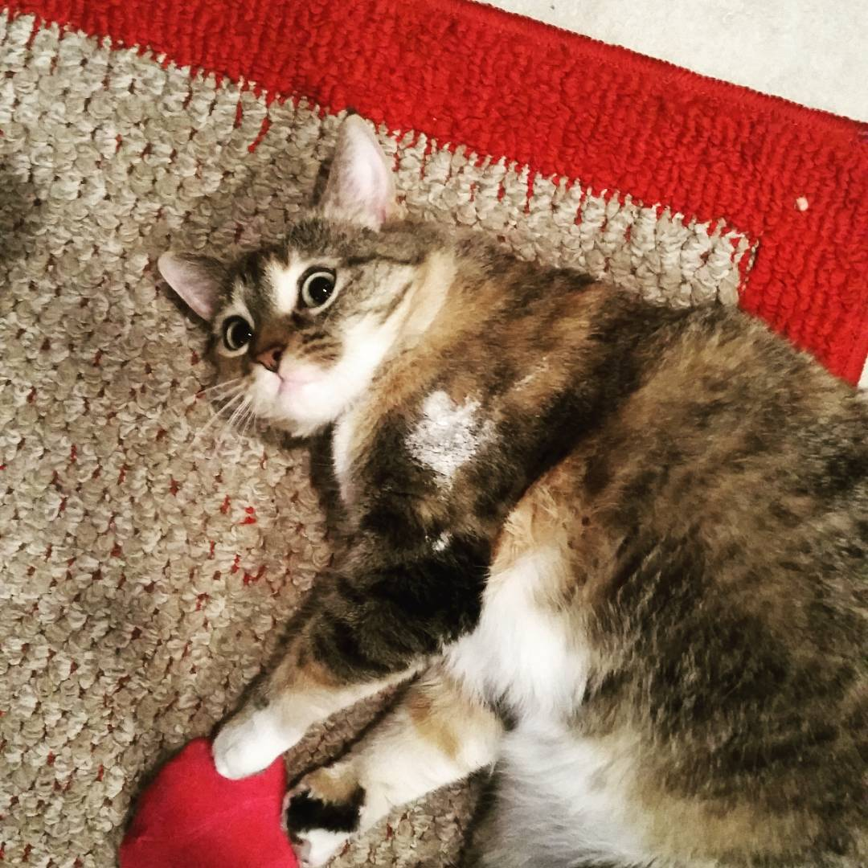
About Me
Graduated with computer science degree from University of North Texas in 2014
2 Years @ USAA (awesome place to work)
4 Months @ Ethereum Foundation/Independent Consultant
Working with blockchain technology for 5 years
1 wife (Laura) and 3 cats (Vivian, Fry, and Leeloo)

Slide 3
What is this stuff and how did we get here?

Slide 4
Blockchain
Decentralized, distributed database that keeps a permanent tamper-resistant record of all previous transactions.
A truth machine that enables disintermediation.
3 Components:
Data Layer
Networking/Gossip Layer
Consensus Layer

Slide 5
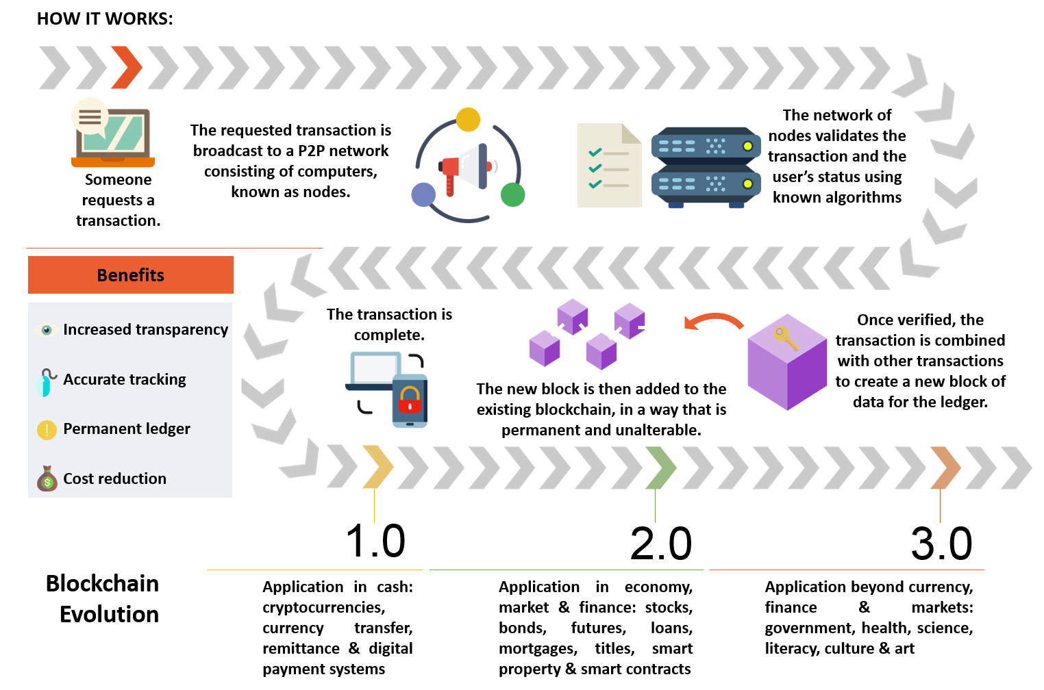
Courtesy blockcon.co

Slide 6
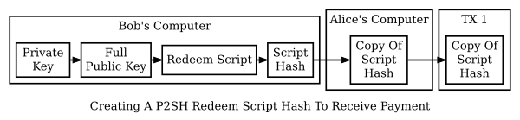

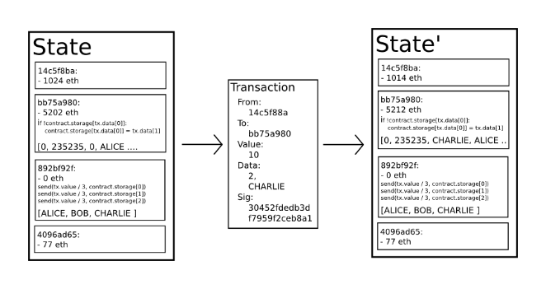

Progress

Slide 7
Smart Contracts
Self-enforceable, trustless pieces of code.
“Instead of just moving money, let’s put programs on the blockchain!”
Shares the blockchain benefits:
Permanency
Transparency
Security
Redundancy
Decentralization

Slide 8
How is blockchain being used?

Slide 9
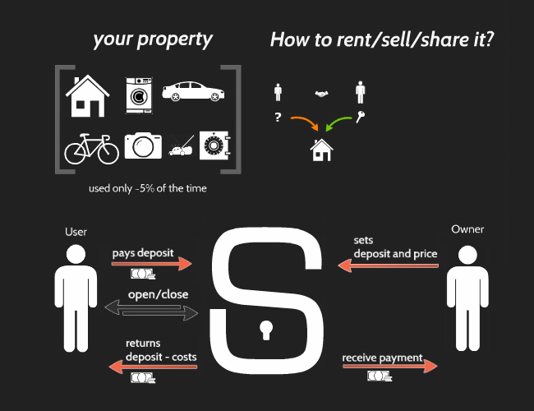
Example 1: IoT and Rentable Assets
Slock.it | @SlockItProject

Slide 10
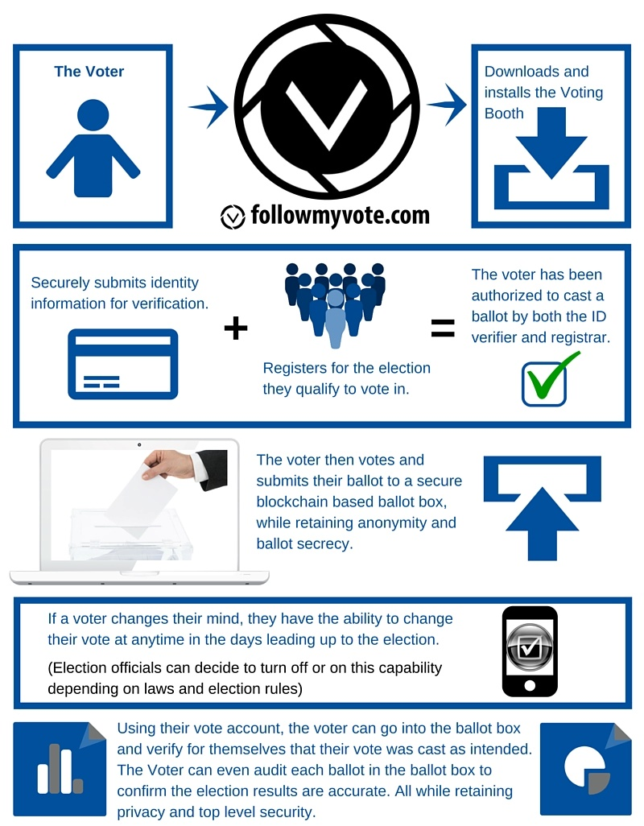
Example 2: Transparent Voting

Slide 11
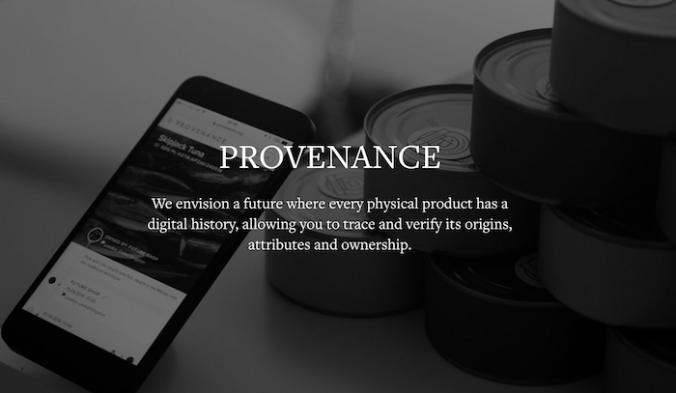
Example 3: Transparent Asset Tracking
Provenance.org | @ProvenanceHQ

Slide 12
Opportunities

Slide 13
How Do I Get Started?
Opportunities in…
Hardware: drones, IoT, identity
Software: every programming language
Networking/Backend: gossip protocols, architecture
Research: theoretical models, consensus protocol research
Legal: legality of blockchain based assets
Getting Started
Research blockchains and join some open source projects
Feel free to talk to me for any questions or resources ☺

Slide 14
Women in Blockchain
“The Women in Blockchain Organization seeks to provide safe spaces for women-identifying technologists, academics, professionals, coders, designers, and anyone interested to share their experiences and knowledge of blockchain technology. Our goal is to provide the space and resources for our community members to connect, learn, and grow. ”
Web: womeninblockchain.io
Twitter: @WBlockchain
Facebook: facebook.com/womeninblockchain

Slide 15
From a Woman Blockchainer
“Basically every major industry in the world right now is trying their hand at blockchaining. Women and people of color have an incredible amount to bring to conversations about building technology and have great skills to lend in building cool, and hopefully better, tech. In my view, blockchain isn’t just about building cool shit (though that’s a big part and not to be discounted cause it’s also fun), but has the potential to help us demand a more equitable and transparent world.”
Web: womeninblockchain.io
Twitter: @WBlockchain
Facebook: facebook.com/womeninblockchain

Slide 16
Rate and review the session on our mobile app
Hudson Jameson | @hudsonjameson

