Slide 1

Hudson Jameson
Intro to Solidity
2017 Edition

Slide 2






Hudson Jameson
Cryptocurrency/blockchain space since 2011.
USAA: 2014-2016
Ethereum Foundation: 2016-current
Oaken Innovations: 2016-current
1 Wife & 3 Cats

Slide 3

Solidity
High level language for Ethereum contracts.

Slide 4

How many high level languages does Ethereum have? (Include defunct/deprecated, but not EWASM)

Slide 5
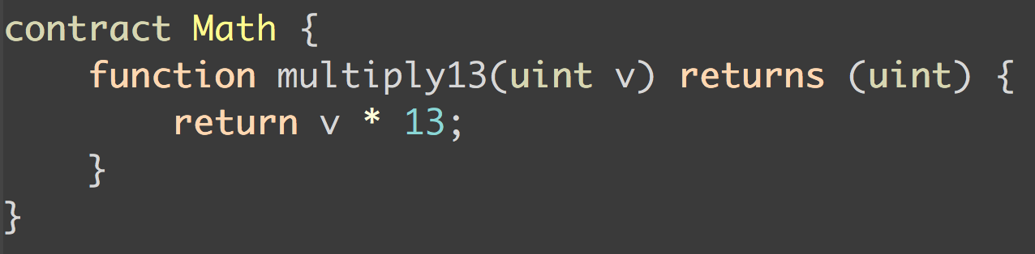
It looks like Javascript (with types).
Contracts are like classes.

Slide 6
Code is compiled to the
Ethereum Virtual Machine (EVM).
EVM
Once deployed to the EVM, code is completely isolated and cannot reach outside of the EVM.

Slide 7
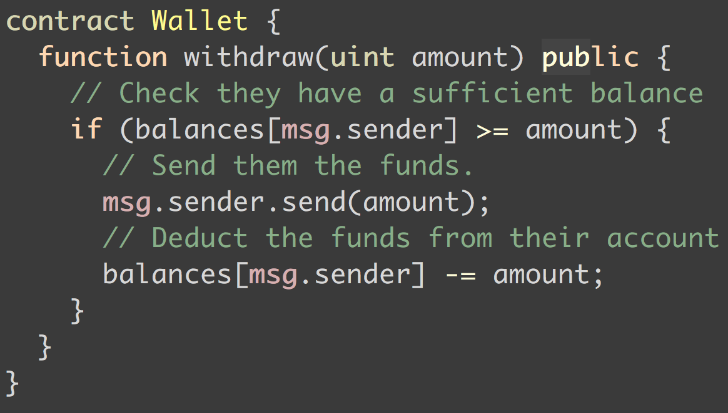
Easy to write contracts
Hard to make sure they are secure

Slide 8

6
Mutan
Serpent
LLL
Solidity
Bamboo
Viper
How many high level languages does Ethereum have?
(Include defunct/deprecated, but not EWASM)

Slide 9
Contracts standards are beginning to emerge!

Slide 10
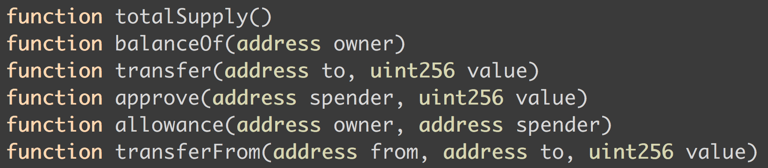
ERC20

Slide 11
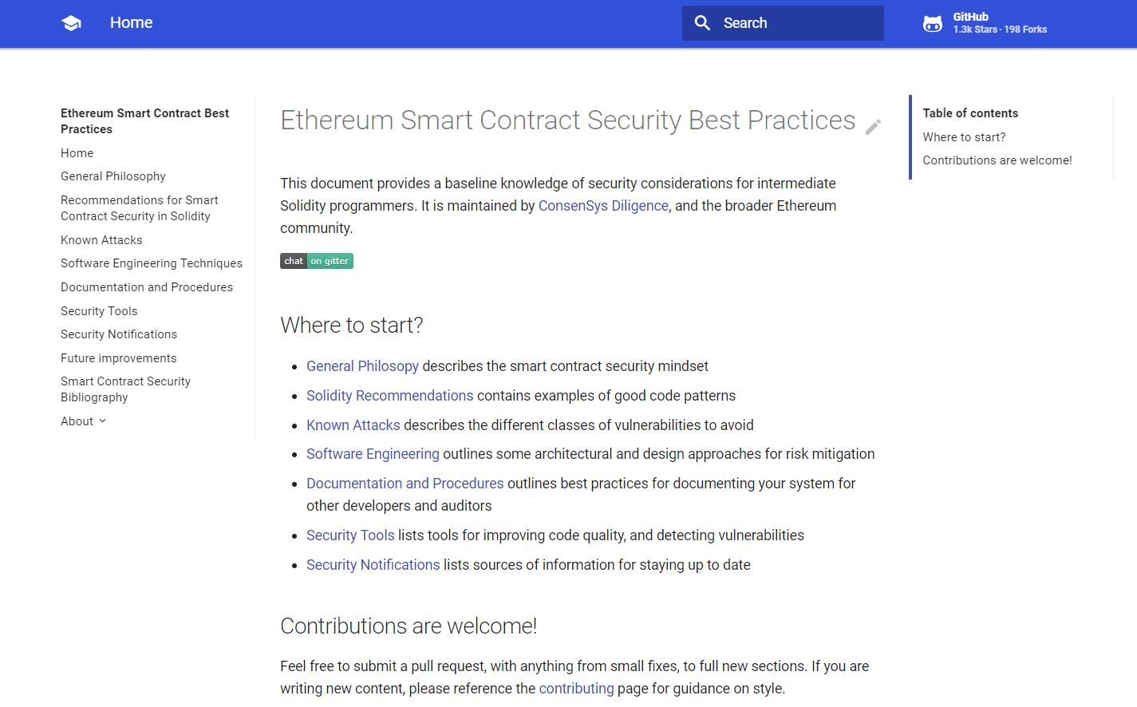
https://consensys.github.io/smart-contract-best-practices/

Slide 12
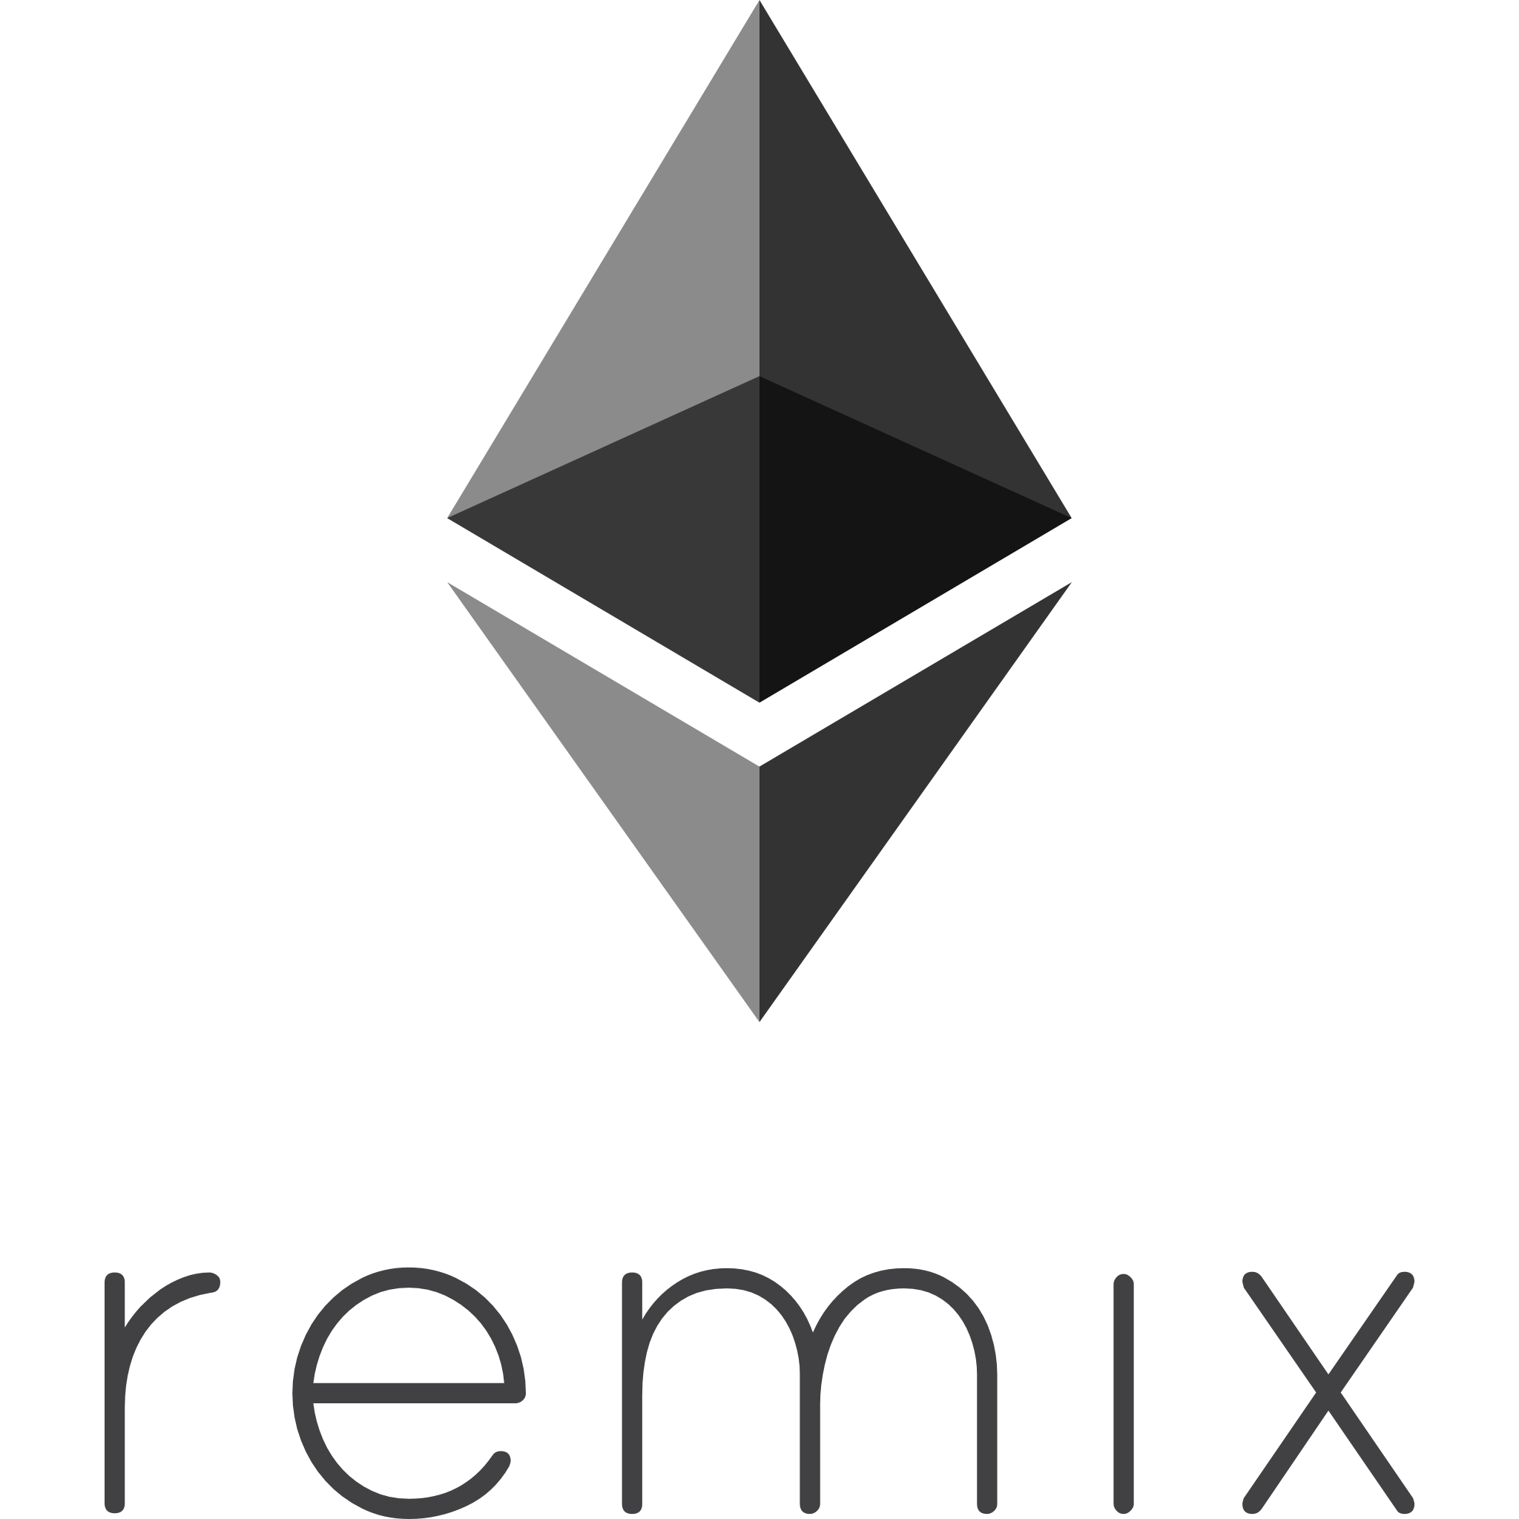


Ultimate Software Combo

Slide 13
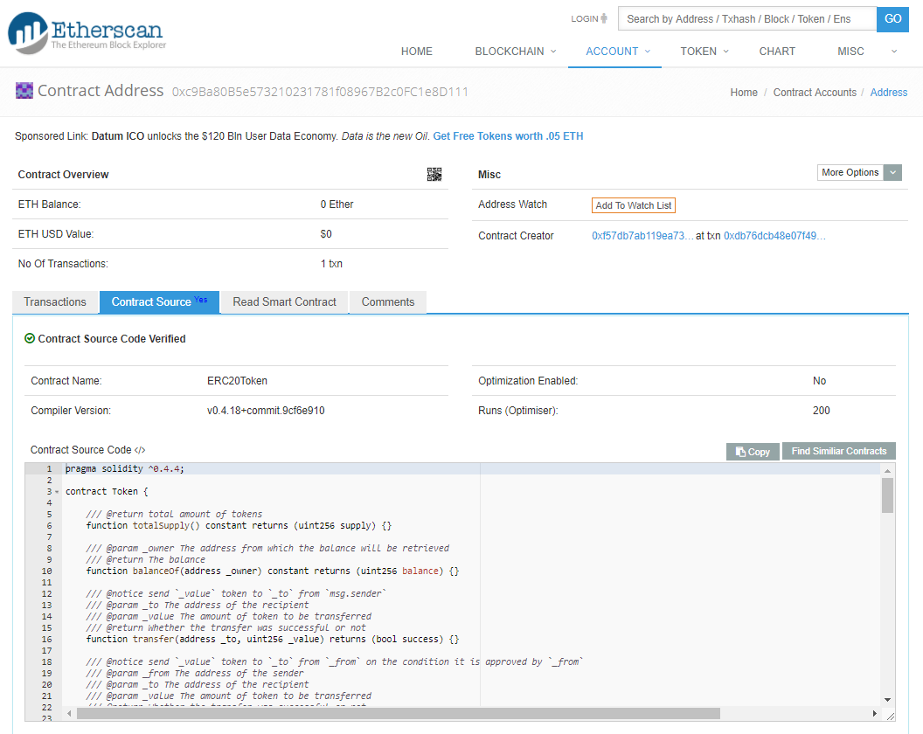

Slide 14
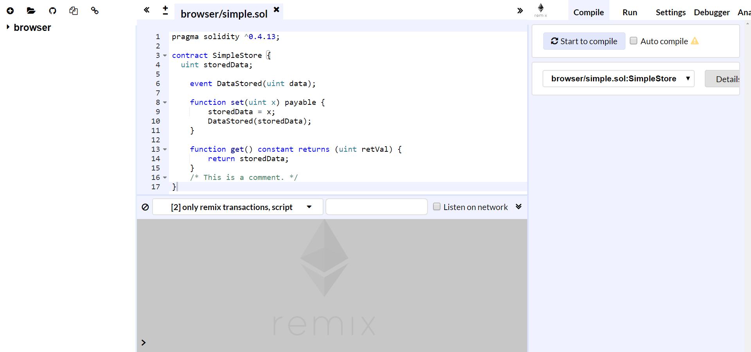

Slide 15
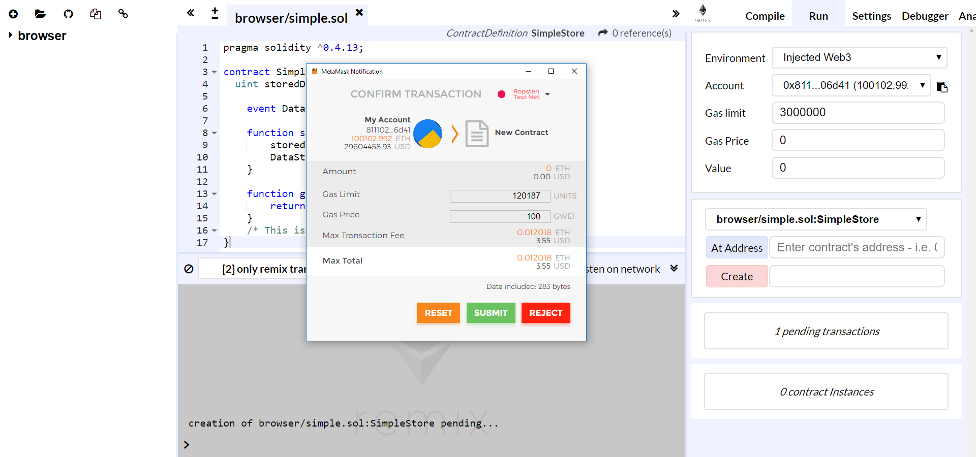

Slide 16
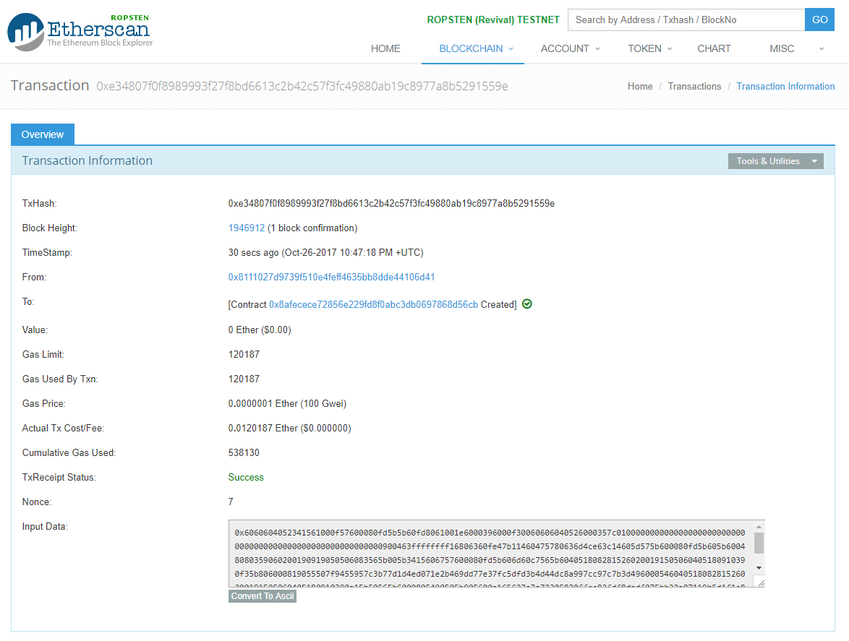

Slide 17
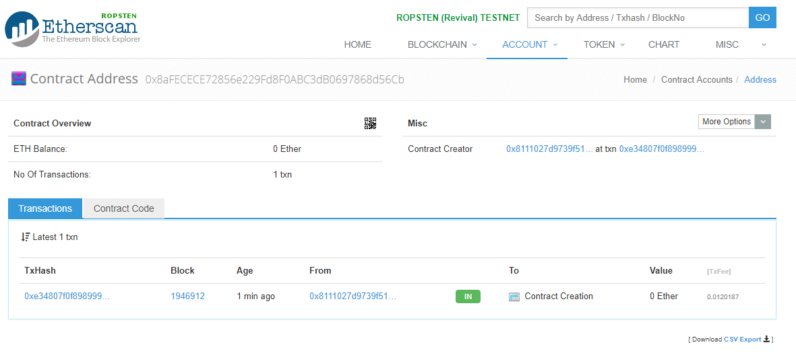

Slide 18
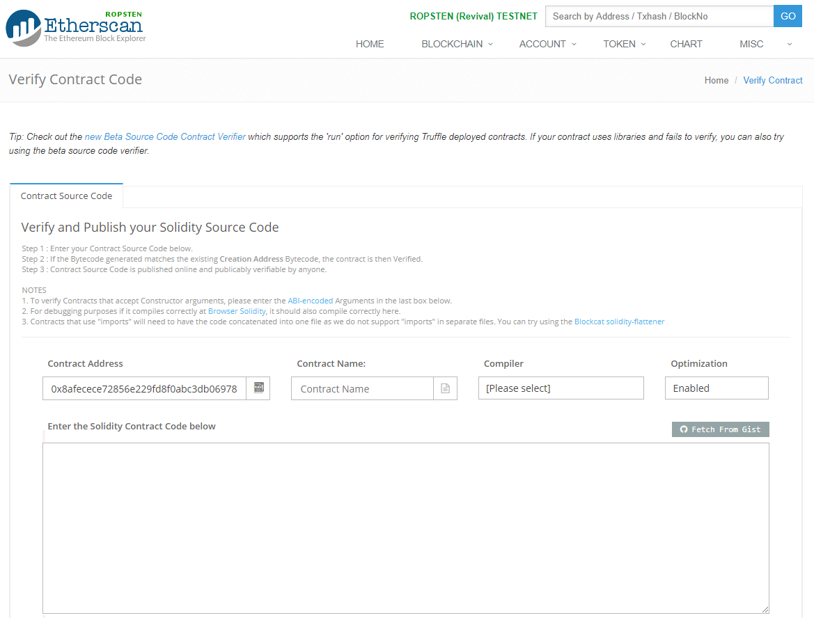

Slide 19
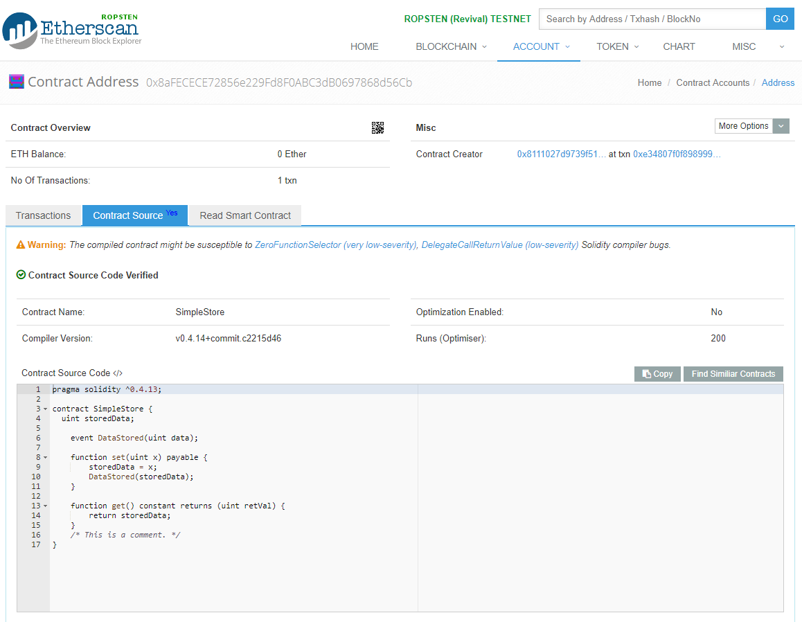

Slide 20
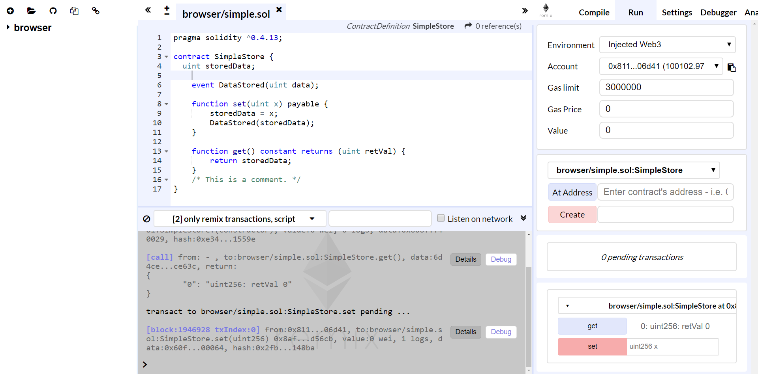

Slide 21
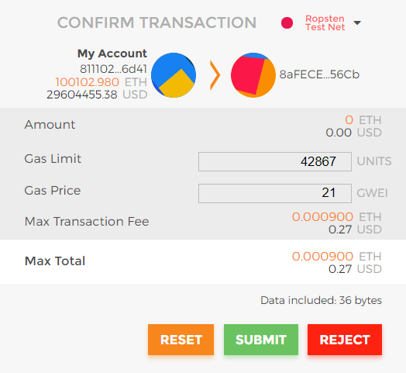
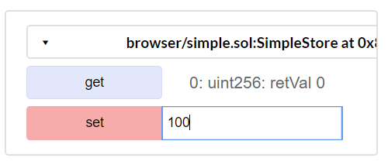

Slide 22
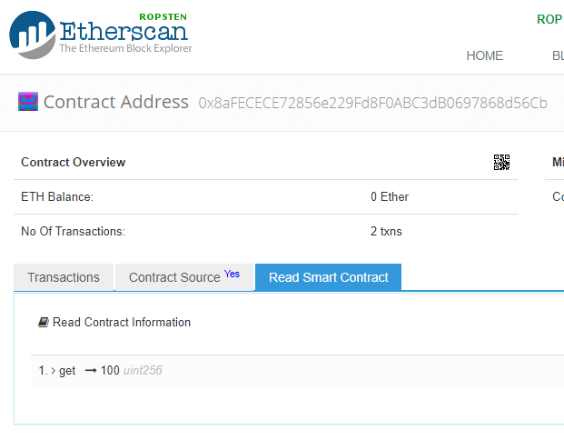

Slide 23

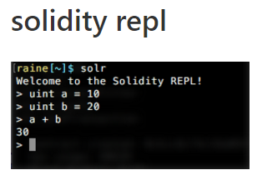
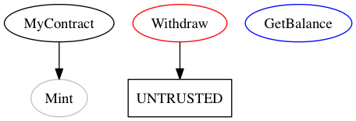

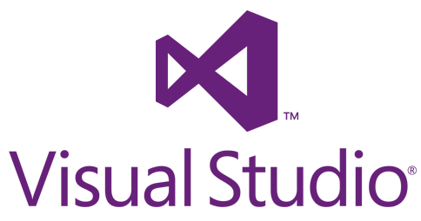









IDEs & Integrations
Tools
evmdis (EVM Disassembler)
Populus (Dapp framework)

Slide 24
Get Started Today!
<3
Slides: hudsonjameson.com/speakingengagements/
Twitter: @hudsonjameson
Reddit: /u/souptacular

