Slide 1
ORGAN DONATION MANAGEMENT SYSTEM
24-06-2021
DATABASE APPLICATIONS COURSE PROJECT
TEAM 6
NAME | USN | ROLL NUMBER
Sahana Kubsad | 01fe19bcs091 | 218
Sneha Sangeet | 01fe19bcs092 | 219
Samarth H | 01fe19bcs094 | 221
Sourabh Kumar | 01fe19bcs102 | 228
SCHOOL OF COMPUTER SCIENCE AND ENGINEERING

Slide 2
REQUIREMENTS:
DATA REQUIREMENTS:
Client : Client name.date of birth,organ requested,organ donated,contact , type(donor/recipient), address ,blood group, medical record,insurance,staff,procured
Organ Available: Organ name, date ,time,procured
Procured : Procured time,procured date,description,staff
Staffs : Staff name.designation,contact,salary ,address,email
Insurance : Company name. Insurance type,amount,date insured,company contact
DBA FINAL REVIEW
ORGAN DONATION MANAGEMENT SYSTEM
SCHOOL OF COMPUTER SCIENCE AND ENGINEERING

Slide 3
FUNCTIONAL REQUIREMENTS:
Administrator:
Insert values in the table
Alter the tables
Delete the tables or values
Edit the tables or values
Normal User:
View information about any government organization where organ transplantation takes place
Registration can be under government approved organization
Can register himself if in need of an organ or want to be a donor
DBA FINAL REVIEW
ORGAN DONATION MANAGEMENT SYSTEM
SCHOOL OF COMPUTER SCIENCE AND ENGINEERING

Slide 4
FUNCTIONALITIES
DBA FINAL REVIEW
ORGAN DONATION MANAGEMENT SYSTEM
Organization Staff will register clients(donor, patient).
List of available organs can be seen by patient.
Patient can request organs.
Patient can procure organs.
Donation and procurement process will be inspected and verified by organization staff.
Donor can enlist for organ donation.
SCHOOL OF COMPUTER SCIENCE AND ENGINEERING

Slide 5
ER ANALYSIS:
ENTITY SETS:
DBA FINAL REVIEW
ORGAN DONATION MANAGEMENT SYSTEM
CLIENT
STAFFS
ORGAN AVAILABLE
PROCURED
INSURANCE
SCHOOL OF COMPUTER SCIENCE AND ENGINEERING

Slide 6
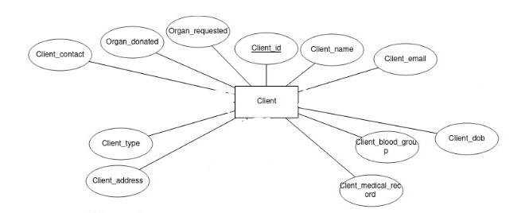
ER ANALYSIS:
ENTITIES AND THEIR ATTRIBUTES:
DBA FINAL REVIEW
ORGAN DONATION MANAGEMENT SYSTEM
1.CLIENT
CLIENT_ID
Name
Dob
Type
Email
Contact
Address
Medical History
Blood Group
Organ Donated
Organ Requested
SCHOOL OF COMPUTER SCIENCE AND ENGINEERING

Slide 7
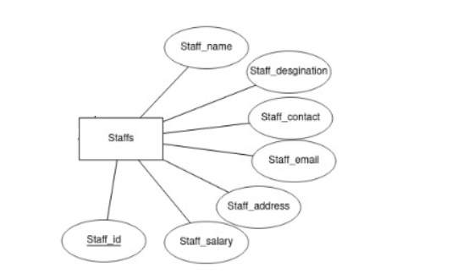
DBA FINAL REVIEW
ORGAN DONATION MANAGEMENT SYSTEM
2.STAFFS
STAFF_ID
Staff_name
Staff_designation
Staff_contact
Staff_email
Staff_address
Staff_salary
SCHOOL OF COMPUTER SCIENCE AND ENGINEERING

Slide 8
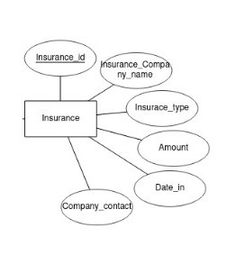
DBA FINAL REVIEW
ORGAN DONATION MANAGEMENT SYSTEM
3. INSURANCE
INSURANCE_COMPANY_ID
2) Insurance_type
3) Amount
4) Date-in
5) Company_contact
SCHOOL OF COMPUTER SCIENCE AND ENGINEERING

Slide 9
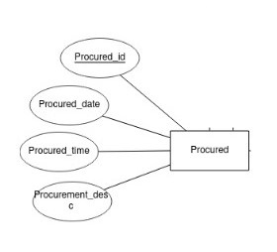
DBA FINAL REVIEW
ORGAN DONATION MANAGEMENT SYSTEM
4. PROCURED
1) PROCURED_ID
2) Procured_date
3) Procured_time
4) Procurement_desc
5) Staff_id
SCHOOL OF COMPUTER SCIENCE AND ENGINEERING

Slide 10
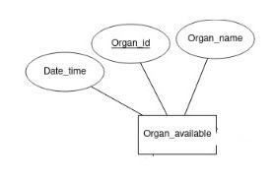
DBA FINAL REVIEW
ORGAN DONATION MANAGEMENT SYSTEM
5.ORGAN_AVAILABLE
ORGAN_ID
Organ_name
Date_time
Client_ID
Procured_ID(foreign key)
SCHOOL OF COMPUTER SCIENCE AND ENGINEERING

Slide 11
RELATIONSHIP SETS:
DBA FINAL REVIEW
ORGAN DONATION MANAGEMENT SYSTEM
1.Registers : Client is registered by a staff (Many to one)
2.Donated_by : Organ available is donated_by the Client(donor) (Many to one)
3.Used_in : Organ available is used in procured (One to one)
4.Insured : Client is insured by Insurance (One to one)
5.Performed_by : Procurement performed by staffs (One to one)
SCHOOL OF COMPUTER SCIENCE AND ENGINEERING

Slide 12
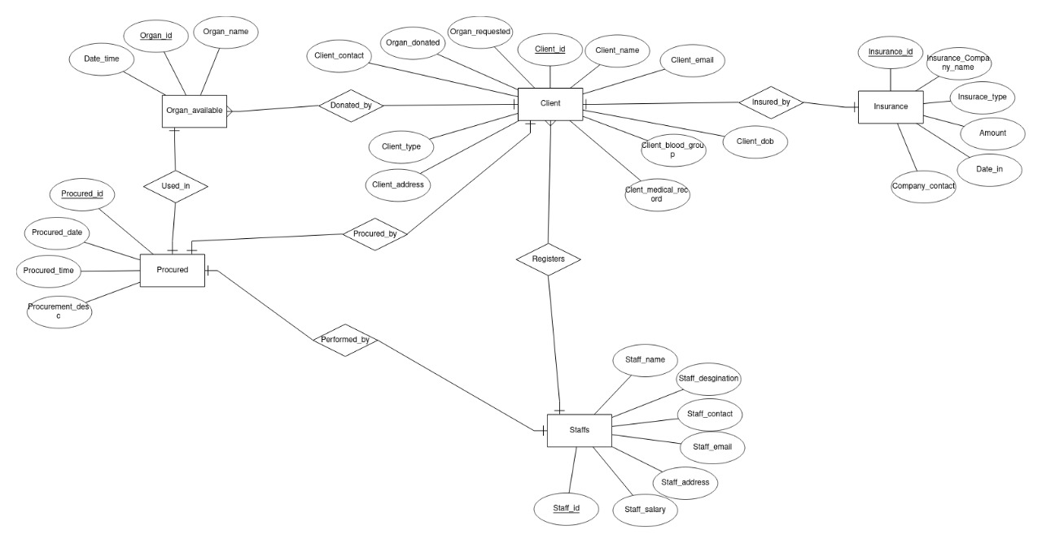
DBA FINAL REVIEW
ORGAN DONATION MANAGEMENT SYSTEM
ER DIAGRAM
SCHOOL OF COMPUTER SCIENCE AND ENGINEERING

Slide 13
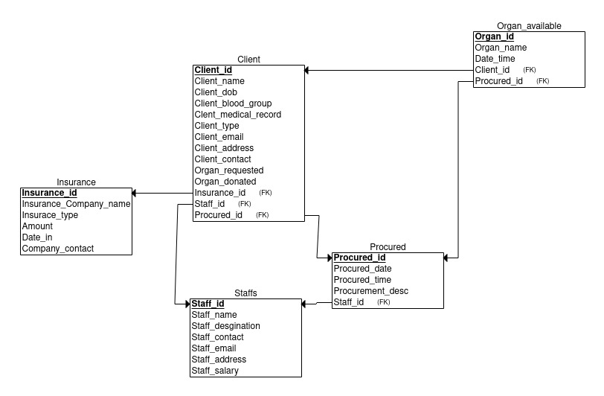
RELATIONAL SCHEMA
DBA FINAL REVIEW
ORGAN DONATION MANAGEMENT SYSTEM
SCHOOL OF COMPUTER SCIENCE AND ENGINEERING

Slide 14
DBA FINAL REVIEW
ORGAN DONATION MANAGEMENT SYSTEM
FUNCTIONAL DEPENDENCIES AND NORMALIZATION
Client(Client_ID,Client_dob,Client_blood_group,Client_name,Organ_donated,Organ_requested,Client_contact,Client_email,Client_address,Client_type,Client_medical_record)
The relation is in 1NF as it does not contain any multi-valued or composite attributes.
The relation is in 2NF as it is in First Normal Form and it has no partial dependency
The relation is in 3NF as there is no transitive dependency for the non-prime attributes
Organ Available(Organ_id,Organ_name,Date_time)
The relation is in 1NF as it does not contain any multi-valued or composite attributes.
The relation is in 2NF as it is in First Normal Form and it has no partial dependency.
The relation is in 3NF as there is no transitive dependency for the non-prime attributes
SCHOOL OF COMPUTER SCIENCE AND ENGINEERING

Slide 15
DBA FINAL REVIEW
ORGAN DONATION MANAGEMENT SYSTEM
PROCURED (Procured_id,Procured_Date,Procured_time,Procured_desc)
The relation is in 1NF as it does not contain any multi-valued or composite attributes.
The relation is in 2NF as it is in First Normal Form and it has no partial dependency.
The relation is in 3NF as there is no transitive dependency for the non-prime attributes
STAFFS(Staff_id,Staff_Name,Staff_email,Staff_contact,Staff_address,Staff_salary,Staff_desgination)
The relation is in 1NF as it does not contain any multi-valued or composite attributes.
The relation is in 2NF as it is in First Normal Form and it has no partial dependency.
The relation is not in 3NF as there is transitive dependency for the non-prime attributes.
(Staff_salary,Staff_designation)->(Staff_id) & (Staff_salary)->(Staff_designation).
SCHOOL OF COMPUTER SCIENCE AND ENGINEERING

Slide 16
DBA FINAL REVIEW
ORGAN DONATION MANAGEMENT SYSTEM
INSURANCE(Insurance_ID,,Company_Name,Company_Contact,Insurance_type,Insured_Date,insured_Amount)
The relation is in 1NF as it does not contain any multi-valued or composite attributes.
The relation is in 2NF as it is in First Normal Form and it has no partial dependency.
The relation is not in 3NF as there is transitive dependency for the non-prime attributes.
(Company_Name,Company_contact)->(Insurance_ID)&(Company_contact)->(Company_name)
SCHOOL OF COMPUTER SCIENCE AND ENGINEERING

Slide 17
Tables(after normalization)
DBA FINAL REVIEW
ORGAN DONATION MANAGEMENT SYSTEM
CLIENT
STAFFS
JOB DESIGNATION
ORGAN AVAILABLE
PROCURED
INSURANCE
INSURE
SCHOOL OF COMPUTER SCIENCE AND ENGINEERING

Slide 18
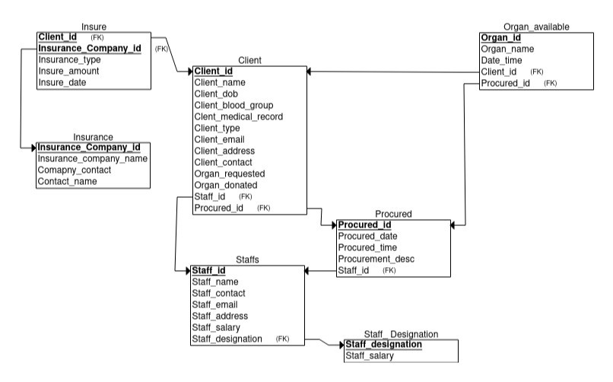
NORMALIZATION
RELATIONAL SCHEMA:
DBA FINAL REVIEW
ORGAN DONATION MANAGEMENT SYSTEM
SCHOOL OF COMPUTER SCIENCE AND ENGINEERING

Slide 19
FUNCTIONALITIES COVERED
DBA FINAL REVIEW
ORGAN DONATION MANAGEMENT SYSTEM
1.Add client
2.Display client
3.Add organ
4.Display organ available
5.Match recipient with organ
6.Print bill
7.Add staff
8.Display staff
SCHOOL OF COMPUTER SCIENCE AND ENGINEERING

Slide 20
TECH STACK
DBA FINAL REVIEW
ORGAN DONATION MANAGEMENT SYSTEM
1.Angular Frontend
2.Django(Backend)
3.Mysql(Database)
4.API
SCHOOL OF COMPUTER SCIENCE AND ENGINEERING

Slide 21

IMPLEMENTATION
LOGIN:
DBA FINAL REVIEW
ORGAN DONATION MANAGEMENT SYSTEM
SCHOOL OF COMPUTER SCIENCE AND ENGINEERING

Slide 22
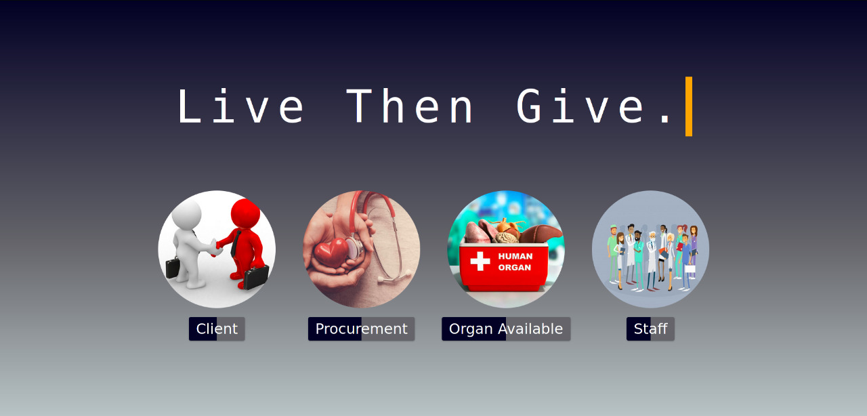
DASHBOARD:
DBA FINAL REVIEW
ORGAN DONATION MANAGEMENT SYSTEM
SCHOOL OF COMPUTER SCIENCE AND ENGINEERING

Slide 23
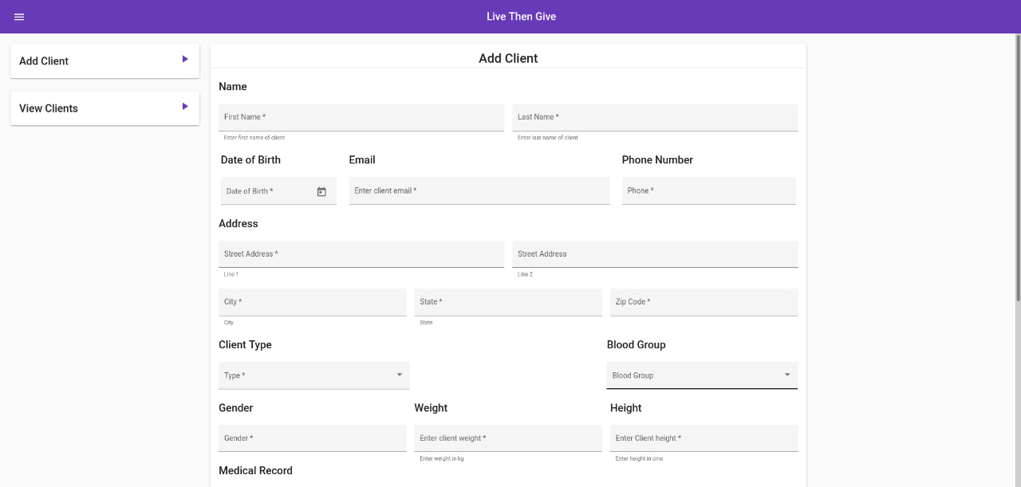
ADD CLIENT
DBA FINAL REVIEW
ORGAN DONATION MANAGEMENT SYSTEM
SCHOOL OF COMPUTER SCIENCE AND ENGINEERING

Slide 24
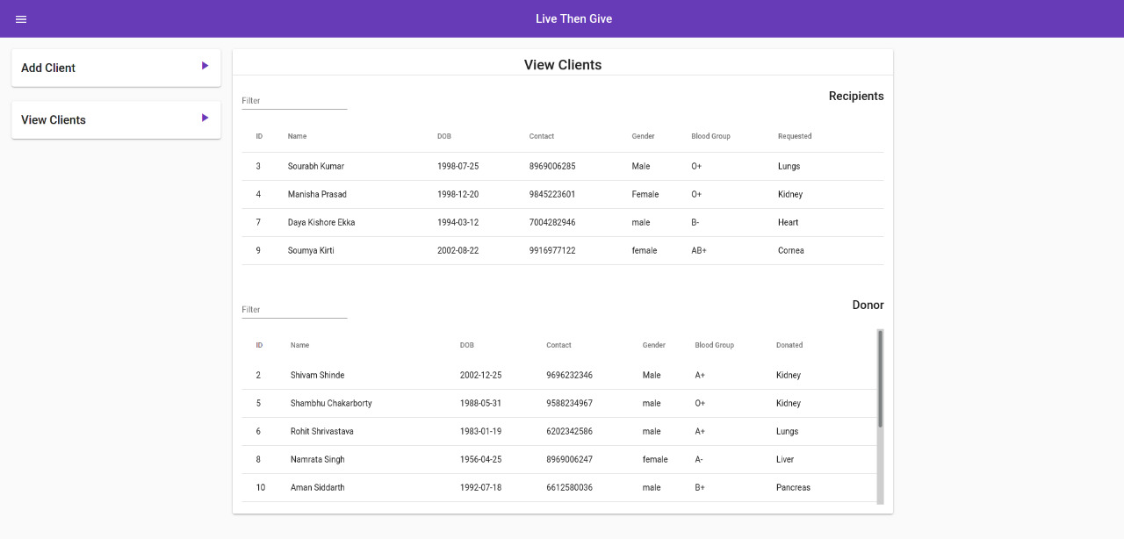
DISPLAY CLIENT
DBA FINAL REVIEW
ORGAN DONATION MANAGEMENT SYSTEM
SCHOOL OF COMPUTER SCIENCE AND ENGINEERING

Slide 25
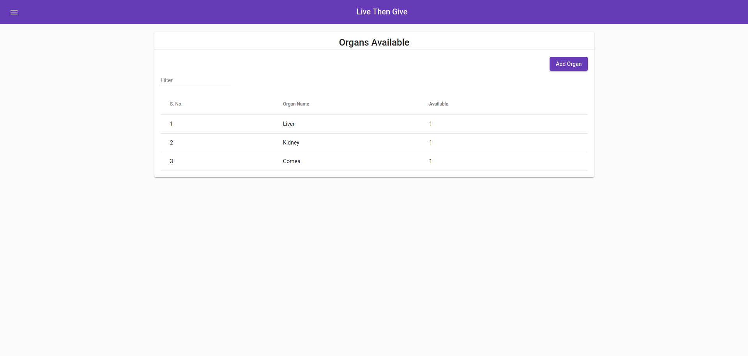
DISPLAY ORGAN AVAILABLE
DBA FINAL REVIEW
ORGAN DONATION MANAGEMENT SYSTEM
SCHOOL OF COMPUTER SCIENCE AND ENGINEERING

Slide 26
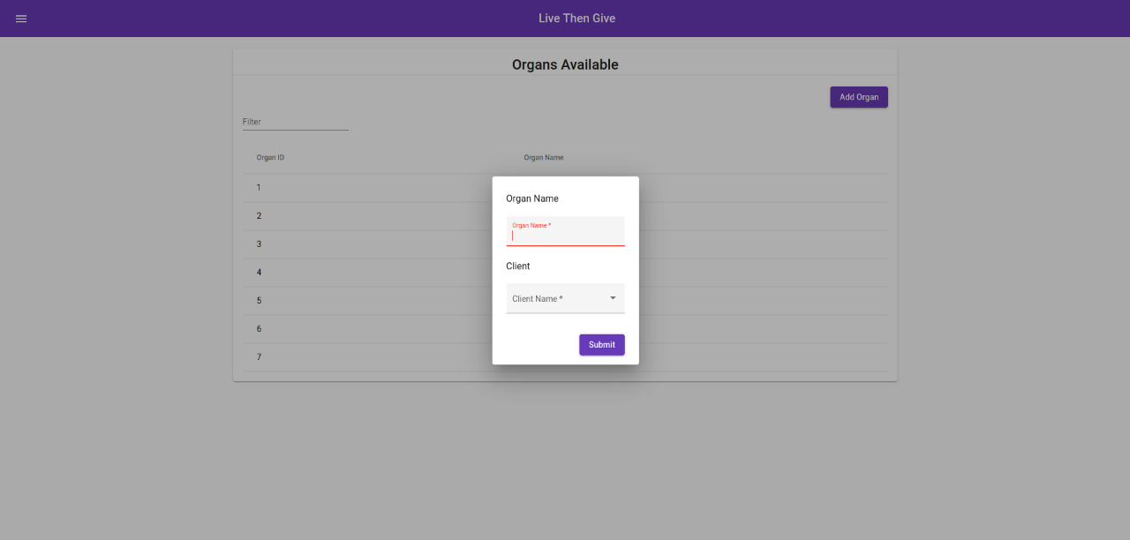
ADD ORGANS AVAILABLE
DBA FINAL REVIEW
ORGAN DONATION MANAGEMENT SYSTEM
SCHOOL OF COMPUTER SCIENCE AND ENGINEERING

Slide 27
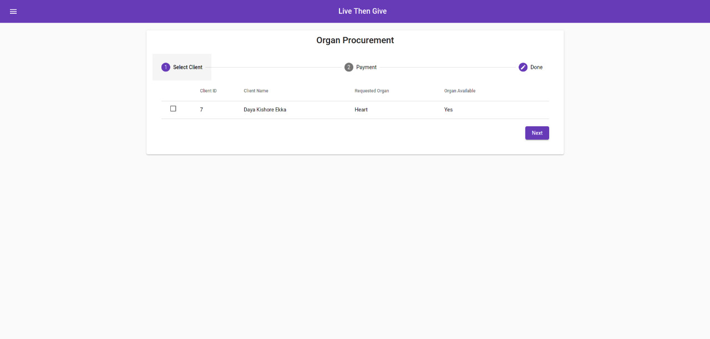
Procurement
Step 1:Display recipient and match if it's available
DBA FINAL REVIEW
ORGAN DONATION MANAGEMENT SYSTEM
SCHOOL OF COMPUTER SCIENCE AND ENGINEERING

Slide 28
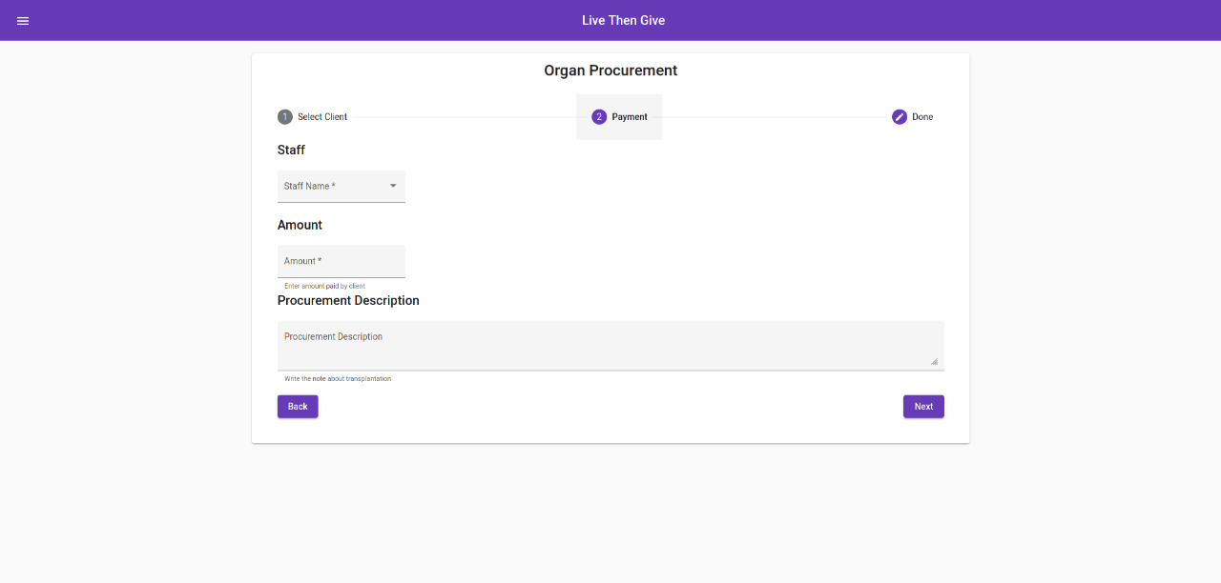
Procurement
Step2:Fill procurement details
DBA FINAL REVIEW
ORGAN DONATION MANAGEMENT SYSTEM
SCHOOL OF COMPUTER SCIENCE AND ENGINEERING

Slide 29
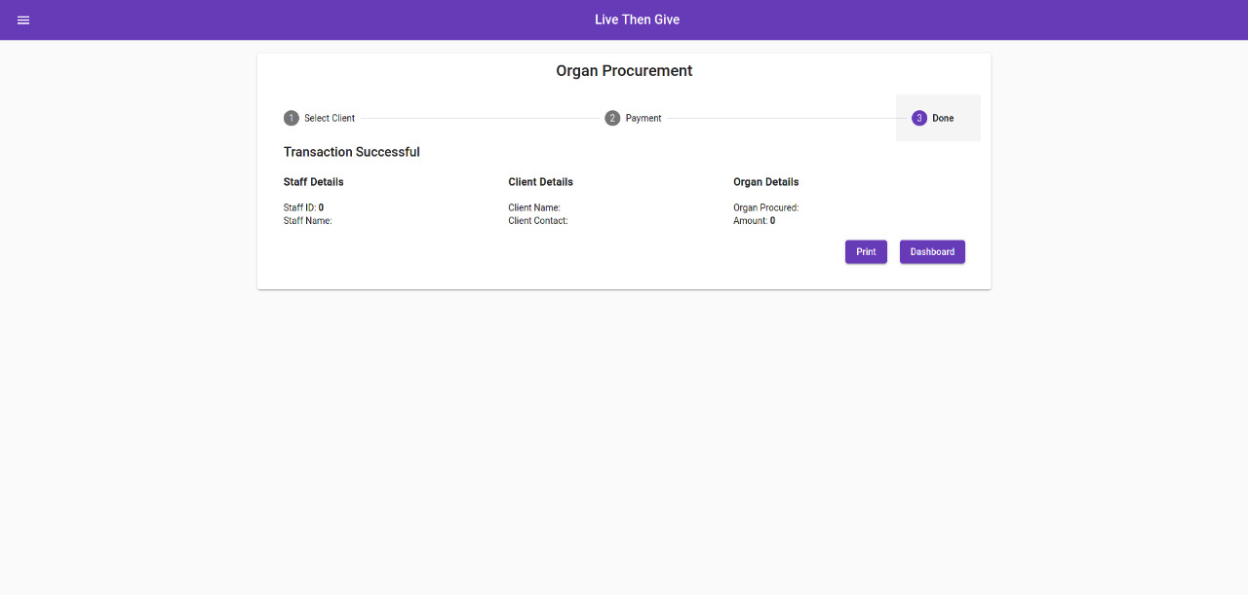
Procurement
Step 3:Review filled details
DBA FINAL REVIEW
ORGAN DONATION MANAGEMENT SYSTEM
SCHOOL OF COMPUTER SCIENCE AND ENGINEERING

Slide 30
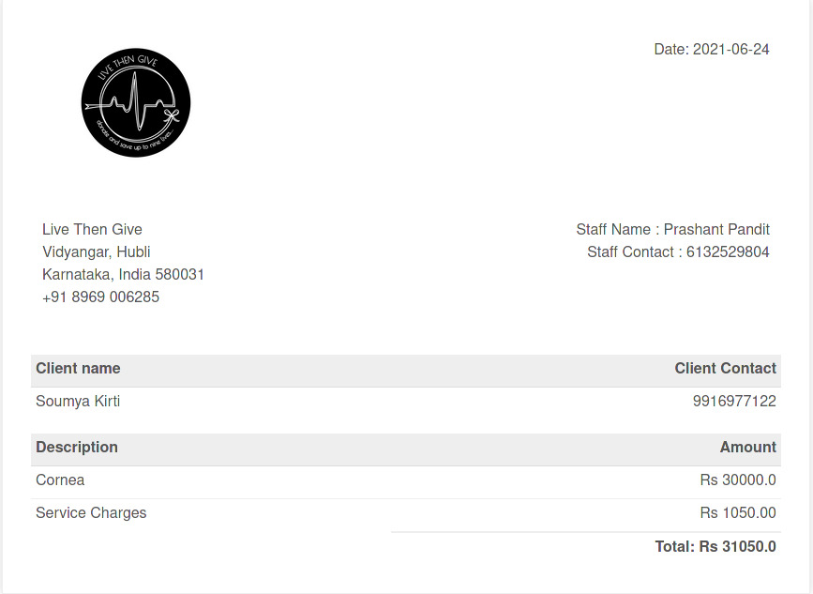
Procurement
Step 4:Print Bill
DBA FINAL REVIEW
ORGAN DONATION MANAGEMENT SYSTEM
SCHOOL OF COMPUTER SCIENCE AND ENGINEERING

Slide 31
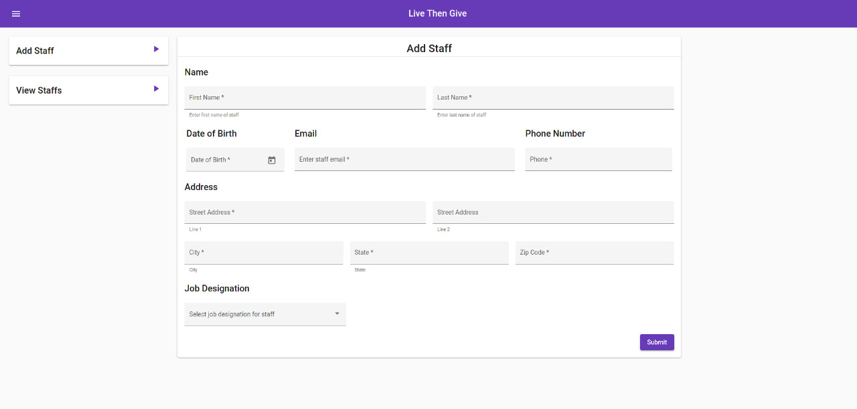
ADD STAFF
DBA FINAL REVIEW
ORGAN DONATION MANAGEMENT SYSTEM
SCHOOL OF COMPUTER SCIENCE AND ENGINEERING

Slide 32
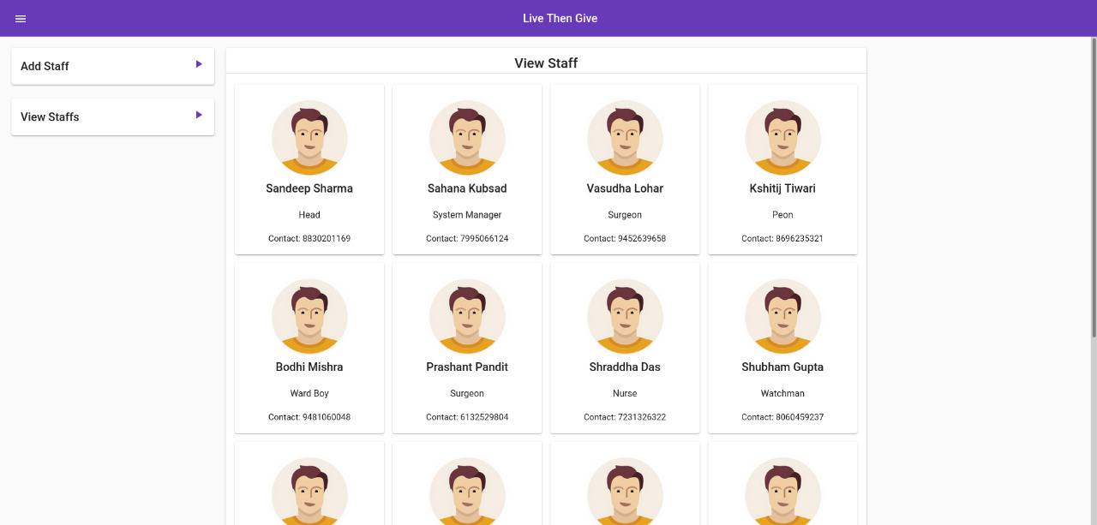
DISPLAY STAFF
DBA FINAL REVIEW
ORGAN DONATION MANAGEMENT SYSTEM
SCHOOL OF COMPUTER SCIENCE AND ENGINEERING

Slide 33
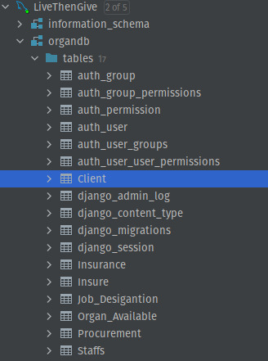
DATABASE
DBA FINAL REVIEW
ORGAN DONATION MANAGEMENT SYSTEM
Database Tree
SCHOOL OF COMPUTER SCIENCE AND ENGINEERING

Slide 34
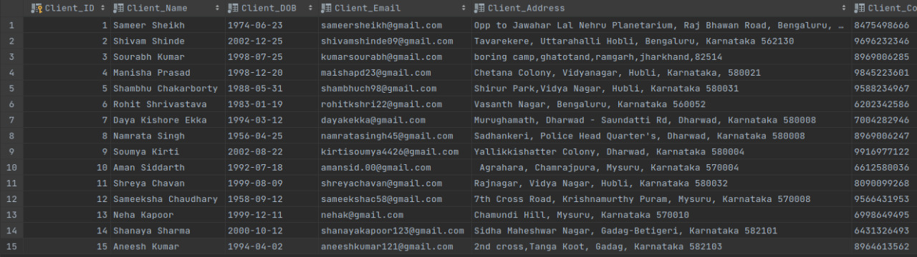
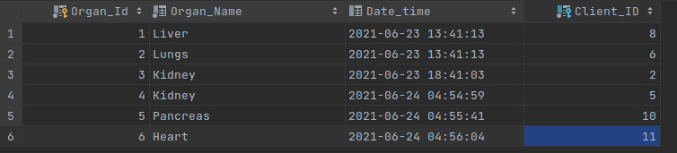
DBA FINAL REVIEW
ORGAN DONATION MANAGEMENT SYSTEM
Client
Organ Available
Procurement
SCHOOL OF COMPUTER SCIENCE AND ENGINEERING

Slide 35
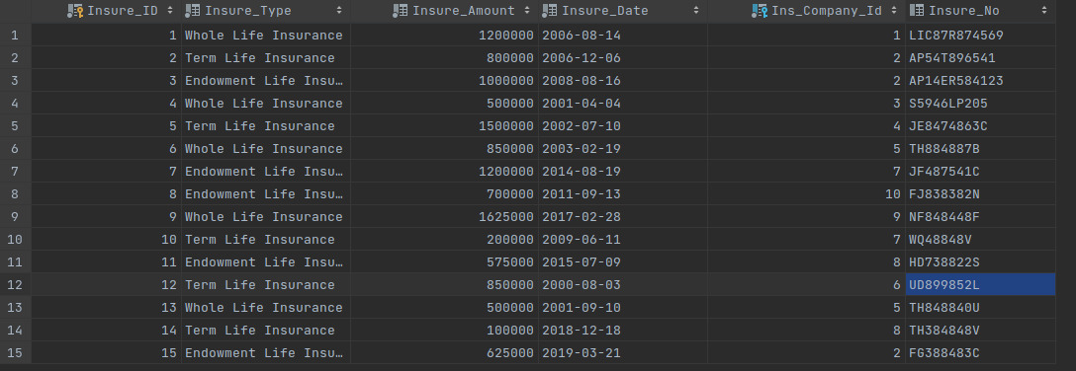
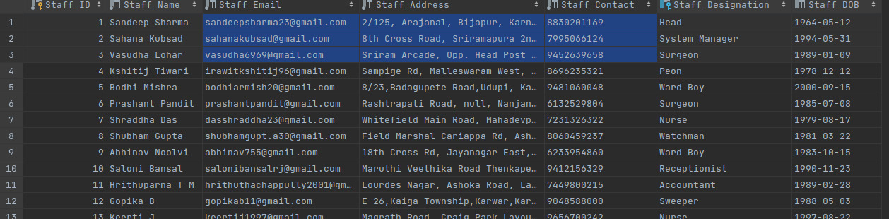
DBA FINAL REVIEW
ORGAN DONATION MANAGEMENT SYSTEM
Insure
Staffs
SCHOOL OF COMPUTER SCIENCE AND ENGINEERING

Slide 36
DBA FINAL REVIEW
ORGAN DONATION MANAGEMENT SYSTEM
THANK YOU
SCHOOL OF COMPUTER SCIENCE AND ENGINEERING

