Slide 1


Slide 2

Dylan Pollard

Slide 3

Heading
Body Text

Slide 4

Introduction
Body Text
Heading
Body Text

Slide 5

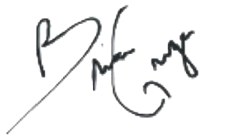
This is to certify that both parties acknowledge and agree to the terms of this proposal, between
Cali Web Studios and Dylan Pollard .
By: Cali Web Studios
To: Client name
Name: Brian McGregor
Date: 07/25/2025
Phone: (209) 209-4386
Email: info@caliwebstudios.com
Name: Dylan Pollard
Date: 07/25/2025
Phone: (804) 512-8905
Email: dylan5gators@gmail.com

Slide 6


