Slide 1

Name here

Slide 2
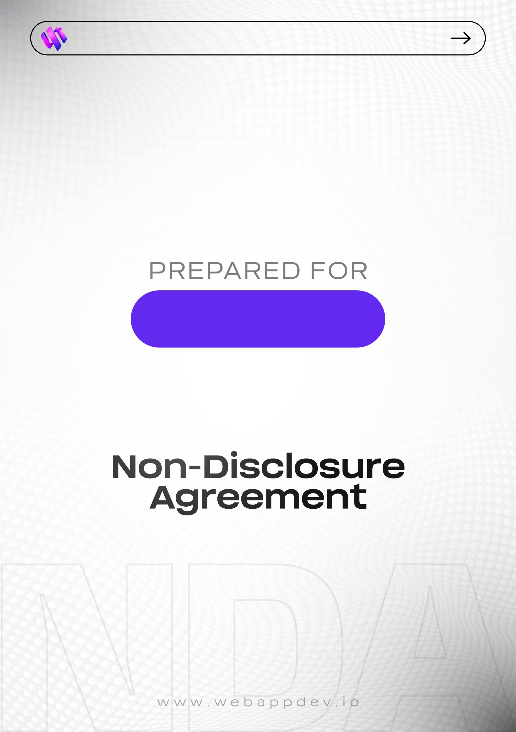
Dylan Pollard

Slide 3
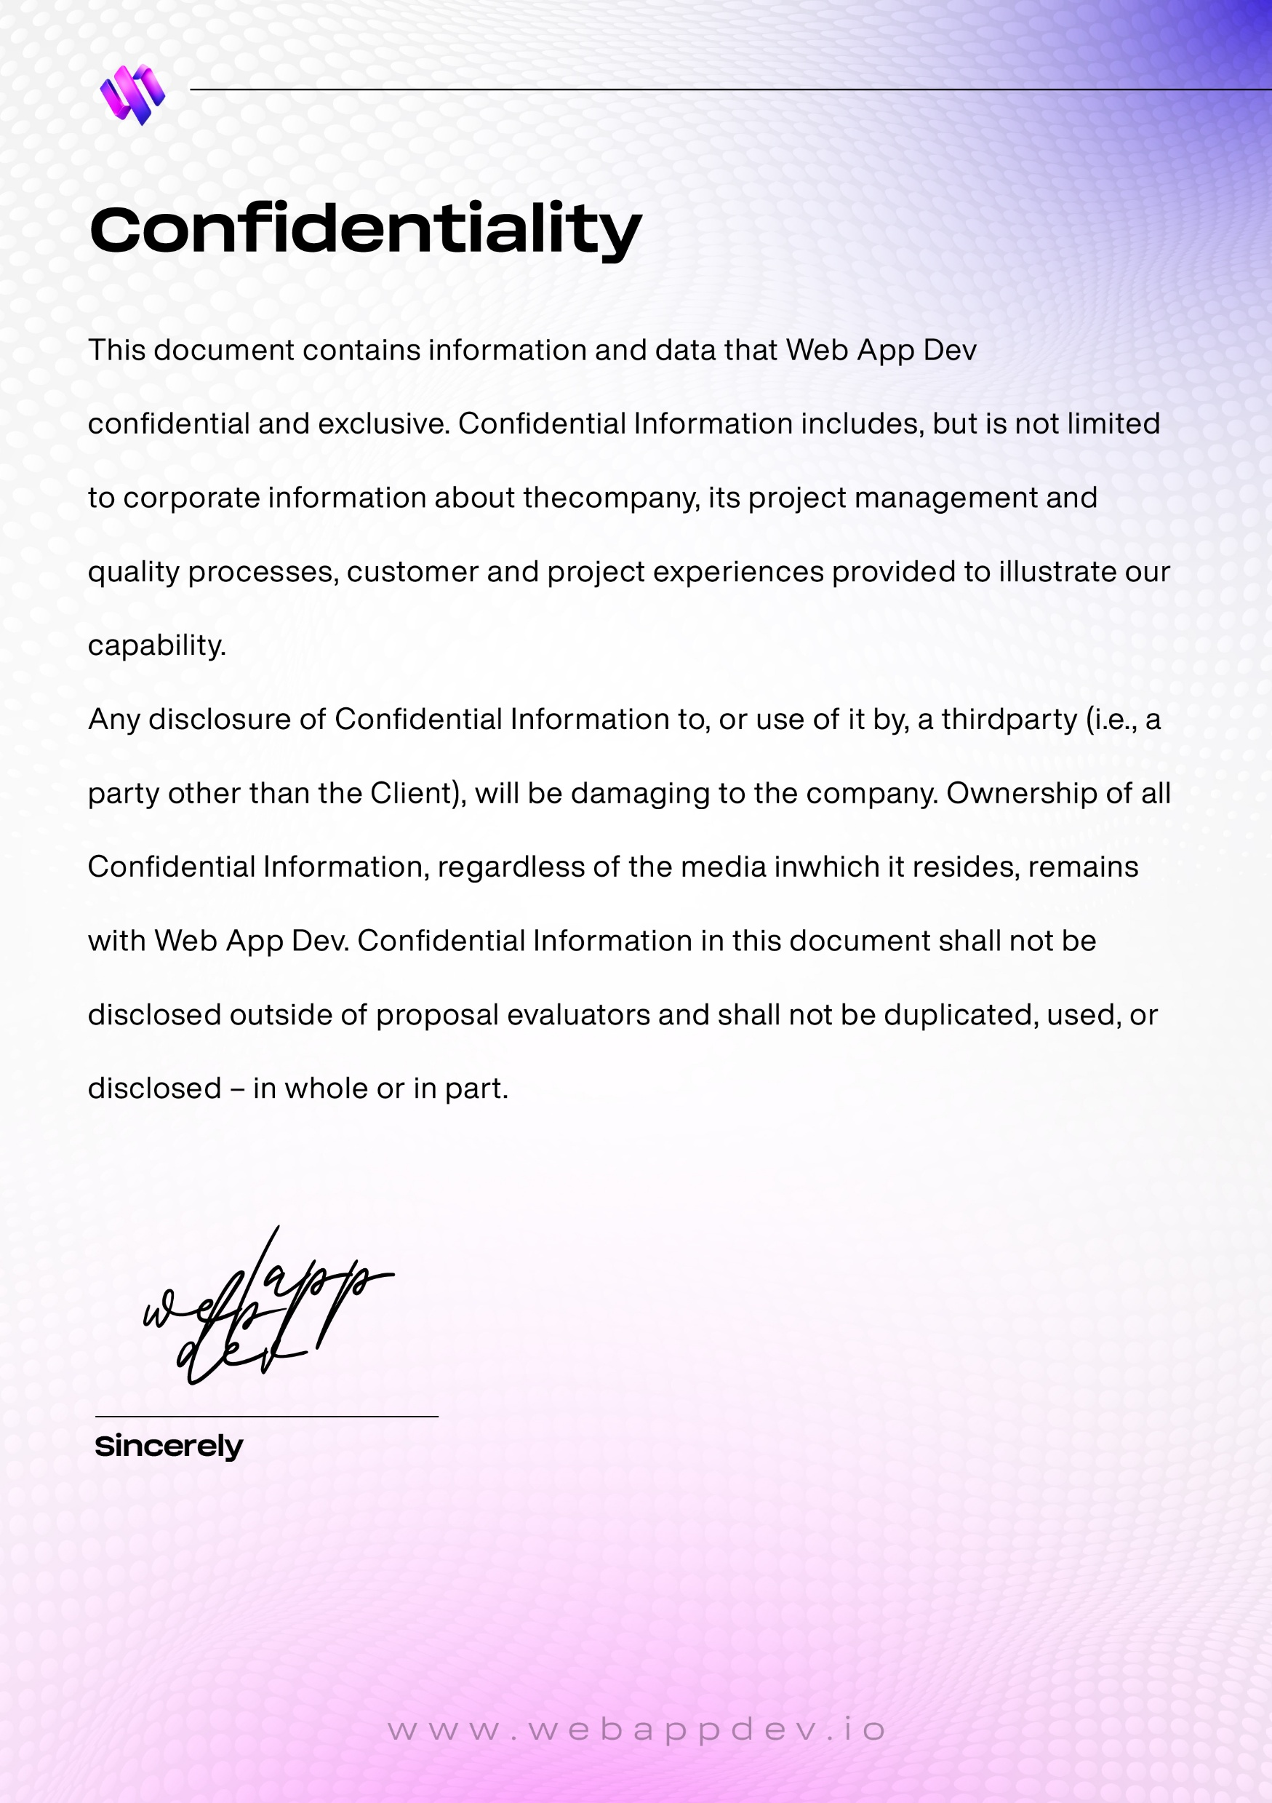
Project summary goes here.

Slide 4
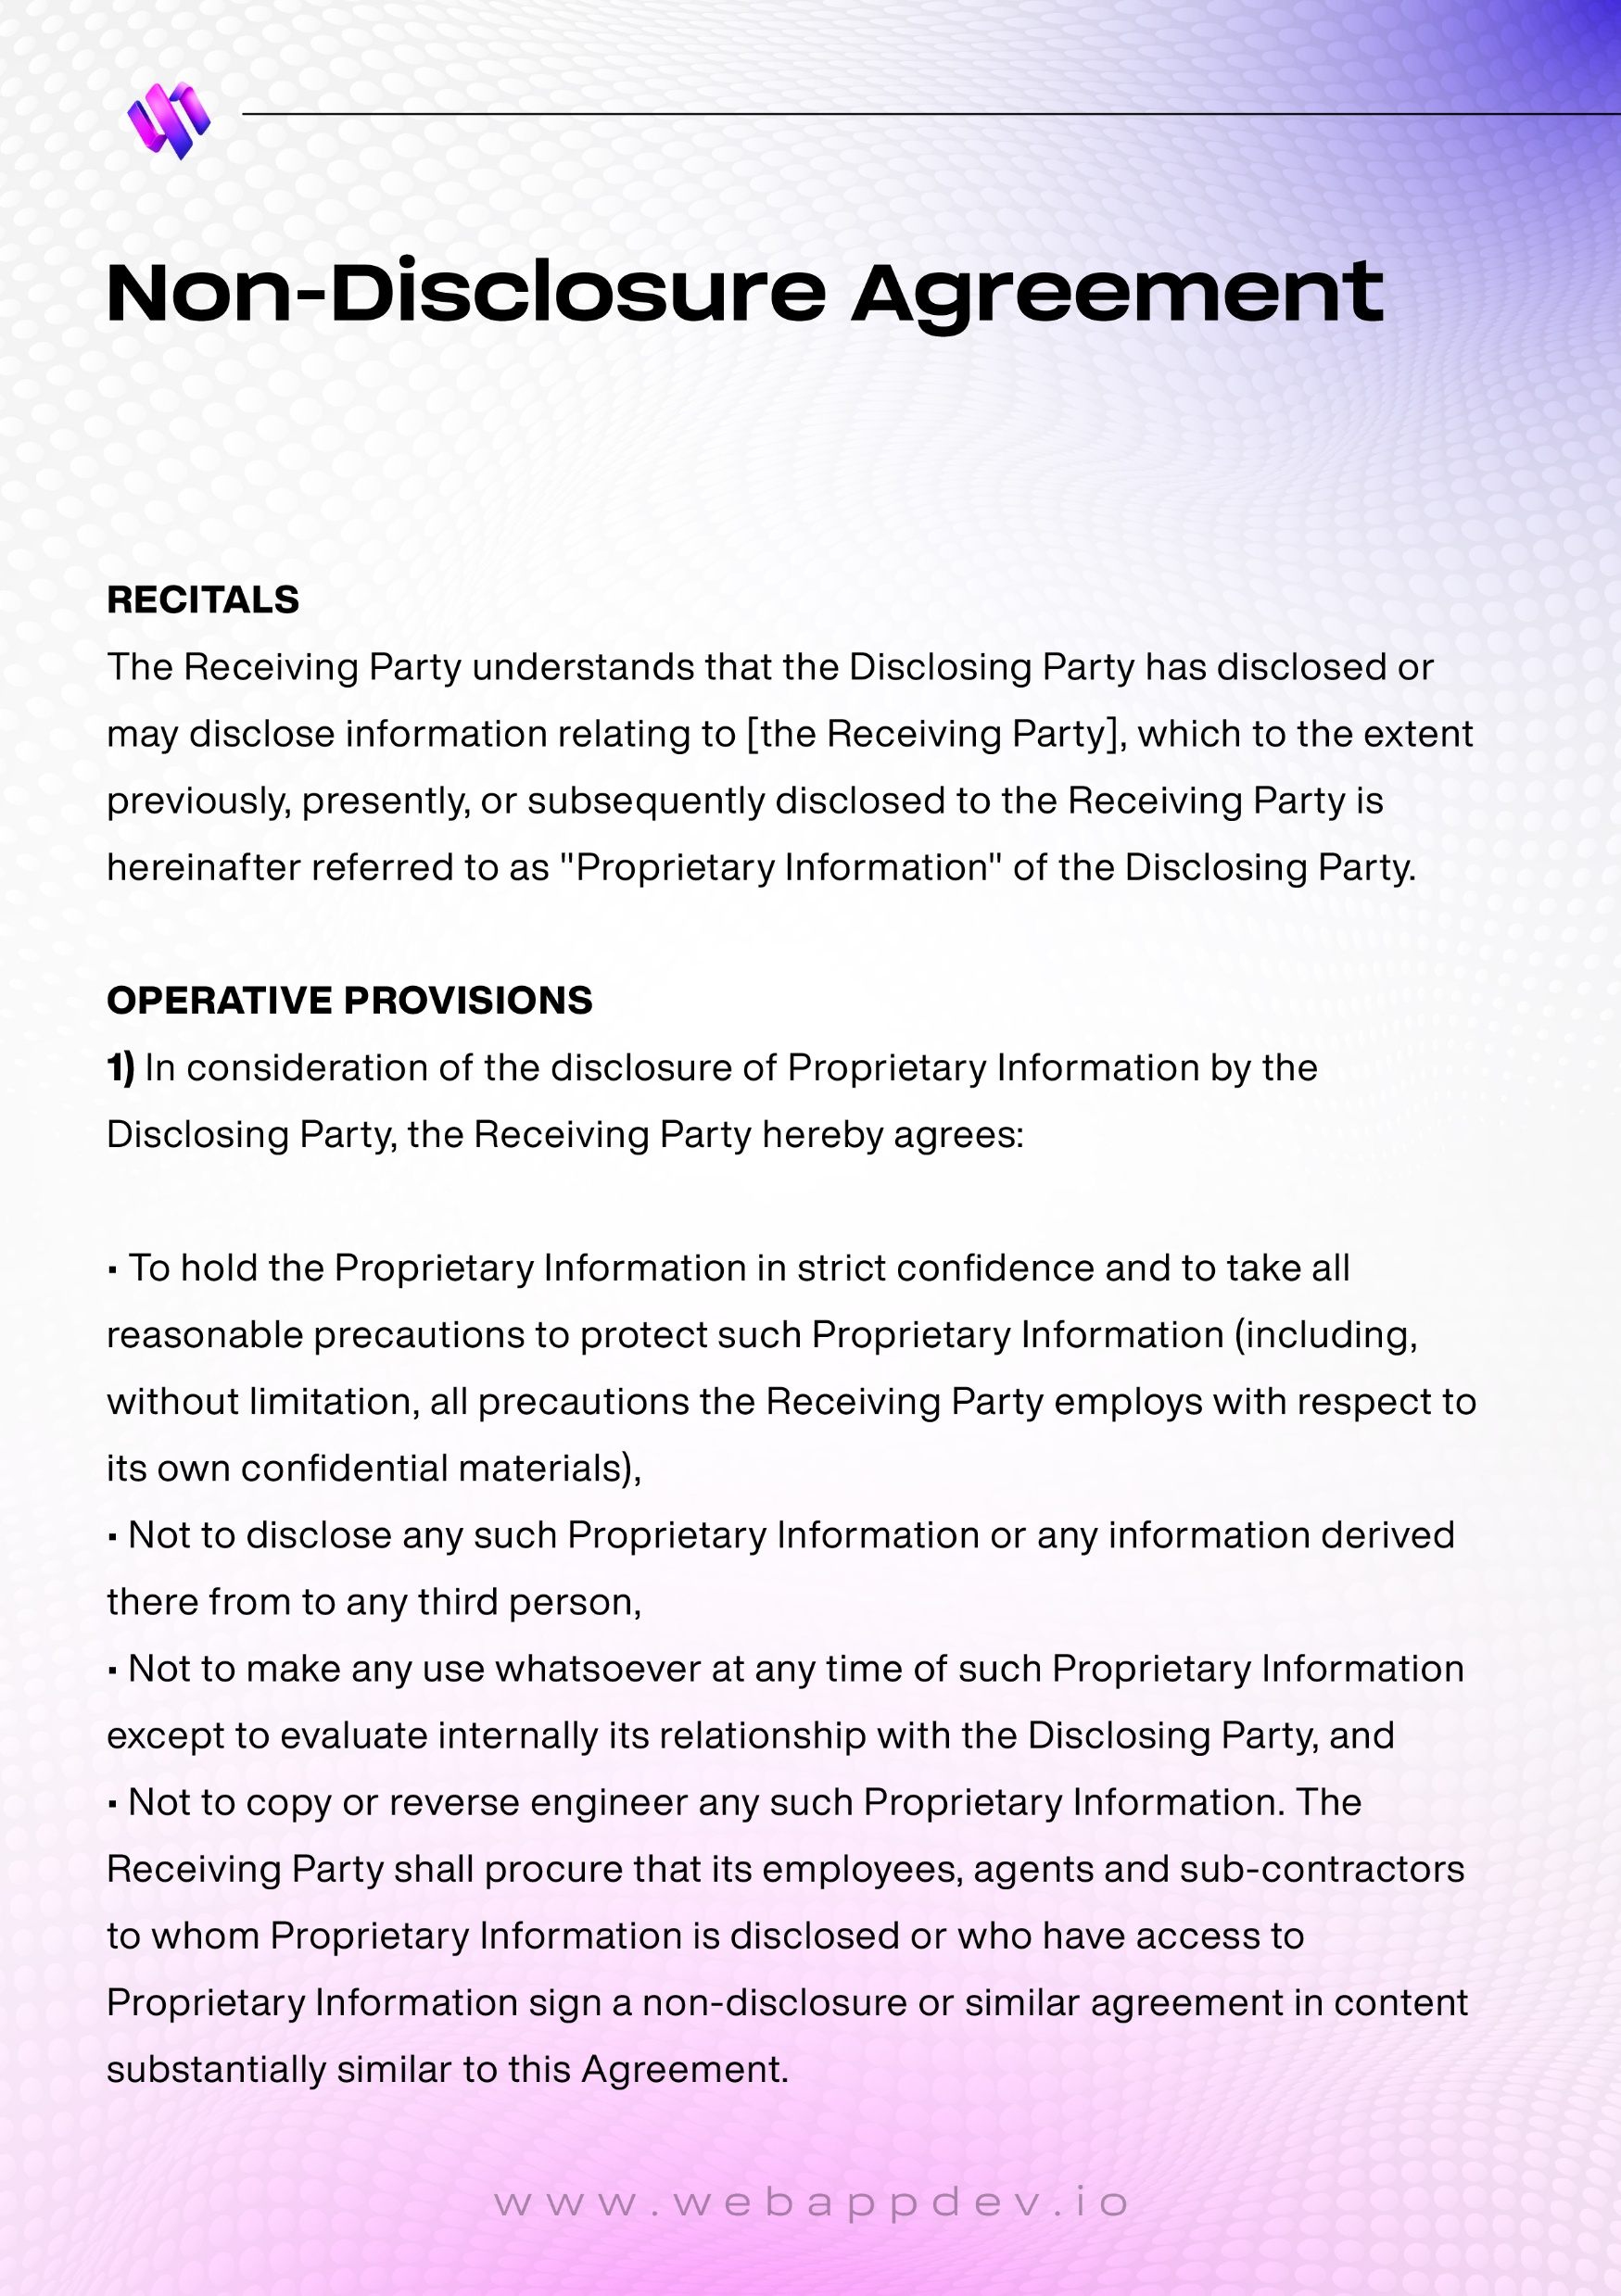
This agreement is made on [09/18/2025] between “Dylan Pollard” and
“Web App Dev” Collectively referred to as the "Parties".

Slide 5
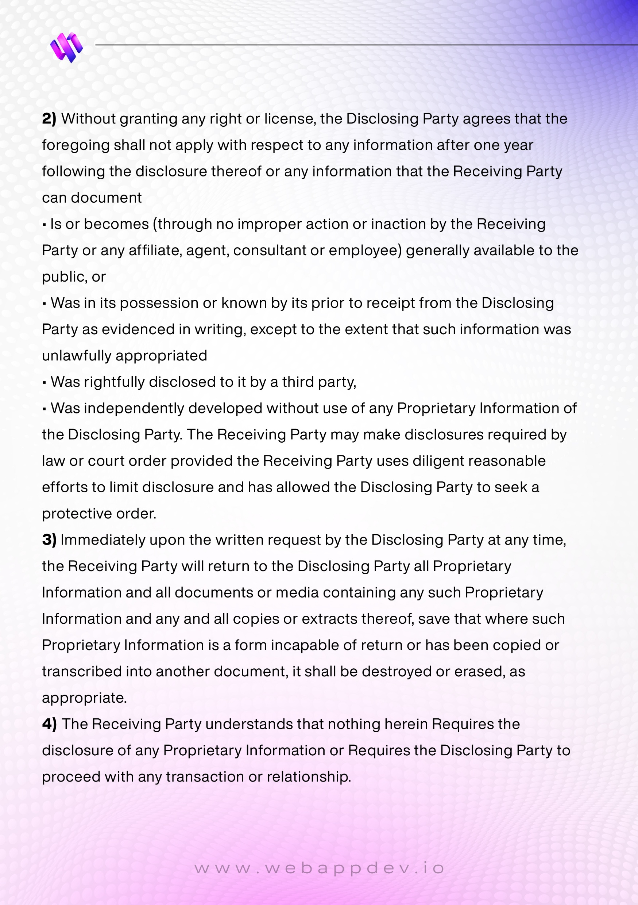

Slide 6
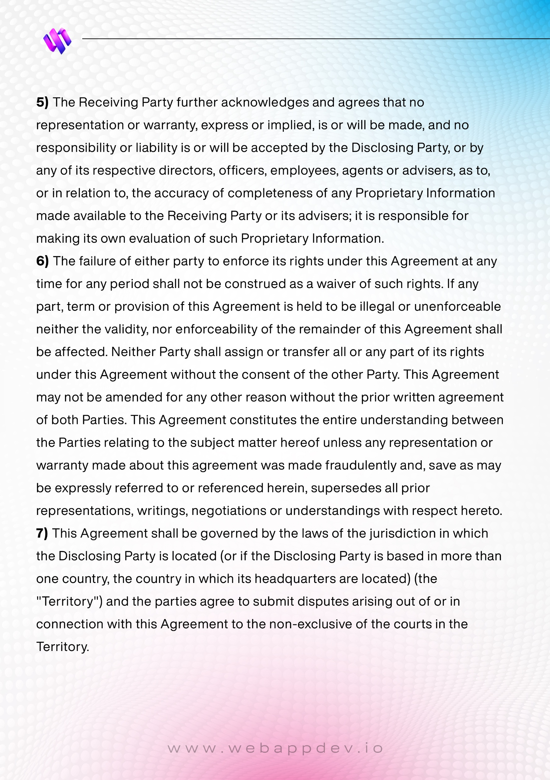

Slide 7
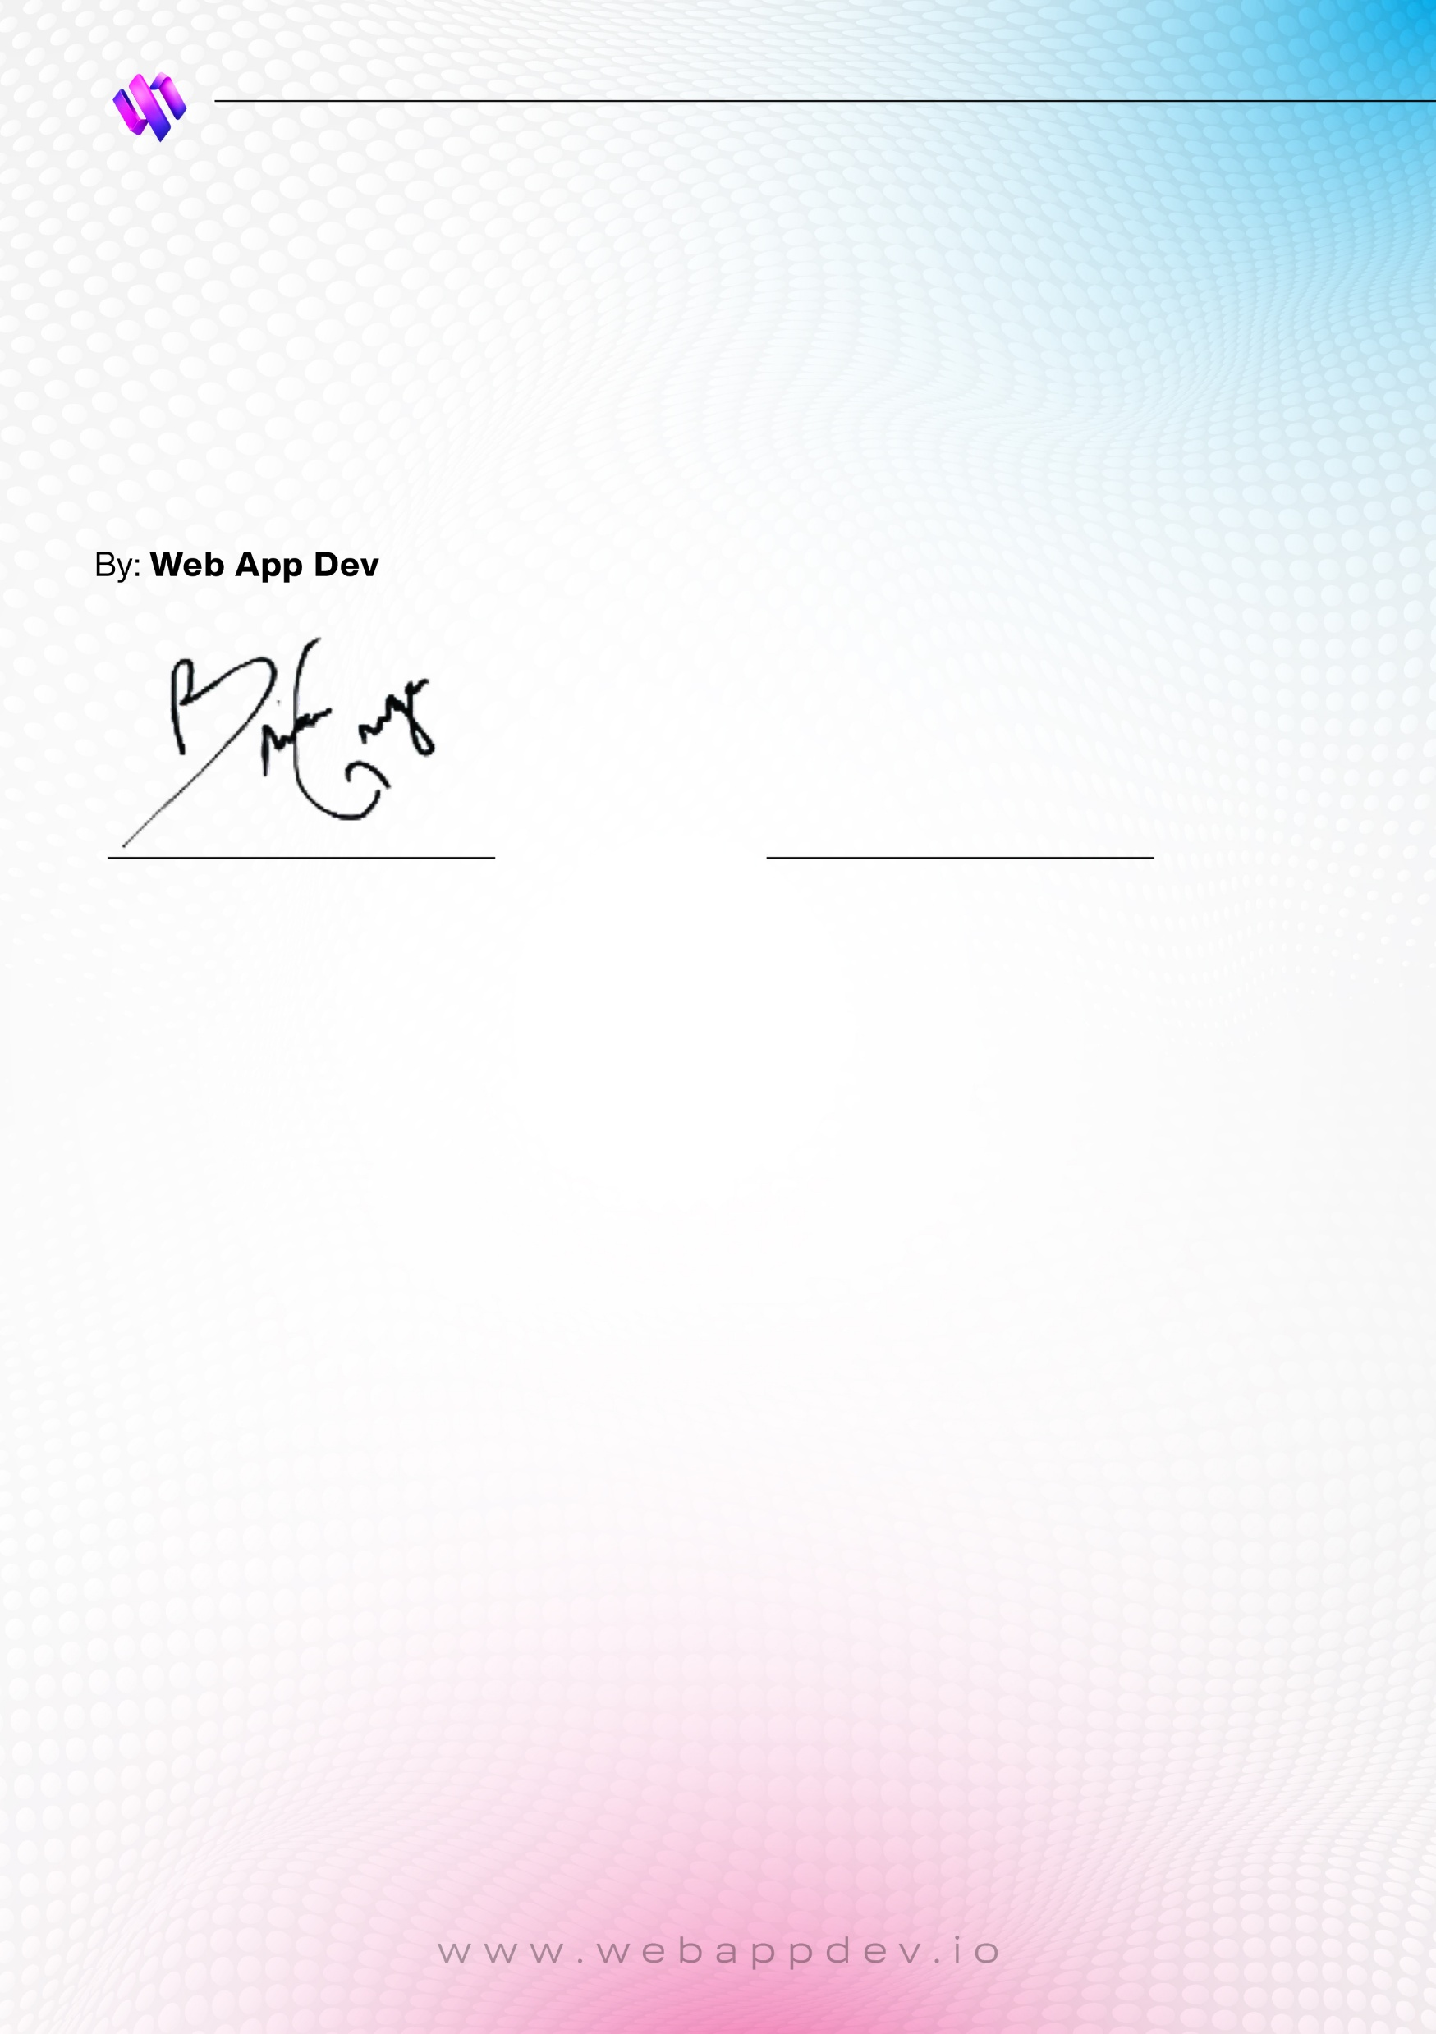
This is to certify that i hare read the Non-Disclosure Agreement between
Web App Vault and Dylan Pollard and provide my Acknowledgement.
For: Dylan Pollard
Name: Brian McGregor
Date: 07/25/2025
Phone: (209) 209-4386
Email: info@caliwebstudios.com
Name: Dylan Pollard
Date: 07/25/2025
Phone: (804) 512-8905
Email: dylan5gators@gmail.com

