Slide 1


Spring MVC
DURGA ADIMULAM
DECEMBER 23, 2020

Slide 2
What is MVC?
MVC stands for Model View Controller
It is an Architectural Pattern
MVC divides applications into 3 parts : Model, View & Controller

Slide 3
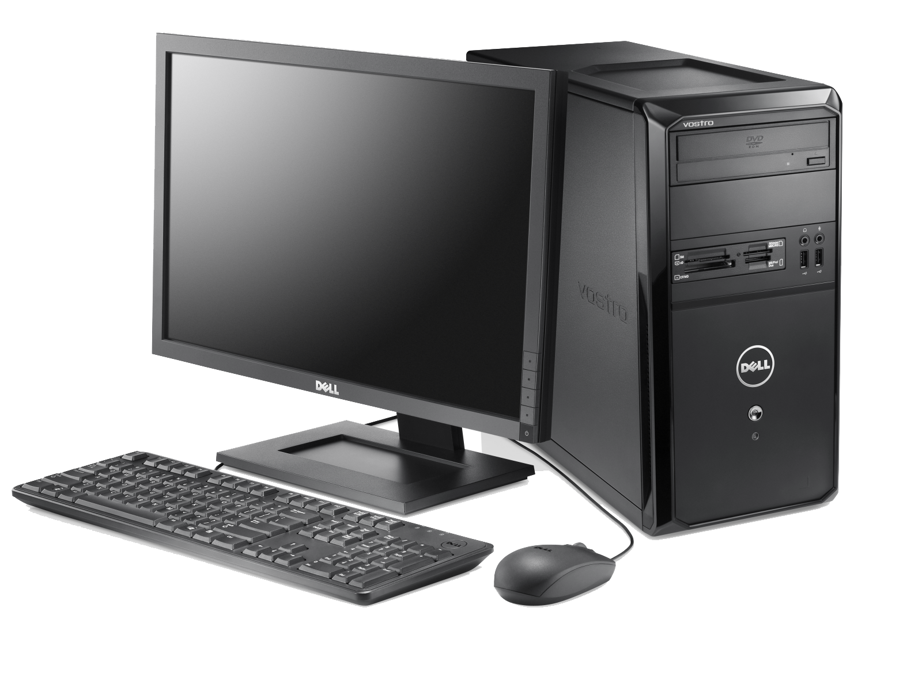
MVC Architecture
Controller
Model
Database
View
Server

Slide 4
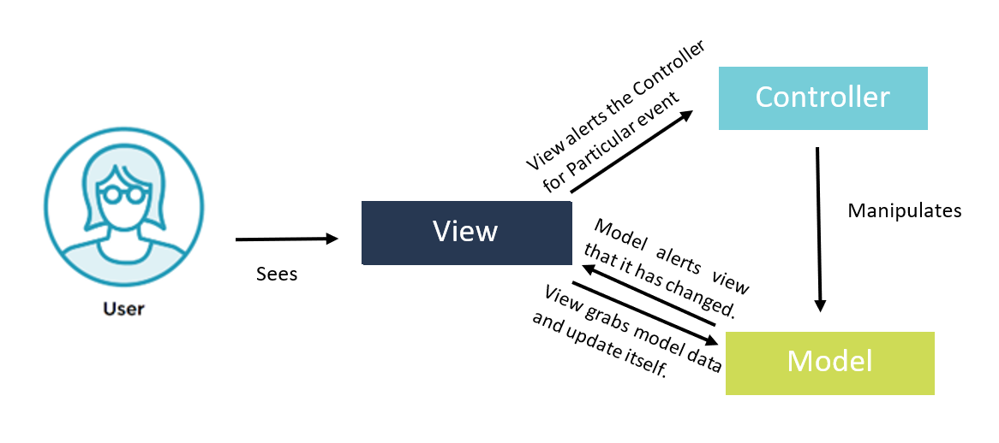
MVC Architecture

Slide 5
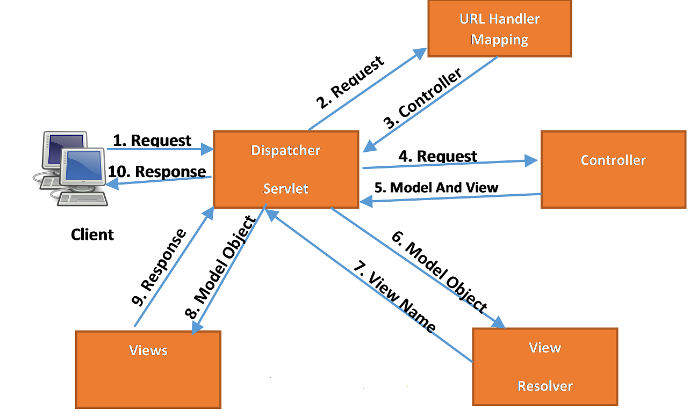
Spring MVC Architecture

Slide 6
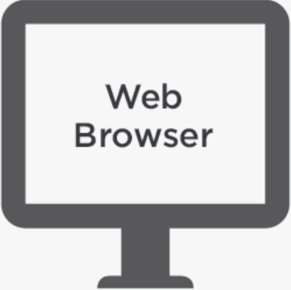
URL Handling Mapping
2.Request
3. Controller
1. Request
4. Request
Dispatcher Servlet
Client
Controller
10. Response
5. ModelAndView
9. Response
6. Model Object
8. Model Object
7. View Name
Views
View Resolver

Slide 7
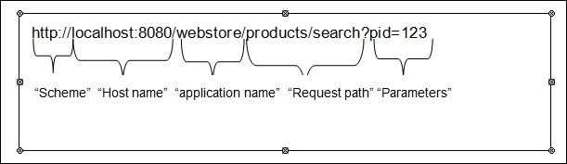
Spring MVC Architecture

Slide 8
Spring MVC Annotations
Annotation | Description
@Controller | is used to make a class as a web controller, which can handle client requests and send a response back to the client. This is a class-level annotation.
@RequestMapping | It's a method level annotation that is specified over a handler method. It provides the mapping between the request path and the handler method.
@RequestParam | This Annotation is used to bind HTTP parameters into method arguments of handler methods
@RequestBody | This annotation can convert inbound HTTP data into Java objects passed into the controller's handler method
@RestController | This is a convenience annotation for developing a RESTful web service with the Spring MVC framework. The @RestController is a combination of @Controller and @ResponseBody
@PathVariable | This is another annotation that is used to retrieve data from the URL. Unlike @RequestParam annotation which is used to extract query parameters, this annotation enables the controller to handle a request for parameterized URLs

Slide 9
References
https://docs.spring.io/spring-framework/docs/current/reference/html/web.html

