Slide 1


CRYPTOGRAPHY PROJECT
Submitted to Dr. Kavitha CR
By Sourabh Sooraj
Purpose: Encrypted E-mail Client

Slide 2

Problem Statement
These days, the internet is a scary place and even a simple task such as sending an email becomes an act of secrecy. So it is vital that we keep on our toes and find new ways to secure our forms of communication. That is the very problem that I have decided to tackle. This project aims at creating an encrypted email client using the age old method of encryption, the Vigenere Cipher. Many a cipher can be used to formulate the task, but the Vigenere cipher is a fitting example of the limitless possibilities of encryption.

Slide 3
Constructing a UI
First, we use Photoshop to design a UI.
The design is then transported to NetBeans where we will code the different components of the UI.
Our E-mail client consists of a space for entering the receiver address, another space for entering the subject and finally, a space for entering the message itself.
Finally to top it all off, a send button.

Slide 4
NetBeans
We use NetBeans to create different applications, and the Java component makes the coding and functioning much simpler.
The components like Text Fields and Buttons are already laid out in a simple click and drag format and the corresponding functions are generated.
We can now program the different functions to perform different tasks.
From here on out, we move our efforts to the Code editor, so that we can get to the emailing component.

Slide 5
Coding
Here is where the heavy stuff begins, here we first connect our code to the package of the application.
We then proceed to write the code for sending an email.
We give in our port code and other inputs. We also import the given packages for our convenience:
import java.util.Properties;
import javax.mail.*;
import javax.mail.internet.*;
import javax.swing.*;
After that, we will be using Vignere cipher to encrypt our message. So the code for that will be written as well.
To ensure extra security, we will be including a password block, so the receiver will have to verify their identity through an outside source and once verified, the corresponding plain text will be sent out to them as well.

Slide 6
Inputs
Once the coding is done, we pre-define our, that is the sender’s credentials for authentication and the pop-up that asks us to enter the key will show up and we give the required input.
We will be using Gmail so will also have to make sure that our receiver has enabled the option to receive emails from non-verifiable sources. Google has disabled this for security concerns but for our example, we will have to enable it temporarily.
Now that that’s done, we are ready to send our encrypted email!
After running the application, just enter the details in the UI.

Slide 7

After Sending
Incase the receiver did not enable the option for emails to be received from unknown sources mentioned before, they will not receive it, instead, an alert will show up on their account.
Ask the receiver to enable the option and try again, else if it was enabled in the first place, they should receive the email.
The Email will show up in the form of a cipher text, encrypted with the Vigenere cipher. Incase the sender had confirmed the receiver’s identity through an outside source and had communicated the correct key, the corresponding plain text will be sent to them as well.
We have successfully sent an encrypted email.

Slide 8

One Drawback
Does not accept special characters and is case and space sensitive.

Slide 9
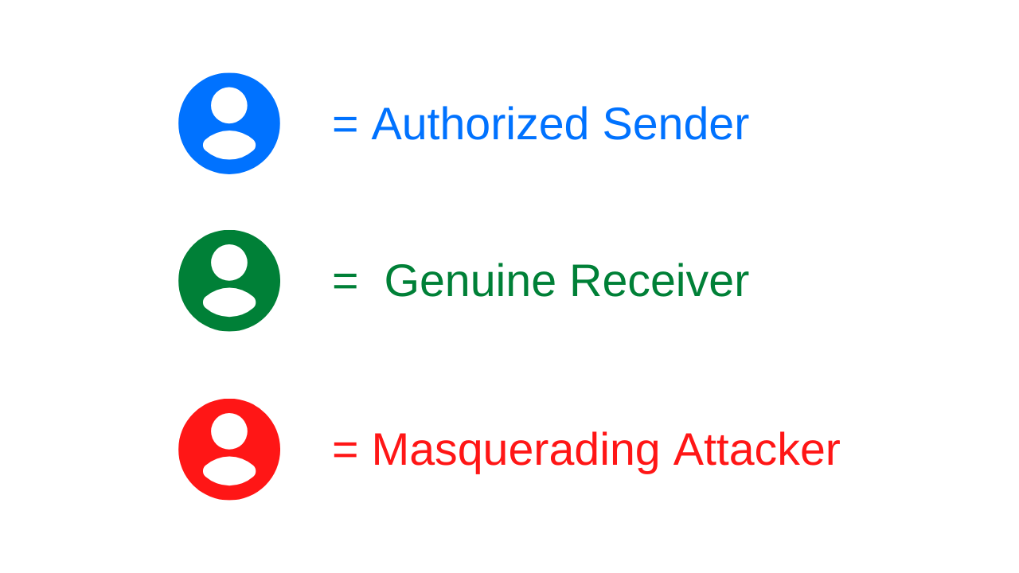

Slide 10
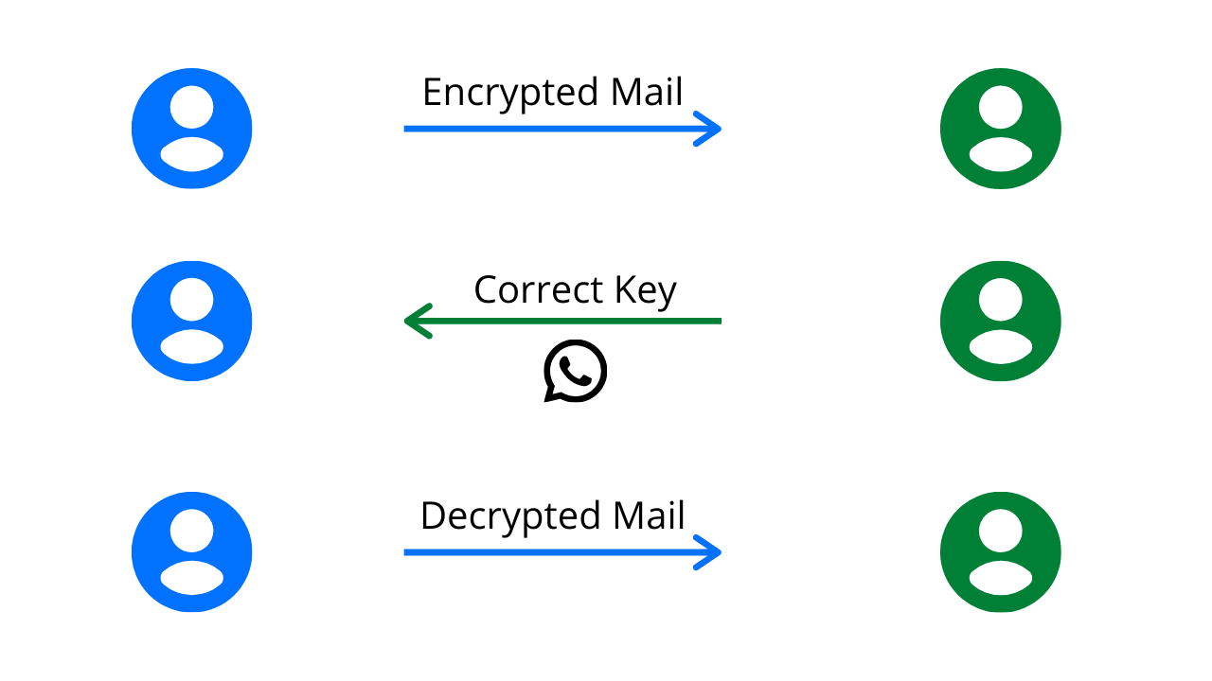

Slide 11
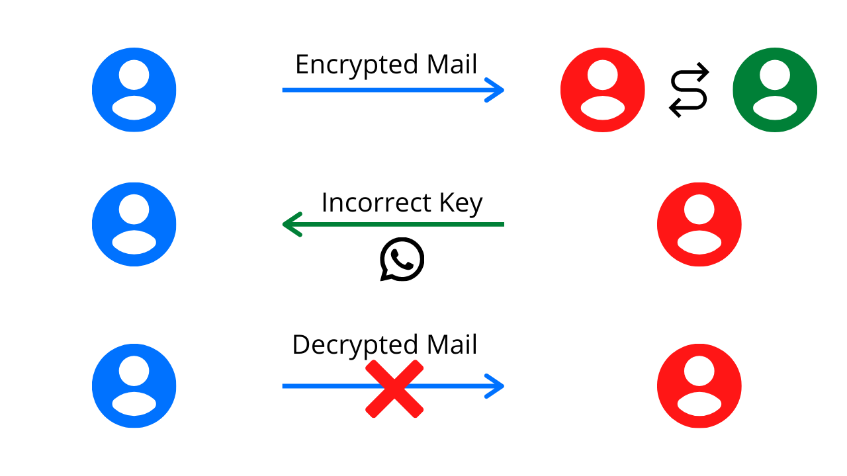

Slide 12
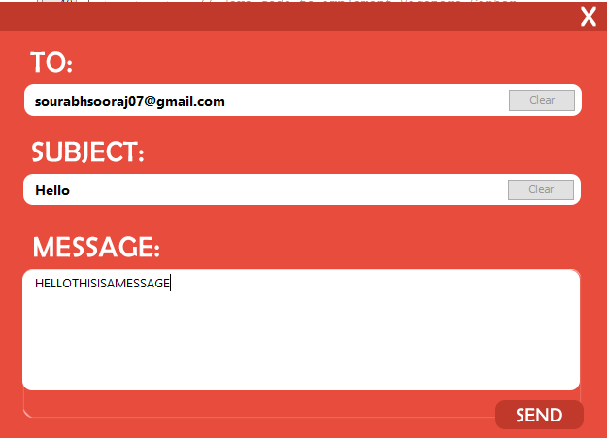
TESTING

Slide 13
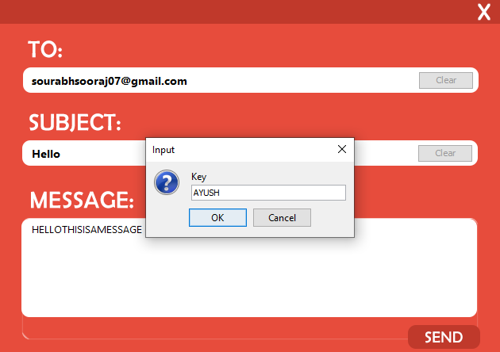
TESTING

Slide 14
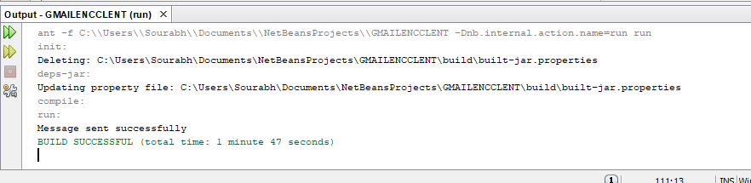
TESTING

Slide 15
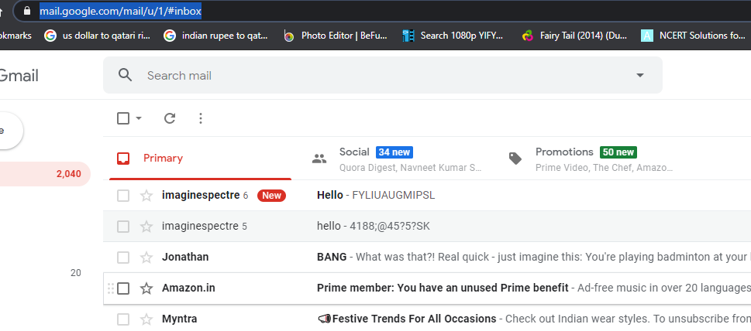
TESTING

Slide 16
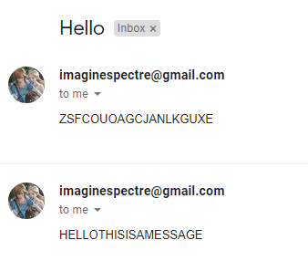
TESTING

Slide 17
Applications
This client can be used to send encrypted Emails around the world.
With a better Cryptographic cipher or a better method of encryption, it can even be used for higher level purposes.
A convenient utility and GUI can be personalized to your liking.
Can be used as a case study tool to understand how emailing and basic encryption works.

Slide 18
References
https://www.youtube.com/channel/UCLuXaf-zBsw8Lzz6nqr66Jw
https://www.geeksforgeeks.org/vigenere-cipher/
https://stackoverflow.com/
https://javaee.github.io/javamail/docs/api/com/sun/mail/smtp/package-summary.html
https://medium.com/@angela.amarapala/sending-email-confirmation-for-account-activation-with-spring-java-cc3f5bb1398e
https://www.javatpoint.com/java-joptionpane
https://docs.oracle.com/javase/tutorial/uiswing/components/dialog.html

Slide 19
Thank you!

