Slide 1

CLOUD COMPUTING PRESENTATION
SIEMENS

Slide 2
Presented by:
B.Tech-III,6th Sem,SVNIT
U19CS082
SOURABH PATEL

Slide 3
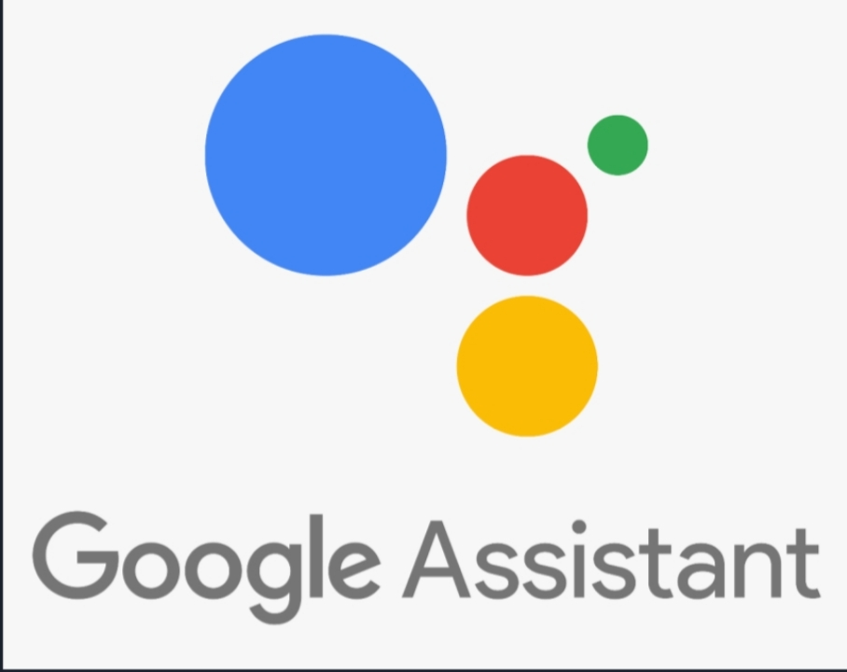
Contents
1) About siemens.
8) Cloud Services benefits.
2) Location.
9) Summery.
3) Business areas of siemens.
4) challenges.
5) Why AWS?
6) Services Provided by AWS.
7) It Reduces Cost.

Slide 4
About siemens
Siemens is a technology company focused on industry, infrastructure, mobility, and healthcare. Creating technologies for more resource-efficient factories and resilient supply chains to smarter buildings and grids, to cleaner, comfortable transportation and advanced healthcare, the company empowers customers to transform the industries that form the backbone of economies, transforming the everyday for billions of people.
I

Slide 5



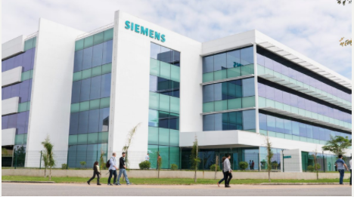


More than 200
India
China
Germany
Brazil
Middle East
USA

Slide 6
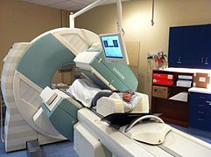
Different Business Areas
Power and Gas, Siemens Gamesa Renewable Energy (spun off into Siemens Energy)
Power generation services
Energy management
Smart Infrastructure (formerly Building Technologies)
Process Industries and Drives
Financial services
Healthineers Digital Factory (Software)
A Siemens SPECT/CT scanner in operation

Slide 7
Challenges
For developing new and advanced Healthcare devices siemens needs good platform with advanced developing tools. Which costs a lot to install in every devices.
To process the big data and store the results siemens needs lot of storage.
To host, it needs a secure platform(Paas).
To overcome from these challenges siemens a cloud services like AWS.

Slide 8
Why AWS …?
As the name suggest, a platform is provided to clients to develop and deploy software. The client can focus on the application development rather than having to worry about hardware and infrastructure. It also takes care of most of the operating system, servers and networking issues.
1) AWS comes among top software providers.
2) It is low cost and less vulnerable as servers are automatically and being checked for all know security issues. The hole process is not visible to developers and thus does not pose a risk of data breach. The new version of development tools are developed by AWS.

Slide 9
Services provided by AWS
Siemens AG Launches Industry-Leading EnergyIP MDM Application on AWS
Siemens decided it was time to modernize its EnergyIP meter data management (MDM) application, which enables more than 200 electricity, gas, and water utility companies to manage more than 90 million meters. For the past 20 years, Siemens has offered on-premises EnergyIP MDM, but recently the company recognized it could improve computing efficiency and customer service by offering a cloud-hosted MDM service as well. Migrating its complex enterprise application to the cloud was a daunting project, but Amazon Web Services (AWS) assisted at every stage of the transition.

Slide 10
Services provided by AWS
Siemens Energy Accelerates Application Development Using metaphactory Knowledge Graph
Siemens Energy is a German-based industrial manufacturing company that offers solutions for virtual power plants, grid management, and storage solutions. Siemens Energy uses Amazon Neptune to oversee a fleet of thousands of large gas turbines operating in multiple countries across the globe. Siemens Energy metaphactory through a free trial in AWS Marketplace, which enabled it to go to market quickly and cost-effectively.

Slide 11
Services provided by AWS
Siemens Finds New Value in Employee Surveys Using AWS Machine Learning Services
Siemens surveys employees quarterly using AWS machine learning technologies to translate and analyze results in less than two weeks. The company’s survey-processing solution uses Amazon Translate, a neural machine translation service; Amazon SageMaker, a managed machine learning service; and Amazon Comprehend, a natural language processing service that finds relationships in text.

Slide 12
Services provided by AWS
Siemens Handles 60,000 Cyber Threats per Second Using AWS Machine Learning
Siemens built an AI-enabled cybersecurity platform on AWS. The company is a global electrification, automation, and digitalization leader. The platform uses Amazon SageMaker to make predictions and act, AWS Glue to extract, transform, and load data, and AWS Lambda to run code in response to events.

Slide 13
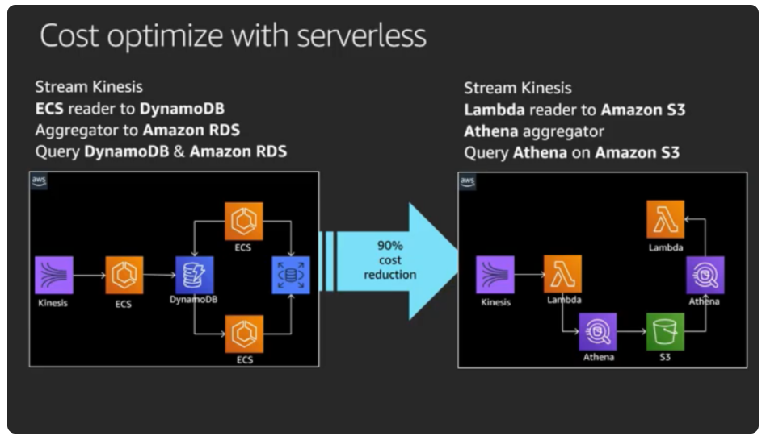
It Reduces Cost
This helped in achieving a lower Total Cost of Ownership(TCO) by Pay As You Go model! As Services which are not used much need not pay!

Slide 14
Cloud Services benefits
1) Easy to use
2) Flexible
3) Cost-Effective
4) Reliable
5) Scalable and high-performance
6) Secure.

Slide 15
Summary
Through AWS cloud services, siemens company has overcome its challenges by siemens reducing tools cost while improving 24x7 availability and customer support, which states that cloud services are essential for the company’s growth and increase productivity. And to provide an efficient service to users.
In this type of Design Pattern, they states that they focused more on their work, software engineers to do their best that is writing code and not bothering about the servers and its maintenance.

Slide 16
THANK YOU SIR
U19CS082
SOURABH PATEL

