Slide 1
Data Warehousing
Data Warehousing

Slide 2
Past Business Scenerio
No Web for Business
  Customers appear ”physically” in the store
  Customers do not change to other stores more easily
Data Warehousing

Slide 3
Today’s Business
The Web made Business Intelligence (BI) more necessary
  Customers do not appear ”physically” in the store
  Customers can change to other stores more easily
Thus,
  Can know customers using data and BI
  Web logs makes is possible to analyze customer behavior in a more detailed than before (what was not bought?)
  Combine web data with traditional customer data
Wireless Internet adds further to this
  Customers are always ”online”
  Customer’s position is known
  Combine position and customer knowledge => very valuable
Data Warehousing

Slide 4
Data Warehousing
On October 11, 2000, find the 5 top-selling products for each product subcategory that contributes more than 20% of the sales within its product category?
Regular database models and systems are not suitable for this type of queries
Data Warehousing

Slide 5
Data Warehousing
Learn how to design, build, and use a data warehouse
Multidimensional modeling
  • Dimensions, facts, measures
Data Warehousing

Slide 6
Why?
Data is a valuable asset for ERP, etc.
Data is available from every step of a sales pipeline, from
  Internal Data Sources
    ERP systems, Sales/Financials, Support/CRM, Marketing
  External Data Sources
    Social networks, Clickstreams, Websites, Supply chain/Logistics (Through customer support)
Data Warehousing

Slide 7
Why?
Data is available
  As increase in software as a service (SaaS) products contributes to the data
  In 2016, the use of cloud services for business processes have accelerated past current forecasts by 30%
But, more data does not necessarily translate into better analytics
But, it difficult to build meaningful analytics with various data sources
Data Warehousing

Slide 8
Why?
Key Problems of Business
1) Complex and unusable models
  Many DB models are difficult to understand
  DB models do not focus on a single clear business purpose
2) Same data found in many different systems
  Example: customer data in 14 systems
  The same concept is defined differently
3) Data is suited for operational systems
  Just for Accounting, billing, etc., Do not support analysis across business functions
4) Data quality is bad
  Missing data, imprecise data, different use of systems
5) Data are ”volatile”
  Data deleted in operational systems (6 months), but Data change over time – no historical information
Data Warehousing

Slide 9
Why?
To give full picture, analytics must require more than one data source
Centralizing data provides the structure necessary to enable cross-platform analytics
To identify an anomaly before it had a long-term negative impact
Data Warehousing

Slide 10
Enterprise Organizations Challenge
Collect diverse kinds of data and maintain large databases from
  Multiple, Heterogeneous and Distributed information sources
Challenge
  To integrate such data to provide easy and efficient access to it
Data Warehousing

Slide 11
To answer…
Analyzing operations, to
  Increase the customer focus
    By the buying patterns of preference, time
  Look for source of profit or to manage product portfolio
    By comparing the performance of sales by quarter, year, geographic regions
Data Warehousing

Slide 12
Solution
New analysis environment
where data is
  Integrated (logically and physically)
  Subject oriented (versus function oriented)
  Supporting management decisions (different organization)
  Stable (data not deleted, several versions)
  Time variant (data can always be related to time)
Data Warehousing

Slide 13
Earlier Approach
Traditional heterogeneous DB integration
Query based approach: data is integrated based on query
Data Warehousing

Slide 14
Data Warehouse vs. Heterogeneous DBMS
Traditional heterogeneous DB integration
  A query driven approach
    Data is integrated based on query
    Build wrappers/mediators on top of heterogeneous databases
    When a query is posed to a client site, a meta-dictionary is used to translate the query into queries appropriate for individual heterogeneous sites involved
    And the results are integrated into a global answer set
    Advantages
      Access to most up-to-date data Different interfaces
Data Warehousing

Slide 15
Data Warehouse vs. Heterogeneous DBMS
Traditional heterogeneous DB integration
  A query driven approach
  Problems
    Complex information filtering and integration process
    Competes for resources at local sources
    Inefficient and Expensive for frequent queries especially for queries requiring aggregations
    Delay in query processing
      Slow or unavailable information sources
      Complex filtering and integration
    Data loss at the sources (e.g. historical data cannot be recovered
Data Warehousing

Slide 16
Data Warehouse vs. Heterogeneous DBMS
Data warehouse
  Alternative to the traditional approach of heterogeneous database integration
  Update-driven
    Information from heterogeneous sources is integrated in advance and stored in warehouses for direct query and analysis
  High performance
    As data are copied, preprocessed, integrated, summarized and restructured into one semantic data store
  Support multidimensional queries from historical information
Data Warehousing

Slide 17
Operational DBMS vs. Data Warehouse
OLTP (On-Line Transaction Processing)
  Major task of traditional relational DBMS
    Day-to-day operations
      Purchasing, inventory, banking, manufacturing, payroll, registration, accounting, etc.
Data Warehouse Systems
  Known as OLAP (On-line Analytical Processing)
Data Warehousing

Slide 18
Operational DBMS vs. Data Warehouse
  User and system orientation
    OLTP – Customer oriented
      Transaction and query processed by clerks and clients
    OLAP – Market oriented
      Data analysis by knowledge workers – managers, executives and analysts
  Data contents for easy decision making
    OLTP – Current data (Too detailed)
    OLAP – Large amount of historical data
      To provide summarization and aggregation
      Stores and manages information at different level of granularity
  Database design
    OLTP – ER Model and application oriented database design
    OLAP – Star or Snowflake model and subject oriented database design
Data Warehousing

Slide 19
Operational DBMS vs. Data Warehouse
  View
    OLTP – Current data within an enterprise or department
    OLAP – Spans the multiple versions of a database schema due to evolutionary process of an organization and integrated from many data stores
      Stored on multiple storage media
  Access patterns
    OLTP – Consist of short, atomic transactions - Update
    OLAP – Consist of MOSTLY read-only complex queries
Data Warehousing

Slide 20
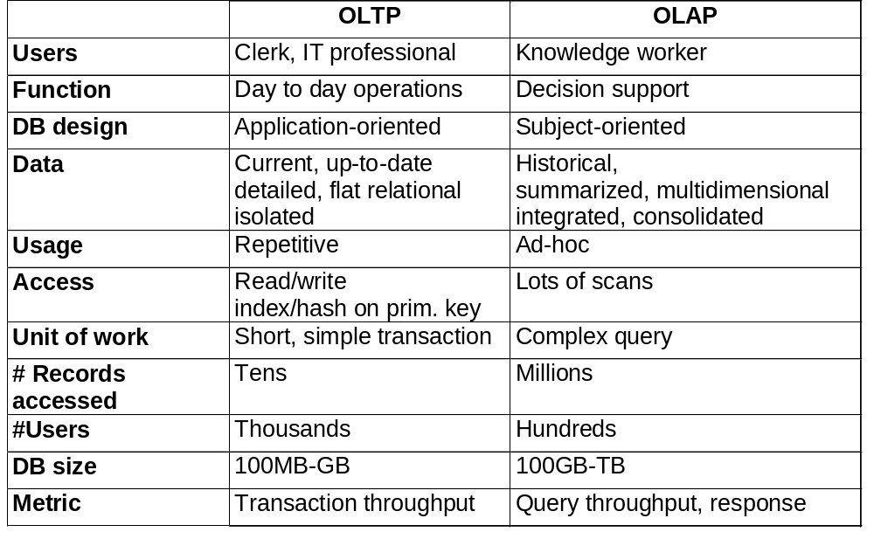
OLTP vs. OLAP
Data Warehousing

Slide 21
Goals
How data centralization enables better analytics
How to redefine data for proper usage
How the right BI tool eliminates the data analyst bottleneck
How to define single sources of truth for your organization
How to build a data-driven (not just data-rich) organization
Data Warehousing

Slide 22
Data Warehousing
What is a data warehouse?
A multi-dimensional data model
Data warehouse architecture
Data warehouse implementation
From data warehousing to data mining
Data Warehousing

Slide 23
Data Warehousing
The standard model to aggregate data and provide business-directed analytics, for nearly 30 years
  Data is extracted from various sources, transformed to a predefined model, and loaded into the data warehouse
  This extract, transform, and load (ETL) process results in query able analytics contextualized by key dimensions (e.g., customer, product, location)
But this process is slow and leads to latencies in the data warehouse
Stale data (even just a week or two old) can be useless data for many purposes
Data Warehousing

Slide 24
Data Warehousing
The Argument for Data Centralization
  For disparate data sources to be compared, they must contain common fields that can be mapped or linked
  Evaluate each data source for existing common fields and, if you can, resolve minor variances (for example, region vs. state vs. zip code)
  Standardize data references, though some tools will allow you to specify relationships without needing to unify labels (e.g., product_id vs. product_number)
Data Warehousing

Slide 25
What is Data Warehouse?
Defined in many different ways
  A decision support database that is maintained separately from the organization’s operational database
  Support information processing by providing a solid platform of consolidated, historical data for analysis
“A data warehouse is a subject-oriented, integrated, time-variant, and nonvolatile collection of data in support of management’s decision-making process”—W. H. Inmon
Data Warehousing

Slide 26
Data Warehouse—Subject-Oriented
Organized around major subjects, such as customer, product, sales
Focusing on the modeling and analysis of data for decision makers, not on daily operations or transaction processing
Provide a simple and concise view around particular subject issues by excluding data that are not useful in the decision support process
Data Warehousing

Slide 27
Data Warehouse - Data Integration
Why this Problem?
  Different interfaces
  Different data representations
  Duplicated information
  Inconsistent information
Solution
  Collect and combine information
  Provide an integrated view
  Provide a uniform user interface
  Support sharing of data
Data Warehousing

Slide 28
Data Integration-Approach 1
Query based approach: data is integrated based on query
Advantages
  Access to most up-to-date data Different interfaces
Disadvantages
  Delay in query processing
    Slow or unavailable information sources
    Complex filtering and integration
  Inefficient and expensive for frequent queries
  Competes with local processing at sources
  Data loss at the sources (e.g. historical data cannot be recovered
Data Warehousing

Slide 29
Data Integration-Approach 2
Data Warehouse approach: data is integrated in advance
Data is stored in DW for querying and analysis
Advantages
  High query performance
  Does not interfere with local processing at sources
    Assumes that data warehouse update is possible during downtime of local processing
    Complex queries are run at the data warehouse
    OLTP queries are run at the source systems
Disadvantages
  The most current source data is not available
Data Warehousing

Slide 30
Data Warehouse—Integrated
Constructed by integrating multiple, heterogeneous data sources, like
  Relational databases, flat files, on-line transaction records
Data cleaning and data integration techniques applied, to ensure consistency in among different data sources
  Naming conventions
  Encoding structures
  Attribute measures, etc.
    e.g., Hotel price: currency, tax, breakfast covered, etc.
    When data is moved to the warehouse, it is converted
Data Warehousing

Slide 31
Data Warehouse—Time Variant
The time horizon for the data warehouse is significantly longer than that of operational systems
  Operational database: current value data
  Data warehouse data: provide information from a historical perspective (e.g., past 5-10 years)
Every key structure in the data warehouse
  Contains an element of time, explicitly or implicitly
Data Warehousing

Slide 32
Data Warehouse—Nonvolatile
A physically separate store of data transformed from the operational environment
A data warehouse
  Does not require transaction processing, recovery, and concurrency control mechanisms
  Requires only two operations in data accessing:
    initial loading of data and access of data
Data Warehousing

Slide 33
Data Warehouse
Different functions and different data:
  Missing data: Decision support (DS) requires historical data which operational DBs do not typically maintain
  Data consolidation: DS requires consolidation (aggregation, summarization) of data from heterogeneous sources
  Data quality: Different sources typically use inconsistent data representations, codes and formats which have to be reconciled
Nowadays, There are more and more systems which perform OLAP analysis directly on relational databases
Data Warehousing

Slide 34
Data Warehousing
What is a data warehouse?
A multi-dimensional data model
Data warehouse architecture
Data warehouse implementation
From data warehousing to data mining
Data Warehousing

Slide 35
From Tables and Spreadsheets to Data Cubes
A data warehouse is based on a multidimensional data model which views data in the form of a data cube
Data cube is defined by dimensions and facts
  Dimensions
    A data cube allows data to be modeled and viewed in multiple dimensions
    Dimensions are the entities with respect to which an organization wants to keep records
    e.g. , For the data cube sales, the dimensions are time, item, branch, location that allows to keep track of things like monthly sales of items and the branches and locations at which the items were sold
Data Warehousing

Slide 36
From Tables and Spreadsheets to Data Cubes
Dimensions
  Each dimension may have a table associated with it, called a Dimension table
  Which further describes the dimension, e.g.
    A dimension table item contains attributes (item_name, brand, type)
    A dimension table time contains attributes (day, week, month, quarter, year)
  Dimension tables can be specified by the users or experts or automatically generated and adjusted based on data distribution
Data Warehousing

Slide 37
From Tables and Spreadsheets to Data Cubes
  Facts
    Represented with Fact table that contains the name of the facts, or measures, as well as keys to each of the related dimension tables
    Numerical measures to analyze the relationship between dimensions, such as
      Dollars_sold (Sales amount in dollars)
      Units_sold (Number of units sold)
Data Warehousing

Slide 38
Data Cubes
Cross Tabulations
  Useful for the historical data
  Sale of Electronics Item during June
Month/Product | TV | PC | VCR | Total
June | 5 | 10 | 2 | 17
July | 6 | 10 | 1 | 17
August | 5 | 9 | 1 | 15
Total | 16 | 29 | 4 | 39

Slide 39
Data Cubes
Cross Tabulations
  Useful for the historical data
  Sale of Electronics Item during June
Dimensions
Month/Product | TV | PC | VCR | Total
June | 5 | 10 | 2 | 17
July | 6 | 10 | 1 | 17
August | 5 | 9 | 1 | 15
Total | 16 | 29 | 4 | 39
Aggregated w. r. t.
X axis
Aggregated
w. r. t. X & Y axis
Aggregated w. r. t. Y axis

Slide 40
From Tables and Spreadsheets to Data Cubes
Data cube
  In data warehousing literature, an n-D base cube is called a base cuboid
  The top most 0-D cuboid, which holds the highest-level of summarization, is called the apex cuboid
    Denoted by ALL
  The lattice of cuboids forms a data cube
    Each showing the data at a different level of summarization or group by
Data Warehousing

Slide 41
Cuboids Corresponding to the Cube
all
0-D(apex) cuboid
product
date
country
1-D cuboids
product,date
product,country
date, country
2-D cuboids
3-D(base) cuboid
product, date, country
Data Warehousing

Slide 42

Cube
Date
1Qtr
2Qtr
3Qtr
4Qtr
sum
Product
TV
PC
U.S.A
VCR
sum
Canada
Country
Mexico
sum
All, All, All
Data Warehousing

Slide 43
Another Cube: A Lattice of Cuboids
all
0-D(apex) cuboid
time
item
location
supplier
1-D cuboids
time,location
item,location
location,supplier
time,item
2-D cuboids
time,supplier
item,supplier
time,location,supplier
3-D cuboids
time,item,location
time,item,supplier
item,location,supplier
4-D(base) cuboid
time, item, location, supplier
Data Warehousing

Slide 44
Conceptual Modeling of Data Warehouses
  Star schema
    Most common schema
    A fact table is connected to a set of dimension tables
      A large central table (fact table)
        Containing the bulk of the data, with no redundancy
      Dimension tables
        Set of smaller attendant tables, one for each dimension
  Snowflake schema
  Fact constellations
Data Warehousing

Slide 45
Example of Star Schema
time
time_key
day
day_of_the_week
month
quarter
year
item
item_key
item_name
brand
type
supplier_type
Sales Fact Table
time_key
item_key
branch_key
branch
location
location_key
branch_key
branch_name
branch_type
location_key
street
city
state_or_province
country
units_sold
dollars_sold
avg_sales
Measures
For different cities, state and country will have redundancy
(…, Surat, Gujarat, India) and (…, Ahmedabad, Gujarat, India)
Data Warehousing

Slide 46
Characteristics of Star Schema
Every dimension is represented with the only one-dimension table
Dimension table should contain the set of attributes
Dimension table is joined to the fact table using a foreign key
Dimension table are not joined to each other
Fact table would contain key and measure
Easy to understand and provides optimal disk usage
Dimension tables are not normalized
Data Warehousing

Slide 47
Conceptual Modeling of Data Warehouses
  Star schema
  Snowflake schema
    A refinement of star schema where some dimensional hierarchy is normalized into a set of smaller dimension tables, forming a shape similar to snowflake
      To reduce redundancies
        Such a table is easy to maintain and saves storage space
  Fact constellations
Data Warehousing

Slide 48
Example of Snowflake Schema
time
item
time_key
day
day_of_the_week
month
quarter
year
item_key
item_name
brand
type
supplier_key
supplier
Sales Fact Table
supplier_key
supplier_type
time_key
item_key
branch_key
branch
location
location_key
location_key
street
city_key
branch_key
branch_name
branch_type
units_sold
dollars_sold
city
city_key
city
state_or_province
country
avg_sales
Measures
Data Warehousing

Slide 49
Conceptual Modeling of Data Warehouses
  Star schema
  Snowflake schema
    A refinement of star schema where some dimensional hierarchy is normalized into a set of smaller dimension tables, forming a shape similar to snowflake
      To reduce redundancies
        Such a table is easy to maintain and saves storage space
      But, Reduce the effectiveness of browsing, since more joins will be needed to execute a query
      So, system performance will be affected
      Therefore, not popular
  Fact constellations
Data Warehousing

Slide 50
Snowflake Schema
Characteristics
Uses smaller disk space
Easier to implement a dimension is added to the Schema
Due to multiple tables query performance is reduced
Problem
More maintenance efforts because of the more lookup tables
Data Warehousing

Slide 51
Star Schema vs Snowflake Schema
Star Schema | Snow Flake Schema
Hierarchies for the dimensions are stored in the dimensional table. | Hierarchies are divided into separate tables.
Contains a fact table surrounded by dimension tables. | One fact table surrounded by dimension table which are in turn surrounded by dimension table
Only single join creates the relationship between the fact table and any dimension tables. | Requires many joins to fetch the data.
Simple DB Design. | Very Complex DB Design.
Denormalized Data structure and query also run faster. | Normalized Data Structure.
High level of Data redundancy | Very low-level data redundancy
Cube processing is faster. | Cube processing might be slow because of the complex join.
Offers higher performing queries using Star Join Query Optimization. | The Snow Flake Schema is represented by centralized fact table which unlikely connected with multiple dimensions. Compare to Star poor performance.
Data Warehousing

Slide 52
Conceptual Modeling of Data Warehouses
  Star schema
  Snowflake schema
  Fact constellations
    Sophisticated applications may require Multiple fact tables to share dimension tables
    Viewed as a collection of stars, therefore called galaxy schema or fact constellation
Data Warehousing

Slide 53
Example of Fact Constellation
time
time_key
day
day_of_the_week
month
quarter
year
item
Shipping Fact Table
item_key
item_name
brand
type
supplier_type
Sales Fact Table
time_key
time_key
item_key
shipper_key
item_key
branch_key
from_location
branch
location_key
location
to_location
branch_key
branch_name
branch_type
units_sold
location_key
street
city
province_or_state
country
dollars_cost
dollars_sold
units_shipped
avg_sales
shipper
Measures
shipper_key
shipper_name
location_key
shipper_type
Data Warehousing

Slide 54
Schema Selection
Data Warehouse spans the entire organization, such as customers, items, sales, assets and personnel
  Scope is enterprise-wide
  Fact-constellation schema is commonly used
    As it can model multiple, interrelated subjects
Data Mart is a department subset of the data warehouse that focuses on the selected subjects
  Scope is department-wide
  Star or Snowflake schema are commonly used
    As both modeling single subjects
Data Warehousing

Slide 55
Cube Definition Syntax (BNF) in DMQL
Cube Definition (Fact Table)
  define cube <cube_name> [<dimension_list>]: <measure_list>
Dimension Definition (Dimension Table)
  define dimension <dimension_name> as (<attribute_or_subdimension_list>)
Special Case (Shared Dimension Tables)
  First time as “cube definition”
  define dimension <dimension_name> as <dimension_name_first_time> in cube <cube_name_first_time>
Data Warehousing

Slide 56
Defining Star Schema in DMQL
define cube sales_star [time, item, branch, location]:
    dollars_sold = sum(sales_in_dollars), avg_sales = avg(sales_in_dollars), units_sold = count(*)
define dimension time as (time_key, day, day_of_week, month, quarter, year)
define dimension item as (item_key, item_name, brand, type, supplier_type)
define dimension branch as (branch_key, branch_name, branch_type)
define dimension location as (location_key, street, city, province_or_state, country)
Data Warehousing

Slide 57
Defining Snowflake Schema in DMQL
define cube sales_snowflake [time, item, branch, location]:
    dollars_sold = sum(sales_in_dollars), avg_sales = avg(sales_in_dollars), units_sold = count(*)
define dimension time as (time_key, day, day_of_week, month, quarter, year)
define dimension item as (item_key, item_name, brand, type, supplier(supplier_key, supplier_type))
define dimension branch as (branch_key, branch_name, branch_type)
define dimension location as (location_key, street, city(city_key, province_or_state, country))
Data Warehousing

Slide 58
Defining Fact Constellation in DMQL
define cube sales [time, item, branch, location]:
    dollars_sold = sum(sales_in_dollars), avg_sales = avg(sales_in_dollars), units_sold = count(*)
define dimension time as (time_key, day, day_of_week, month, quarter, year)
define dimension item as (item_key, item_name, brand, type, supplier_type)
define dimension branch as (branch_key, branch_name, branch_type)
define dimension location as (location_key, street, city, province_or_state, country)
define cube shipping [time, item, shipper, from_location, to_location]:
    dollar_cost = sum(cost_in_dollars), unit_shipped = count(*)
define dimension time as time in cube sales
define dimension item as item in cube sales
define dimension shipper as (shipper_key, shipper_name, location as location in cube sales, shipper_type)
define dimension from_location as location in cube sales
define dimension to_location as location in cube sales
Data Warehousing

Slide 59
Measures of Data Cube
How to compute measures?
  A numerical function that can be evaluated at each point in the data cube space
  By aggregating the data corresponding to the respective dimension-value pairs
  Three categories
Data Warehousing

Slide 60
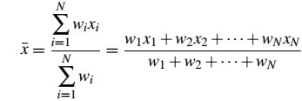
Measures of Data Cube: Three Categories
Distributive: If the result derived by applying the function to n partitions aggregate values is the same as that derived by applying the function on all the data without partitioning
    E.g., count(), sum(), min(), max()
Algebraic: If it can be computed by applying an algebraic function to one or more distributive measures
    E.g., avg() → sum()/count() which are distributive aggregate functions
      Here, sum() and count() are typically saved in precomputation, so the derivation of avg() of data cube is straightforward
    Weighted arithmetic mean
Holistic: A measure that must be computed on the entire data set as a whole
    Cannot be computed by partitioning the given data into subsets and merging the values obtained for the measure in each subset
    E.g., median(), mode(), rank()
Data Warehousing

Slide 61
Concept Hierarchy
Defines a sequence of mappings from a set of low-level concepts to higher-level, more general concepts
For example, concept hierarchy for the dimension location, mapping a set of low-level concepts (i.e. cities) to higher-level, more general concepts (i.e. countries)
Allows the data to be handled at varying levels of abstraction
Data Warehousing

Slide 62
A Concept Hierarchy: Dimension (location)
all
country
Europe
...
North_America
state
Germany
...
Spain
Canada
...
Mexico
city
Frankfurt
...
Vancouver
...
Toronto
L. Chan
...
M. Wind
Data Warehousing

Slide 63
Concept Hierarchy
Also defined by discretizing or grouping values for a given dimension or attribute, resulting in a set-grouping hierarchy
  A total or partial order can be defined among groups of values
  For example, set-grouping hierarchy for the dimension price → an interval ($X…$Y] denotes the exclusive $X to inclusive $Y
There may be more than one concept hierarchy for a given attribute or dimension based on different user viewpoints
  For example, organize price by defining ranges for inexpensive, moderately_priced and expensive
Concept hierarchy provided manually by system users, domain experts or knowledge engineers or may be automatically generated based on statistical analysis of the data distribution
Data Warehousing

Slide 64


View of Warehouses and Hierarchies
Specification of hierarchies
Schema hierarchy
  Region < Country < City < Office
  day < {month < quarter; week} < year
Set_grouping hierarchy
  {1..10} < inexpensive
Data Warehousing

Slide 65
Sample Data Cube
Sales volume as a function of product, month, and region
Dimensions: Product, Location, Time
Hierarchical summarization paths
Region
Industry Region Year
Category Country Quarter
Product City Month Week
Office Day
Product
Month
Data Warehousing

Slide 66
A Sample Data Cube
Date
Total annual sales
of TV in U.S.A.
1Qtr
2Qtr
3Qtr
4Qtr
sum
Product
TV
PC
U.S.A
VCR
sum
Canada
Country
Mexico
sum
All, All, All
Data Warehousing

Slide 67

Browsing a Data Cube
Visualization
OLAP data cube operations
Interactive querying and analysis
Data Warehousing

Slide 68
Typical OLAP Operations
Roll up (drill-up)
Drill down (roll down)
Slice and dice
Pivot (rotate)
Other operations
  Drill across
  Drill through
Data Warehousing

Slide 69
Typical OLAP Operations
Roll up (Drill-up)
  Summarize data
  By climbing up hierarchy or by dimension reduction
  If,
    Concept hierarchy for location is City < State < Country
    Roll up on location (from cities to countries)
      Grouping the data by country rather than city
Data Warehousing

Slide 70
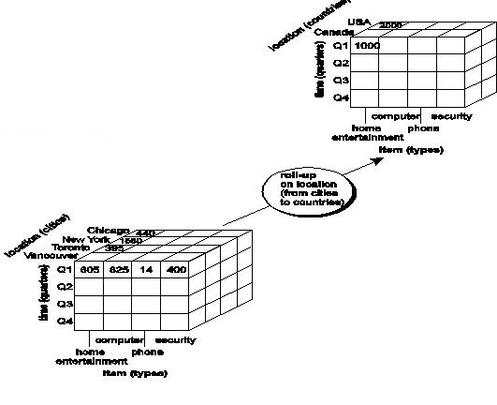
OLAP Operation – Roll Up
(Drill-Up)
Summarize data, by
Climbing up hierarchy or Dimension reduction
Concept hierarchy for location
City < State < Country
Roll up on location (from cities to countries)
Grouping the data by
country rather than city
Data Warehousing

Slide 71
Typical OLAP Operations
Drill Down
  Reverse of roll-up
  Navigates from less detailed data to more detailed data
  By stepping down a concept hierarchy or introducing new dimensions
  Provide detail of the total sales from the level of quarter to the more detailed level of month
Data Warehousing

Slide 72
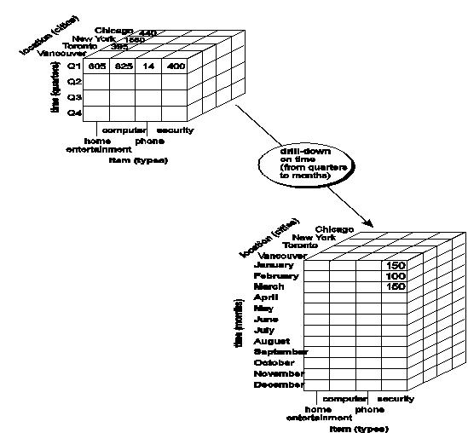
OLAP Operation – Drill Down
(Roll Down)
Reverse of roll-up
Navigates from less detailed data
to more detailed data
  By stepping down a concept hierarchy
  or introducing new dimensions
Provide detail of the total sales from the level of quarter to the more detailed level of month
Data Warehousing

Slide 73
Typical OLAP Operations
Slice
  Project and select on one dimension of the given cube
  Resulting in a subcube
Data Warehousing

Slide 74
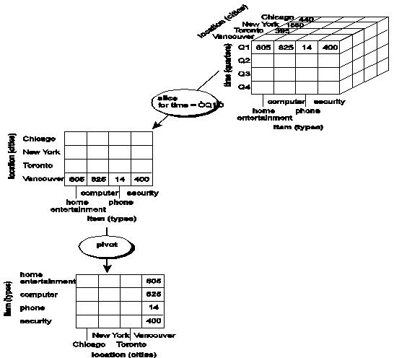
OLAP Operation – Slice
Project and select on one dimension of the given cube
Resulting in a subcube
Data Warehousing

Slide 75
Typical OLAP Operations
Dice
  Project and select on two or more dimensions of the cube
  Resulting in a subcube
Data Warehousing

Slide 76
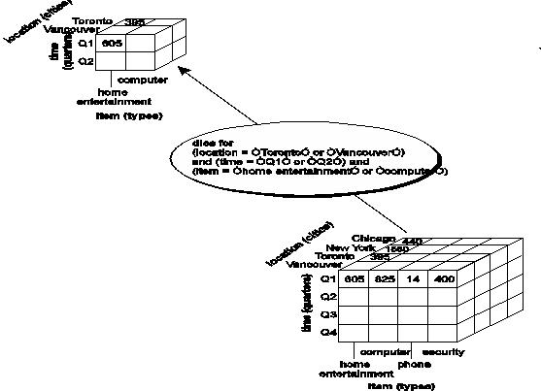
OLAP Operation – Dice
Project and select on two or more dimensions of the cube
Resulting in a subcube
Data Warehousing

Slide 77
Typical OLAP Operations
Pivot (rotate):
  Visualization operation
  Reorient/Rotating the 3-D cube on axes
  Transform a 3D cube into series of 2D planes
Data Warehousing

Slide 78
OLAP Operation – Pivot
Visualization operation
Reorient/Rotating the 3-D cube on axes
Transform a 3D cube into series of 2D planes
Data Warehousing

Slide 79

Typical OLAP Operations
Data Warehousing

Slide 80
Typical OLAP Operations
Other operations
  Drill across: involving (across) more than one fact table
  Drill through: through the bottom level of the cube to its back-end relational tables (using SQL)
  Ranking of top N or bottom N items
  Computing averages
  Growth rates
  Interests
  Depreciation
  Currency conversions
  Statistical functions…
Data Warehousing

Slide 81
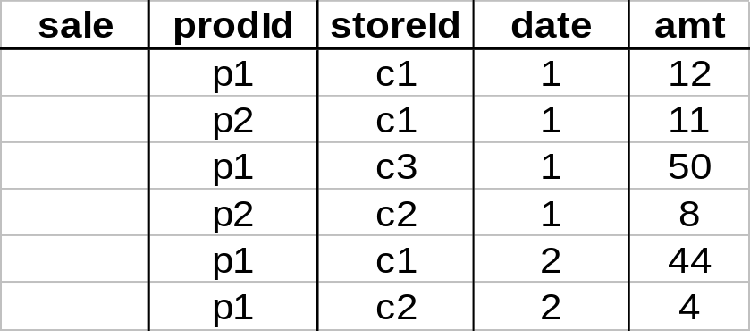
Aggregates
Roll up on date
Add up amounts for date=1
InSELECT sum(amt) FROM SALE WHERE date = 1
81

Slide 82
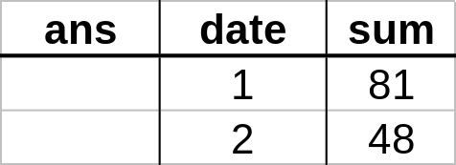
Aggregates
Add up amounts by day
SELECT date, sum(amt) FROM SALE GROUP BY date

Slide 83
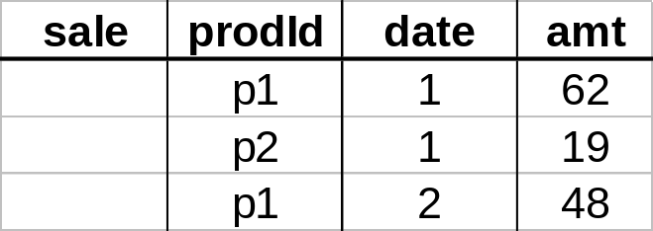
Another Example
Add up amounts by day, product
In SQL: SELECT date, sum(amt) FROM SALE
GROUP BY date, prodId
rollup
drill-down

Slide 84
Aggregates
Operators: sum, count, max, min, median, ave
“Having” clause
Using dimension hierarchy
  average by region (within store)
  maximum by month (within date)

Slide 85
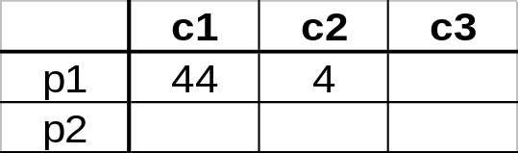
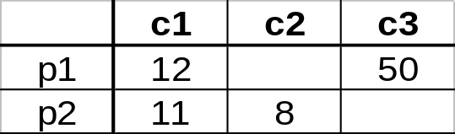
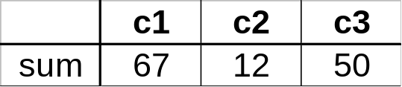
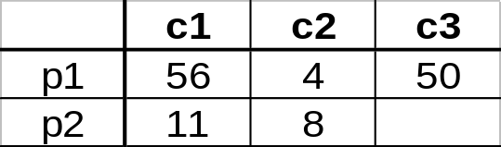
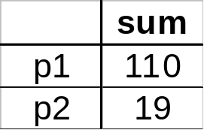
Cube Aggregation
Example: computing sums
day 2
. . .
day 1
129
rollup
drill-down

Slide 86
Cube Operators
day 2
. . .
day 1
sale(c1,*,*)
129
sale(c2,p2,*)
sale(*,*,*)

Slide 87
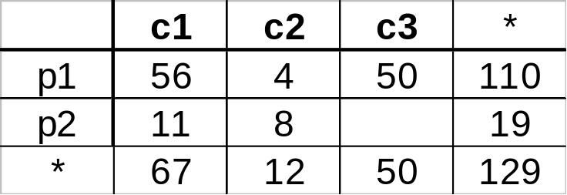
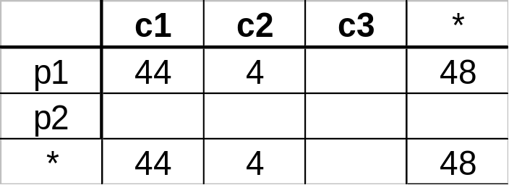
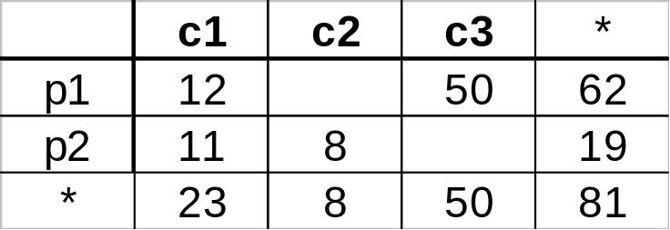
Extended Cube
*
day 2
sale(*,p2,*)
day 1

Slide 88
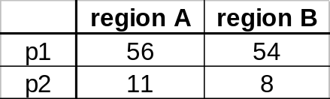
Aggregation Using Hierarchies
day 2
customer
day 1
region
country
(customer c1 in Region A;
customers c2, c3 in Region B)

Slide 89
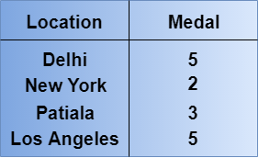
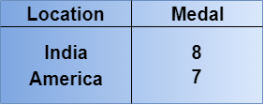
Example
Roll-up (drill-up):-
The roll-up operation performs aggregation on a data cube either by climbing up the hierarchy or by dimension reduction.
Consider an example:-
Delhi, New York, Patiala and Los Angeles wins 5, 2, 3 and 5 medals respectively. So in this example, roll upon Location from cities to countries.
Roll-up
More detailed data to less detailed data. WRITE SQL QUERY.
Data Warehousing

Slide 90
Example
Drill-down:-
Drill-down is the reverse of roll-up.That means lower level summary to higher level summary.
Drill-down can be performed either by:-
1 Stepping down a concept hierarchy for a dimension
2 By introducing a new dimension.
Consider an example:-
Drill-down on Location form countries to cities.
Drill-down
Less detailed data to More detailed data. WRITE SQL QUERY.
Data Warehousing

Slide 91
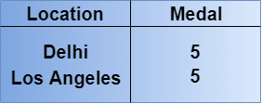
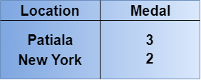
Example
Slice and dice
The slice operation performs a selection on one dimension of the given cube, resulting in a subcube.Reduces the dimensionality of the cubes.
For example, if we want to make a select where Medal = 5
Slice Operation
The dice operation defines a sub-cube by performing a selection on two or more dimensions.
For example, if we want to make a select where Medal = 3 or Location = New York
Dice Operation
WRITE SQL QUERY.
Data Warehousing

Slide 92
Querying the Multidimensional Model
Based on a starnet model
Consists of radial lines emanating from a central point, where each line represents a concept hierarchy for a dimension
Each abstraction level in the hierarchy is called a footprint
Data Warehousing

Slide 93
A Star-Net Query Model
Customer Orders
Shipping Method
Customer
CONTRACTS
AIR-EXPRESS
ORDER
TRUCK
PRODUCT LINE
Time
Product
ANNUALY
QTRLY
DAILY
PRODUCT ITEM
PRODUCT GROUP
CITY
SALES PERSON
COUNTRY
DISTRICT
REGION
DIVISION
Location
Each circle is called a footprint
Promotion
Organization
Data Warehousing

Slide 94
Data Warehousing
What is a data warehouse?
A multi-dimensional data model
Data warehouse architecture
Data warehouse implementation
From data warehousing to data mining
Data Warehousing

Slide 95
Data Warehouse Design Process
Typical data warehouse design process
  Choose a business process to model
    e.g., orders, invoices, etc.
    If the process is organizational, consider DW or if it is departmental, then consider DMart
  Choose the grain (atomic level of data) of the business process e.g. individual transactions or individual daily snapshots
  Choose the dimensions that will apply to each fact table record e.g. item, time, customer, supplier, etc
  Choose the measure that will populate each fact table record e.g. dollars_sold, units_sold, avg_sales, etc.
Data Warehousing

Slide 96
Data Warehouse: A Multi-Tiered Architecture
Monitor
&
Integrator
OLAP Server
Other
sources
Metadata
Analysis
Query
Reports
Data mining
Operational
DBs
Extract
Transform
Load
Refresh
Data
Warehouse
Serve
Data Marts
Data Sources
1. Data Storage
2. OLAP Engine
3. Front-End Tools
Data Warehousing

Slide 97
Data Warehouse: A Multi-Tiered Architecture
Bottom Tier
  DataWareHouse Server
    Almost a relational database system
    Back end tools and utilities are used to feed data from operational databases or other external sources
      By performing Extraction, Cleaning and Transformation, as well as Load and refresh functions to update DW
Middle Tier
  OLAP Server
    Implemented with
      ROLAP – extended RDBMS that maps operations on multidimensional data to standard relational operations
      MOLAP – a special purpose server that directly implements multidimensional data and operations
Top Tier
  Front End Tools
    Contains tools for query and reporting, analysis, and/or data mining
Data Warehousing

Slide 98
Data Warehouse Back-End Tools and Utilities
Data extraction
  Get data from multiple, heterogeneous, and external sources
Data cleaning
  Detect errors in the data and rectify them when possible
Data transformation
  Convert data from legacy or host format to warehouse format
Load
  Sort, summarize, consolidate, compute views, check integrity, and build indices and partitions
Refresh
  Propagate the updates from the data sources to the warehouse
Data Warehousing

Slide 99
Metadata Repository
Meta data -Data about data
  For DW, it is the data that define warehouse objects
  Play an important role
    Used as a directory to help the decision support system analyst to locate the contents of the data warehouse
    As a guide to the mapping of data when the data are transformed from the operational environment to the DW environment, etc.
Stores:
  Description of the structure of the data warehouse
    Schema
    View
    Dimensions and Hierarchies
    Derived data definition
    Data mart locations and contents
Data Warehousing

Slide 100
Metadata Repository
Stores:
  Operational meta-data
    Data lineage (history of migrated data and transformation applied to it)
    Currency of data (active, archived or purged)
    Monitoring information (warehouse usage statistics, error reports, audit trails)
  The algorithms used for summarization
    Related to measure and dimension
  The mapping from operational environment to the data warehouse
    Source databases and their contents
    Data partitions
    Data extraction
    Cleaning, transformation rules, data refresh and purging rules and security
Data Warehousing

Slide 101
Metadata Repository
Stores:
  Data related to system performance
    Indices and profiles that improve data access and retrieval performance
    Rules for the timing and scheduling of refresh, update and replication cycles
  Business metadata
    Business terms and definitions
    Ownership of data, charging policies
Stored and managed persistently (on Disk) at Bottom tier
Data Warehousing

Slide 102
Three Data Warehouse Models
Enterprise warehouse
  Collects all of the information about subjects spanning the entire organization
  Data ranges from GB to TB or beyond
  Implemented on mainframes, super servers or parallel architecture platforms
  Time to design and build in years
Data Mart
Virtual warehouse
Data Warehousing

Slide 103
Three Data Warehouse Models
Enterprise warehouse
  Collects all of the information about subjects spanning the entire organization
  Data ranges from GB to TB or beyond
  Implemented on mainframes, super servers or parallel architecture platforms
  Time to design and build in years
Data Mart
  A subset of corporate-wide data that is of value to a specific groups of users
  Scope is confined to specific, selected groups, such as marketing data mart or sales data mart
  Implemented on low cost departmental servers
  Implementation time in weeks
  Categorized as
    Independent where data captures from operational systems or external information provider
    Dependent where data captures directly from enterprise data warehouse
Virtual warehouse
Data Warehousing

Slide 104
Three Data Warehouse Models
Enterprise warehouse
  Collects all of the information about subjects spanning the entire organization
  Data ranges from GB to TB or beyond
  Implemented on mainframes, super servers or parallel architecture platforms
  Time to design and build in years
Data Mart
  A subset of corporate-wide data that is of value to a specific groups of users
  Scope is confined to specific, selected groups, such as marketing data mart or sales data mart
  Implemented on low cost departmental servers
  Implementation time in weeks
  Categorized as
    Independent where data captures from operational systems or external information provider
    Dependent where data captures directly from enterprise data warehouse
Virtual warehouse
  A set of views over operational databases
  Only some of the possible summary views may be materialized
  Easy to build but requires excess capacity on operational database servers
Data Warehousing

Slide 105
Differences between Data Warehouse and Data Mart
Parameter | Data Warehouse | Data Mart
Definition | A Data Warehouse is a large repository of data collected from different organizations or departments within a corporation. | A data mart is an only subtype of a Data Warehouse. It is designed to meet the need of a certain user group.
Usage | It helps to take a strategic decision. | It helps to take tactical decisions for the business.
Objective and Subject-area | The main objective of Data Warehouse is to provide an integrated environment and coherent picture of the business at a point in time for entire company. | A data mart mostly used in a business division at the department level. One subject area- for example, Sales figure.
Designing | The designing process of Data Warehouse is quite difficult. | The designing process of Data Mart is easy.
 | Fact constellation schema is used. | It is built focused on a dimensional model using a start schema.
Data Handling | Data warehousing includes large area of the corporation which is why it takes a long time to process it. | Data marts are easy to use, design and implement as it can only handle small amounts of data.
Data type | The data stored inside the Data Warehouse are always detailed when compared with data mart. | Data Marts are built for particular user groups. Therefore, data short and limited compare to DW.
Data storing | Designed to store enterprise-wide decision data, not just marketing data. | Dimensional modeling and star schema design employed for optimizing the performance of access layer.
Data type | Time variance and non-volatile design are strictly enforced. | Mostly includes consolidation data structures to meet subject area's query and reporting needs.
Data Warehousing

Slide 106
Differences between Data Warehouse and Data Mart
Parameter | Data Warehouse | Data Mart
Data value | Read-Only from the end-users standpoint. | Transaction data regardless of grain fed directly from the Data Warehouse.
Source | In Data Warehouse Data comes from many sources. | In Data Mart data comes from very few sources.
Size | The size of the Data Warehouse may range from 100 GB to 1 TB+. | The Size of Data Mart is less than 100 GB.
Implementation time | The implementation process of Data Warehouse can be extended from months to years. | The implementation process of Data Mart is restricted to few months.
Data Warehousing

Slide 107
Data Warehouse Design Process
Top-down, bottom-up approaches or a combination of both
Top-down
  Starts with overall design and planning
    If technology is mature and well known and business problems that must be solved are clear and well understood
    DW as a single repository feeds data into data marts
    Minimizes the integration problems
    Expensive, take long time to develop and common data model for the entire organization
Bottom-up
  Starts with experiments and prototype
    Useful in the early stage of business modeling and technology development, allows to move forward at less expense by independent data mart
    But, leads to problems when integrating various disparate data marts into a consistent enterprise DW
Combined
  Planned and strategic nature of the top-down approach and rapid implementation of the bottom-up approach
Data Warehousing

Slide 108
Data Warehouse Design Process
Top-down, bottom-up approaches or a combination of both
Top-down
  Starts with overall design and planning
    If technology is mature and well known and business problems that must be solved are clear and well understood
    Minimizes the integration problems
    Expensive, take long time to develop and common data model for the entire organization
Bottom-up
  Starts with experiments and prototype
    Useful in the early stage of business modeling and technology development, allows to move forward at less expense by independent data mart
    Data flows from source into data marts, then into the data warehouse
    But, leads to problems when integrating various disparate data marts into a consistent enterprise DW
Combined
  Planned and strategic nature of the top-down approach and rapid implementation of the bottom-up approach
Data Warehousing

Slide 109
Data Warehouse Design Process
From software engineering point of view
  Planning
  Requirement Study
  Problem Analysis
  WareHouse Design
  Data Integration
  Testing
  Deployment of DataWareHouse
Waterfall: Structured and systematic analysis at each step before proceeding to the next
Spiral: Rapid generation of increasingly functional systems, short turn around time, quick modification
Data Warehousing

Slide 110
Data Warehouse Development: A Recommended Approach
Incremental and Evolutionary Manner
Multi-Tier Data Warehouse
Distributed Data Marts
Enterprise Data Warehouse
Data Mart
Data Mart
Model refinement
Model refinement
Define a high-level corporate data model
Data Warehousing

Slide 111
OLAP Server Architectures
Relational OLAP (ROLAP)
Multidimensional OLAP (MOLAP)
Hybrid OLAP (HOLAP)
Specialized SQL servers
Other OLAPs
  DOLAP
  WOLAP
  MOLAP
  SOLAP
Data Warehousing

Slide 112
OLAP Server Architectures
Relational OLAP (ROLAP)
  Uses relational tables or extended-relational DBMS to store and manage warehouse data and OLAP middle ware
  Includes optimization of DBMS backend, implementation of aggregation navigation logic and additional tools and services
  Greater scalability than MOLAP
  Advantages
    Scalable (billions of facts)
    Flexible, design easier to change
    New techniques adapted from MOLAP like Indexes, materialized views, special handling of star schemas
  Disadvantages
    Storage use (often 3-4 times MOLAP)
    Response times
Data Warehousing

Slide 113
OLAP Server Architectures
Multidimensional OLAP (MOLAP)
  Sparse array-based multidimensional storage engine
  Fast indexing to pre-computed summarized data
  Advantages
    Less storage use (“foreign keys” not stored)
    Faster query response times
  Disadvantages
    Less flexible, e.g., cube must be re-computed when design changes
Data Warehousing

Slide 114
OLAP Server Architectures
Hybrid OLAP (HOLAP)
  Flexibility, e.g., low level: relational, high-level: array
  e.g., Microsoft SQLServer
  Advantages
    Scalable and Fast
  Disadvantages
    Complexity
Specialized SQL servers
  Specialized support for SQL queries over star/snowflake schemas
  e.g., Redbricks
Data Warehousing

Slide 115
Other OLAPs
Desktop OLAP (DOLAP) | In Desktop OLAP, a user downloads a part of the data from the database locally, or on their desktop and analyze it. DOLAP is relatively cheaper to deploy as it offers very few functionalities compares to other OLAP systems.
Web OLAP (WOLAP) | Web OLAP which is OLAP system accessible via the web browser. WOLAP is a three-tiered architecture. It consists of three components: client, middleware, and a database server.
Mobile OLAP | Mobile OLAP helps users to access and analyze OLAP data using their mobile devices
Spatial OLAP | SOLAP is created to facilitate management of both spatial and non-spatial data in a Geographic Information system (GIS)
Data Warehousing

Slide 116
ROLAP Example
A data warehouse for Big University consists of four dimensions: student, course, semester and instructor, and two measures count and avg grade.
At the lowest conceptual level (e.g., for a given student, course, semester and instructor combination), the avg grade measure stores the actual course grade of the student. And at higher conceptual levels, avg grade stores the average grade for the given combination.
(a) Draw a snowflake schema diagram for the data warehouse.
Data Warehousing

Slide 117
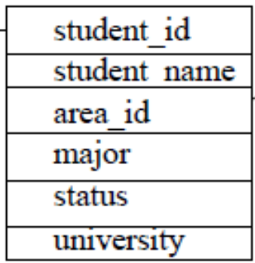
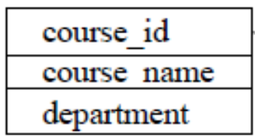

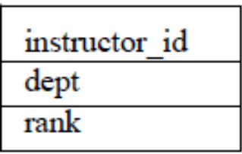
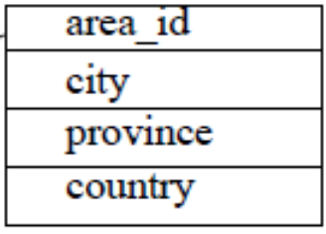
ROLAP Example
(a) Snowflake Schema
Dimension Tables
Student Course Semester Instructor
Area
Data Warehousing

Slide 118
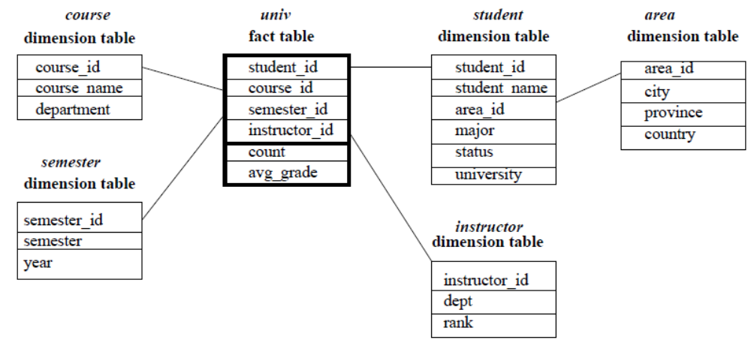
ROLAP Example
(a) Snowflake Schema
Data Warehousing

Slide 119
ROLAP Example
(b) Starting with the base cuboid [student, course, semester, instructor], what specific OLAP operations should one perform in order to list the average grade of “CS” departments for each Big University student.
Data Warehousing

Slide 120
ROLAP Example
(b) OLAP operation to perform:
To list the average grade of “CS” courses for each Big University student
  Roll-up on course from course id to department
  Roll-up on student from student id to university
  Dice on course, student with department=“CS” and university = “Big-University”
  Drill-down on student from university to student name
Data Warehousing

Slide 121
Data Warehouse
What is a data warehouse?
A multi-dimensional data model
Data warehouse architecture
Data warehouse implementation
From data warehousing to data mining
Data Warehousing

Slide 122
Data warehouse implementation
DW system handles huge volumes of data
OLAP servers demand that decision support query should be answered in the order of seconds
DW needs
  Highly efficient aggregation computation techniques
  Access methods
  Query processing techniques
Data Warehousing

Slide 123
Efficient Data Cube Computation
Highly efficient aggregation/CUBE computation techniques
  Aggregation → group-by’s
  Each group-by → cuboid
  Set of group-by’s → A lattice of cuboids → Cube
Data cube can be viewed as a lattice of cuboids
  The bottom-most cuboid is the base cuboid
  The top-most cuboid (apex) contains only one cell
Data Warehousing

Slide 124
Cube Operation
For the cube with three attributes / dimensions
  City, Item, Year
  Need to compute the following Group-Bys
    (date, item, city),
    (date, item), (date, city), (item, city),
    (date), (item), (city)
    () → group-by is empty
    contains the total sum of all sales
  Total no. of cuboids/group-by’s
  = 2³ = 8
()
(city)
(item)
(year)
(city, item)
(city, year)
(item, year)
(city, item, year)
Data Warehousing

Slide 125
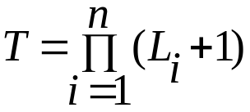
No. of Cuboids of Cube
Total no. of cuboids
  If no hierarchies associated with each dimension
    T=2^{n}
  If hierarchies
    where L_{i}=No. of levels associated with dimension i,
    1 is added to L_{i} for virtual level all
Example
  If 10 dimension, each having 5 levels (including all)
    T= 5¹⁰ = 9.8 x 10⁶ (Approx)
    Very large
Data Warehousing

Slide 126
No. of Cuboids of Cube
Size of each cuboid also depends on the cardinality (i.e. no. of distinct values) of each dimension
For example, if in Sales cube, each city sold every item
  |city| x |item| tuples in the city-item group-by alone
Storage space of cube (i.e. Precomputation) depends on
  No. of dimensions
  No. of concept hierarchies
  Cardinality
Data Warehousing

Slide 127
Selected Computation of cuboids
Materialization of data cube
  No materialization
    No precomputation any of the Nonbase cuboids
    Computing expensive multidimensional aggregates on the fly
    Slow
  Full materialization
  Partial materialization
Data Warehousing

Slide 128
Selected Computation of cuboids
Materialization of data cube
  No materialization
    No precomputation any of the Nonbase cuboids
    Computing expensive multidimensional aggregates on the fly
    Slow
  Full materialization
    Precompute/Materialize every cuboid
    Resultant lattice is Full cube
    Need of huge amount of memory space
  Partial materialization
Data Warehousing

Slide 129
Selected Computation of cuboids
Materialization of data cube
  No materialization
    No precomputation any of the Nonbase cuboids
    Computing expensive multidimensional aggregates on the fly
    Slow
  Full materialization
    Precompute/Materialize every cuboid
    Resultant lattice is Full cube
    Need of huge amount of memory space
  Partial materialization
    Selectively compute a proper subset of the whole set of possible cuboids
      Based on size, sharing, access frequency, etc.
Data Warehousing

Slide 130

Iceberg Cube
Computing only the cuboid cells whose count or other aggregates satisfying the condition like
      HAVING COUNT(*) >= minsup
Motivation
  Only a small portion of cube cells may be “above the water’’ in a sparse cube
  Only calculate “interesting” cells—data above certain threshold
  Avoid explosive growth of the cube
    Suppose 100 dimensions, only 1 base cell. How many aggregate cells if count >= 1? What about count >= 2?
Data Warehousing

Slide 131
Chapter 3: Data Warehousing and OLAP Technology: An Overview
What is a data warehouse?
A multi-dimensional data model
Data warehouse architecture
Data warehouse implementation
From data warehousing to data mining
April 10, 2019
Data Warehousing

Slide 132
Data Warehouse Usage
Three kinds of data warehouse applications
  Information processing
    supports querying, basic statistical analysis, and reporting using crosstabs, tables, charts and graphs
  Analytical processing
    multidimensional analysis of data warehouse data
    supports basic OLAP operations, slice-dice, drilling, pivoting
  Data mining
    knowledge discovery from hidden patterns
    supports associations, constructing analytical models, performing classification and prediction, and presenting the mining results using visualization tools
April 10, 2019
Data Warehousing

Slide 133
Chapter 3: Data Warehousing and OLAP Technology: An Overview
What is a data warehouse?
A multi-dimensional data model
Data warehouse architecture
Data warehouse implementation
From data warehousing to data mining
Summary
April 10, 2019
Data Warehousing

Slide 134
Design of Data Warehouse
Need to understand and analyze business needs, Known as Business Analysis Framework consisting of Four views regarding the design of a DW
  Top-down view
    Allows selection of the relevant information necessary for the DW like current and future business needs
  Data source view
    Exposes the information being captured, stored, and managed by operational systems
    Modeled by ER model
  Data warehouse view
    Consists of fact tables and dimension tables
    Represents the actual information that is stored inside the DW, including precalculated totals and counts, as well as information regarding the source, date, time, etc. to provide historical context
  Business query view
    Sees the perspectives of data in the DW from the view of end-user
April 10, 2019
Data Warehousing

Slide 135
After DW design
Initial deployment of the warehouse
  Initial installation
  Roll-out planning
  Training
  Orientation
  Platform upgradation
  Maintenance
DW Administration
  Data refreshment
  Data source synchronization
  Planning for disaster recovery
  Managing access control and security
  Managing data growth
  Managing database performance
  DW enhancement and extension
Scope Management
  Controlling the number and range of queries, dimensions and reports
  Limiting the size of the DW or schedule
April 10, 2019
Data Warehousing

Slide 136
Big Data Warehousing

Slide 137
Traditional Data Warehouse
A central repository of information, created by
  Integrating data from multiple disparate sources
  Storing current as well as historical data
Utilized to create trending reports for senior management, such as annual and quarterly comparisons
The data uploaded from operational systems such as sales, customer relationship management, and marketing systems

Slide 138
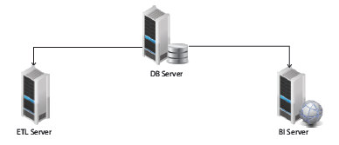
Traditional DW Architecture
Monolithic Servers
Majority of DWs run on monolithic-style server systems
Data warehouse solution has three key monolithic servers
  The database (DB) server,
  The extraction, transformation, and loading (ETL) server and
  The Business Intelligence (BI) server

Slide 139
Traditional DW Architecture
Monolithic Servers
  Powerful machines
    Accommodate multiple users accessing the systems and achieve low-latency response times to queries
  Works well for queries
    On the data for which the data structures are known
  Runs trend analyses and business reporting
    On a certain subset of data or lines of business
  Additionally, produces a lot of network traffic
    As the ETL server must pull data from the DB server in order to process the request and load the results back into the DB server

Slide 140
Traditional DW Architecture
Monolithic Servers
  The database (DB) server
    The database of the data warehouse, the data marts, and the data staging area
    Purpose is to be used as the data repository that the other two servers will read from and/or feed data into
  The extraction, transformation, and loading (ETL) server
    Purpose is to house the extract, transform, and load systems that will be responsible for collecting data and changing it into a more usable form to produce reports or decision making systems
  The Business Intelligence (BI) server
    Houses the reporting and dashboard components the business uses to gain insight into the data found on the DB server

Slide 141
Traditional DW Advantages
Known structures of data can easily be related to one another
  Data that is known to most of a company’s personnel and that is tightly coupled to other aspects of the company makes it an invaluable source of information for critical decisions
Answers business questions quickly, making them the most efficient place to find information on the status of the enterprise
  By adding custom-tailored business intelligence dashboards, data in a DW can be interpreted at a glance
Well known technologies most professionals understand, like RDBMS and DWs, have been around for several decades and have small learning curves
  Almost anyone with a basic knowledge of these systems can perform analysis with relative ease. Even recent college graduates have a general understanding of these technologies and don't require extensive training to be able to contribute to projects or solve data problems

Slide 142
Traditional DW Limitations
Inflexibility in integrating new data models
  When new sources of information are identified, it can take tremendous effort to integrate these new data models into a highly-structured and tightly-coupled system like a DW
Takes a great deal of effort to implement changes to a DW in order to answer new questions
  When an enterprise’s priorities change or markets change, the business will want a system that can change just as quickly to answer new questions
  But, having to modify or build new data structures, dashboards, and reports is a large undertaking because the new designs ideally should be compatible with the old in order to provide a holistic view of enterprise data

Slide 143
Traditional DW Limitations
DWs are ill-suited for data discovery
  Businesses increasingly rely on data to inform decisions; however, the problem with DWs is that much of the data they contain may end up being left behind in the upload portion of the ETL process due to size constraints or the business not being interested in certain data at the time of transfer
  An incomplete data set mined for a specific purpose will be ill suited to answer any other question, meaning that businesses trying to use a DW for data discovery will likely draw incorrect conclusions about patterns and trends

Slide 144
Traditional DW Limitations
The downtime for a complete hardware upgrade can be massive
  Due to the monolithic architecture of DW, if ever an upgrade of an entire server is needed, an enterprise runs the risk of downtime while the upgrade is in progress
  The time and effort spent migrating a current system architecture to a new server makes upgrading even more costly

Slide 145
Data Warehouse vs Big Data
Data warehouse
  Common words for last 10-20 years
Big data
  Hot trend for last 5-10 years
Both of them hold a lot of data, used for reporting, managed by an electronic storage device

Slide 146
Data Warehouse vs Big Data
BASIS FOR COMPARISON | DATA WAREHOUSE | BIG DATA
Meaning | An architecture, not a technology Extracting data from varieties SQL based data source (mainly relational database) and help for generating analytic reports A data repository, which using for any analytic reports, has been generated from ETL process | A technology, which stands on volume, velocity, and variety of the data Volumes define the amount of data coming from different sources, velocity refers to the speed of data processing, and varieties refer to the number of types of data (mainly support all type of data format)
Preferences | If an organization wants to know some informed decision (like what is going on in their corporation, next year planning based on current year performance data etc), they prefer to choose data warehousing, as for this kind of report they need reliable or believable data from the sources | If organization need to compare with a lot of big data, which contain valuable information and help them to take a better decision (like how to lead more revenue, more profitability, more customers etc), they obviously preferred Big Data approach
Accepted Data Source | One or more homogeneous (all sites use the same DBMS product) or heterogeneous (sites may run different DBMS product) data sources | Any kind of sources, including business transactions, social media, and information from sensor or machine specific dat
Accepted type of formats | Handles mainly structural data (specifically relational data) | Accepted all types of formats: Structure data, relational data, and unstructured data including text documents, email, video, audio, stock ticker data and financial transaction

Slide 147
Data Warehouse vs Big Data
BASIS FOR COMPARISON | DATA WAREHOUSE | BIG DATA
Subject-Oriented | Subject oriented because it actually provides information on the specific subject (like a product, customers, suppliers, sales, revenue etc) not on organization ongoing operation. It does not focus on ongoing operation, it mainly focuses on analysis or displaying data which help on decision making. | Also subject-oriented, the main difference is a source of data, as big data can accept and process data from all the sources including social media, sensor or machine specific data. It also provide exact analysis on data specifically on subject oriented.
Time-Variant | The data collected is actually identified by a particular time period. As it mainly holds historical data for an analytical report. | Big Data have a lot of approach to identified already loaded data, a time period is one of the approaches on it. As Big data mainly processing flat files, so archive with date and time will be the best approach to identify loaded data. But it also works with streaming data, so it not always holding historical data.
Non-volatile | Previous data never erase when new data added to it. This is one of the major features of a data warehouse. As it is totally different from an operational database, so any changes on an operational database will not directly impact to a data warehouse. | For Big data, again previous data never erase when new data added to it. It stored as a file which represents a table. But, here sometime in case of streaming directly use technology as operation environment.
Distributed File System | Processing of huge data in Data Warehousing is really time-consuming and sometimes it took an entire day for complete the process. | This is one of the big utility of Big Data. HDFS defined to load huge data in distributed systems by using map reduce program.

Slide 148
Data Warehouse vs Big Data
Both are not same, so they are not interchangeable
An organization can follow Data Warehouse or Big Data or the combination of both big data as well as data warehouse solution based on their need

Slide 149
Big Data Warehouse Architecture

Slide 150
Big Data Warehouse Architecture
Distributed Architecture
  Implementing a DW using big data technologies takes an enterprise away from monolithic architecture and into distributed architectures, in which several servers or components of hardware work together to accomplish a task or process
  Big data technologies are the equivalent of a file system as opposed to a database.
  This gives big data technologies some compelling advantages like unlimited computing power and storage space, automatic data redundancy, automatic load balancing, or the ability to store an unlimited amount of data in any format
  Depending on how a BDW is implemented, an enterprise can save money on hardware by outsourcing the data center and by leveraging cloud computing services to host and process data. Since most big data technologies are based on open source projects, enterprises can save money on licenses and other fees

Slide 151
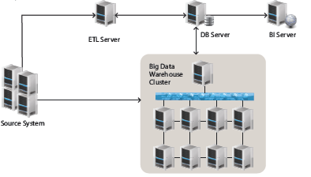
Use case - Big Data Repository to Traditional DW

Slide 152
Use case - Big Data Repository to Traditional DW
In this solution, an enterprise can run its current ETL processes on a traditional DW that houses the data attributes important to the business
Additionally, an enterprise will create ELT processes that collect all data from source transactional systems
Not having to retroactively load data or run heavy data mining queries will give an enterprise the flexibility to answer new questions as they arise and find new trends and patterns without slowing the source system. Once an enterprise establishes the new data model that will be required in the traditional DW, it can collect the new data quickly and easily, in a way that will be transparent to other departments
With this solution, an enterprise could also use the big data repository as a backup site for the traditional DW in case of a catastrophic system failure
Additionally, if an enterprise has processes that transfer data from a big data repository to the DW table structures, no retroactive loads will be required upon recovery

Slide 153
Use case-Augmented BD Processing to DW or DM
By augmenting data processing from a monolithic structure to a distributed system, an enterprise can use the distributed system as a data aggregation/integration point for data that might not be available in the traditional DW
This solution is typically used when an enterprise has a very processor intensive function that takes too long to complete or because an enterprise needs to run calculations on raw data that is impractical to store in a DW system
By leveraging big data technologies that offer greater computing power and storage space, an enterprise can process data quickly and efficiently

Slide 154
Big Data-ELT Workflow
In traditional DW environments, ETL is the term usually associated with the process of data acquisition and processing
With big data technologies, the order of execution is usually different compared to classic DW processes, wherein an ELT process has the load step occurring before the transform step
  Due to the fact that big data technologies are distributed file systems that can ingest data of any kind and format
  Thus, an enterprise can use big data technologies to extract raw data from source systems, load it to a big data implementation program, and later transform it into any required format or structure
  Useful when mining new trends and behavior patterns from data; because one is managing raw, unstructured data, the same piece of information can be used to gain insight into multiple scenarios or can be used to answer other questions that the business may ask
  When dealing with structured data, the ELT flow can still apply, only data profiling and staging are done within the same distributed system

Slide 155
Big DW Advantages
Limitless storage space and computing power to process terabytes of data
  As easy as adding new servers to a cluster
    This is something monolithic servers and databases cannot accomplish due to their physical limitations
  Big data technologies can be implemented on cheap commodity servers, the investment to create a cluster is minimal as compared to building a system on a larger, higher-end server
  Technologies are available for free through open source projects, licensing costs can be kept low compared to the cost of database licenses
    Example, one could create a cluster of 10 servers that have 100 TB of storage and 40 processing cores that would cost as much as a single server that has less storage capacity and fewer processing cores

Slide 156
Big DW Advantages
Effortless integration of any and all data types and models
  Because big data is implemented on a file system and not a DBMS, an enterprise is able to ingest any and all formats and structures of data without incurring upfront overhead costs of integration
Flexibility to run purpose-built DW business decision systems, trend analysis and predictive analytics processes
  Since a BDW can handle structured, semi-structured, and unstructured data, it can output very loosely coupled data that can be changed, manipulated and combined in any way to discover new insights on data
No downtime for forklift upgrades
  Unlike systems using a more monolithic architecture, big data is able to accommodate entire sets of servers being taken offline for upgrade without incurring downtime or data loss
  Since big data technologies replicate their data across difference nodes in the cluster, the risk of losing data due to hardware changes is minimal

Slide 157
Big DW Limitations
Personnel will need to be trained on how to use new technologies
  Because these technologies are relatively new and introduce new programming models (map, reduce), few professionals know how to properly leverage these technologies
  This in turn introduces a few challenges such as:
    Rapid technological change
    Personnel must know a wide range of technologies and how they can be integrated

Slide 158
Big DW Limitations
This in turn introduces a few challenges such as:
  Rapid technological change
    Because of their open source nature, big data technologies are undergo faster iteration cycles than traditional proprietary technologies, and new solutions are introduced into the market quickly
    An example of this is that Hadoop will soon go to phase 2.0, addressing the single point of failure Namenode and implementing the concept of a Namenode Federation to address the single point of failure issue
  Personnel must know a wide range of technologies and how they can be integrated
    An example of this is how the Hadoop project has spawned an entire ecosystem
    Just knowing and training for Hadoop is not enough; personnel must also know how to implement and integrate frameworks and systems like Avro, Cassandra, Chukwa, Hbase, Hive, Mahout, Pig, Impala, Sqoop, Oozie and ZooKeeper

Slide 159
Summary: Data Warehouse and OLAP Technology
Why data warehousing?
A multi-dimensional model of a data warehouse
  Star schema, snowflake schema, fact constellations
  A data cube consists of dimensions & measures
OLAP operations: drilling, rolling, slicing, dicing and pivoting
Data warehouse architecture
OLAP servers: ROLAP, MOLAP, HOLAP
Efficient computation of data cubes
  Partial vs. full vs. no materialization
  Indexing OALP data: Bitmap index and join index
  OLAP query processing
From OLAP to OLAM (on-line analytical mining)
April 10, 2019
Data Warehousing

Slide 160
References (I)
S. Agarwal, R. Agrawal, P. M. Deshpande, A. Gupta, J. F. Naughton, R. Ramakrishnan, and S. Sarawagi. On the computation of multidimensional aggregates. VLDB’96
D. Agrawal, A. E. Abbadi, A. Singh, and T. Yurek. Efficient view maintenance in data warehouses. SIGMOD’97
R. Agrawal, A. Gupta, and S. Sarawagi. Modeling multidimensional databases. ICDE’97
S. Chaudhuri and U. Dayal. An overview of data warehousing and OLAP technology. ACM SIGMOD Record, 26:65-74, 1997
E. F. Codd, S. B. Codd, and C. T. Salley. Beyond decision support. Computer World, 27, July 1993.
J. Gray, et al. Data cube: A relational aggregation operator generalizing group-by, cross-tab and sub-totals. Data Mining and Knowledge Discovery, 1:29-54, 1997.
A. Gupta and I. S. Mumick. Materialized Views: Techniques, Implementations, and Applications. MIT Press, 1999.
J. Han. Towards on-line analytical mining in large databases. ACM SIGMOD Record, 27:97-107, 1998.
V. Harinarayan, A. Rajaraman, and J. D. Ullman. Implementing data cubes efficiently. SIGMOD’96
April 10, 2019
Data Warehousing

Slide 161
References (II)
C. Imhoff, N. Galemmo, and J. G. Geiger. Mastering Data Warehouse Design: Relational and Dimensional Techniques. John Wiley, 2003
W. H. Inmon. Building the Data Warehouse. John Wiley, 1996
R. Kimball and M. Ross. The Data Warehouse Toolkit: The Complete Guide to Dimensional Modeling. 2ed. John Wiley, 2002
P. O'Neil and D. Quass. Improved query performance with variant indexes. SIGMOD'97
Microsoft. OLEDB for OLAP programmer's reference version 1.0. In http://www.microsoft.com/data/oledb/olap, 1998
A. Shoshani. OLAP and statistical databases: Similarities and differences. PODS’00.
S. Sarawagi and M. Stonebraker. Efficient organization of large multidimensional arrays. ICDE'94
OLAP council. MDAPI specification version 2.0. In http://www.olapcouncil.org/research/apily.htm, 1998
E. Thomsen. OLAP Solutions: Building Multidimensional Information Systems. John Wiley, 1997
P. Valduriez. Join indices. ACM Trans. Database Systems, 12:218-246, 1987.
J. Widom. Research problems in data warehousing. CIKM’95.
April 10, 2019
Data Warehousing

Slide 162
References (III)
Courtney Webster, “Integrated Analytics Platforms and Principles for Centralizing Your Data”, O’reilly
April 10, 2019
Data Warehousing

