Slide 1

Full Stack Developer at E-Rental Pvt Ltd
Summer Training Presentation
Department of Computer Science And Engineering
Sardar Vallabhbhai National Institute of Technology Surat Gujarat India 395007
Internal Guide :
Dr. BALU L. PARNE
External Guide :
Mr. SADDAM HUSSAIN
Presented By: U19CS082
SOURABH PATEL

Slide 2
Content
Front-end
Backend
API Handling
My Contribution

Slide 3
Frontend
HTML
CSS
JavaScript
Reactjs
Bootstrap
Material UI

Slide 4
Backend
Java
Spring Boot
Opps
SQL

Slide 5
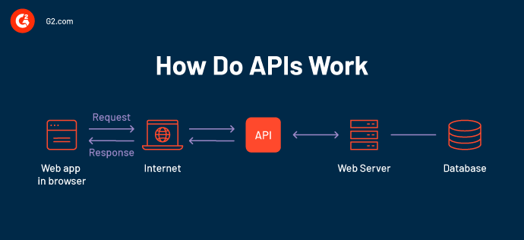
API(Application Programming Interface)
which is a software intermediary that allows two applications to talk to each other.
When you use an app like Facebook, send an instant message, you’re using an API.
or check the weather on your phone, you’re using an API.

Slide 6
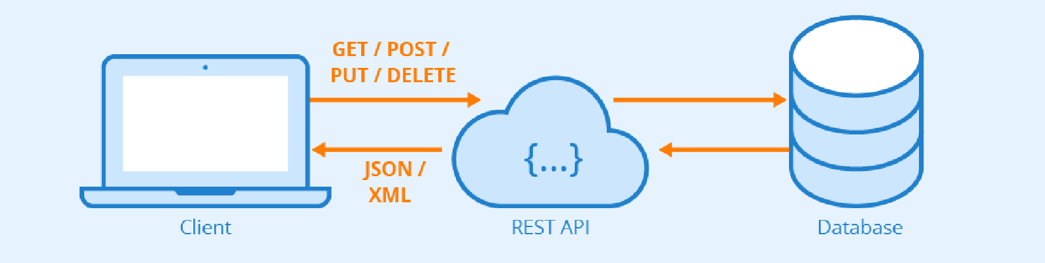
REST API :- Representational State Transfer
A REST API also known as RESTful API.
It is an application programming interface that conforms to the constraints of REST architectural style.
It allows for interaction with RESTful web services.

Slide 7
REST API METHODS
GET - Receive data about an API resource.
POST - Create an API resource.
PUT – Update an API resource.
DELETE – Delete an API resource.

Slide 8
My Contribution
In this internship mainly I involved in UI flow.
User interface is developed using ReactJS, which is JavaScript framework.
Apart from that, I also involved in some part of backend.
Backend is developed using Spring boot, which java library.

Slide 9
From where started…
I started from routing of components by using react-router-dom.
Created some sliders for hot-deal, feature product etc.
After routing I started handling API in front-end.

Slide 10
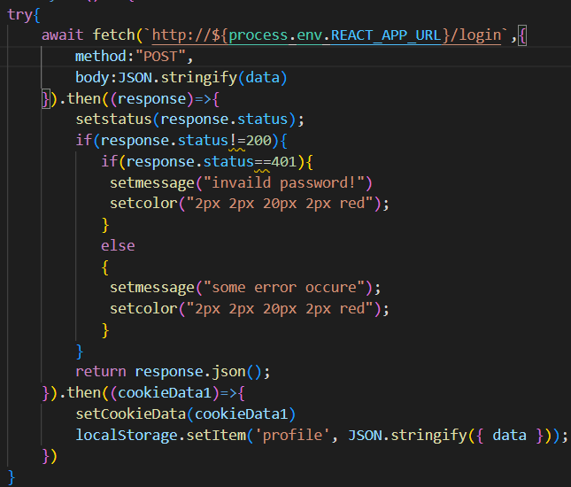
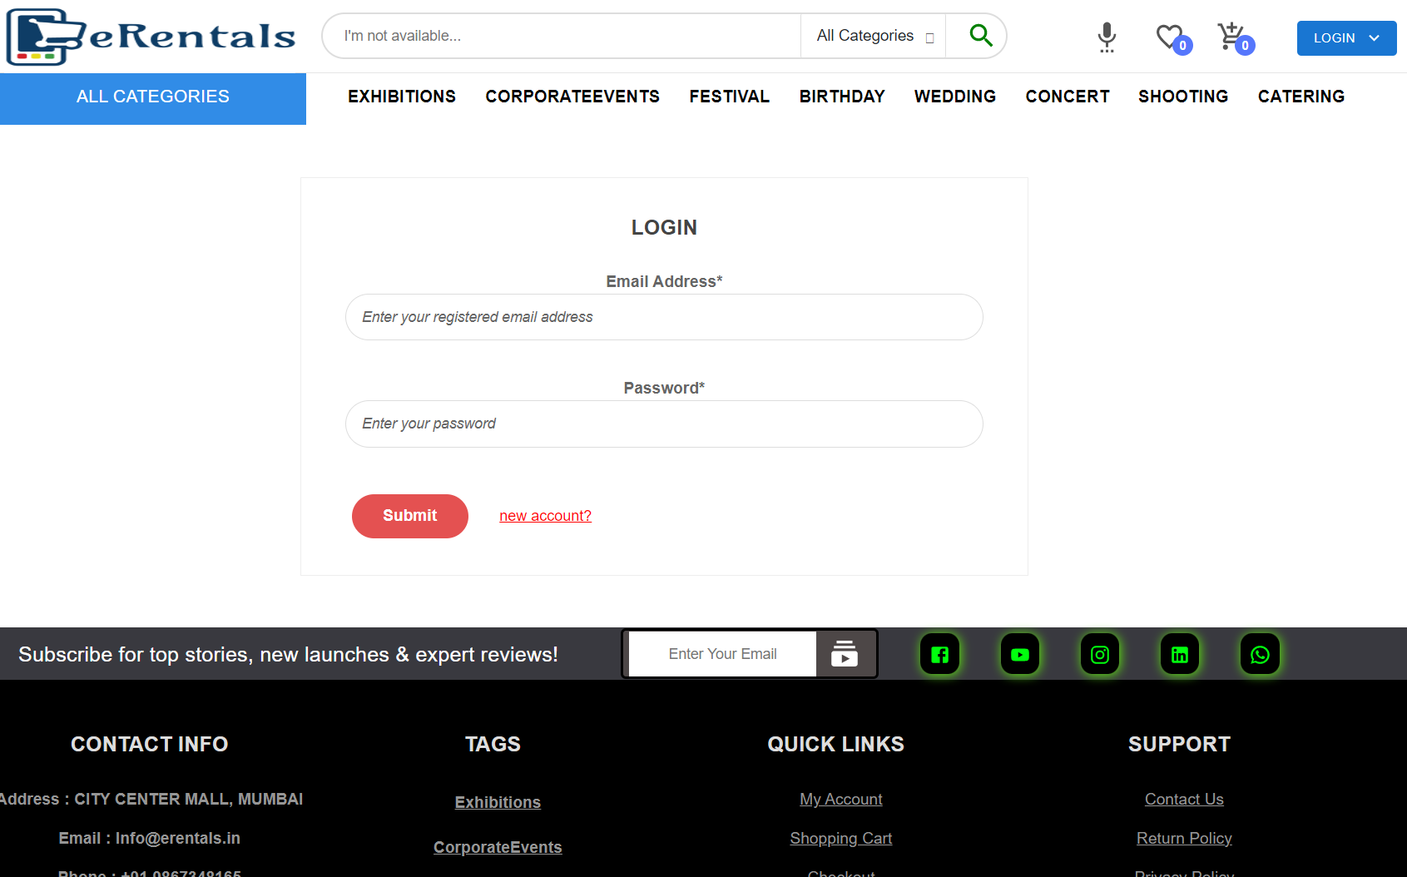
How to send data from frontend to backend
Fetch API function
Login page

Slide 11
How to make request for updation
Cart data is fetched using API .
When we click on increment or decrement or delete then we send the product_id.
backend update cart data according to operations.

Slide 12
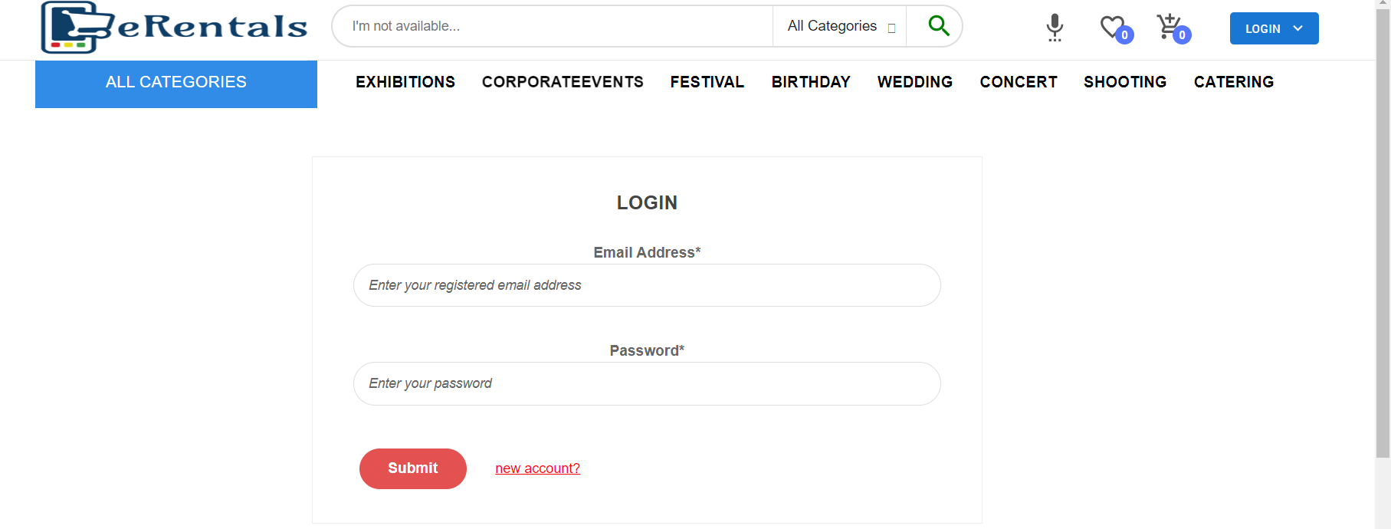
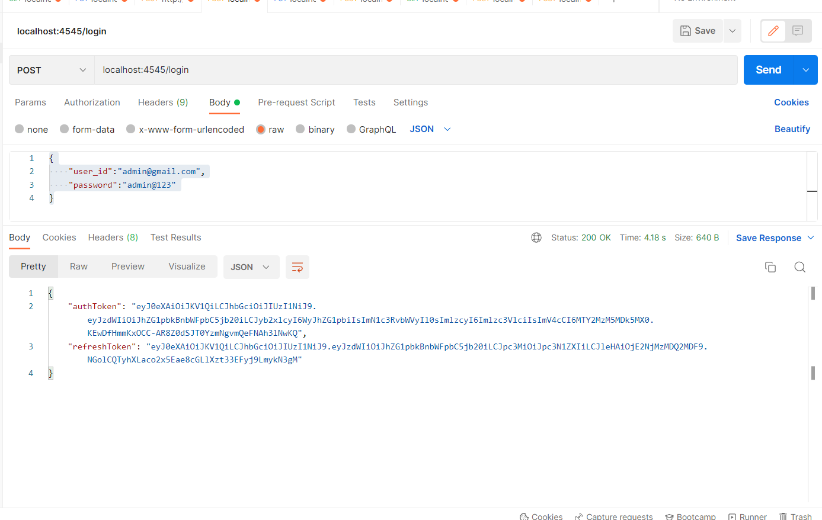
API Testing
Login page
Login Page in Backend testing

Slide 13
THANK YOU

