Slide 1
Full Stack Developer at E-Rental Pvt Ltd
Summer Training Presentation
Sourabh Patel
U19CS082
Department of Computer Science And Engineering
Sardar Vallabhbhai National Institute of Technology

Slide 2
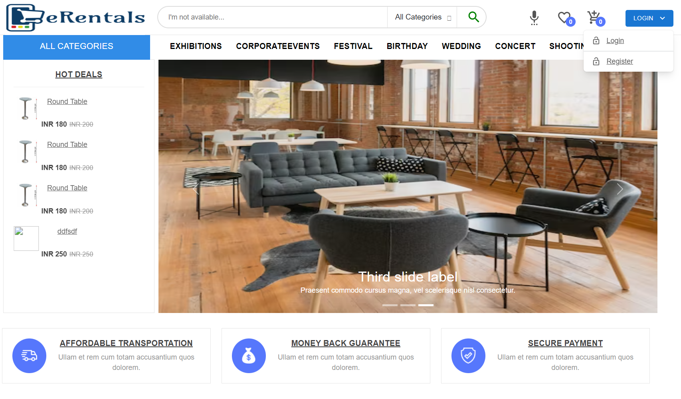
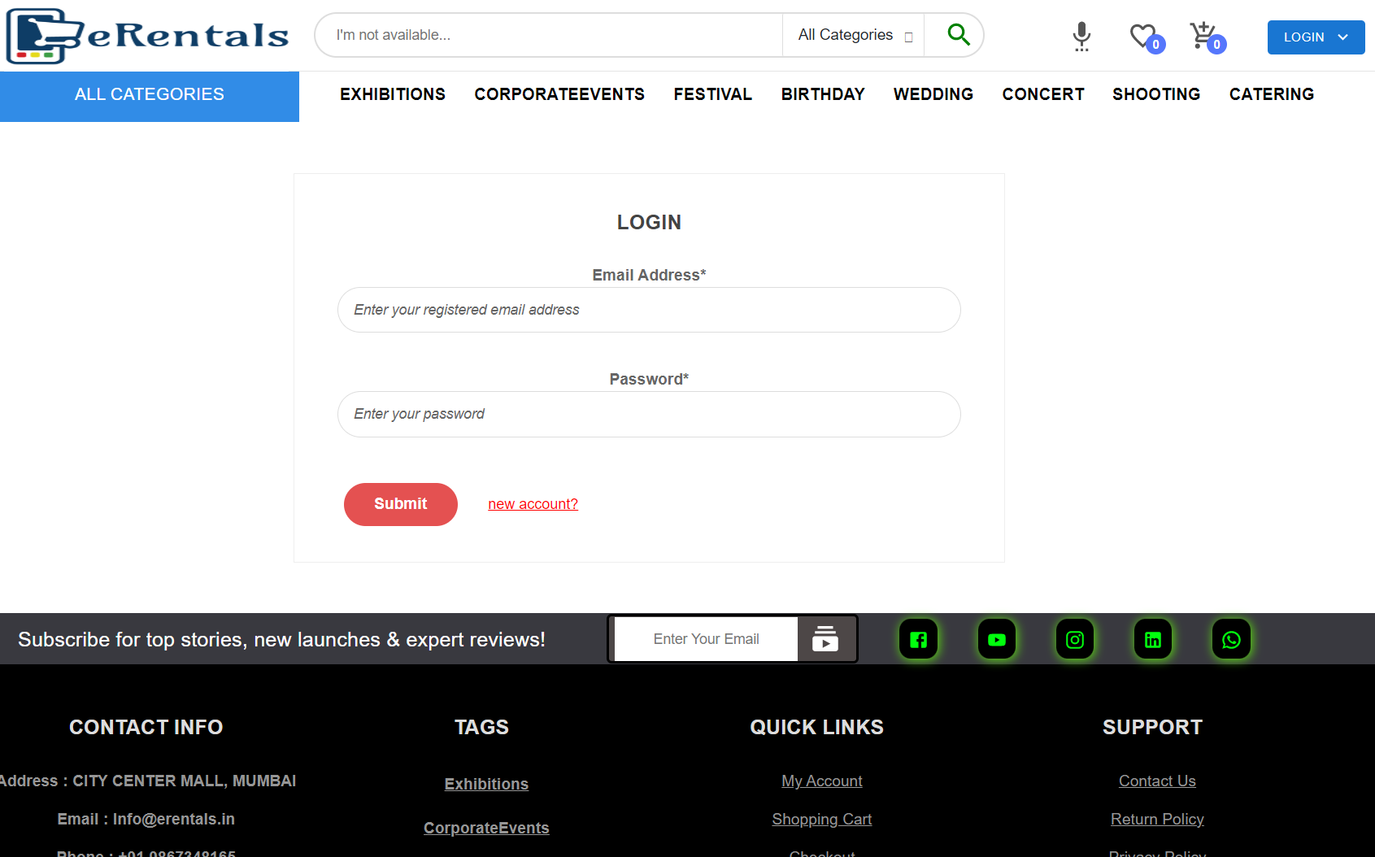
UI FLOW
HOME
LOGIN/REGISTER

Slide 3
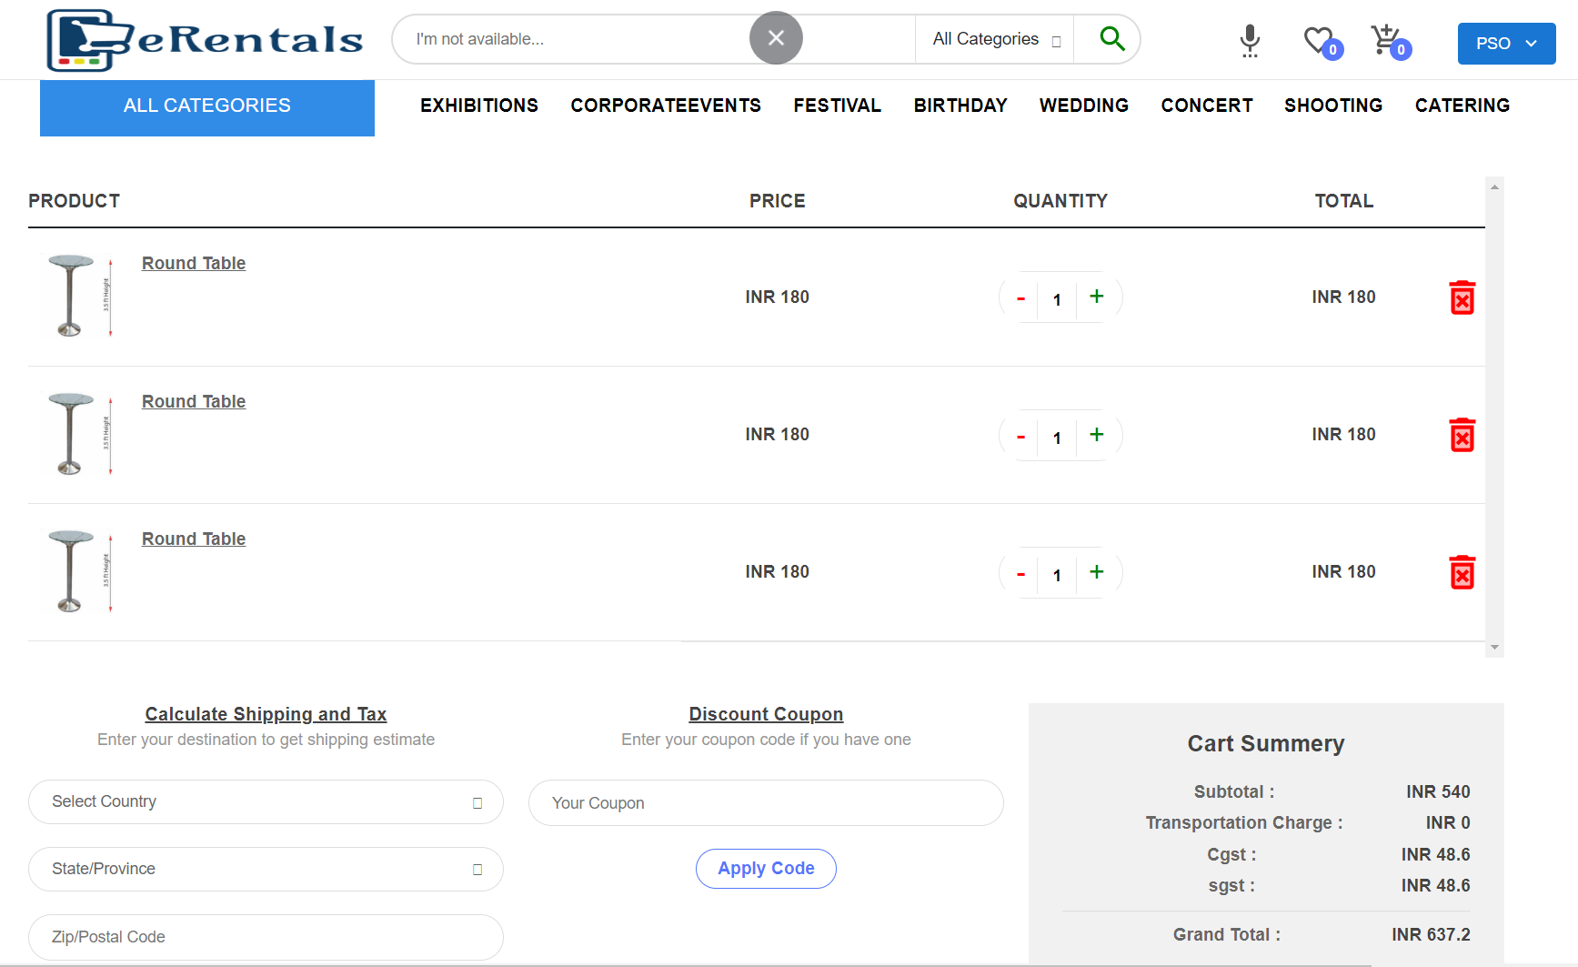
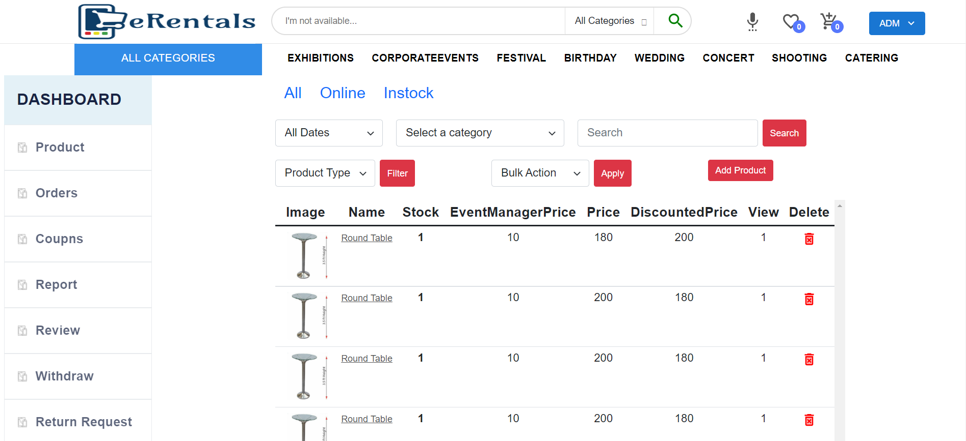
UI FLOW
CART
ADMIN PRODUCT

Slide 4
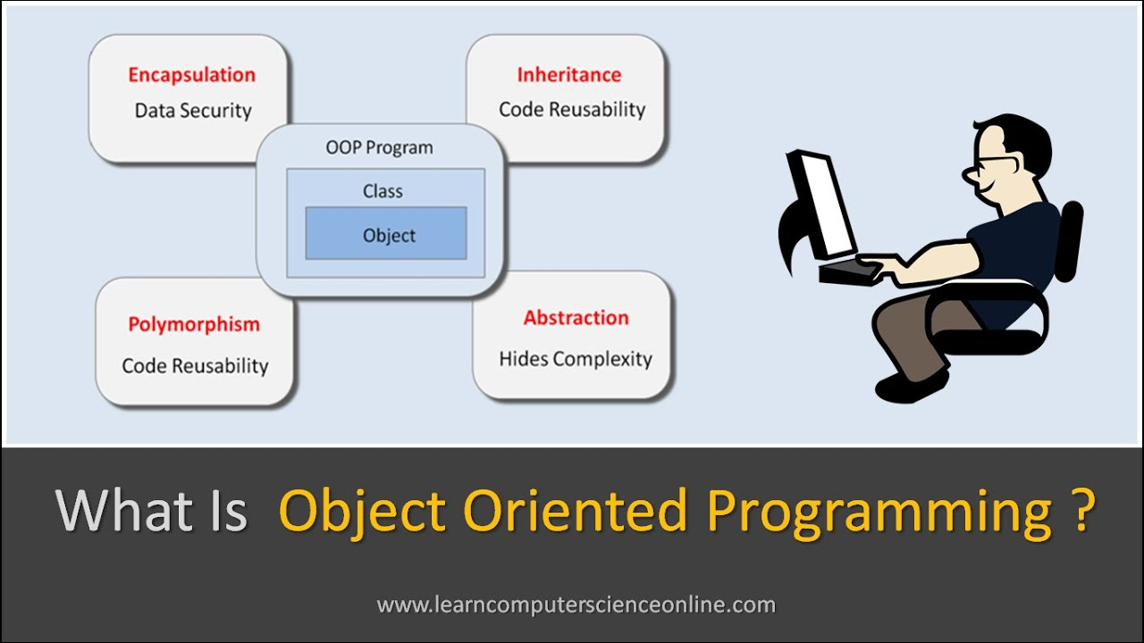
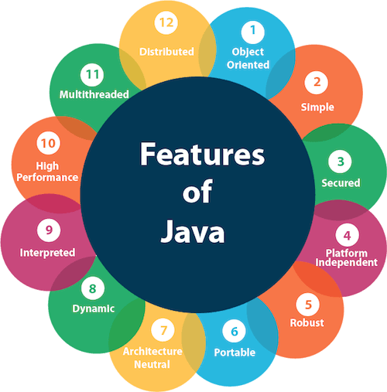
OOPs (Object-Oriented Programming System)
The main aim of OOP is to bind together the data & the functions that operate on them so that no other part of the code can access this data except that function.
Notes:
Object oriented program refers to programming languages that use objects. The main aim of OOP is to bind together the data & the functions that operate on them so that no other part of the code can access this data except that function.

Slide 5
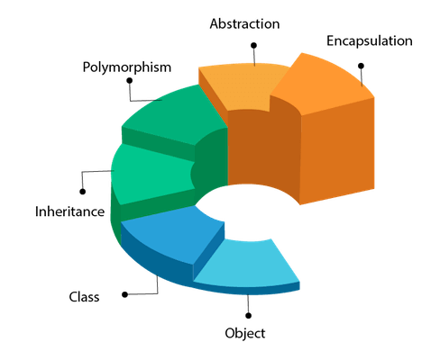
6 Main Concepts of OOPs
Class
Object
Inheritance
Polymorphism
Abstraction
Encapsulation

Slide 6
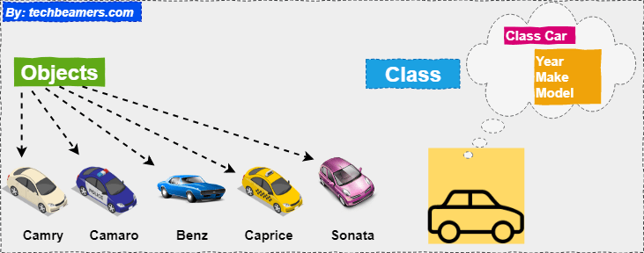
Class :- A class in OOP is a plan which describes the object. We call it a blueprint of how the object should be represented. Mainly a class would consist of a name, attributes, and operations.
Objects :- Any real-world entity which can have some characteristics of which can perform some tasks is called Object. This object is also called an instance i.e. a copy of an entity in a programming language.

Slide 7
Inheritance :-
There are mainly 4 types of inheritance,
Single level inheritance
Multi-level inheritance
Hierarchical inheritance
Hybrid inheritance
Polymorphism :-
There are mainly 2 types of polymorphism,
Runtime Polymorphism
Compile Time Polymorphism
Notes:
Inheritance is the ability to extend the functionality from the base entity in new entity belonging to the same group. This will help us to reuse the functionality which is already defined before and extend into a new entity.
Polymorphism can be defined as the ability to use the same name for doing different things. More precisely we say it as ‘many forms of single entity’. This play a vital role in the concept of OOPS.

Slide 8

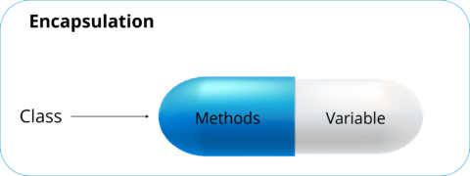
Abstraction :-
Encapsulation :-
Notes:
Abstraction allows us to expose limited data and functionality of objects publicly and hide the actual implementation. It is the most important pillar in OOPS. In our example of Mobile class and objects like Nokia, Samsung, iPhone.
Encapsulation is defined as the process of enclosing one or more details from the outside world through access right. It says how much access should be given to particular details.

Slide 9
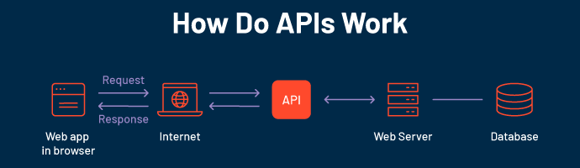
API(Application Programming Interface)
which is a software intermediary that allows two applications to talk to each other.
Each time you use an app like Facebook, send an instant message, or check the weather on your phone, you’re using an API.

Slide 10
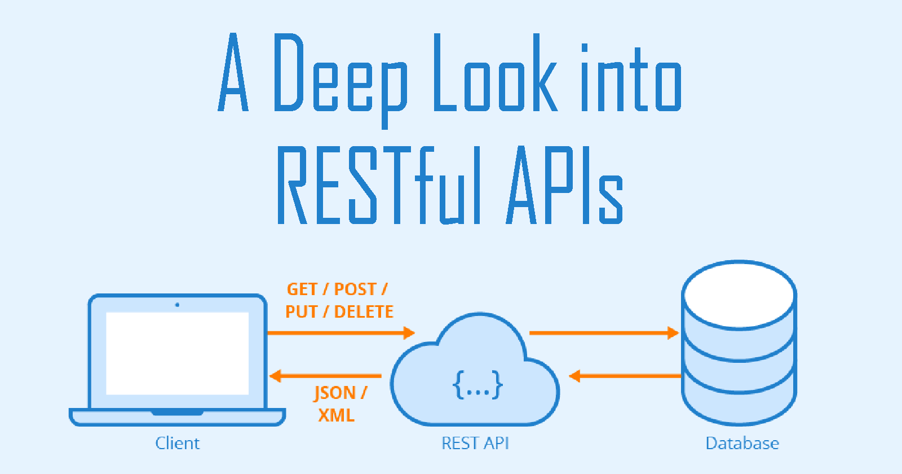
REST API :- REpresentational State Transfer
A REST API (also known as RESTful API) is an application programming interface (API or web API) that conforms to the constraints of REST architectural style and allows for interaction with RESTful web services.

Slide 11
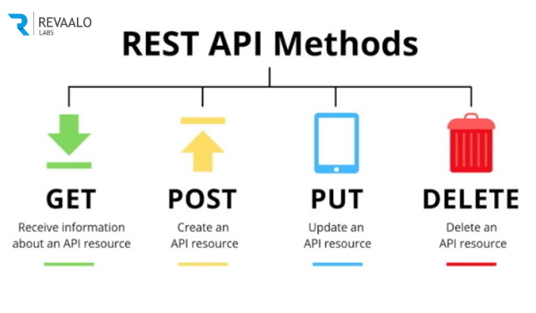
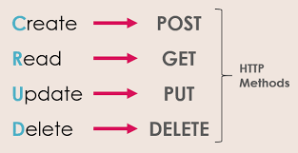

Slide 12
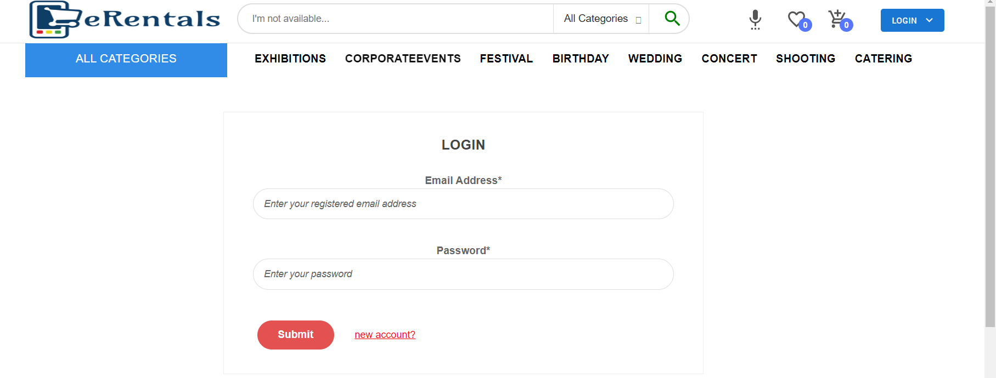
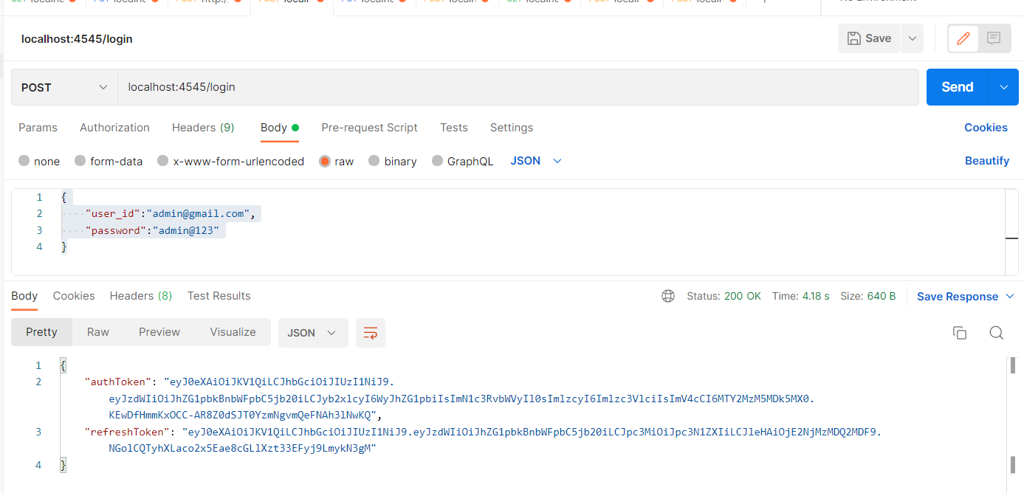
Implementation
Login page
Login Page in Backend testing

Slide 13
THANK YOU

